Slide 1
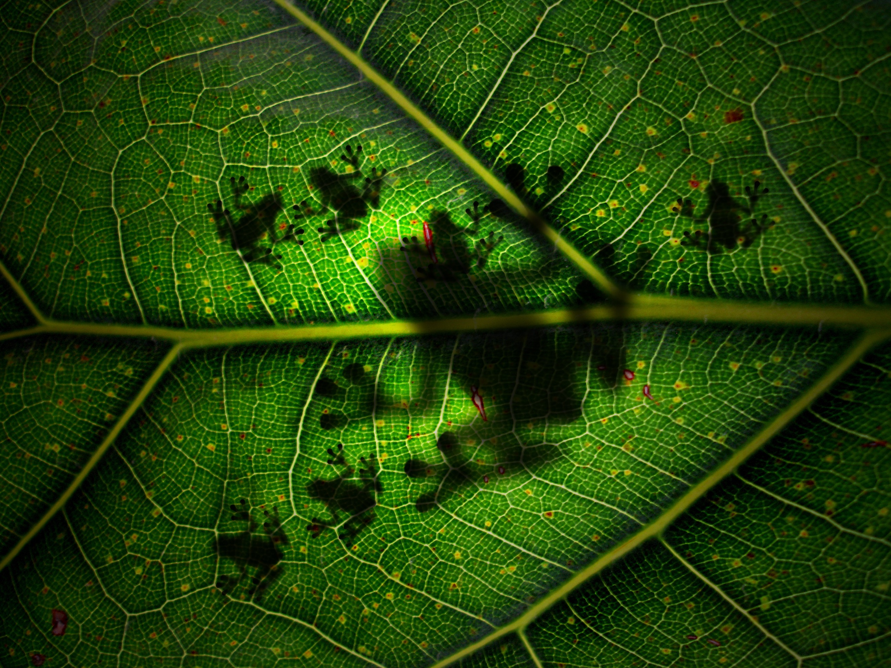

Plants and Animals
Cognitive Learning Systems, Inc © 2016

Slide 2

Plants and Animals
Plants
Cognitive Learning Systems, Inc © 2016

Slide 3
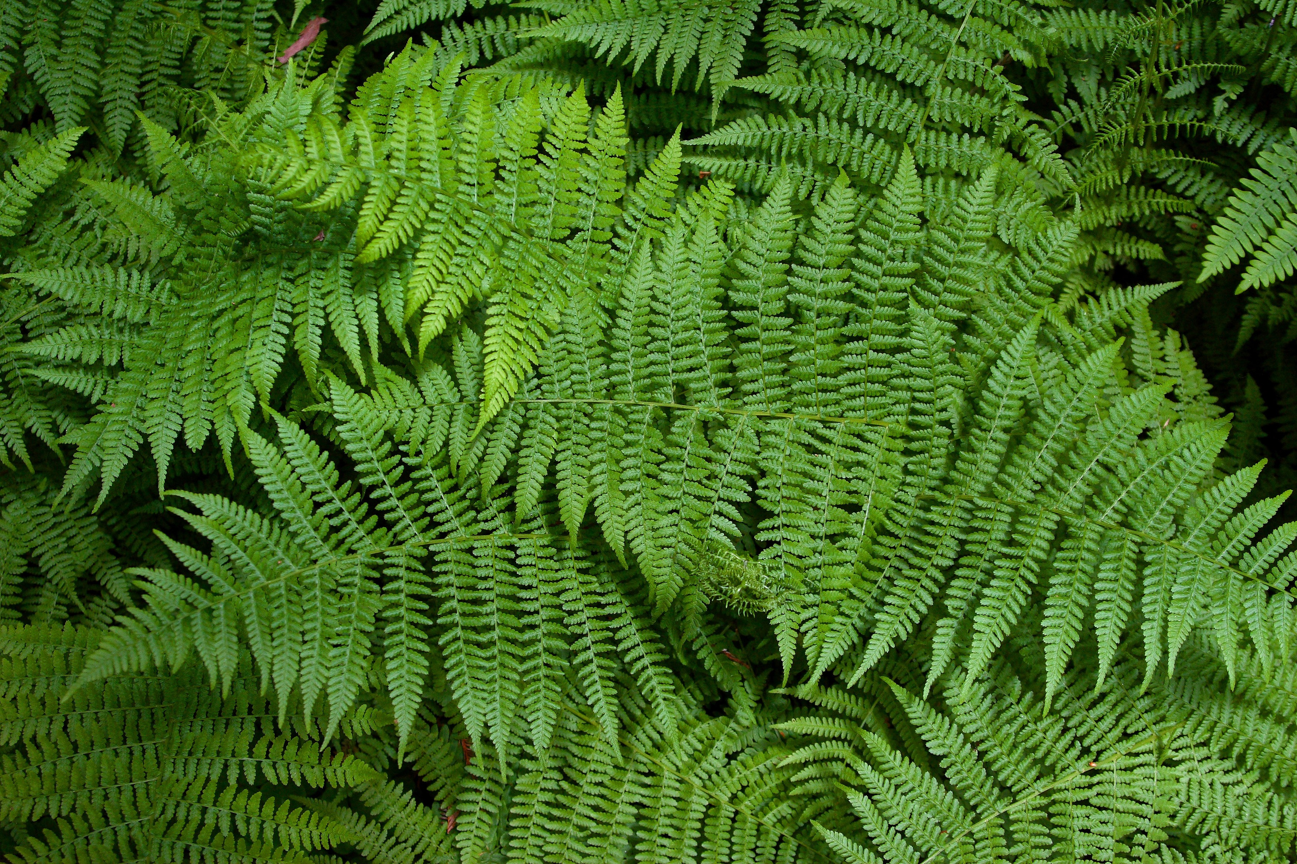
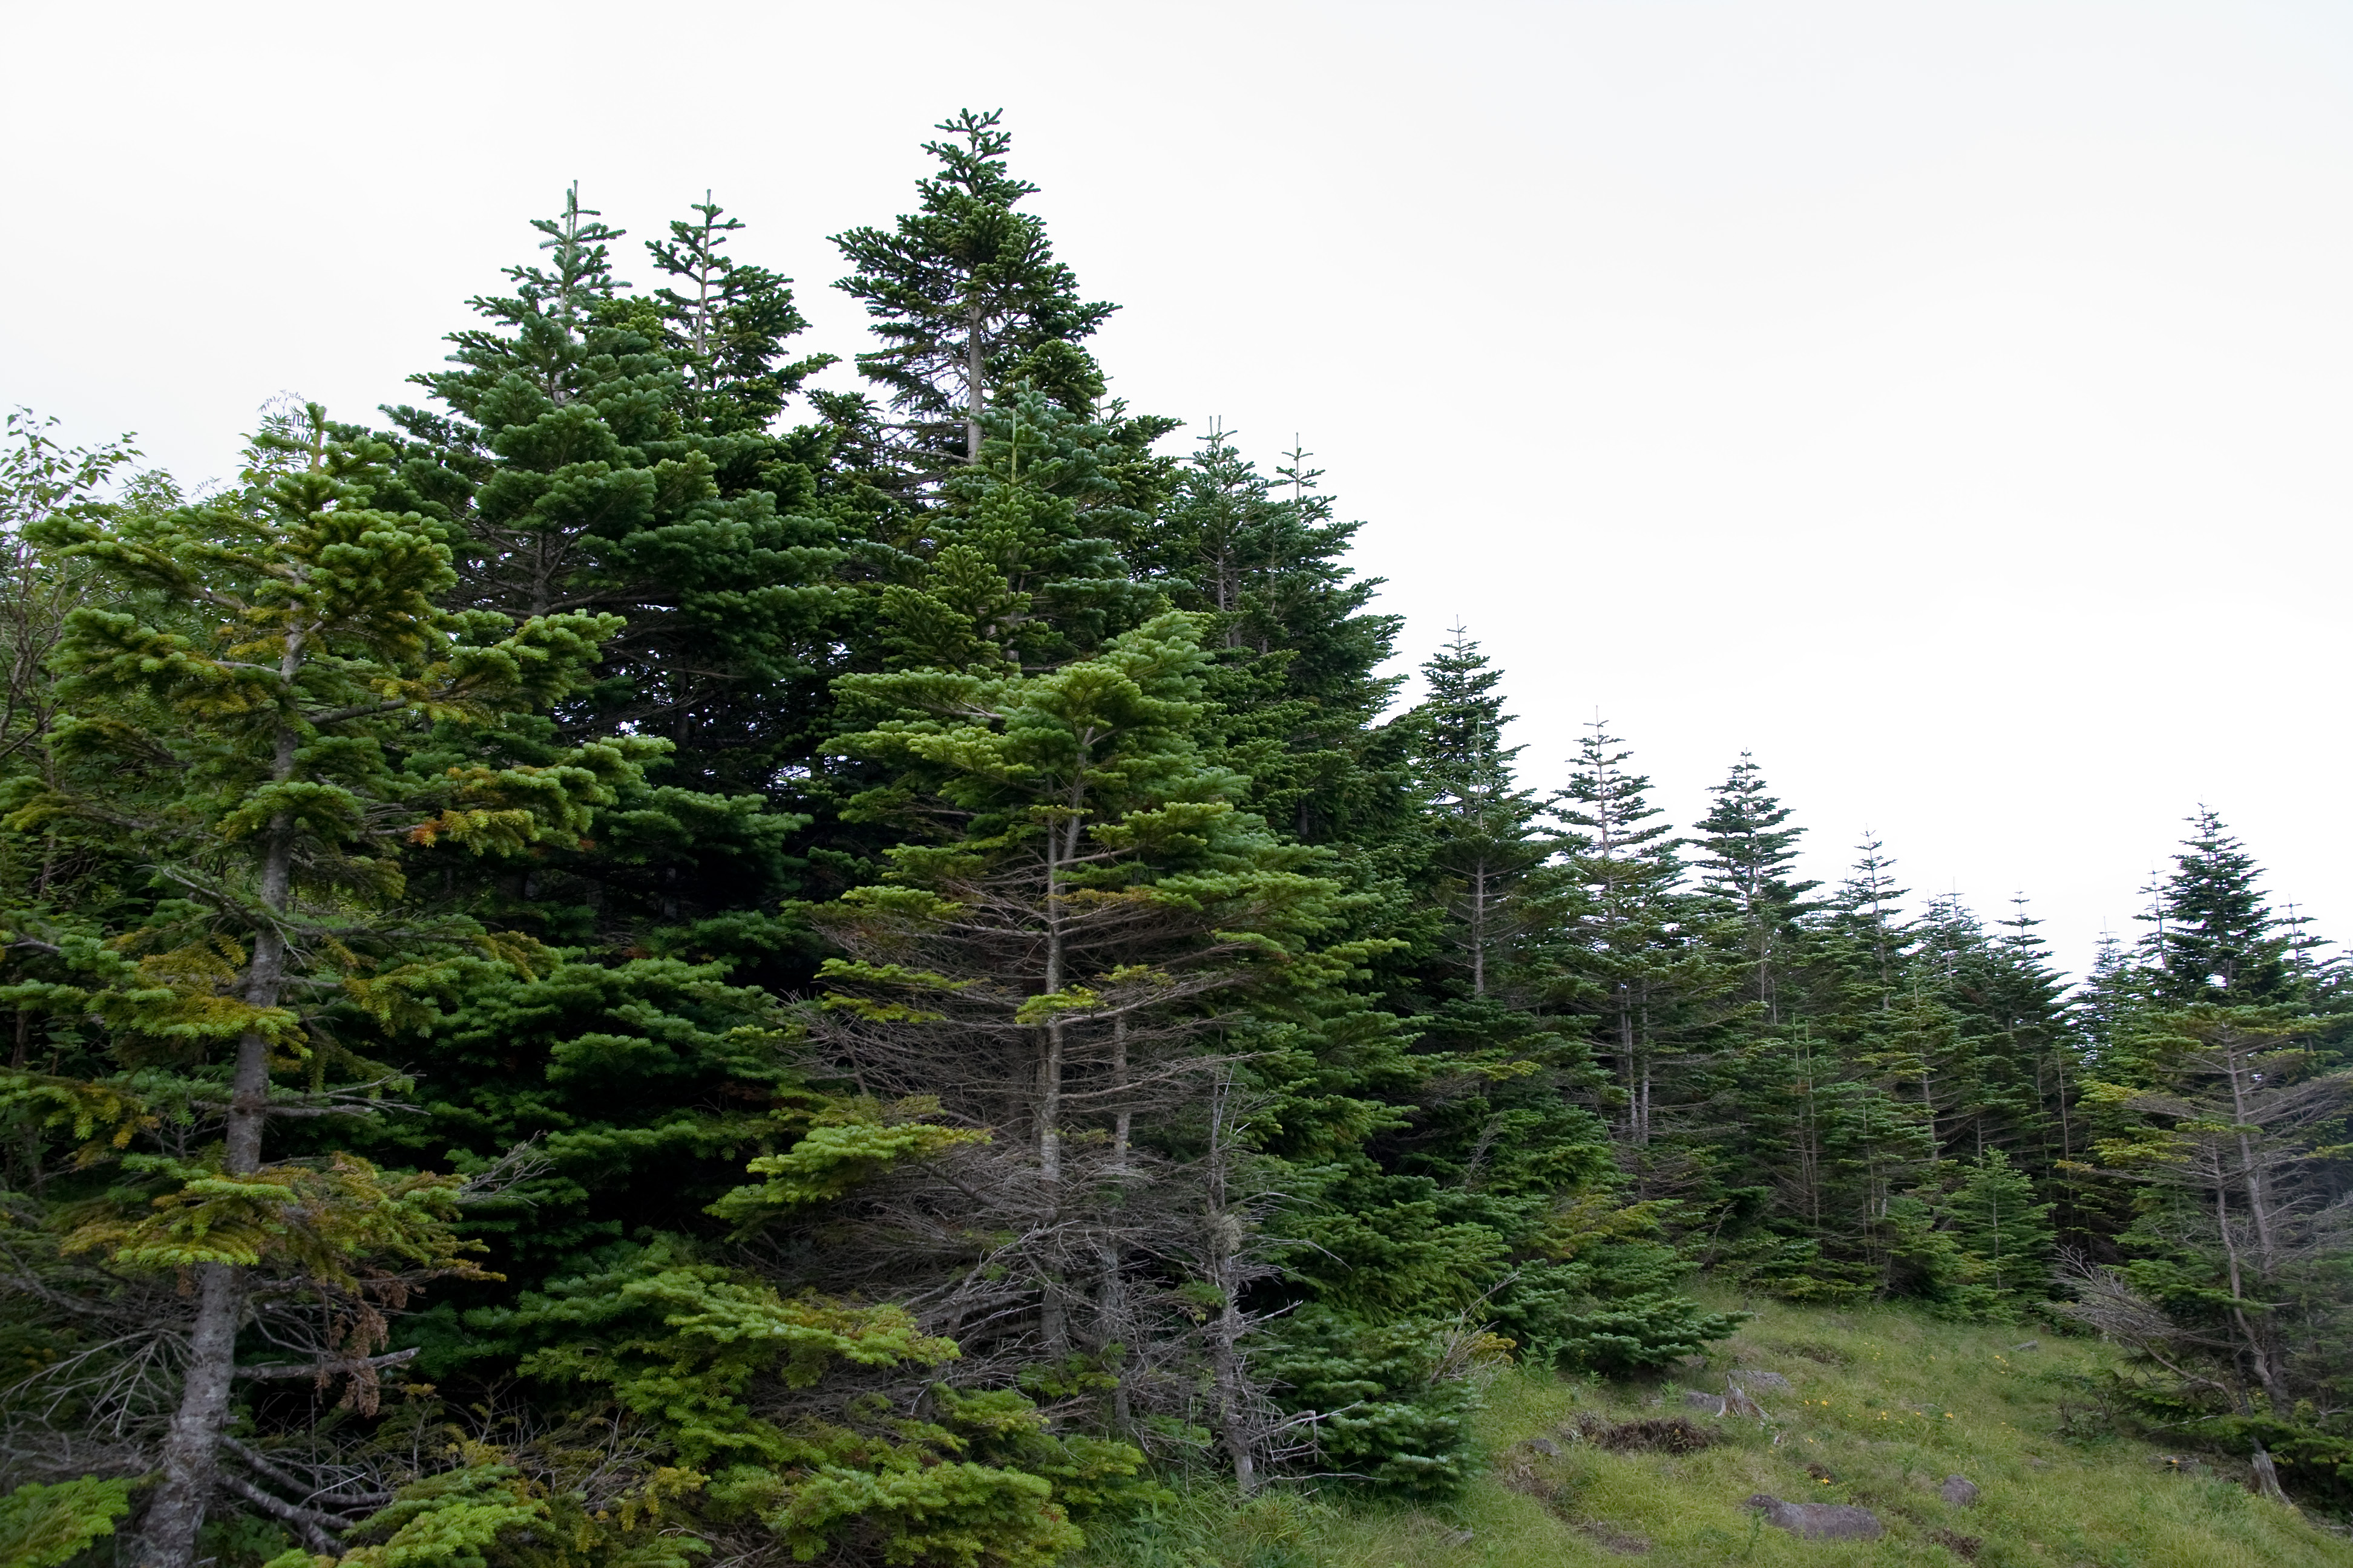
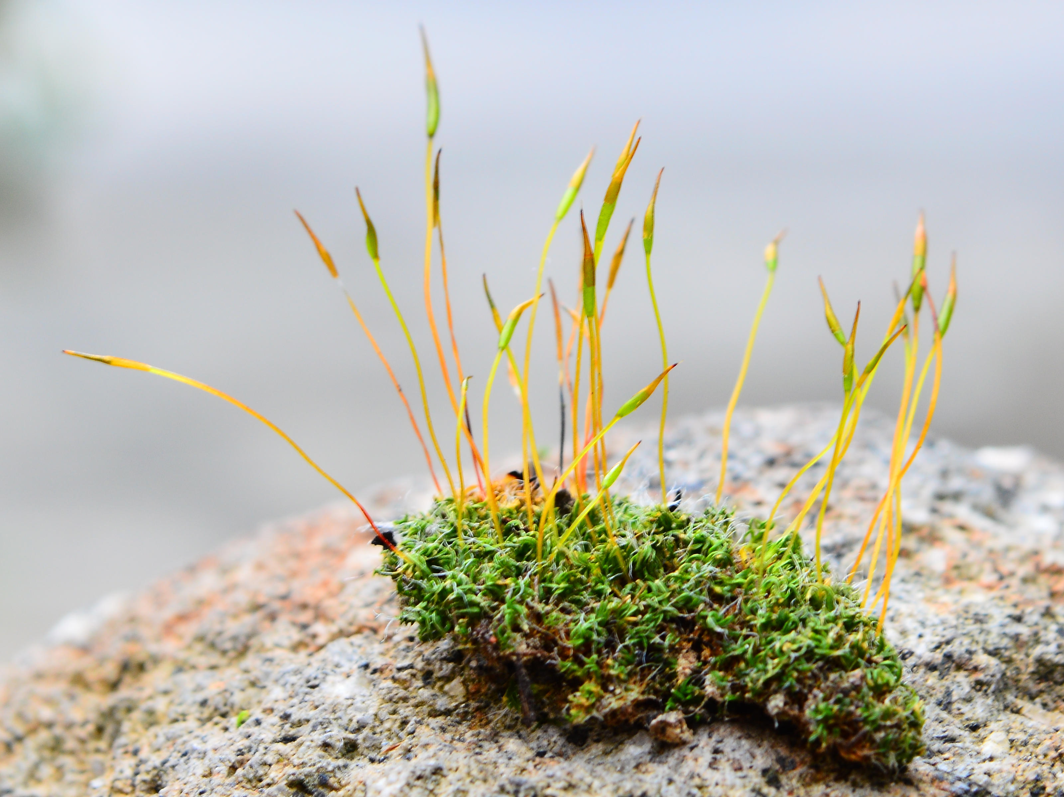
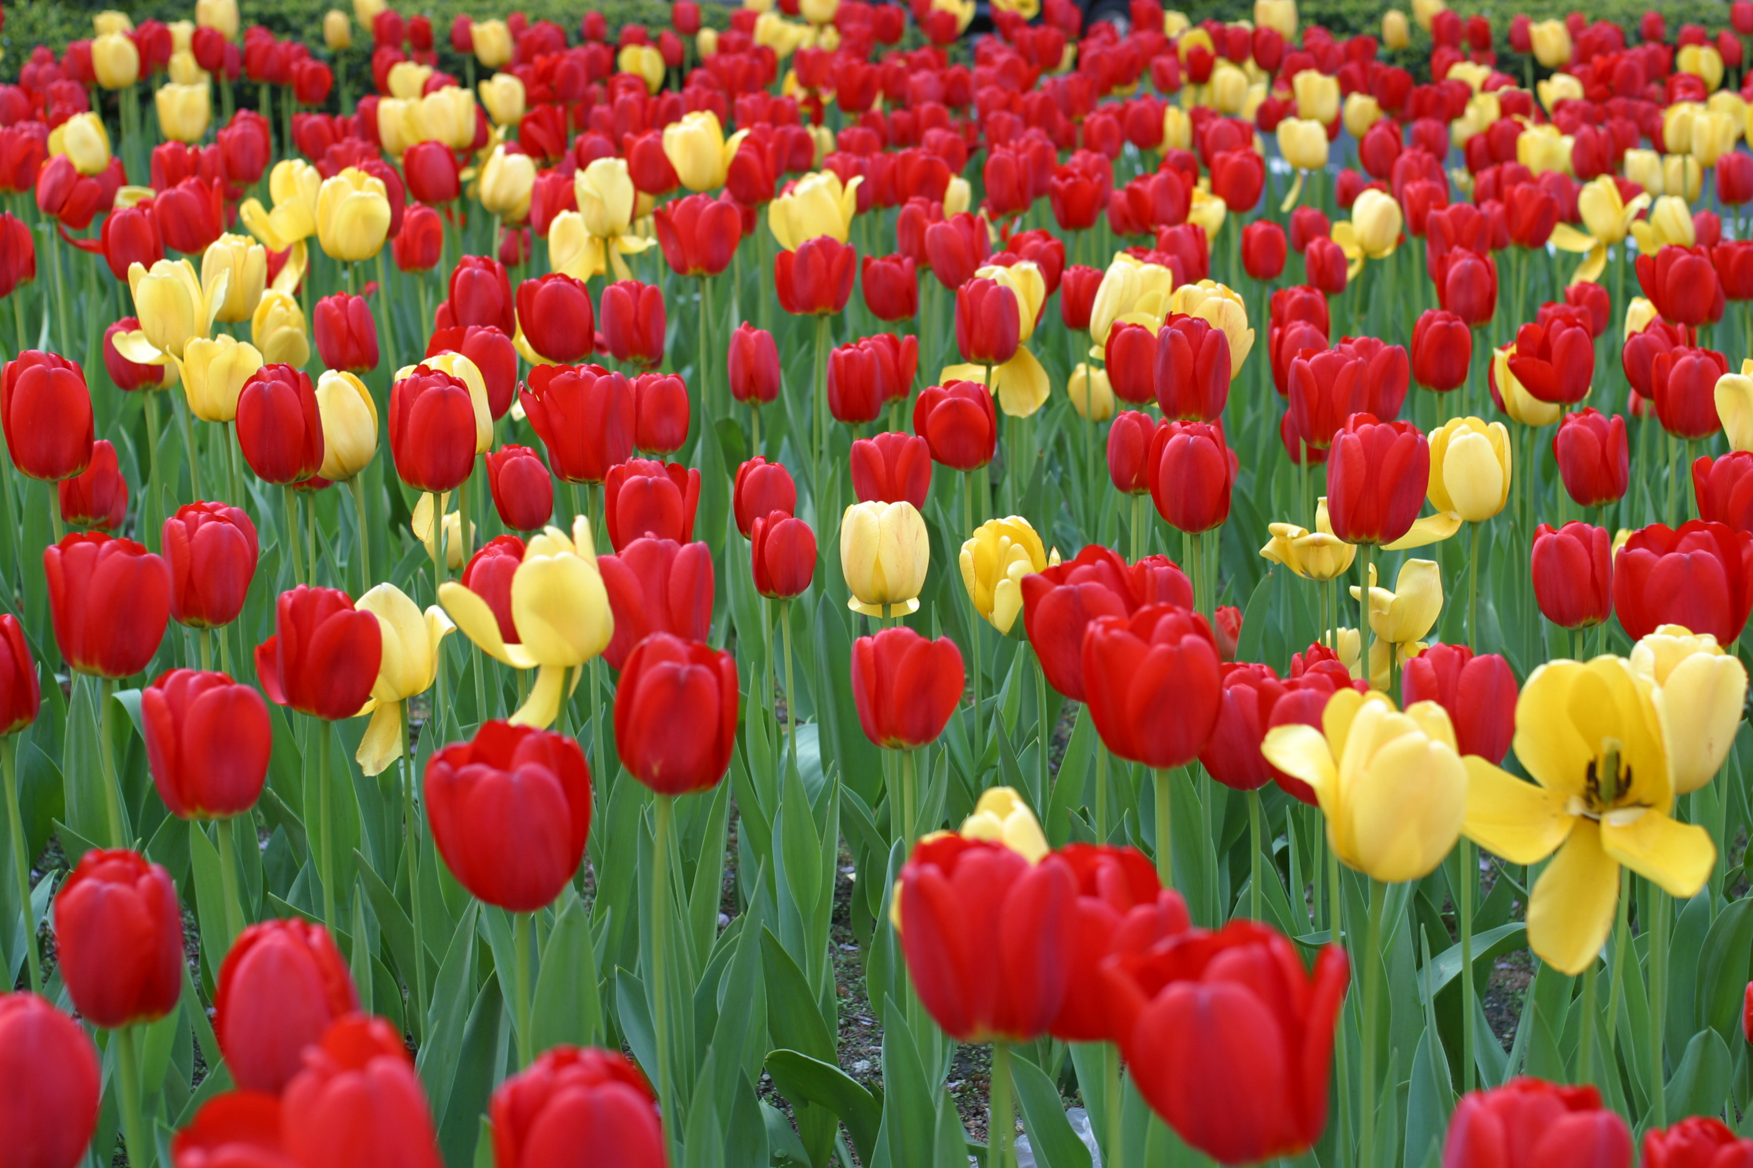
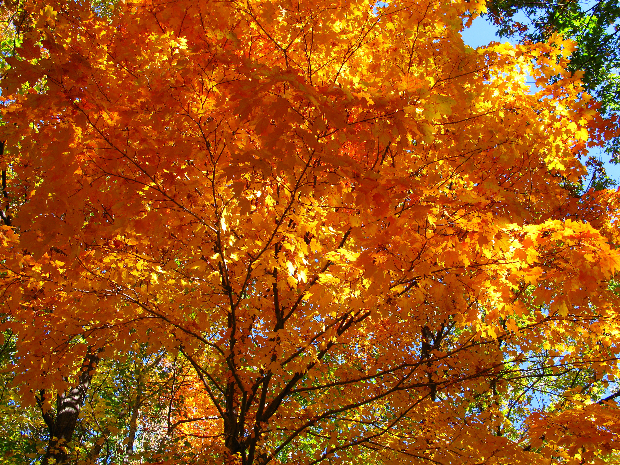
Types of Plants
ferns
pine trees
moss
tulips
maple tree
Cognitive Learning Systems, Inc © 2016
Notes:
Teacher’s Notes
Begin the lesson by introducing the GAP Unit to the class. This GAP Unit focuses plants and animals, structures and functions of plants, classification of animals, and life cycles of plants and animals. The questions below may be used as a way to introduce the topic to the students.
Look at the pictures. These are all pictures of plants. The pictures show a fern (upper left), tulips (lower left), pine tree (center), moss (upper right), and maple tree (lower right).
Do the plants all look the same? What do you think they have in common? Student answers will vary.
How are the plants different? Student answers will vary.
Allow students time to discuss the similarities and differences of the plants. This should be an open discussion providing time for students to express their opinions. They will have an opportunity later in the unit to come to more firm conclusions about structures such as stems, roots and leaves.
Image Credits:
Ferns at Muir Woods, California, Retrieved September 30, 2016, Retrieved from https://en.wikipedia.org/wiki/Fern#/media/File:Sa-fern.jpg
The conifer forest in Yatsugatake, Honshu, Japan, dominated by Abies mariesii. Retrieved September 30, 2016, Retrieved fromhttps://sco.wikipedia.org/wiki/Gymnosperm#/media/File:Forest_in_Yatsugatake_11.jpg
A bit of moss, showing both the gametophyte and sporophyte forms. Retrieved September 30, 2016, Retrieved from https://upload.wikimedia.org/wikipedia/commons/3/33/Moss_Gametophytes_Sporophytes.JPG
Tulips on Park Avenue, NYC, September 30, 2016, Retrieved from https://commons.wikimedia.org/wiki/File:Tulips_On_Park_Ave.JPG
Fall Sugar Maple Acer saccharum tree, Retrieved September 30, 2016, Retrieved from https://commons.wikimedia.org/wiki/File:Fall-orange-maple-tree_-_West_Virginia_-_ForestWander.jpg

Slide 4
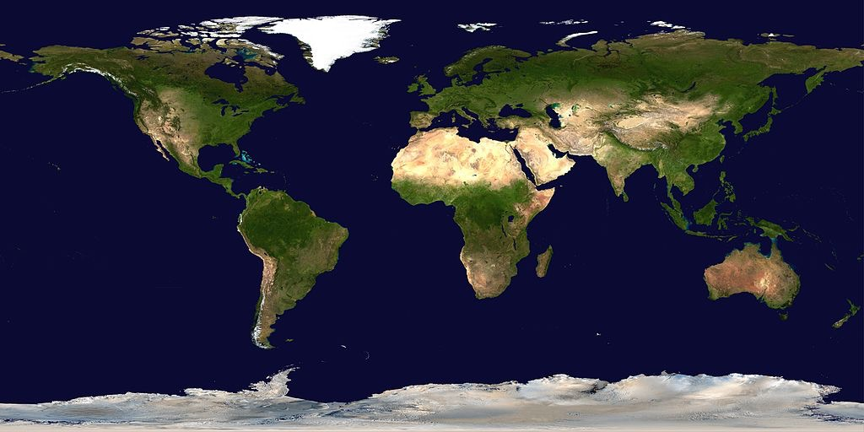
Where are plants found?
Cognitive Learning Systems, Inc © 2016
Notes:
Teacher’s Notes
Direct students attention to the large map of the world. Ask students the following questions:
Look at the picture. This is a map of the world. The blue areas are water, the tan and green areas are land. Where would you find plants?
Student answers will vary.
Would you find plants on the land?
Student answers will vary. Discuss various answers proposed by students.
Would you find plants under the water? Would you find plants growing in the water?
Student answers may vary.
After allowing some time for discussion tell students that plants are found both on the land, under the water and growing in the water. Give some examples such as the trees and flowers they may see near the school or their own homes. Discuss plants that grow in the water such was water lilies (lily pads), grasses, and sea weed. Tell students that although there are plants that grow in the water and on land, plants are in greater variety on land as compared to in the water. Use this difference to lead into a discussion of the needs and structures of typical “land” plants which will be presented in the next set of slides.
Image Credits:
Satellite composition of the whole Earth's surface. Retrieved October 13, 2016, retrieved from https://commons.wikimedia.org/wiki/Atlas_of_the_world#/media/File:Whole_world_-_land_and_oceans_12000.jpg

Slide 5

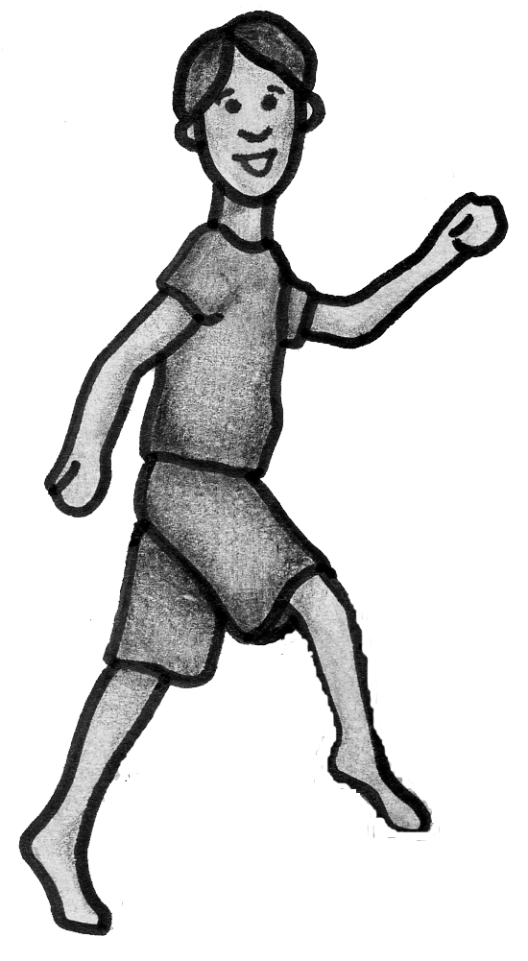
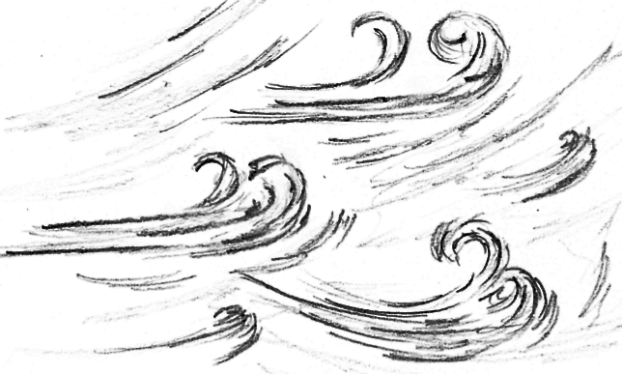
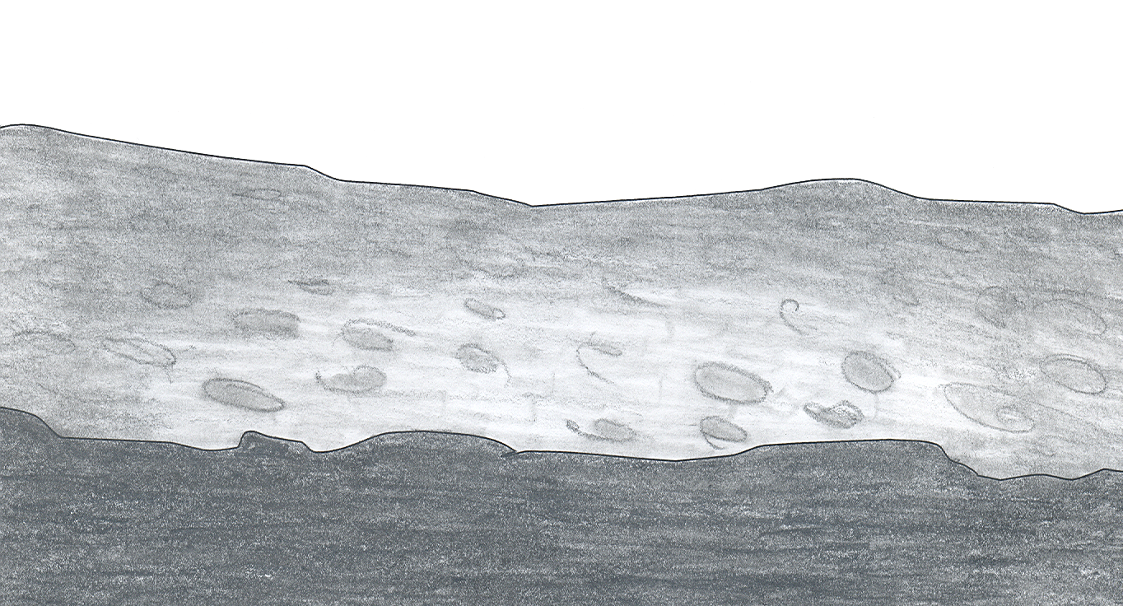
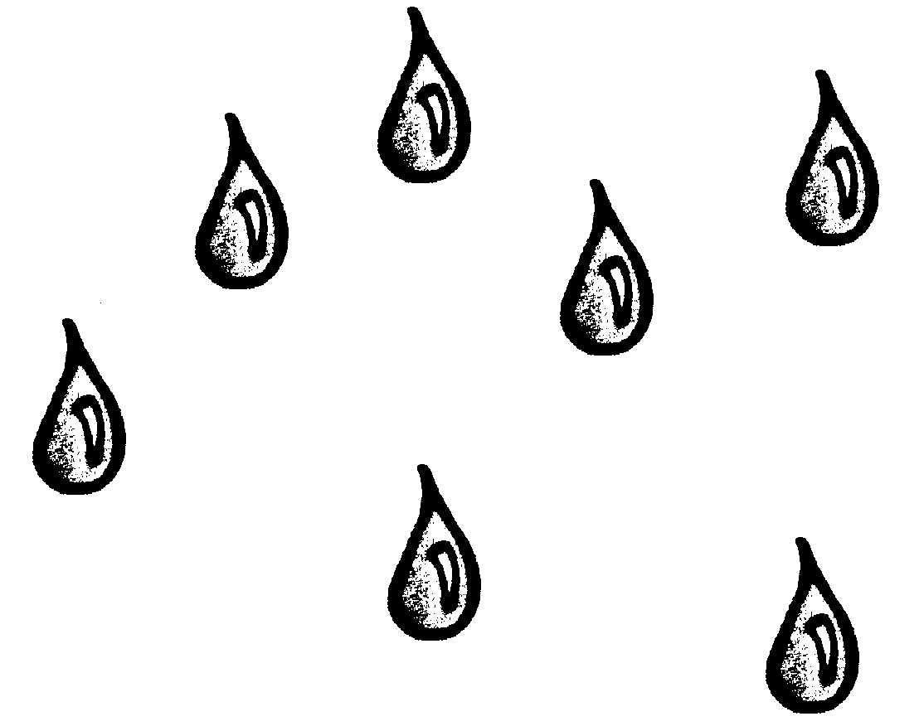
Needs of Plants
What does a plant need?
Light
Carbon dioxide
Water
Minerals and nutrients
Where does a plant get what it needs?
Above the ground
Above the ground
Below the ground
Below the ground
Cognitive Learning Systems, Inc © 2016
Notes:
Teacher’s Notes
Use this slide and the next several slides to help students focus on the structures and functions of plants. The structures of plants presented in this set represent the structures found in most “land plants.” From a classification perspective, the term “land plants” actually refers to plants found both on land AND in the water that evolved over time beyond the structure of simple algae. Therefore sea weed, water lilies and plants other than algae that grow in the water are technically classified as “land plants” because they have structures that have evolved beyond the simple structures of algae.
Because this distinction is likely beyond the level of understanding of many elementary students, this set of slides does NOT make a distinction between land plants and algae. In addition, it represents the structures found in plants that grow both on the land and under the water through drawings of plants found on the land. However, students should be led to understand that with a few exceptions, almost all plants that they would encounter on land and in the water have the same basic parts: roots, stems and leaves. (Exceptions include mosses which technically do not have roots. Mosses have structures that serve similar purpose as roots, but are less extensive and more superficial. They are called rhizoids.)
This slide introduces students to four basic needs of plants: light (which can be from the sun or can be artificially generated), carbon dioxide, nutrients and water. Over the course of the long history of the Earth, plants evolved specific structures to obtain these substances. The structures they developed evolved in part because plants are immobile. They cannot move from place to place in order to obtain their requirements for life.
Discuss the four basic needs of plants and where these resources are located: above or below the ground. Understanding the location of these resources should help students associate the parts of the plant shown in the next slide with the various resources.
Image Credits:
Emily Verner, own work, LabLearner

Slide 6
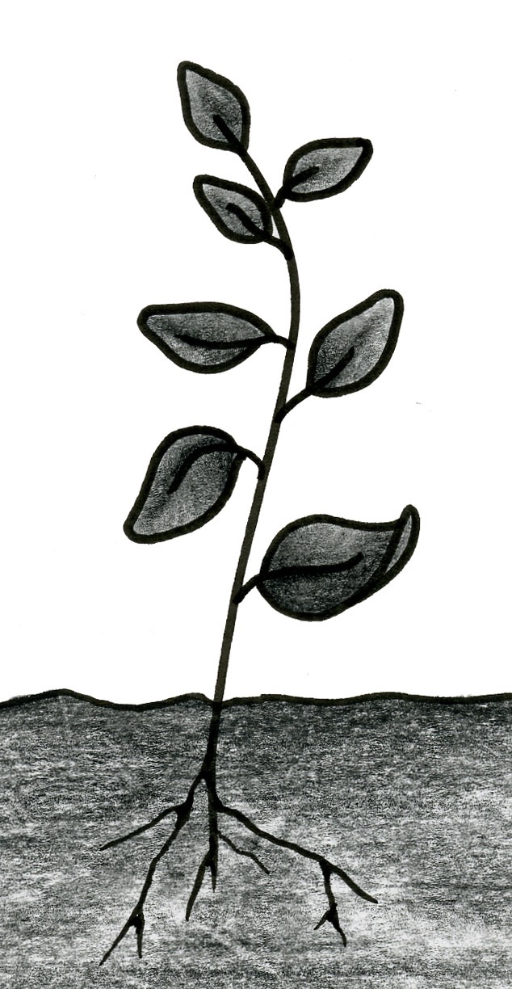
Parts of a Plant
Leaf
  Absorbs light
  Absorbs carbon dioxide
  Makes sugar
  Releases oxygen
Stem
  Provides support
  Moves water from the roots to the other parts of the plant
  Moves food from the leaves to the other parts of the plant
Root
  Absorbs water
  Absorbs minerals and nutrients
  Anchors the plant
Cognitive Learning Systems, Inc © 2016
Notes:
Teacher’s Notes
Direct students’ attention to three main parts of the plant: roots, stem and leaves. Discuss the various functions of each and the location of each. Encourage students to make connections between the location of different plant structures and the need for certain resources. For example, plants need water and nutrients which, in most cases, are located beneath the surface of the Earth. Roots are the parts of plants that are located underground and can obtain the water and nutrients needed by plants.
The functions listed in this slide are basic functions. However, the information listed below is provided if students ask additional questions.
Stems can also store food, have structures that protect the plant such as thorns, and perform photosynthesis on plants that do not have leaves with large surface areas such as cacti.
Leaves also help regulate water loss by opening and closing small holes on them called stomata, can help protect the plant such as the spines (leaves) on cactus, and can help attract insects to aid in pollination.
Roots can also store food such as in carrots, sweet potatoes and radishes.
Students may question whether the same structures exist in plants that they see growing in water. In general, roots, stems and leaves are found in the plants that grow below and in water. Their structures may differ slightly and some of the functions of those structures may not be the same as for plants that grow on land. For example, some plants that grow in water have different shaped roots that allow the plants to float on the water rather than anchor the plant to the bottom of the lake, river or ocean.
Image Credits:
Emily Verner, own work, LabLearner

Slide 7
Types of Roots and Stems
Almost all plants have roots and stems.
The roots and stems of plants may look different.
stem
stem
roots
roots
stem
stem
roots
roots
Cognitive Learning Systems, Inc © 2016
Notes:
Teacher’s Notes
Ask students whether they think that the basic parts of a plant appear the same in all plants. Help students understand the concept of similar but not identical parts of plants by showing them the pictures in the next two slides. These slides illustrate different types of roots, stems and leaves found in plants including grasses, flowering plants and trees.
In this slide, the following examples of roots and stems are shown. It is not expected that students should memorize the difference root types.
Top left: Fibrous root which helps to anchor plant and reaches in many directions to obtain nutrients and water. These roots often absorb water before it sinks deep into the ground. The structure of fibrous roots help prevent erosion of soil. Grass has fibrous roots.
Top right: Tap root which anchors the plant in the ground more firmly than fibrous roots and can travel far below the ground to find water. Certain desert plants have very long tap roots. Dandelions are also known for their long tap roots.
Bottom left: Adventitious root which has shallow extensions along the length of the stem. These types of roots often help provide the extra support needed for climbing plants such as ivies.
Bottom right: A taproot with tubers attached. Tubers can be part of the stem or root. They store food. Some examples of tubers are potatoes, carrots, and turnips. Carrots and turnips are tubers that are roots. A potato tuber is part of the stem.
As students view the different types of roots and stems they may ask about examples from their own experiences. The information below is provided should they ask about two common plant structures that are found underground.
Bulbs: A bulb is an underground storage area of the stem. The plant uses the food in the bulb during the growing season. After the growing season is over, food is diverted from the leaves to the bulb for storage until the next growing season. Two examples of these stems are include onions and tulips.
Corm: A corm is an underground storage area of the stem. The plant uses the food in the corm during the growing season. After the growing season is over, food is diverted from the leaves to the corm for storage until the next growing season. Ginger plants have corms.
Image Credits:
Dr. Jurasinski, own work, LabLearner

Slide 8
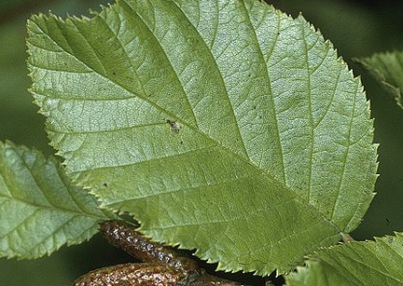
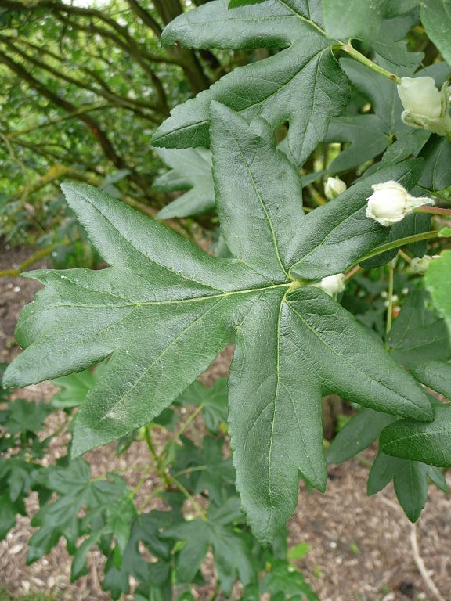
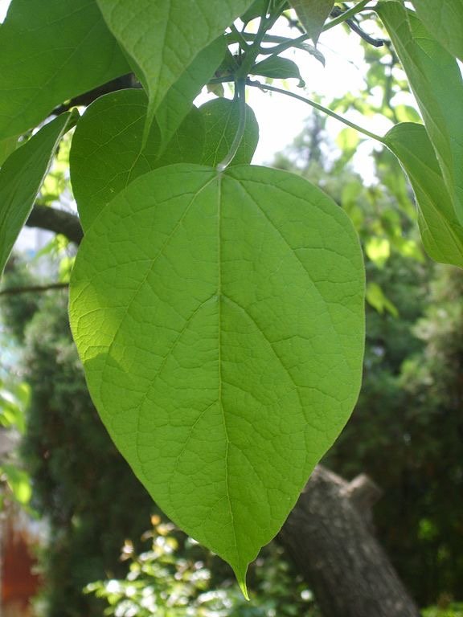
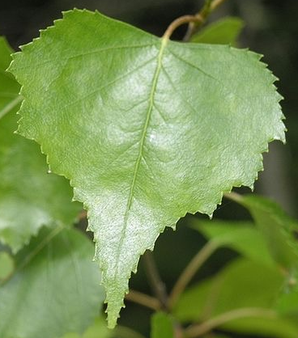
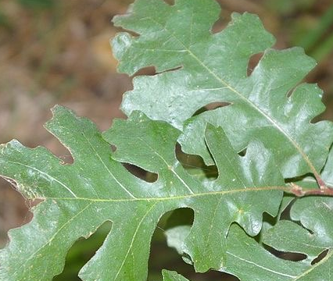
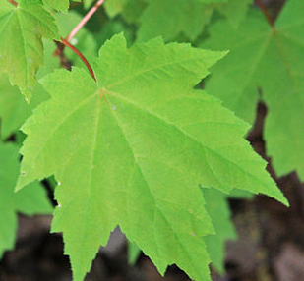
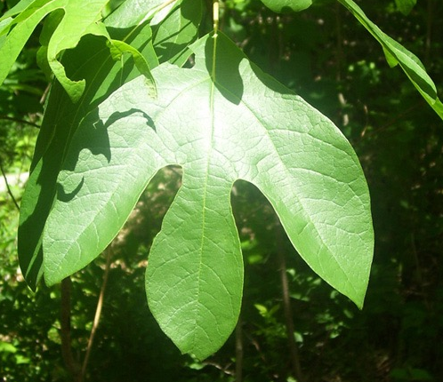
Broad Leaves
Cognitive Learning Systems, Inc © 2016
Notes:
Teacher’s Notes
Complete this set of slides by highlighting two main categories of leaves: broad leaves and needle-like leaves.
Students will have an opportunity to review what they have learned about the parts of plants in the next slide set Check Understanding: Plants.
Image Credits:
Alnus viridis crispa leaves.jpg, Retrieved October 21, 2016, retrieved https://commons.wikimedia.org/wiki/File:Alnus_viridis_crispa_leaves.jpg
Malus trilobata leaves 01 by Line1.jpg, Retrieved October 21, 2016, retrieved https://commons.wikimedia.org/wiki/File:Malus_trilobata_leaves_01_by_Line1.jpg
Catalpa bignonioides's leaf in Korea.JPG, Retrieved October 21, 2016, retrieved https://commons.wikimedia.org/wiki/File:Catalpa_bignonioides%27s_leaf_in_Korea.JPG
Betula populifolia leaves, New Brunswick, Canada, Retrieved October 21, 2016, retrieved https://en.wikipedia.org/wiki/Betula_populifolia#/media/File:Betula_populifolia_leaves.jpg
Leaves of Quercus lobata, Retrieved October 21, 2016, retrieved https://en.wikipedia.org/wiki/Quercus_lobata#/media/File:Quercus_lobata_leaves_Caswell_Memorial_State_Park_San_Joaquin_Valley_California.jpg
Acer rubrum young leaves.jpg, Retrieved October 21, 2016, retrieved https://commons.wikimedia.org/wiki/File:Acer_rubrum_young_leaves.jpg
Sassafras7.jpg, Retrieved October 21, 2016, retrieved https://commons.wikimedia.org/wiki/File:Sassafras7.jpg

Slide 9
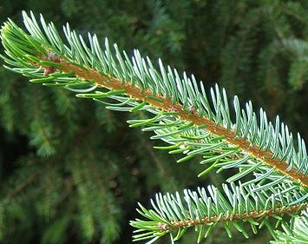
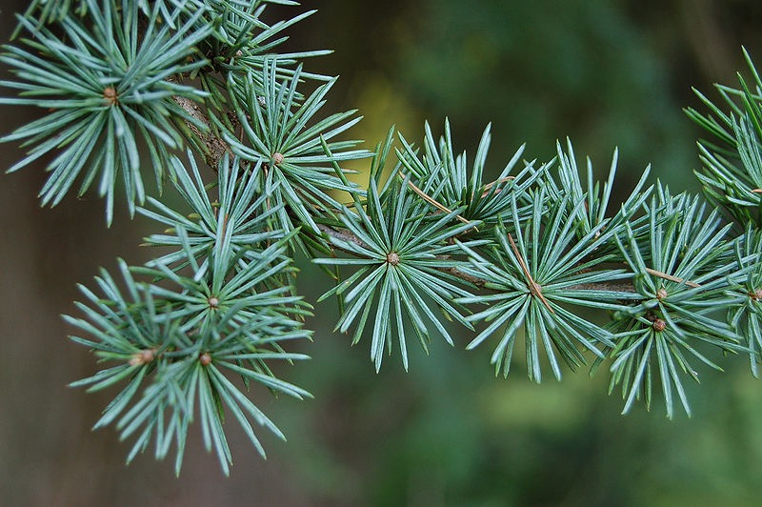
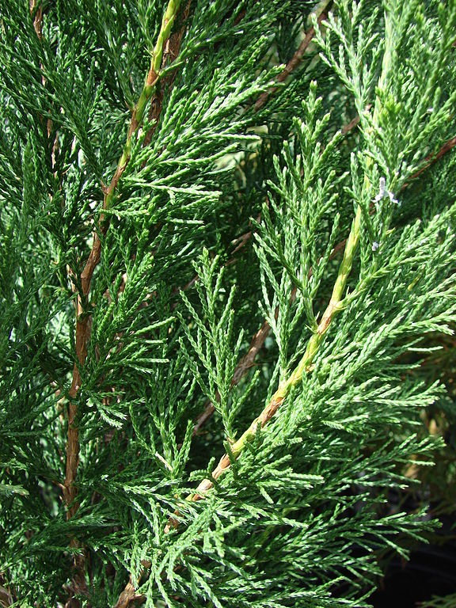
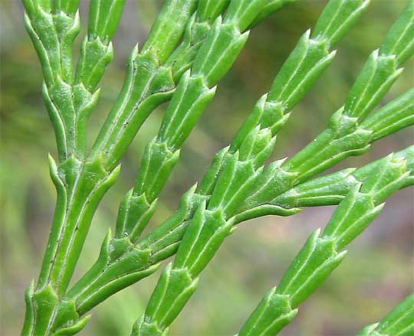
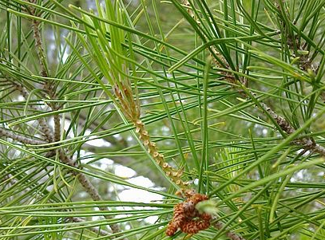
Needle-like Leaves
Cognitive Learning Systems, Inc © 2016
Notes:
Teacher’s Notes
Complete this set of slides by highlighting two main categories of leaves: broad leaves and needle-like leaves.
Students will have an opportunity to review what they have learned about the parts of plants in the next slide set Check Understanding: Plants.
Image Credits:
Lone Pine leaves 2.jpg, Retrieved October 21, 2016, retrieved https://commons.wikimedia.org/wiki/File:Lone_Pine_leaves_2.jpg
Calocedrus decurrens foliage PAN 2.JPG, Retrieved October 21, 2016, retrieved https://commons.wikimedia.org/wiki/File:Calocedrus_decurrens_foliage_PAN_2.JPG
Picea omorika foliage. Cultivated in a forestry plantation, Kielder, Northumberland/Scotland border, UK. Retrieved October 21, 2016, retrieved https://commons.wikimedia.org/wiki/File:Picea_omorika1.jpg
Starr 080117-2025 Juniperus chinensis.jpg, Retrieved October 21, 2016, retrieved https://commons.wikimedia.org/wiki/File:Starr_080117-2025_Juniperus_chinensis.jpg
Atlas Cedar Cedrus atlantica 'Glauca' Needles 3008px.JPG, Retrieved October 21, 2016, retrieved https://commons.wikimedia.org/wiki/File:Atlas_Cedar_Cedrus_atlantica_%27Glauca%27_Needles_3008px.JPG

Slide 10
Check Understanding
Pretend you are a plant.
Your feet are roots, your body is the stem, your hands are branches and leaves.
Look at the pictures and listen to your teacher. See if you can model different types of plants.
Cognitive Learning Systems, Inc © 2016
Notes:
Teacher’s Notes
The Check Understanding Slide Set is provided to help students rehearse and review what they have learned about the structures and functions within the context of a role play. Students will use parts of their bodies to model the three parts of a plant. In general, their feet will be roots, their torsos the stem, and their hands- leaves. The overall goal of this activity is for students to realize that although plants may look different, most plants consist of the same three parts which perform the same functions.

Slide 11
Check Understanding
Pretend to be a dandelion.
A dandelion has
A stem
Broad leaves
One long tap root
Cognitive Learning Systems, Inc © 2016
Notes:
Teacher’s Notes
Explain that students will pretend to be a dandelion. Guide them through the role play using the following directions:
Pretend to be a dandelion. You should:
Stand straight. Your body is a model for the dandelion stem.
Hold your hands out with your palms up and your fingers together. Your hands are a model for the broad leaves of the dandelion.
Stand on one foot. Your foot is a model of the one long tap root of the dandelion.
Image Credits:
Dr. Jurasinski, own work, LabLearner

Slide 12
Check Understanding
Listen as your teacher asks a question.
Move the part of your pretend dandelion that performs a certain job.
Absorbs light and carbon dioxide
2. Absorbs water
3. Supports the plant
Cognitive Learning Systems, Inc © 2016
Notes:
Teacher’s Notes
Explain that you will say a function of a part of a dandelion. The students are to move the part of their “model dandelion” that performs the function.
Image Credits:
Dr. Jurasinski, own work, LabLearner

Slide 13
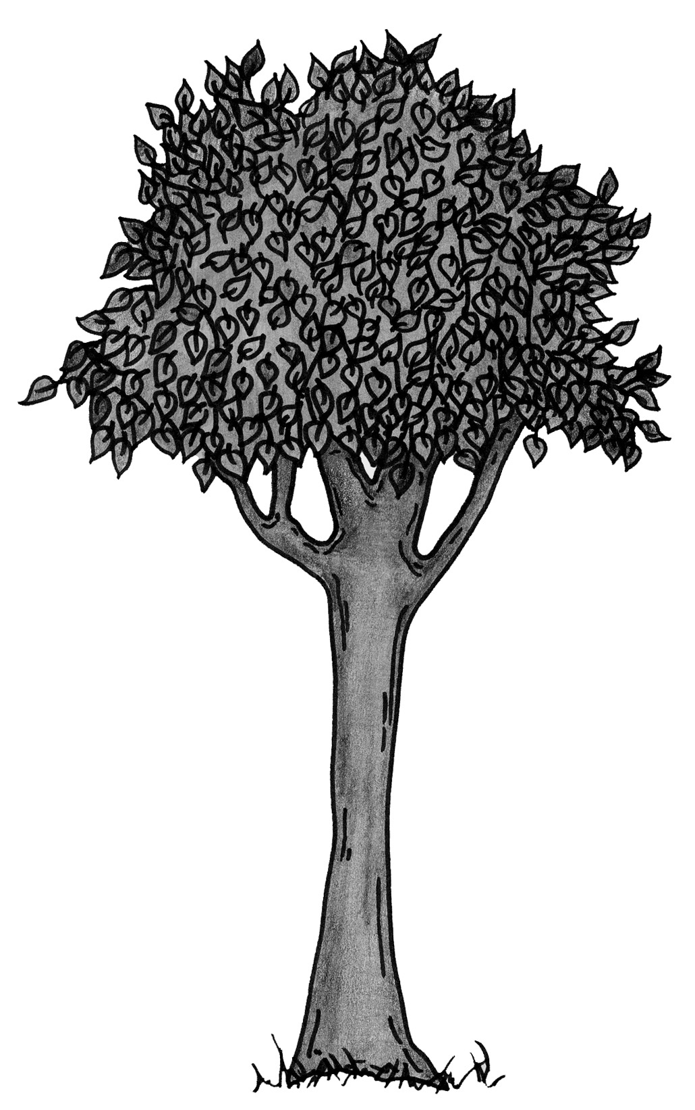
Check Understanding
Pretend to be a tree.
The tree has
Broad leaves
A trunk
Widespread roots
Cognitive Learning Systems, Inc © 2016
Notes:
Teacher’s Notes
Follow the same type of directions for the role play and the correspondence of the structures to the functions of the tree. Use this slide and the next for the second part of the role play.
Pretend to be a tree. You should:
Stand straight (Body models trunk/stem of tree)
Hold hands out with palms up and fingers together (Hands model broad leaves of tree)
Stand on two feet (Two feet model fibrous roots of tree).
Image Credits:
Emily Verner, own work, LabLearner

Slide 14
Check Understanding
Listen as your teacher asks a question.
Move the part of your pretend tree that performs a certain job.
1. Absorbs light and carbon dioxide
2. Absorbs water
3. Supports the plant
Cognitive Learning Systems, Inc © 2016
Notes:
Teacher’s Notes
Options
You may choose to extend the role play with students incorporating other types of plants or may ask students to give suggestions for both plants and ways in which to model the plants. You may also wish to have students work in pairs with one student suggesting a plant and the other modeling it. Several other options are given below for extension of the role play.
Model needle-like leaves by holding up one finger.
Model bulbs by curling into a ball on the floor or kneeling on the floor.
Image Credits:
Emily Verner, own work, LabLearner

Slide 15
Making and Applying Connections
Which part of a plant absorbs water from the ground?
A. roots
B. leaf
C. stem
Cognitive Learning Systems, Inc © 2016
Notes:
Teacher’s Notes
The Making and Applying Connections section of the GAP Unit has been provided as a way to help students rehearse and process the information learned during the Plants and Animals GAP Unit as well as to become more familiar with test-taking strategies and various types of analysis questions.
Answers
Question 1: A
Image Credits:
Dr. Jurasinski, own work, LabLearner

Slide 16
Making and Applying Connections
The pictures show different types of
  A. stems
B. roots
C. leaves
Cognitive Learning Systems, Inc © 2016
Notes:
Teacher’s Notes
Answers
Question 2: C
Alnus viridis crispa leaves.jpg, Retrieved October 21, 2016, retrieved https://commons.wikimedia.org/wiki/File:Alnus_viridis_crispa_leaves.jpg
Atlas Cedar Cedrus atlantica 'Glauca' Needles 3008px.JPG, Retrieved October 21, 2016, retrieved https://commons.wikimedia.org/wiki/File:Atlas_Cedar_Cedrus_atlantica_%27Glauca%27_Needles_3008px.JPG
Acer rubrum young leaves.jpg, Retrieved October 21, 2016, retrieved https://commons.wikimedia.org/wiki/File:Acer_rubrum_young_leaves.jpg
Picea omorika foliage. Cultivated in a forestry plantation, Kielder, Northumberland/Scotland border, UK. Retrieved October 21, 2016, retrieved https://commons.wikimedia.org/wiki/File:Picea_omorika1.jpg

Slide 17
Making and Applying Connections
Which arrow shows the stem of a plant?
A
B
C
Cognitive Learning Systems, Inc © 2016
Notes:
Teacher’s Notes
Answers
Question 3: B
Image Credits:
Emily Verner, own work, LabLearner

Slide 18
Plants and Animals
Animals
Cognitive Learning Systems, Inc © 2016

Slide 19
What Can You Recall?
Listen to the rhyme and look at the picture. Think about what you have learned about plants. Help complete the rhyme.
Let’s get ready to start.
And name a plant’s ________.
Into the ground I shoot.
I am a plant’s _______.
I can be straight or might bend.
I am a plant’s ________.
We might blow in the breeze.
We are a plant’s _________.
Cognitive Learning Systems, Inc © 2016
Notes:
Teacher’s Notes
The What Can You Recall section of the GAP Unit has been provided as a way to help students rehearse and process the information learned previously during the Plants section of the Plants and Animals GAP Unit. The activity focuses on some of the major concepts or facts of the Plants portion of the GAP Unit.
This What Can You Recall section is designed to be the first activity done at the beginning of the Animals section of the Plants and Animals GAP UNIT.
Answers:
Let’s get ready to start.
And name a plant’s parts
Into the ground I shoot
I am a plant’s roots
I can be straight or might bend
I am a plant’s stem
We might blow in the breeze
We are a plant’s leaves
Image Credits:
Dr. Jurasinski, own work, LabLearner

Slide 20
Where are animals found?
Cognitive Learning Systems, Inc © 2016
Notes:
Teacher’s Notes
Begin by explaining that in this part of the GAP Unit, students will focus on other types of living things that are found on Earth- animals. .
Direct students attention to the large map of the world. Ask students the following questions:
Where to do you think animals are found on the Earth?
Student answers will vary. Students should indicate that animals are found on land and in the water.
Are animals found on land? What kinds of animals might be found on land?
Student answers will vary. Discuss various answers proposed by students. Examples might include dogs, cats, lizards, spiders.
Are animals found in the water? What kinds of animals might be found in the water?
Student answers may vary. Examples might include fish, whales, and starfish.
Image Credits:
Satellite composition of the whole Earth's surface. Retrieved October 13, 2016, retrieved from https://commons.wikimedia.org/wiki/Atlas_of_the_world#/media/File:Whole_world_-_land_and_oceans_12000.jpg

Slide 21
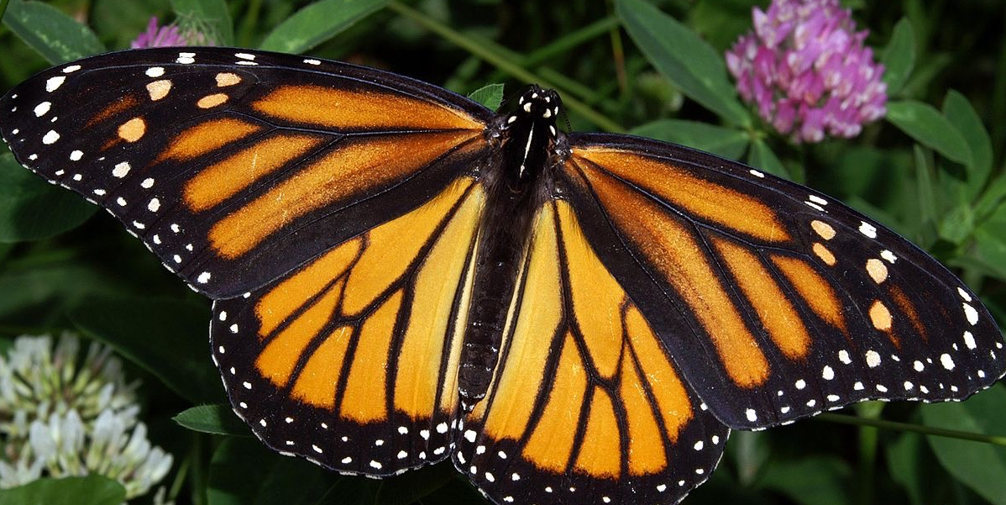
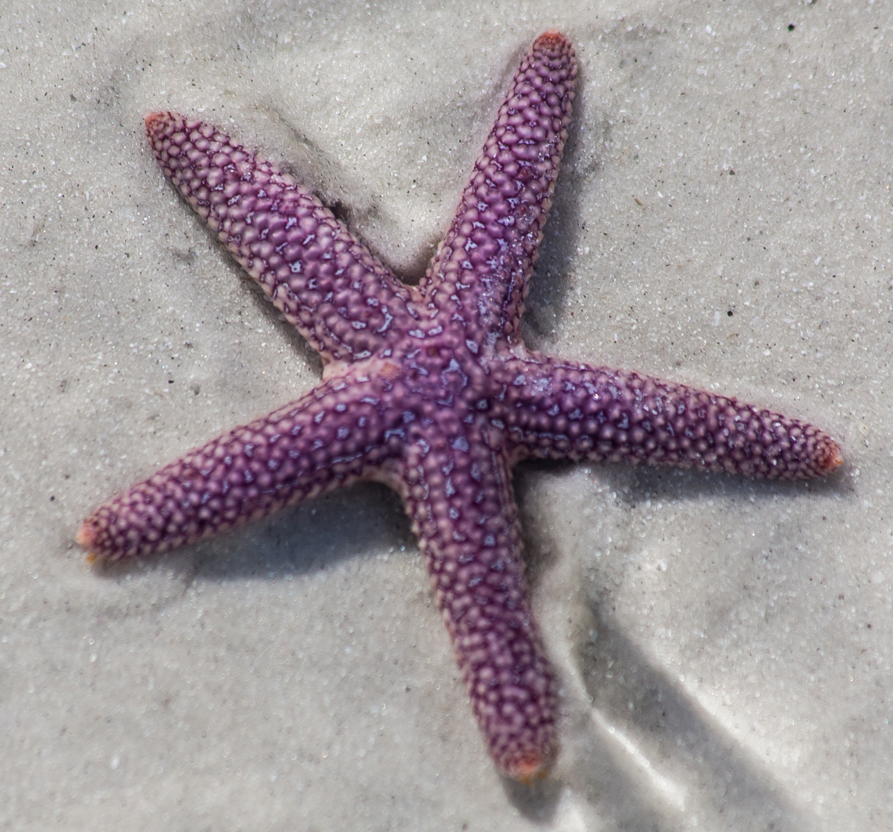
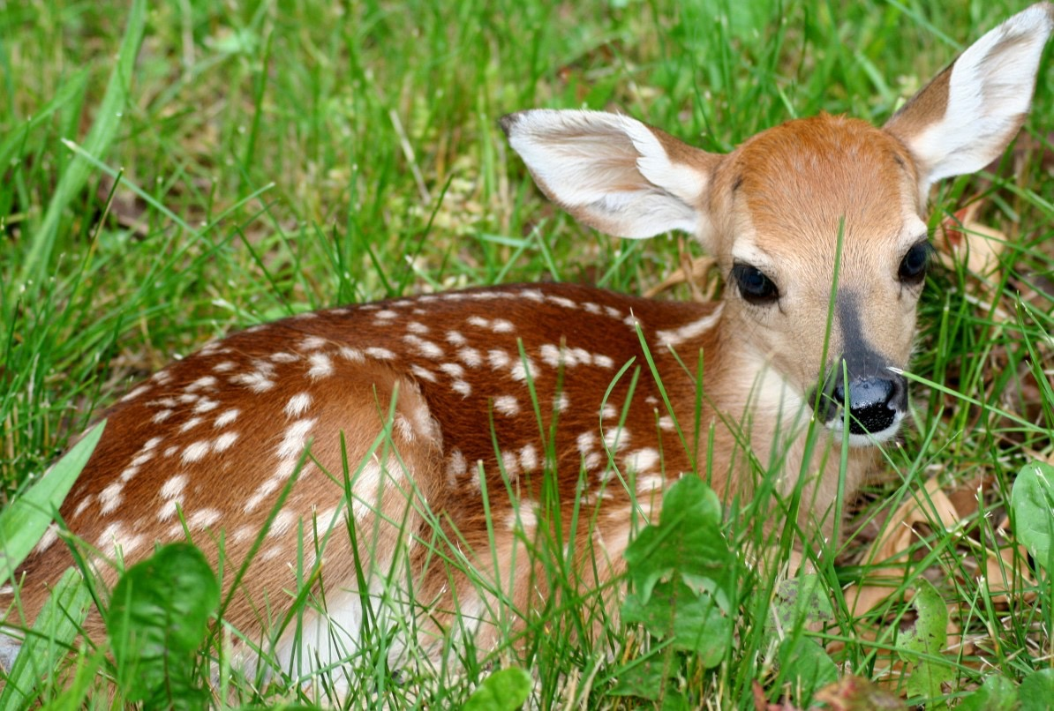
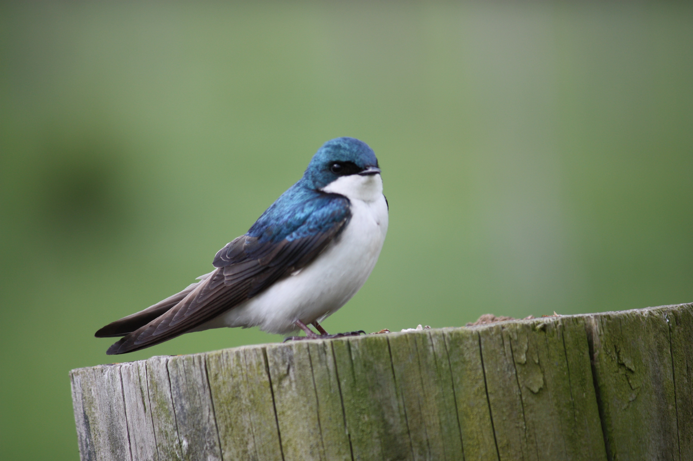
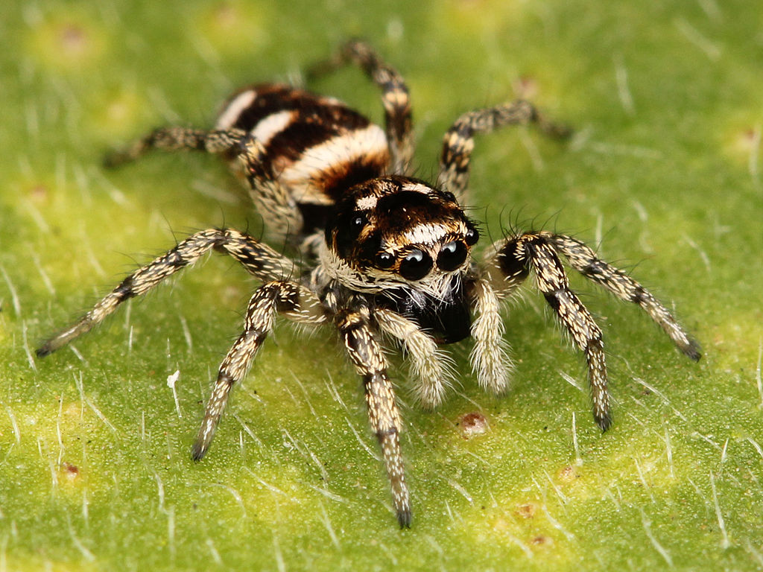
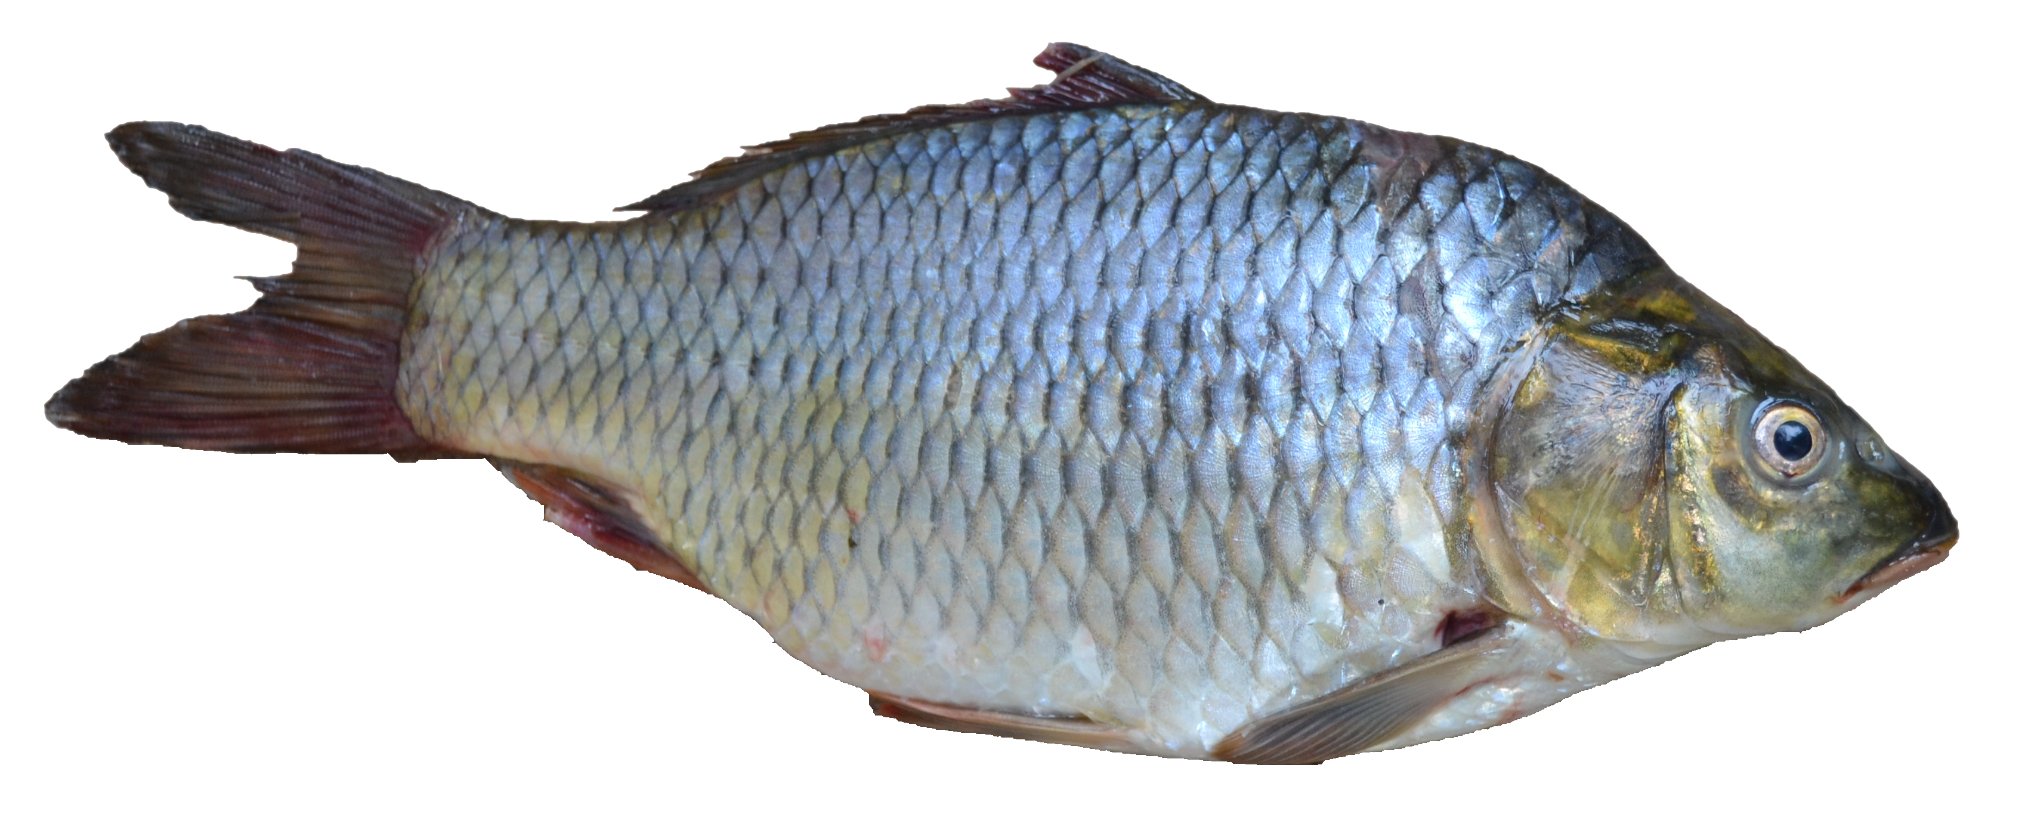
Animals
Almost all plants have the same three parts:
  roots
  stems
  leaves
Look at the pictures of animals.
Do all animals have the same parts?
Cognitive Learning Systems, Inc © 2016
Notes:
Teacher’s Notes
Show students the pictures of animals. Remind students that when they began the GAP Unit, they looked at different pictures of plants. They also investigated the parts of plants. They discovered that even though plants looked different, most plants had the same three parts: roots, stems and leaves.
Ask students the following questions about the animals.
Do all of the animals look the same?
Student answers will vary.
What are some differences among the animals?
Student answers will vary
Do you think all animals have the same parts?
Student answers will vary
Use students answers as a way of leading into a discussion of how scientists classify animals. This will be the focus of the next set of slides.
Image Credits:
A blue bird taken along Cullers Trail in Shenandoah River State Par, Retrieved September 30, 2016, Retrieved from https://commons.wikimedia.org/wiki/File:Blue_Bird_(7414410526).jpg
Fawn lying on grass, retrieved September 20, 2016, https://en.wikipedia.org/wiki/White-tailed_deer#/media/File:Fawn-in-grass.jpg,
Starfish at low tide on Sanibel Island), retrieved on September 20, 2016, retrieved from https://commons.wikimedia.org/wiki/File:Starfish_at_low_tide_on_Sanibel_Island_(8298677162).jpg
Photograph of a Monarch Butterfly, retrieved on September 20, 2016, retrieved from https://en.wikipedia.org/wiki/Monarch_butterfly#/media/File:Monarch_In_May.jpg
Starfish at low tide on Sanibel Island), retrieved on September 20, 2016, retrieved from https://commons.wikimedia.org/wiki/File:Starfish_at_low_tide_on_Sanibel_Island_(8298677162).jpg
Adult female Salticus scenicus jumping spider. Found at China Camp State Park, California.retrieved September 20, 2016, https://en.wikipedia.org/wiki/Zebra_spider#/media/File:Kaldari_Salticus_scenicus_female_01.jpg,
Puntius sarana from Kerala, Retrieved September 30, 2016, Retrieved from https://commons.wikimedia.org/wiki/File:Fish_ _Puntius_sarana_from_Kerala_(India).png

Slide 22
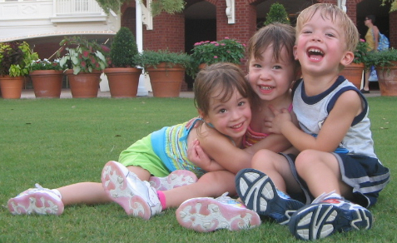
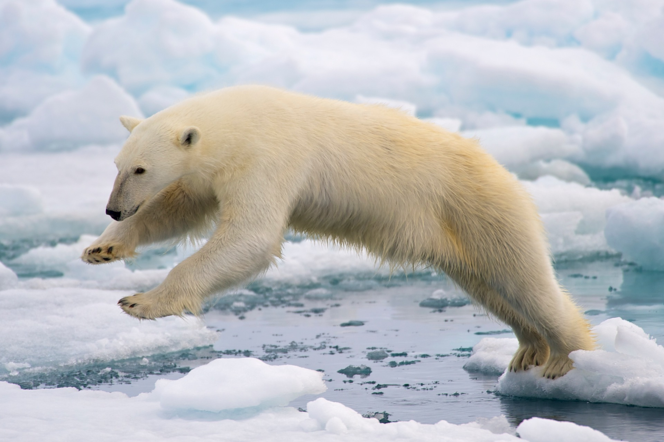
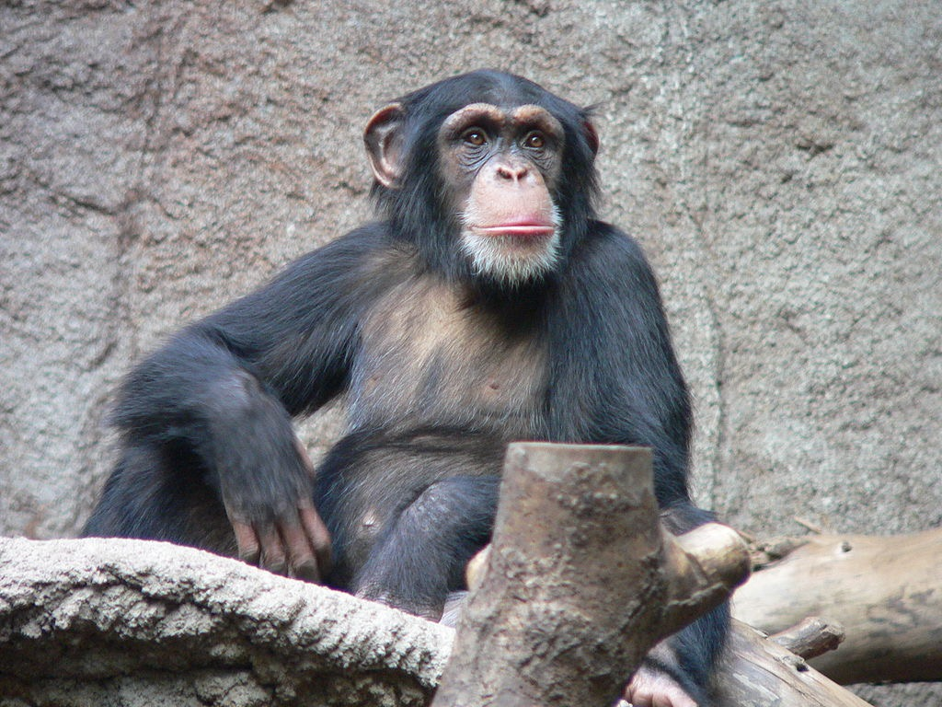
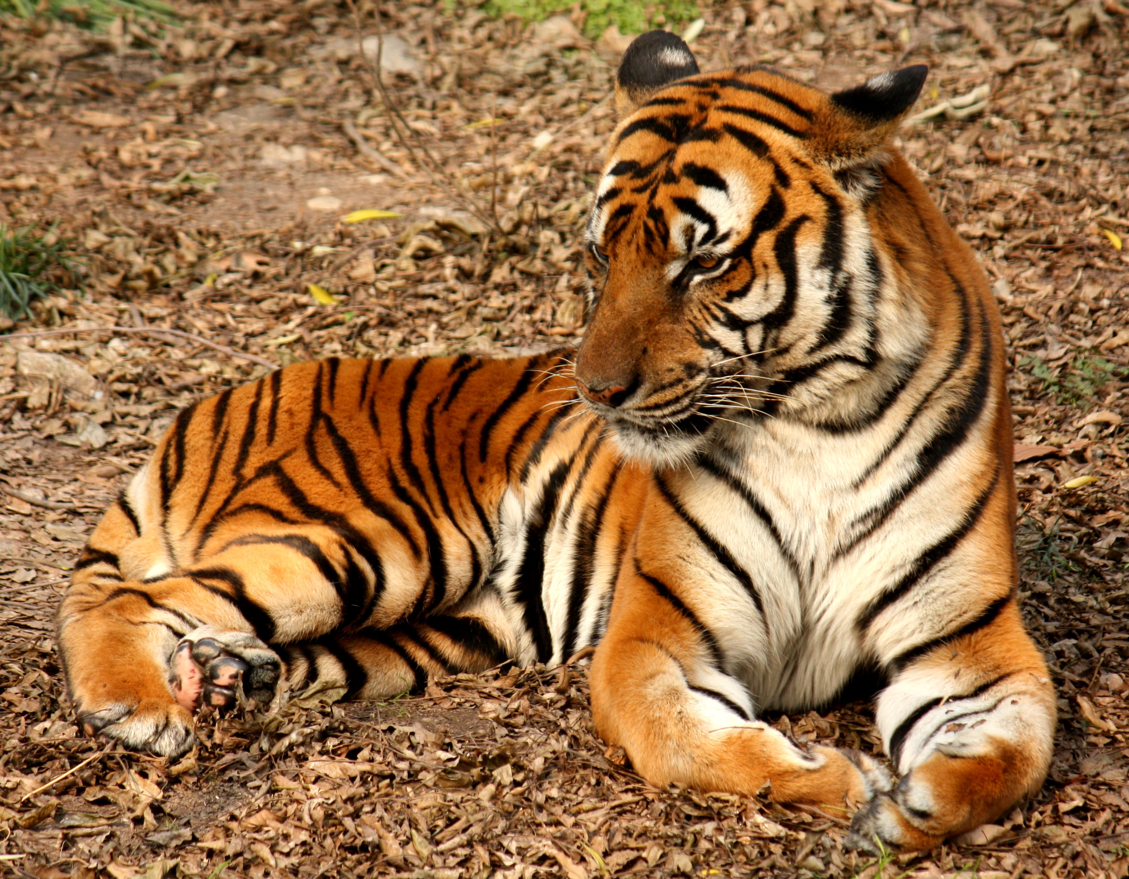
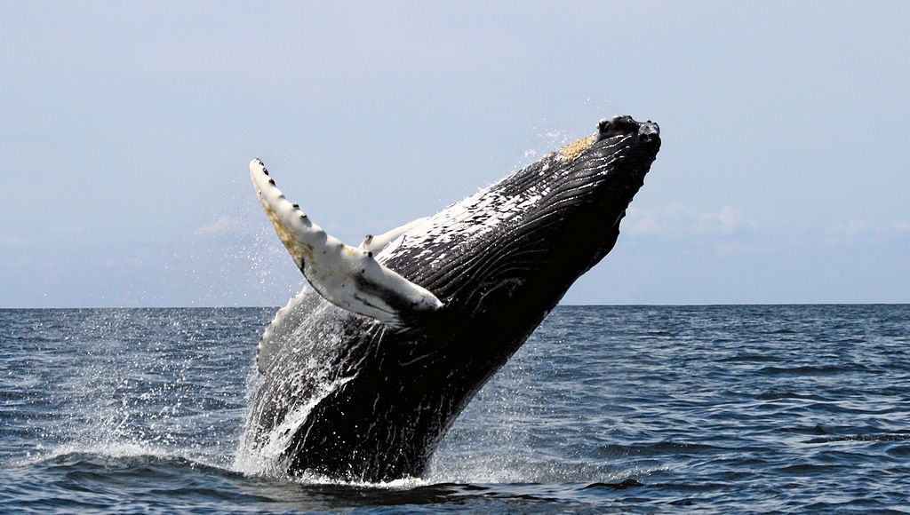
Mammals
Mammals make milk.
Most mammals have hair or fur on their bodies.
Most mammals give birth to live young. They do not lay eggs.
humans
bears
monkeys
tigers and lions
deer
whales
Cognitive Learning Systems, Inc © 2016
Notes:
Teacher’s Notes
After looking at the pictures of animals in the previous slide, students should have concluded that animals are not like plants in that they do not all share the same parts and therefore may not share all of the same functions or abilities.
The next set of slides is designed to help students understand that scientists use similarities in structure AND function to help group animals into categories. The first FIVE slides each describe a different category of animals: mammals, fish, reptiles, birds, and amphibians. Each slide describes a few MAJOR characteristics that the animals in the category share as well as pictures showing examples of the animals in the category. From these slides students should also come to realize that the characteristics are properties that the animals in that particular category have in common, but that these properties are in many cases DIFFERENT from other categories or types of animals.
As each category is discussed with students, it is important to note that students may discover that not all animals in that category share ALL of the characteristics. For example, whales are considered mammals. They bear live young and the females produce milk. However, whales do NOT have fur or hair on their skin. In addition, rays and sharks are classified as fish, yet most rays and sharks do NOT have scales. Yet, both rays and sharks live underwater and breathe through gills.
As students come across these exceptions, they should first be directed to understand that there are some characteristics that the animals DO possess. Otherwise, they would not be classified as a part of that category of animals. Discussion might then focus on the concept of exceptions and that the animals could not be classified in any other category because they do not share the characteristics of the other categories. For example, sharks and rays could not be classified as mammals because they share none of the characteristics of mammals or their characteristics are in contrast to the characteristics of mammals.
After students have investigated the five categories of animals, they will have an opportunity to see that these five smaller categories of animals are part of a larger category of animals called vertebrates or animals that possess a backbone. Therefore, although mammals have characteristics that are mostly different from fish, the one characteristics they do share is a backbone.
Image Credits
Triplets in Disney, courtesy of Dr. Jurasinski (LabLearner)
South Chinese Tiger (Panthera tigris amoyensis) in Shanghai Zoo, Retrieved September 30, 2016, Retrieved fromhttps://en.wikipedia.org/wiki/South_China_tiger#/media/File:2012_Suedchinesischer_Tiger.JPG
Fawn lying on grass, retrieved September 20, 2016, https://en.wikipedia.org/wiki/White-tailed_deer#/media/File:Fawn-in-grass.jpg,
Polar bear jumping on fast ice, retrieved on September 20, 2016, from https://en.wikipedia.org/wiki/Polar_bear#/media/File:Polar_Bear_AdF.jpg,
Common Chimpanzee in the Leipzig Zoo. retrieved on October 16 2016, from https://commons.wikimedia.org/wiki/File:Schimpanse_Zoo_Leipzig.jpg
A humpback breaching in the Stellwagen Bank National Marine Sanctuary. October 16 2016, from https://en.wikipedia.org/wiki/Whale_watching#/media/File:Humpback_stellwagen_edit.jpg

Slide 23
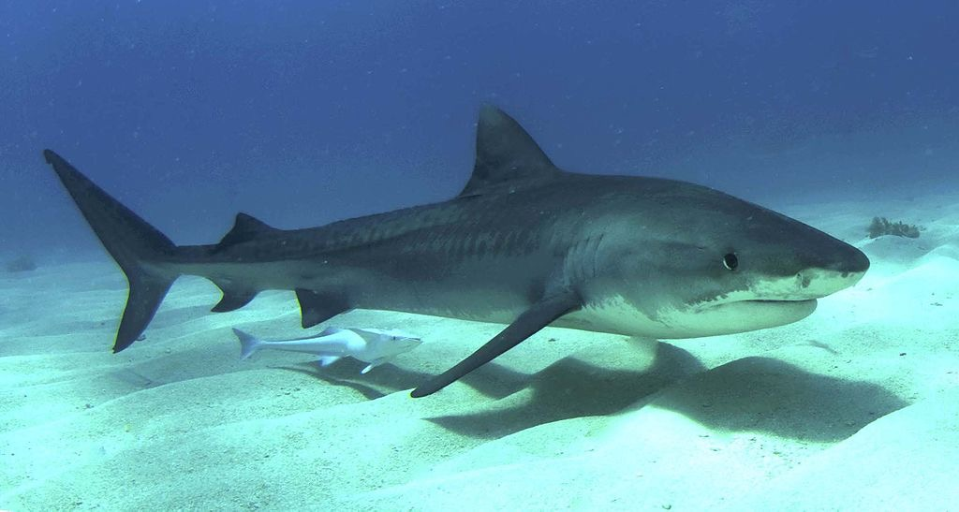
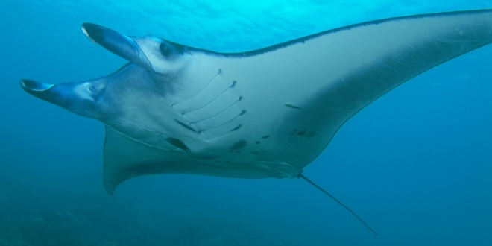
Fish
Fish live in water and breathe through gills.
Most fish have fins.
Most fish have scales covering their body.
Fish lay eggs.
sharks
rays
fish
Cognitive Learning Systems, Inc © 2016
Notes:
Image Credits:
Juvenile tiger shark in the Bahamas, retrieved on October 16 2016, from https://en.wikipedia.org/wiki/Tiger_shark#/media/File:Tigershark3.jpg
M.alfredi with cephalic fins rolled up (Yap, Micronesia), retrieved on October 16 2016, from https://en.wikipedia.org/wiki/Manta_ray#/media/File:Manta_ray_from_Yap.jpg
Puntius sarana from Kerala, Retrieved September 30, 2016, Retrieved from https://commons.wikimedia.org/wiki/File:Fish_ _Puntius_sarana_from_Kerala_(India).png

Slide 24
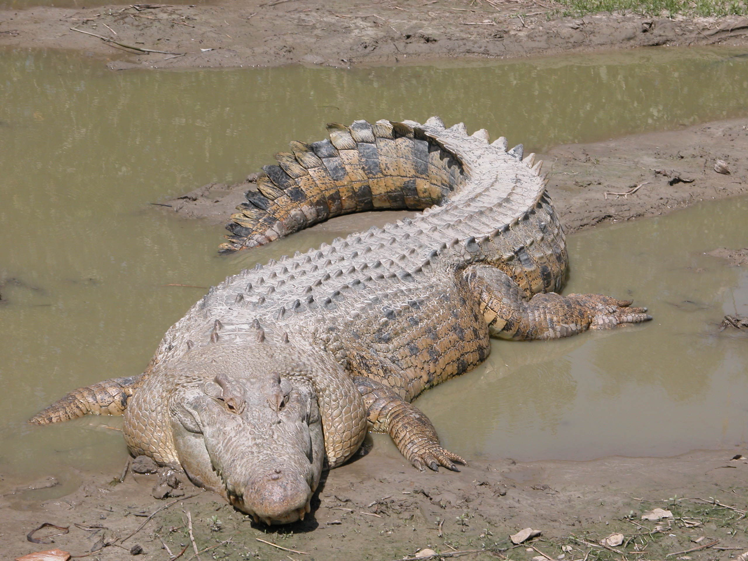
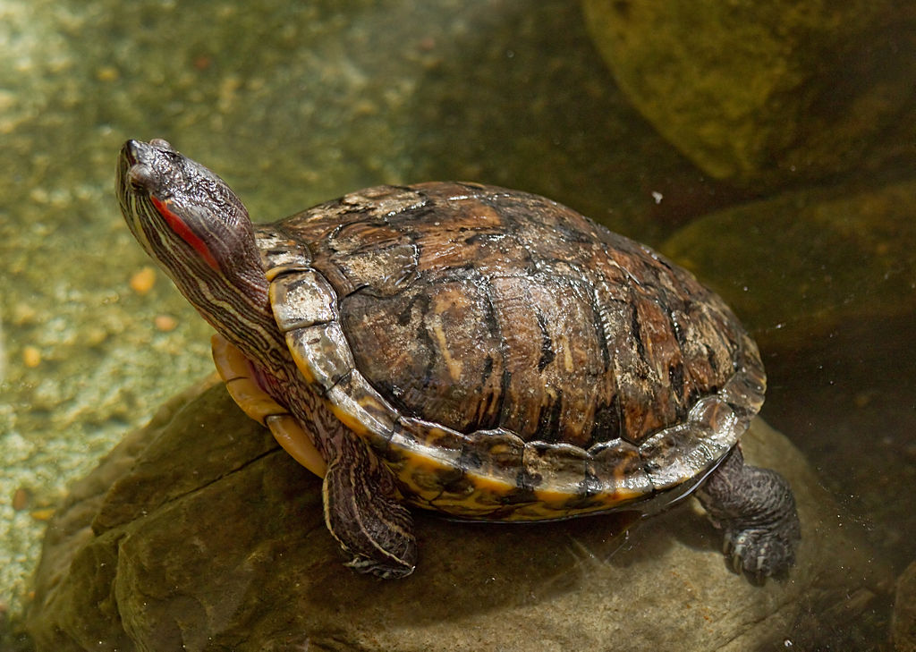
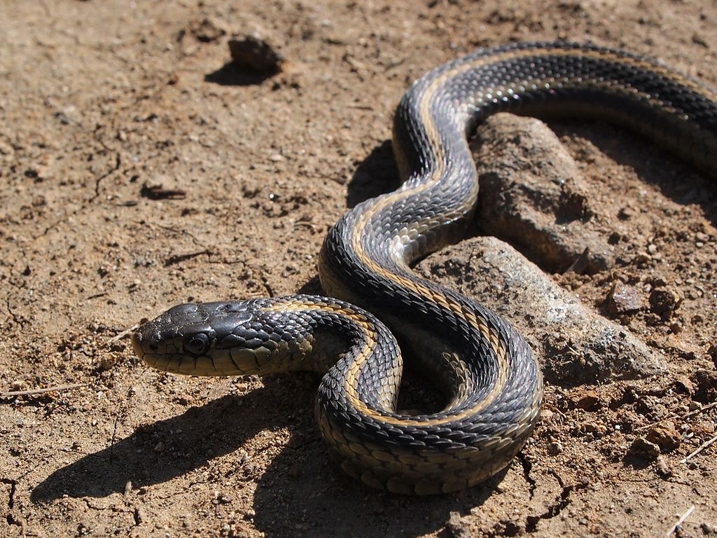
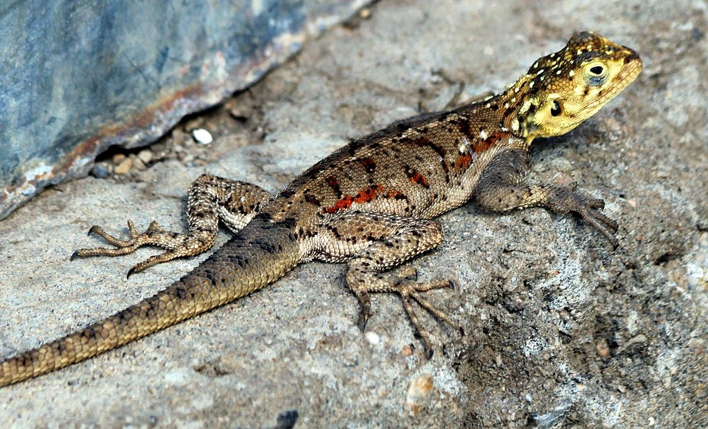
Reptiles have skin with scales.
Reptiles have claws.
Reptiles lay eggs.
Reptiles
turtles
Alligators and crocodiles
lizards
snakes
Cognitive Learning Systems, Inc © 2016
Cognitive Learning Systems, Inc © 2016
Notes:
Image Credits:
Saltwater Crocodile (Crocodylus porosus, Retrieved September 30, 2016, Retrieved from https://en.wikipedia.org/wiki/Saltwater_crocodile#/media/File:SaltwaterCrocodile(%27Maximo%27).jpg
Red Eared slider at the Cincinnati Zoo, Retrieved October 16, 2016, retrieved from https://commons.wikimedia.org/wiki/File:RedEaredSlider05.jpg
Ground agama lizard (Agama aculeata) in Tanzania. Retrieved October 16, 2016, retrieved from https://en.wikipedia.org/wiki/Lizard#/media/File:Lizard_-_e.JPG
Thamnophis elegans terrestris with dark coloring, Retrieved October 16, 2016, retrieved from https://en.wikipedia.org/wiki/Western_terrestrial_garter_snake#/media/File:Big_Sur_Snake.JPG

Slide 25
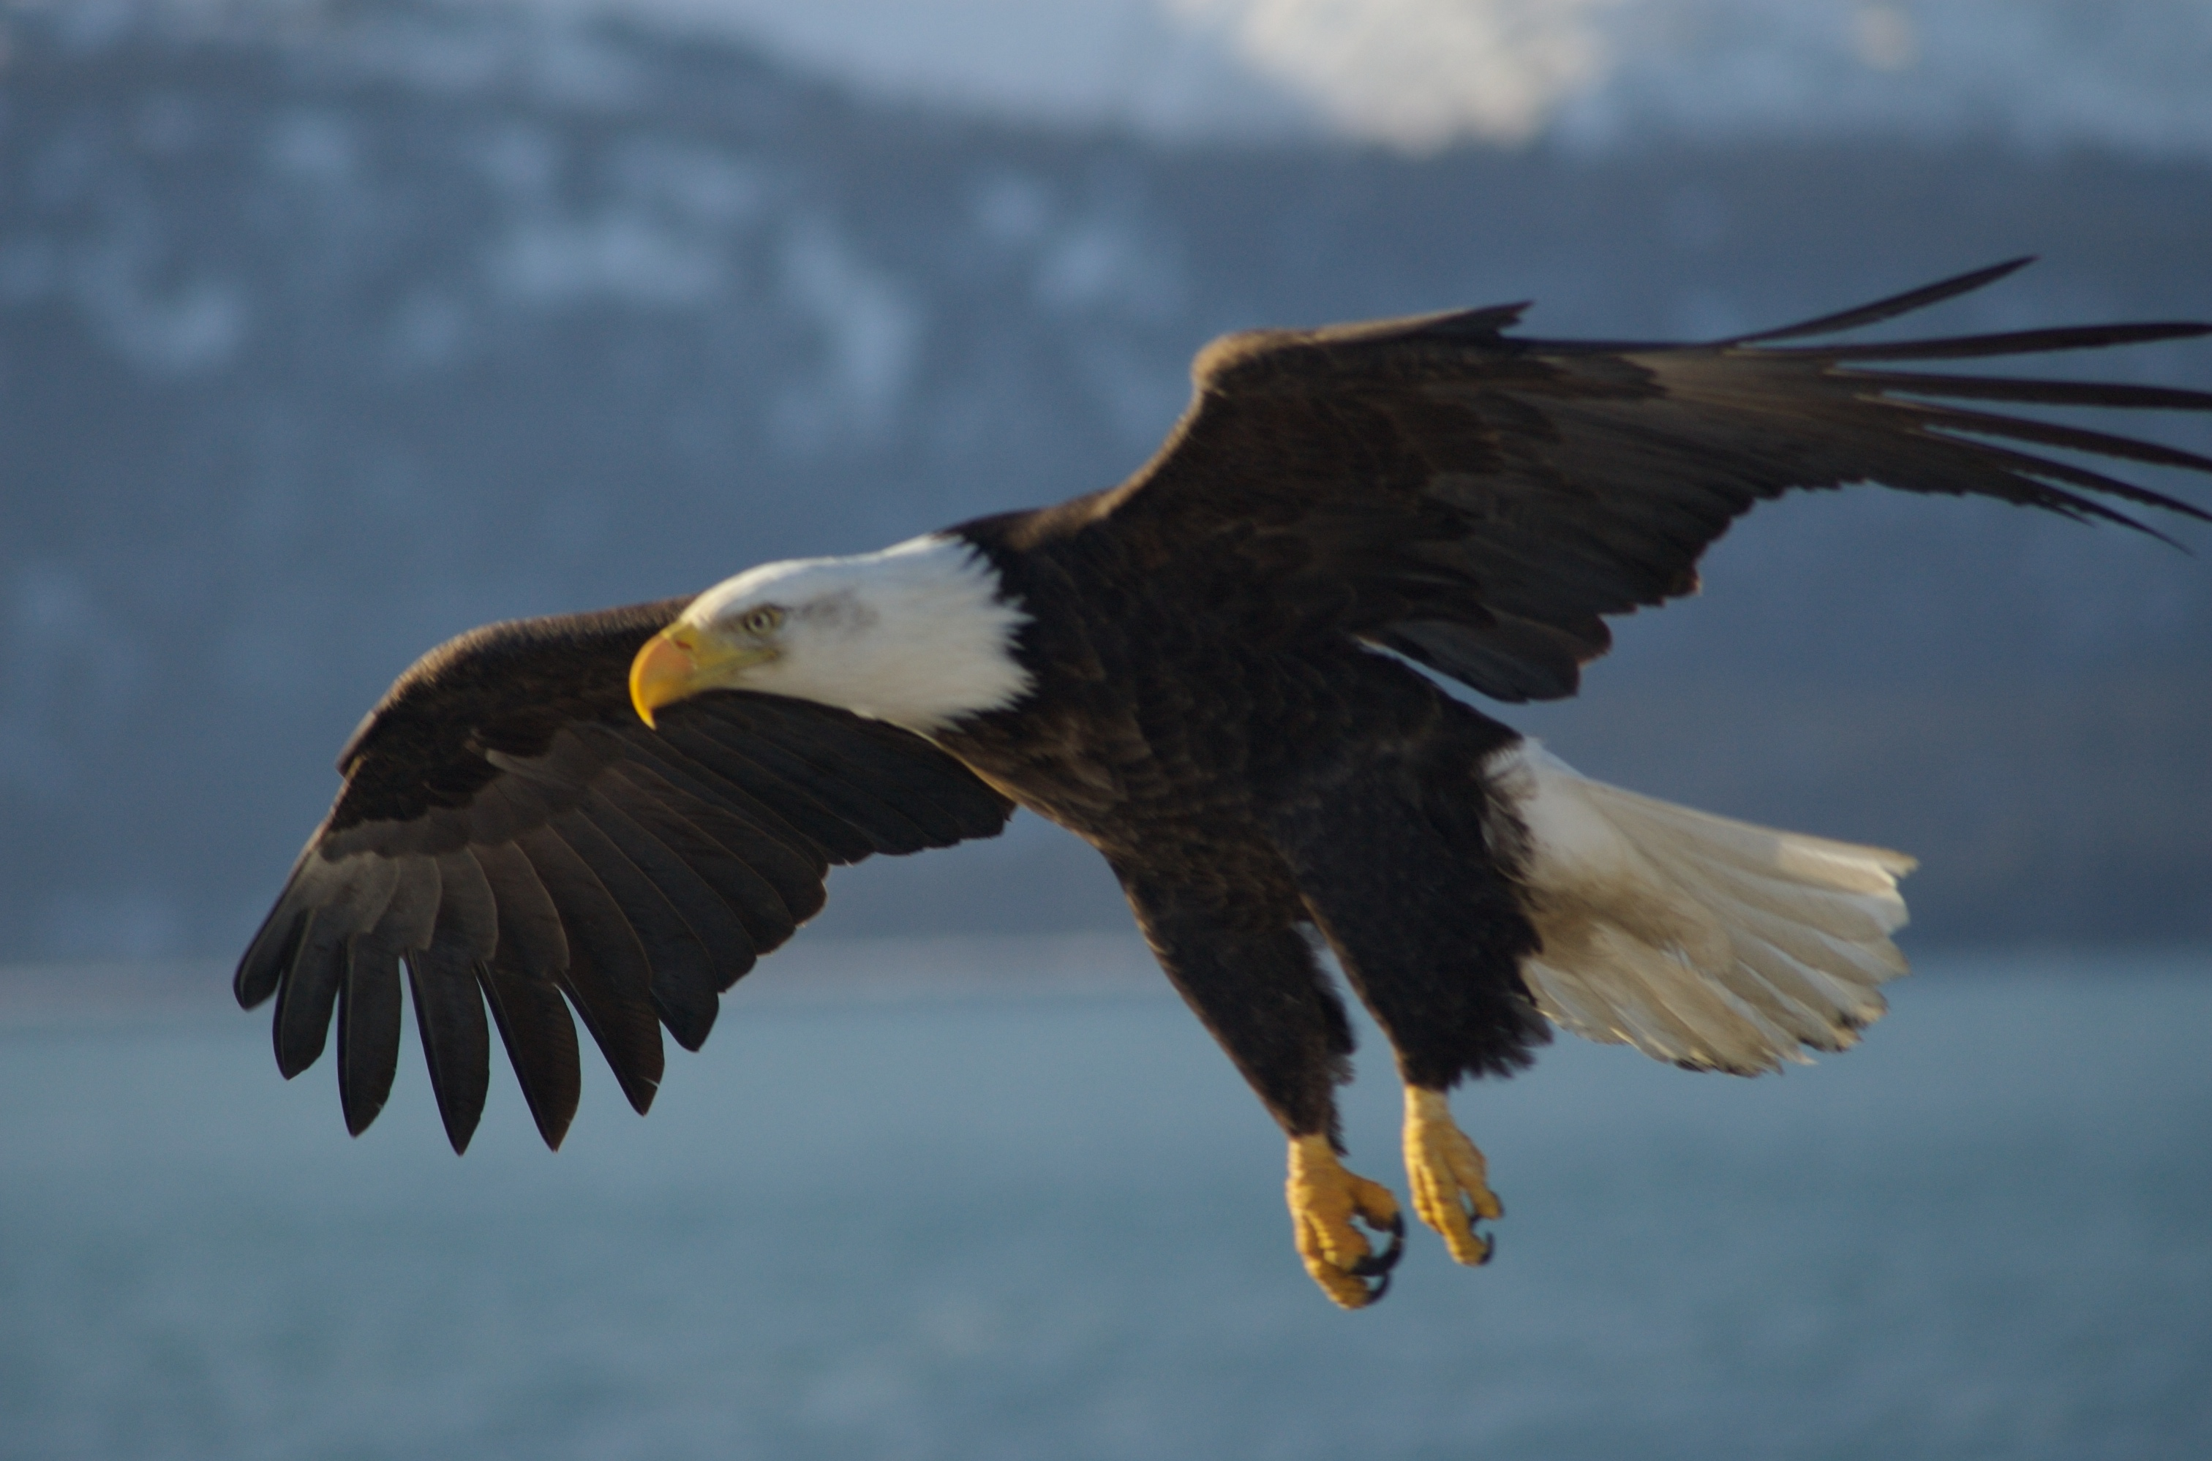
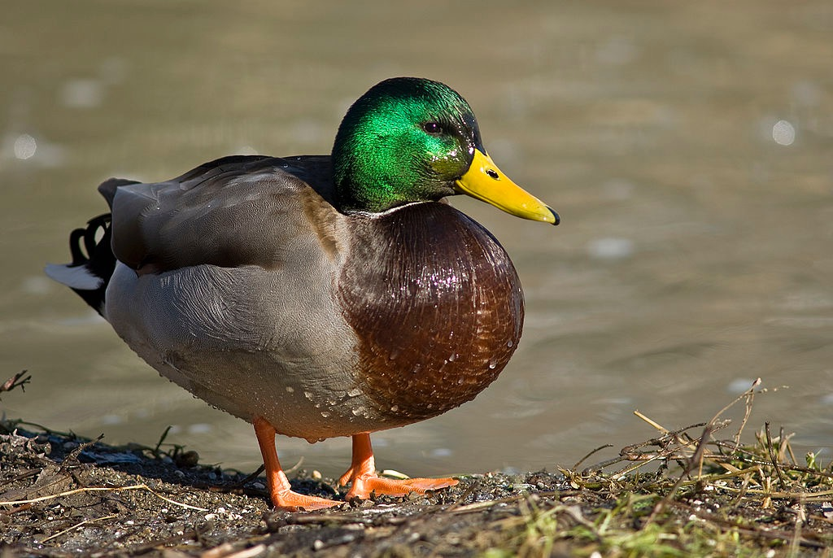
ducks
blue jay
eagles
Birds
Birds have a body covered in feathers.
Birds have wings.
Birds usually have bones that are light and hollow.
Birds lay eggs.
Cognitive Learning Systems, Inc © 2016
Cognitive Learning Systems, Inc © 2016
Notes:
Image Credits:
Bald Eagle Alaska, Retrieved September 30, 2016, Retrieved from https://commons.wikimedia.org/wiki/File:Bald_Eagle_Alaska_(10).jpg
A blue bird taken along Cullers Trail in Shenandoah River State Par, Retrieved September 30, 2016, Retrieved from https://commons.wikimedia.org/wiki/File:Blue_Bird_(7414410526).jpg
A male mallard duck, Retrieved October 16, 2016, retrieved from https://en.wikipedia.org/wiki/Anatidae#/media/File:Male_mallard_duck_2.jpg

Slide 26
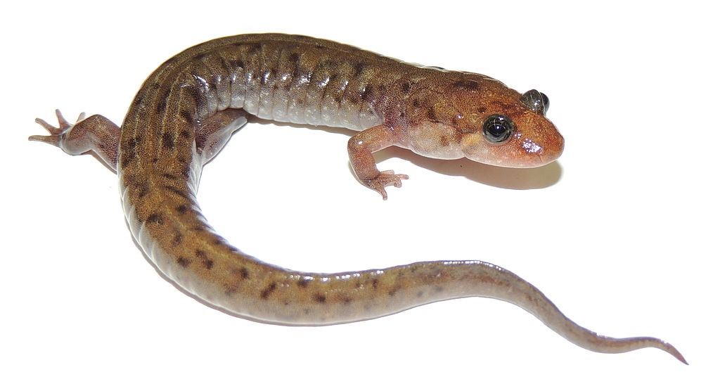
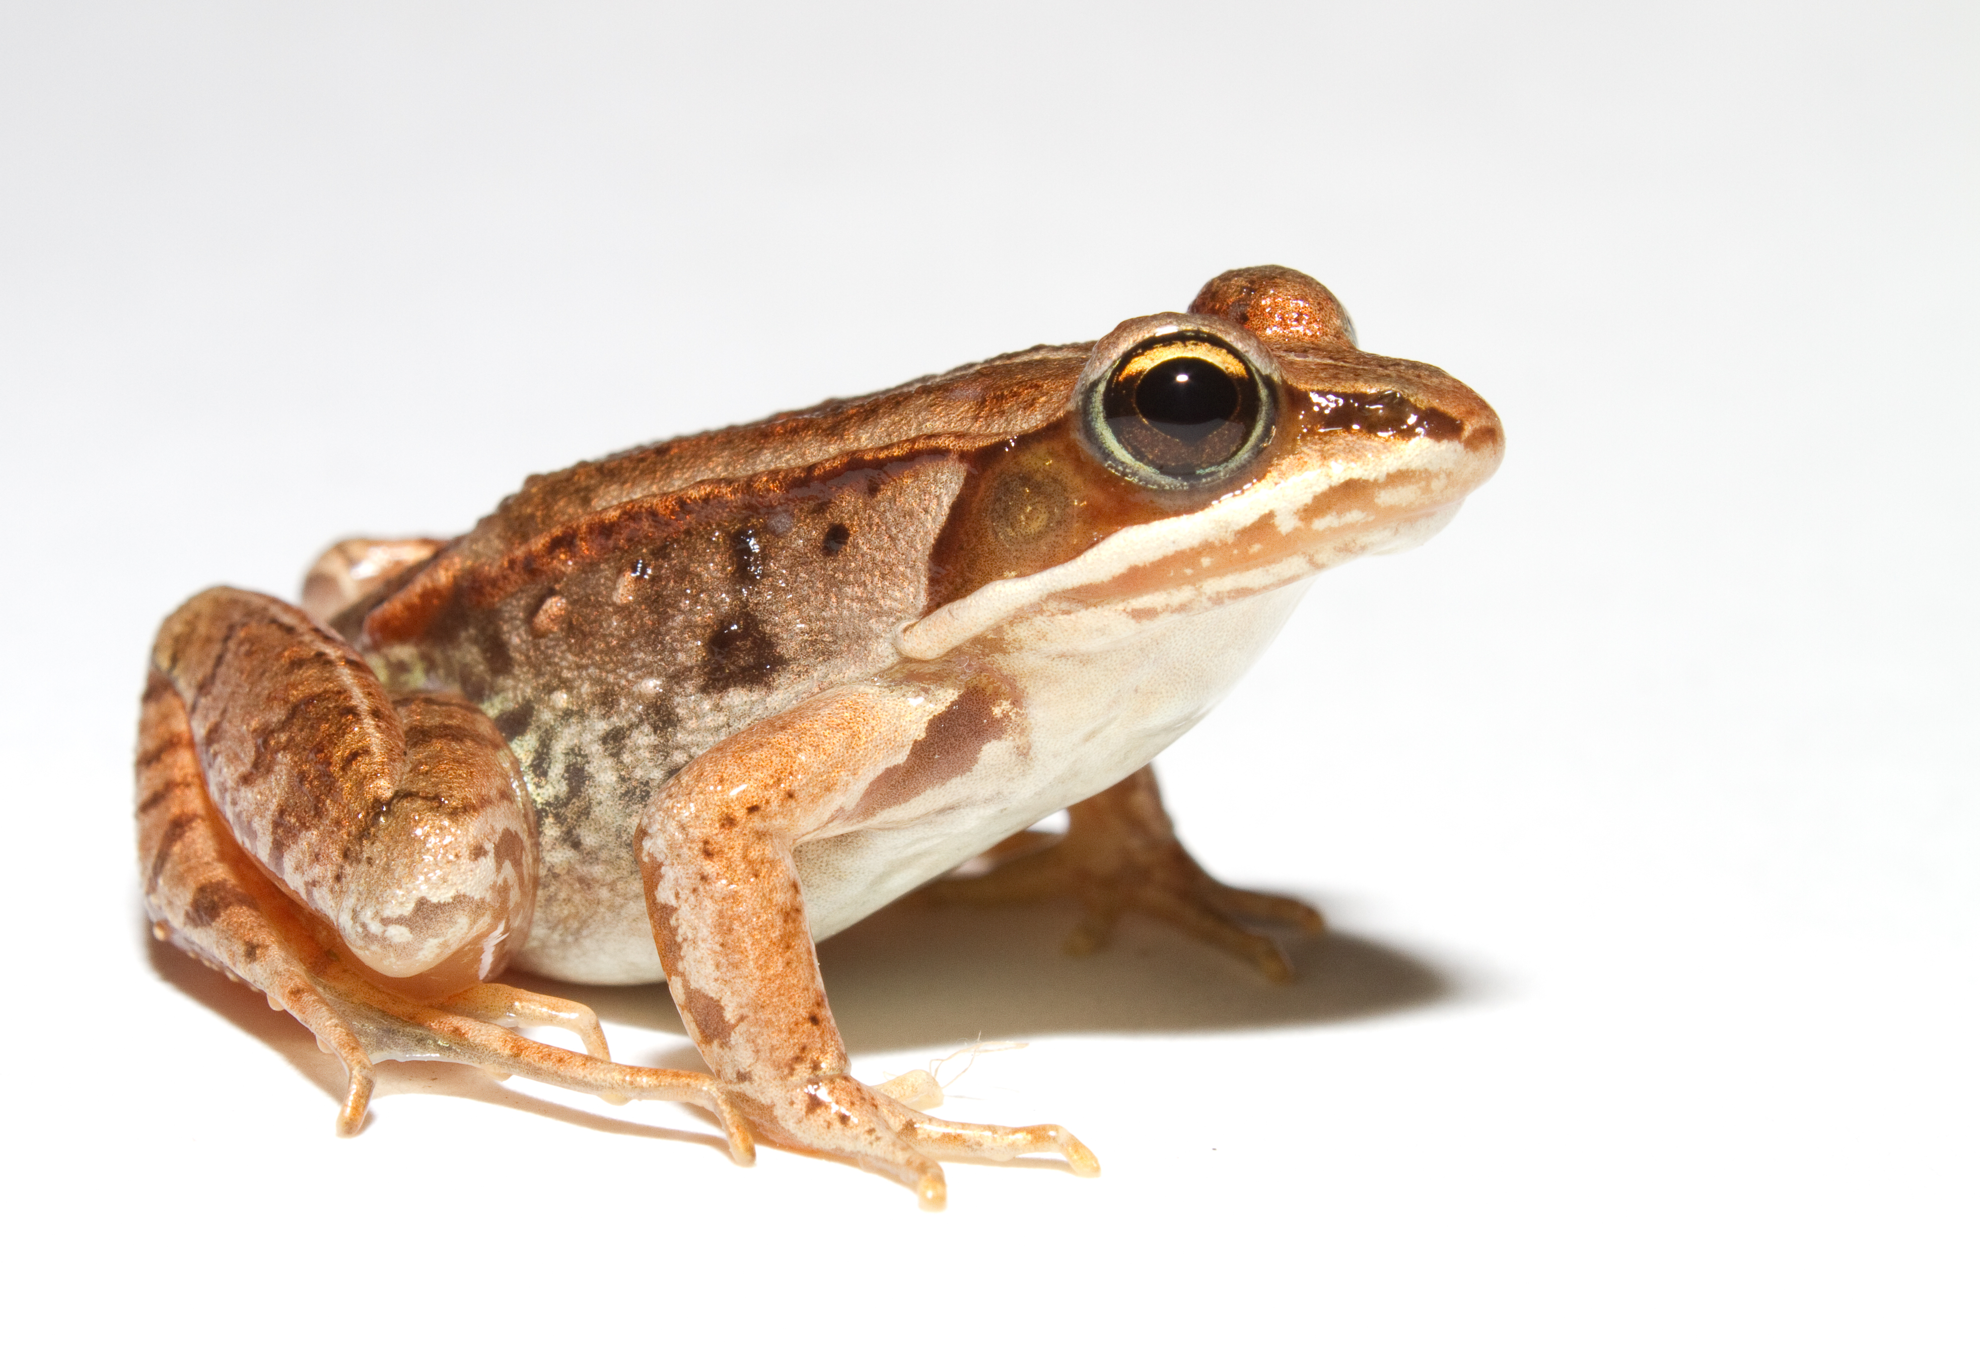
Amphibians
Amphibians have smooth skin without scales, feathers or fur.
Amphibians do not have claws on their feet.
salamander
frog
Amphibians have skin that needs to be moist in order to help them breathe.
Amphibians lay eggs.
Cognitive Learning Systems, Inc © 2016
Notes:
Image Credits:
Lithobates sylvaticus (Woodfrog), Retrieved September 30, 2016, Retrieved from https://commons.wikimedia.org/wiki/File:Lithobates_sylvaticus_(Woodfrog).jpg
Desmognathus monticola found near Berea, Kentucky. Retrieved October 16, 2016, retrieved from https://en.wikipedia.org/wiki/Seal_salamander#/media/File:Seal_salamander_(Desmognathus_monticola).JPG

Slide 27
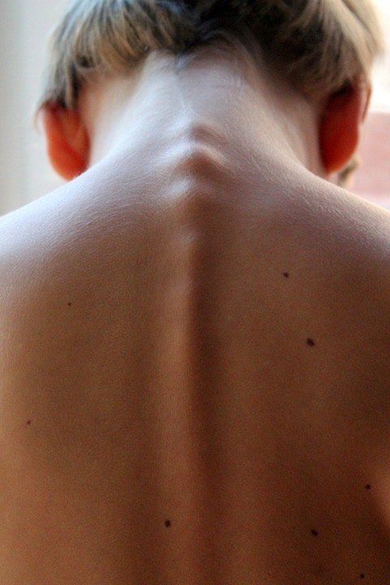
Vertebrates
You are a mammal.
You have something in common with fish, reptiles, birds and amphibians.
You have a backbone.
Find your backbone.
Cognitive Learning Systems, Inc © 2016
Notes:
Teacher’s Notes
Help students find their backbones.
Image Credits:
Triplets in Disney, courtesy of Dr. Jurasinski (LabLearner)
Spinal Column, Retrieved October 21, 2016, retrieved from https://pixabay.com/en/spinal-column-hair-back-neo-child-246273/
Red Eared slider at the Cincinnati Zoo, Retrieved October 16, 2016, retrieved from https://commons.wikimedia.org/wiki/File:RedEaredSlider05.jpg
Lithobates sylvaticus (Woodfrog), Retrieved September 30, 2016, Retrieved from https://commons.wikimedia.org/wiki/File:Lithobates_sylvaticus_(Woodfrog).jpg
A blue bird taken along Cullers Trail in Shenandoah River State Par, Retrieved September 30, 2016, Retrieved from https://commons.wikimedia.org/wiki/File:Blue_Bird_(7414410526).jpg
Juvenile tiger shark in the Bahamas, retrieved on October 16 2016, from https://en.wikipedia.org/wiki/Tiger_shark#/media/File:Tigershark3.jpg

Slide 28
Vertebrates
Animals that have a backbone can be classified in a LARGER group call VERTEBRATES.
Mammals, fish, reptiles, birds and amphibians are all VERTEBRATES.
Are all animals vertebrates?
Cognitive Learning Systems, Inc © 2016
Notes:
Teacher’s Notes
Discuss that because mammals, fish, reptiles, birds and amphibians are vertebrates, they all have a backbone. These backbones may look different than the backbone of a human because the structure of other vertebrates is different than that of humans. However, a backbone exists in all of the vertebrate animals.
Provide time for students to discuss the question about whether all animals are vertebrates before moving to the next slide.
Image Credits:
Triplets in Disney, courtesy of Dr. Jurasinski (LabLearner)
Red Eared slider at the Cincinnati Zoo, Retrieved October 16, 2016, retrieved from https://commons.wikimedia.org/wiki/File:RedEaredSlider05.jpg
Lithobates sylvaticus (Woodfrog), Retrieved September 30, 2016, Retrieved from https://commons.wikimedia.org/wiki/File:Lithobates_sylvaticus_(Woodfrog).jpg
Juvenile tiger shark in the Bahamas, retrieved on October 16 2016, from https://en.wikipedia.org/wiki/Tiger_shark#/media/File:Tigershark3.jpg
A blue bird taken along Cullers Trail in Shenandoah River State Par, Retrieved September 30, 2016, Retrieved from https://commons.wikimedia.org/wiki/File:Blue_Bird_(7414410526).jpg

Slide 29
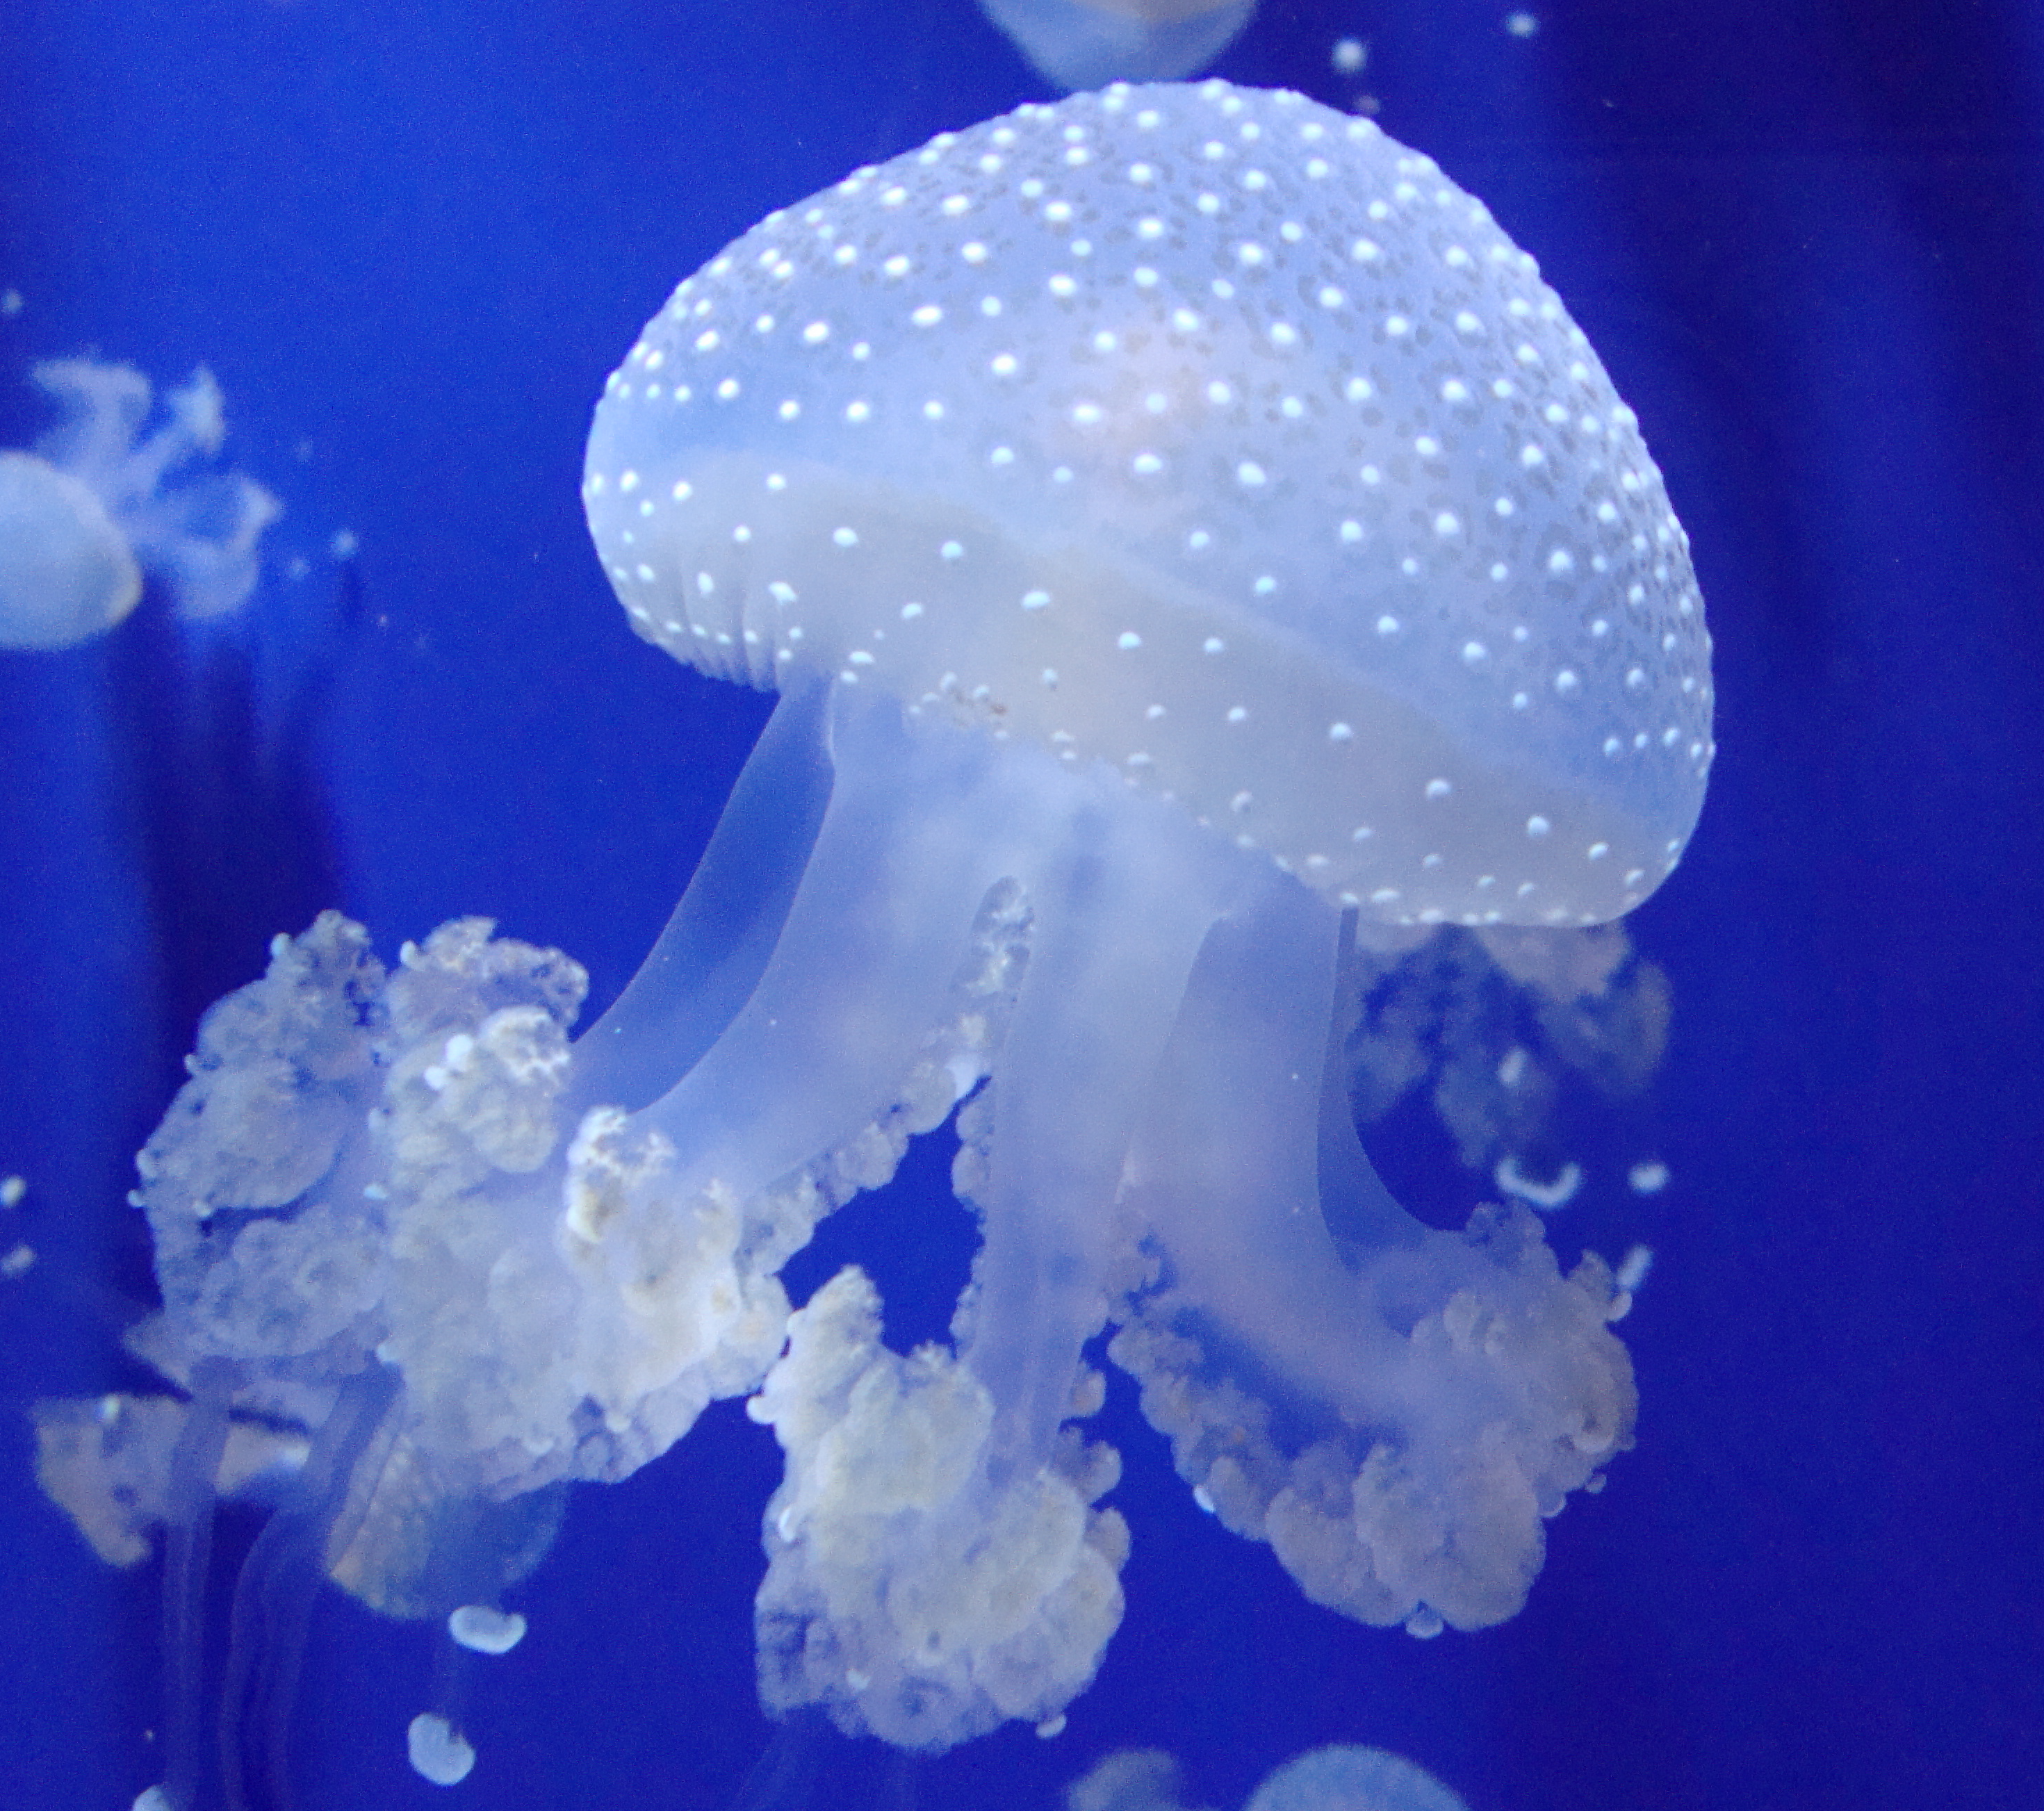
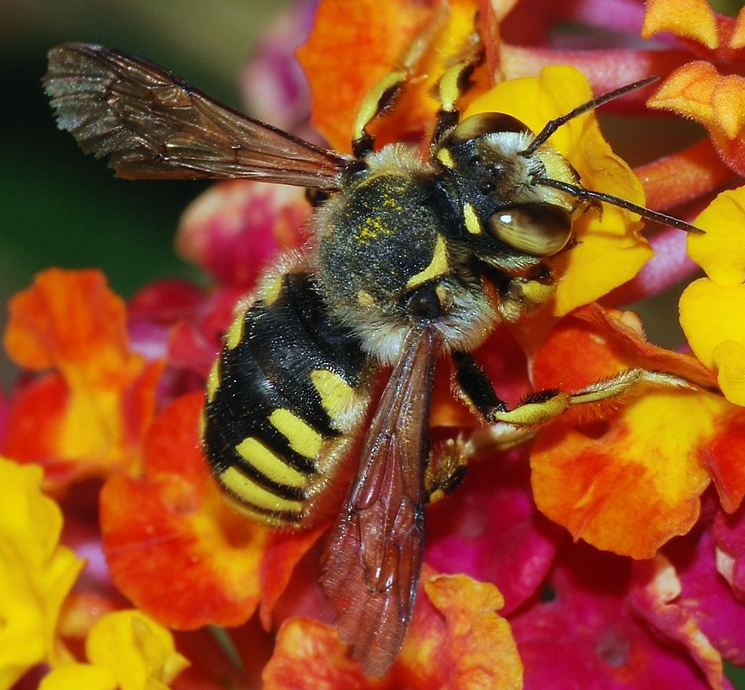
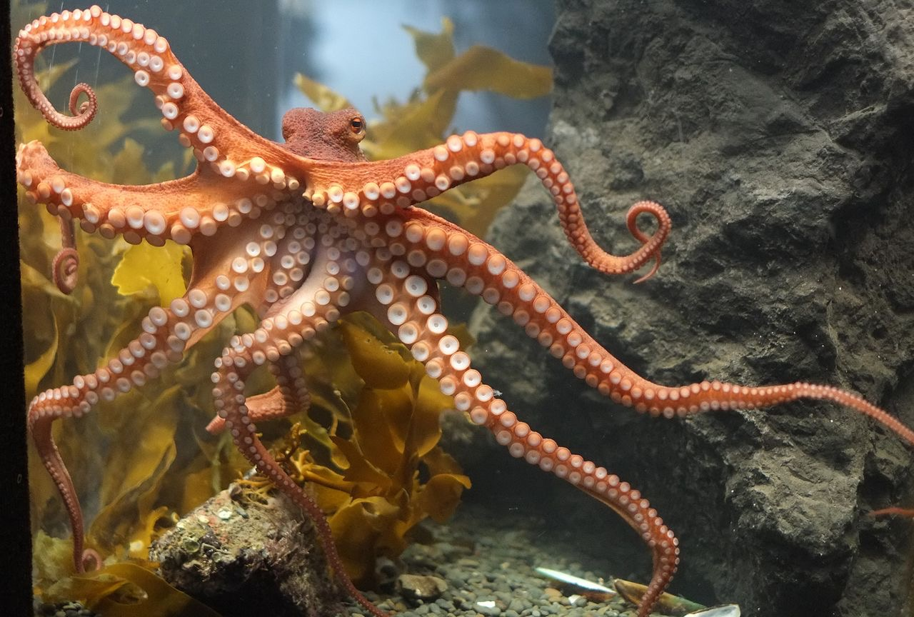




Invertebrates
Starfish
Jellyfish
Invertebrates do not have a backbone.
Invertebrates do NOT all look the same.
Insects
Octopi
Spiders
Snails
Sponges
Lobsters
Worms
Cognitive Learning Systems, Inc © 2016
Notes:
Teacher’s Notes
The Animals section of the GAP Unit ends with the Invertebrates Slide Set. Students have previously discovered that animals can be classified according to characteristics they share. Examples of these categories were mammals, fish, reptiles, birds and amphibians. In addition, these animals can be classified into a larger group based on the presence of a backbone: vertebrates.
Thus, students should be prepared for the next question. Are there animals that do NOT possess a backbone?
In this set of slides, students will be shown examples of invertebrates: those animals without a backbone. In contrast to the vertebrates, students will not be expected to learn the characteristics of the different categories of invertebrates. This is because many of these characteristics require an understanding of tissue, organ and cellular differences that are beyond the level of understanding of early elementary students.
However, two of the conclusions that students should make as they observe the pictures in these two slides are that INSECTS and SPIDERS are INVERTEBRATES and that almost all animals that live in the ocean other than fish, dolphins and whales are INVERTEBRATES.
Image Credits:
Starfish at low tide on Sanibel Island), retrieved on September 20, 2016, retrieved from https://commons.wikimedia.org/wiki/File:Starfish_at_low_tide_on_Sanibel_Island_(8298677162).jpg
Acquario di Genova, Retrive on September 30, 2016, retrive from https://commons.wikimedia.org/wiki/File:Australian_spotted_jellyfish_(Phyllorhiza_punctata)_-_Acquario_di_Genova_-_Italy_-_15_April_2012.jpg
Solitary bee (Anthidium florentinum), feeding on a Lantana camara flower. retrieved September 30, 2016, retrieved from https://upload.wikimedia.org/wikipedia/commons/thumb/c/c4/Anthidium_February_2008-1.jpg/1280px-Anthidium_February_2008-1.jpg
Octopus at Kelly Tarlton’s,retrieved September 30, 2016, retrieved from https://commons.wikimedia.org/wiki/File:Octopus_at_Kelly_Tarlton%27s.jpg,;
Adult female Salticus scenicus jumping spider. Found at China Camp State Park, California.retrieved September 20, 2016, https://en.wikipedia.org/wiki/Zebra_spider#/media/File:Kaldari_Salticus_scenicus_female_01.jpg,
Grapevinesnail 01, Retrieved on September 30, 2016, retrieved from https://commons.wikimedia.org/wiki/File:Grapevinesnail_01.jpg
The freshwater sponge Spongilla lacustris. Retrieved September 20, 2016, retrieved from https://en.wikipedia.org/wiki/Sponge#/media/File:Spongilla_lacustris.jpg
European lobster (Hommarus gammarus)., Retrieved September 30, 2016, retrieved from https://en.wikipedia.org/wiki/Lobster#/media/File:KreeftbijDenOsse.jpg
The turbellarian Pseudoceros dimidiatus, retrieved September 20, 2016, retrieved from https://en.wikipedia.org/wiki/Flatworm#/media/File:Pseudoceros_dimidiatus.jpg

Slide 30
Check Understanding
Try singing this song to help you remember about vertebrates.
Amphibians, mammals, reptiles, and birds
Fish in water too
We’re different in ways
But there’s one thing the same
We’re the vertebrates on the Earth
Walk, crawl, swim or fly
Live under water or where it’s dry
We’re different in ways
But there’s one thing the same
A backbone is what we have
Cognitive Learning Systems, Inc © 2016
Notes:
Teacher’s Notes
Students have previously been introduced to the different types of animals that are vertebrates and invertebrates. The Check Understanding Slide Set is provided to help students rehearse and review what they have learned in the form of two songs. Each song is sung to the melody of Row, Row, Row Your Boat. One song focuses on vertebrates. The song on the slide that follows focuses on invertebrates.

Slide 31
Check Understanding
Try singing this song to help you remember about invertebrates.
Insects, spiders, sponges and worms
Animals underwater
We’re different in ways
But there’s one thing the same
We’re the invertebrates on the Earth
Walk, crawl, swim or fly
Live under water or where it is dry
We’re different in ways
But there’s one thing the same
You won’t find a backbone in us
Cognitive Learning Systems, Inc © 2016

Slide 32
Making and Applying Connections
Which type of animal is an invertebrate?
A
B
bird
insect
C
mammal
D
fish
Cognitive Learning Systems, Inc © 2016
Notes:
Teacher’s Notes
The Making and Applying section of the GAP Unit has been provided as a way to help students rehearse and process the information learned during the Plants and Animals GAP Unit as well as to become more familiar with test-taking strategies and various types of analysis questions.
Answer
Question 1: B
Image Credits:
A blue bird taken along Cullers Trail in Shenandoah River State Par, Retrieved September 30, 2016, Retrieved from https://commons.wikimedia.org/wiki/File:Blue_Bird_(7414410526).jpg
Solitary bee (Anthidium florentinum), feeding on a Lantana camara flower. retrieved September 30, 2016, retrieved from https://upload.wikimedia.org/wikipedia/commons/thumb/c/c4/Anthidium_February_2008-1.jpg/1280px-Anthidium_February_2008-1.jpg
Common Chimpanzee in the Leipzig Zoo. retrieved on October 16 2016, from https://commons.wikimedia.org/wiki/File:Schimpanse_Zoo_Leipzig.jpg
Puntius sarana from Kerala, Retrieved September 30, 2016, Retrieved from https://commons.wikimedia.org/wiki/File:Fish_ _Puntius_sarana_from_Kerala_(India).png

Slide 33
Making and Applying Connections
Which type of animal has scales, claws, and lays eggs?
bird
fish
A
B
mammal
reptile
C
D
Cognitive Learning Systems, Inc © 2016
Notes:
Teacher’s Notes
Answer
Question 2: D
Image Credits:
Bald Eagle Alaska, Retrieved September 30, 2016, Retrieved from https://commons.wikimedia.org/wiki/File:Bald_Eagle_Alaska_(10).jpg
Juvenile tiger shark in the Bahamas, retrieved on October 16 2016, from https://en.wikipedia.org/wiki/Tiger_shark#/media/File:Tigershark3.jpg
South Chinese Tiger (Panthera tigris amoyensis) in Shanghai Zoo, Retrieved September 30, 2016, Retrieved fromhttps://en.wikipedia.org/wiki/South_China_tiger#/media/File:2012_Suedchinesischer_Tiger.JPG
Saltwater Crocodile (Crocodylus porosus, Retrieved September 30, 2016, Retrieved from https://en.wikipedia.org/wiki/Saltwater_crocodile#/media/File:SaltwaterCrocodile(%27Maximo%27).jpg

Slide 34




Making and Applying Connections
Mammals, birds and reptiles all have
scales
wings
A
B
a backbone
fur
D
C
Cognitive Learning Systems, Inc © 2016
Notes:
Teacher’s Notes
Answer
Question 3: C
Image Credits:
H. albicilla wing.png, Retrieved October 21, 2016, retrieved https://commons.wikimedia.org/wiki/File:H._albicilla_wing.png
Skin of a sand lizard, showing squamate reptiles iconic scales, Retrieved October 21, 2016, retrieved https://en.wikipedia.org/wiki/Reptile#/media/File:Lacertae_skin.jpg
Skelton of a snake at the Natural History Museum, Retrieved October 21, 2016, retrieved https://en.wikipedia.org/wiki/Snake_skeleton#/media/File:Snake_skeleton.jpg
Opossum fur.jpg, Retrieved October 21, 2016, retrieved https://commons.wikimedia.org/wiki/File:Opossum_fur.jpg

Slide 35
Plants and Animals
Life Cycles
Cognitive Learning Systems, Inc © 2016

Slide 36


What Can You Recall?
Find a partner.
Put on scales.
Person A makes claws.
Person A is a model of
Person B makes fins.
Person B is a model of
Cognitive Learning Systems, Inc © 2016
Notes:
Teacher’s Notes
The What Can You Recall section of the GAP Unit has been provided as a way to help students rehearse and process the information learned previously during the Animals section of the Plants and Animals GAP Unit. The activity focuses on some of the major concepts or facts of the Animals portion of the GAP Unit.
This What Can You Recall section is designed to be the first activity done at the beginning of the Life Cycles section of the Plants and Animals GAP UNIT.
This activity includes a role play and a “guessing” game. This slide outlines the role play that students will perform. For Model 1 which is on this slide, the teacher will need to provide each pair of students with four pieces of paper and either scotch or masking tape. Each student will make a model of scales with the two pieces of paper. To make scales they should place one piece of paper on top of the other so that half of the one piece of paper is hidden under the other.
Each student should then tape the “scales” to their arm.
Model 1 is designed to help students recall that two different categories of animals- fish and reptiles- can have scales, but that these categories of animals can be differentiated from one another by observing some of their other characteristics.
Image Credits:
Skin of a sand lizard, showing squamate reptiles iconic scales, Retrieved October 21, 2016, retrieved https://en.wikipedia.org/wiki/Reptile#/media/File:Lacertae_skin.jpg
Claw, Retrieved October 21, 2016, retrieved https://pixabay.com/en/claws-bird-falcon-nature-predator-197049/
Dorsal fin 01.jpg, Retrieved October 21, 2016, retrieved https://commons.wikimedia.org/wiki/File:Dorsal_fin_01.jpg

Slide 37
What Can You Recall?
Make wings. Hold your arms out and move them up and down.
You have wings and feathers.
What kind of animal are you?
Cognitive Learning Systems, Inc © 2016
Notes:
Teacher’s Notes
In Model 2, all students role play the same category of animals: birds.
Image Credits:
H. albicilla wing.png, Retrieved October 21, 2016, retrieved https://commons.wikimedia.org/wiki/File:H._albicilla_wing.png

Slide 38
Check Understanding
Discuss with your partner.
I have smooth skin.
I do NOT have claws on my feet.
Who am I?
Cognitive Learning Systems, Inc © 2016
Notes:
Teacher’s Notes
In Models 3 and 4, students will discuss rather than role play the characteristics of two other classes of animals: mammals and amphibians. Model 3 is shown on this slide. Model 4 is shown on the next slide.
Image Credits:
Claw, Retrieved October 21, 2016, retrieved https://pixabay.com/en/claws-bird-falcon-nature-predator-197049/

Slide 39
Check Understanding
Discuss with your partner.
I have fur.
Who am I?
Cognitive Learning Systems, Inc © 2016
Notes:
Teacher’s Notes
Answer: I am a mammal.
Image Credits:
Opossum fur.jpg, Retrieved October 21, 2016, retrieved https://commons.wikimedia.org/wiki/File:Opossum_fur.jpg

Slide 40
Plants and Seeds
  Many plants make seeds. Where are the seeds?
Flowering plants
Seeds are made inside flowers and found in fruits.
Plants without flowers
Seeds are not made in flowers. Seeds are usually made inside cones or other structures.
Crust
Cognitive Learning Systems, Inc © 2016
Notes:
Teacher’s Notes
Previously, students explored parts and functions of plants and different categories of animals. Students will continue their study of plants and animals by learning about life cycles of each. However, prior to focusing on the life cycles of plants, students will first learn about seeds, as they are an intricate part of the life cycle of many plants. The next set of slides will introduce students to the two major categories of seed plants and some of the different structures of seeds and their “housing.”
The information in this slide set will introduce students to two categories of plants: those that house and produce seeds in flowers and fruits and those that produce “naked seeds.” From the slides in this set, students should come to realize that there are two major categories of plants: those that produce flowers and those that do NOT produce flowers. In addition, they should understand that plants produce fruits and seeds that appear different.
Scientists refer to plants that produce seeds in flowers as flowering plants or angiosperms. Not all angiosperm flowers are the same. However, in general, a seed is produced in angiosperms when pollen from the male portion of a flower is deposited on the stigma, part of the female part of the flower. After pollination, the flower undergoes changes developing into a fruit that encloses a single or multiple seeds. It should be noted that this information on angiosperms is provided as background information for teachers. It is NOT expected that students will be required to conceptualize information at this level.
Should students ask, they may find it interesting to know that not all plants produce seeds. Ferns, mosses and worts are the only plants that do NOT produce seeds.
Image Credits:
Tulips on Park Avenue, NYC, September 30, 2016, Retrieved from https://commons.wikimedia.org/wiki/File:Tulips_On_Park_Ave.JPG
The conifer forest in Yatsugatake, Honshu, Japan, dominated by Abies mariesii. Retrieved September 30, 2016, Retrieved fromhttps://sco.wikipedia.org/wiki/Gymnosperm#/media/File:Forest_in_Yatsugatake_11.jpg

Slide 41





beans and peas
Types of Seeds: Flowering Plants
nuts
apples
Crust
seeds from trees
cherries
Cognitive Learning Systems, Inc © 2016
Notes:
Teacher’s Notes
Fruits from flowering plants generally fall into two categories: fleshy fruits such as cherries, apples, etc. and dry fruits such as nuts, peas and beans. The fruit aids in the dispersal of the seeds.
Students may also question the purpose of fruits and other structures which house seeds. Scientists currently believe that fruits and cones (in pine trees and evergreen plants) may have evolved to protect seeds and to aid in their dispersal. There are three main methods of seed dispersal: “hitchhiking” on animals, drifting in fresh water or in the oceans and floating in the wind. Many seeds that are dispersed by the wind have developed shape and structures that help to promote an extended length of travel. For example, maple trees house seeds in what are commonly referred to as “helicopters or twirlers,” structures that are similar in shape to the rotors of a helicopter. These “helicopters” are shown in the upper right corner of this slide.
Image Credits:
Green pea pod 8872.jpg, Retrieved October 21, 2016, retrieved https://commons.wikimedia.org/wiki/File:Green_pea_pod_8872.jpg
Two English Walnuts.jpg, Retrieved October 21, 2016, retrieved https://upload.wikimedia.org/wikipedia/commons/thumb/e/ec/Two_English_Walnuts.jpg/1280px-Two_English_Walnuts.jpg
Acer buergerianum seeds.jpg, Retrieved October 21, 2016, retrieved https://commons.wikimedia.org/wiki/File:Acer_buergerianum_seeds.jpg
Granny Smith Apples.jpg, Retrieved October 21, 2016, retrieved https://commons.wikimedia.org/wiki/File:Granny_Smith_Apples.jpg
Owoc wisni01.jpg, Retrieved October 21, 2016, retrieved https://commons.wikimedia.org/wiki/File:Owoc_wisni01.jpg

Slide 42



Types of Seeds: Plants without flowers
Some plants such as pine trees and other evergreen plants do not make flowers or fruit. The seeds are found in different parts of these plants such as cones.
Crust
Cognitive Learning Systems, Inc © 2016
Notes:
Teacher’s Notes
Plants that do not house seeds in flowers and therefore do not produce flowers or fruits are referred to as gynmosperms. An example of a gymnosperm are pine trees. The seeds of gynmosperms are sometimes called “naked seeds” because they do not have the protective housing of the flower. This term may be slightly misleading because in most cases, these seeds are still housed in a larger structure. One of these most recognizable structures is the pine cone. The seeds lie in between the individual scales of the cone. During the life cycle of the pine tree, the scales eventually open and the seeds are dispersed from the cone. Seeds are produced in gymnosperms in a manner similar to angiosperms. Pollen is produced in the male cone and eggs in the female cone. When pollen reaches the eggs in the female cones, seeds are formed. As with the information on angiosperms, it is not expected that students will be required to use the term “gymnosperm” or understand seeds production at the level presented above.
In the slide three images appear: an image of an entire pine tree, a close up of pine cones, and a magnified image of seeds within a cone. In the rightmost image, the seeds are visible as brown ovals just inside the woody scales.
Image Credits:
Pinus edulis Grand Canyon, South Rim.jpg, Retrieved October 21, 2016, retrieved https://commons.wikimedia.org/wiki/File:Pinus_edulis_Grand_Canyon,_South_Rim.jpg
Pinus edulis cone with seeds 2005-10-15.jpg, Retrieved October 21, 2016, retrieved https://commons.wikimedia.org/wiki/File:Pinus_edulis_cone_with_seeds_2005-10-15.jpg
Pinus edulis Snowpeak.jpg, Retrieved October 21, 2016, retrieved https://commons.wikimedia.org/wiki/File:Pinus_edulis_Snowpeak.jpg

Slide 43




Life Cycle of a Seed Plant
flower
fruit
seed
tree
seedling
Cognitive Learning Systems, Inc © 2016
Notes:
Teacher’s Notes
The Plants Life Cycles Slide Set introduces students to the life cycle of a seed plant. Three examples are provided for students to help them understand that although many plants may look different, most of them share a similar life cycle. As with much of nature, there are exceptions to the life cycle presented here. Ferns, mosses and worts do not have seeds and therefore would have different life cycles.
In general after viewing the next three slides students should understand the basic life cycle of a plant as
There is an adult form of a plant.
The adult form produces seeds.
Seeds may be enclosed in a flower/fruit or a cone.
Seeds are dispersed.
Seeds germinate.
After germination, seeds produce a seedling (and a sapling if trees are produced)
Seedlings grow and develop into an adult plant.
Image Credits:
Emily Verner, own work, LabLearner

Slide 44
Life Cycle of a Seed Plant
fruit
fruit
flower
adult plant
seed
adult plant
seedling
Cognitive Learning Systems, Inc © 2016
Notes:
Image Credits:
Emily Verner, own work, LabLearner

Slide 45

Life Cycle of a Seed Plant
pine cone
seed
tree
seedling
Cognitive Learning Systems, Inc © 2016
Notes:
Image Credits:
Emily Verner, own work, LabLearner

Slide 46



Life Cycle of Animals
caterpillar
egg
chrysalis
eggs
butterfly
Cognitive Learning Systems, Inc © 2016
Notes:
Teacher’s Notes
The Animals Life Cycles Slide Set introduces students to the life cycle of animals. Four examples are provided for students to help them understand that although many animals may look different, some of them share a similar life cycle.
The next two slides provide examples of two categories of animals, insects and amphibians, whose life cycle includes the laying of eggs. The life cycles of birds, fish and reptiles also include eggs. The life cycles of many of the invertebrates also include laying eggs, but as with plants there are exceptions and other modes of reproduction for some of these animals.
In general after viewing transparencies one and two, students should understand the basic life cycle of an animal as
There is an adult form of an animal.
The adult lays eggs.
From one egg comes a baby animal.
The baby animal undergoes metamorphosis.
Following metamorphosis, the baby animal undergoes several changes becoming the adult form of the animal.
In this slide of a butterfly life cycle, the adult butterfly lays eggs. One egg will hatch becoming the caterpillar or larva. The larva will feed and then enter the pupal stage. Inside the pupa or chrysalis, metamorphosis takes place. An adult butterfly will emerge from the chrysalis.
Elementary students may be more familiar with the term “cocoon” as compared to “chrysalis.” The structure shown in the image above is what most people see when viewing the pupal stage. This structure is a chrysalis. A cocoon is technically another outer layer that SOME larvae may spin AROUND the chrysalis to protect it.
Image Credits:
Emily Verner, own work, LabLearner

Slide 47
Life Cycle of Animals
eggs
egg
tadpole
frog
tadpole
Cognitive Learning Systems, Inc © 2016
Notes:
Image Credits:
Dr. Jurasinski, own work, LabLearner

Slide 48

Life Cycle of Animals
puppy
puppy
adult dog
Cognitive Learning Systems, Inc © 2016
Notes:
Teacher’s Notes
The next two slides provide an example of a mammalian life cycle. The second slide is designed to help students put their own life cycle into perspective with those of other mammals/animals.
In general after viewing these two slides, students should understand the basic life cycle of a mammal as
There is an adult form of an animal.
The adult bears a live baby animal.
The baby animal grows into a young animal.
The young animal grows into an adult animal.
Image Credits:
Emily Verner, own work, LabLearner

Slide 49



Life Cycle of Animals
baby
adult
child
Cognitive Learning Systems, Inc © 2016
Notes:
Image Credits:
Human Life Cycle, courtesy of Dr. Jurasinski, LabLearner

Slide 50
Making and Applying Connections
1. Which of these does NOT have a seed?
A
leaf
B
bean
C
apple
D
pine cone
Cognitive Learning Systems, Inc © 2016
Notes:
Teacher’s Notes
The Making and Applying section of the GAP Unit has been provided as a way to help students rehearse and process the information learned during the Plants and Animals GAP Unit as well as to become more familiar with test-taking strategies and various types of analysis questions.
Answer
Question 1: A
Image Credits:
Acer rubrum young leaves.jpg, Retrieved October 21, 2016, retrieved https://commons.wikimedia.org/wiki/File:Acer_rubrum_young_leaves.jpg
Green pea pod 8872.jpg, Retrieved October 21, 2016, retrieved https://commons.wikimedia.org/wiki/File:Green_pea_pod_8872.jpg
Granny Smith Apples.jpg, Retrieved October 21, 2016, retrieved https://commons.wikimedia.org/wiki/File:Granny_Smith_Apples.jpg
Pinus edulis cone with seeds 2005-10-15.jpg, Retrieved October 21, 2016, retrieved https://commons.wikimedia.org/wiki/File:Pinus_edulis_cone_with_seeds_2005-10-15.jpg

Slide 51

Making and Applying Connections
2. Which is the missing part of the life cycle?
?
A
B
C
D
Cognitive Learning Systems, Inc © 2016
Notes:
Teacher’s Notes
Answer
Question 2: C
Image Credits:
Emily Verner, own work, LabLearner
Dr. Jurasinski, own work, LabLearner

Slide 52
Making and Applying Connections
3. Which is the missing part of the life cycle?
?
bean
flower
pine cone
leaf
A
B
C
D
Cognitive Learning Systems, Inc © 2016
Notes:
Teacher’s Notes
Answer
Question 3: B
Image Credits:
Emily Verner, own work, LabLearner

Slide 53

Making and Applying Connections
4. Animals and plants BOTH have
roots
a backbone
seeds
a life cycle
A
B
C
D
Cognitive Learning Systems, Inc © 2016
Notes:
Teacher’s Notes
Answer
Question 4: D
Image Credits:
Striga root connections.jpg, Retrieved October 24, 2016, retrieved from https://commons.wikimedia.org/wiki/File:Striga_root_connections.jpg
Skelton of a snake at the Natural History Museum, Retrieved October 21, 2016, retrieved https://en.wikipedia.org/wiki/Snake_skeleton#/media/File:Snake_skeleton.jpg
Green pea pod 8872.jpg, Retrieved October 21, 2016, retrieved https://commons.wikimedia.org/wiki/File:Green_pea_pod_8872.jpg

