Slide 1


Magnets
Cognitive Learning Systems, Inc © 2016

Slide 2

Magnets
Discovering Magnets
Cognitive Learning Systems, Inc © 2016

Slide 3
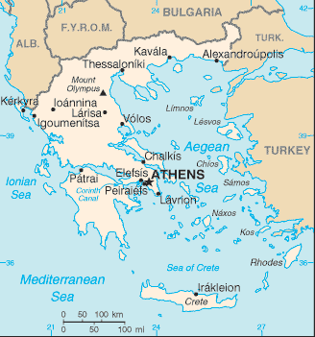
A Special Rock
Over 2000 years ago, people lived in an area of Greece called Magnesia.
They noticed something amazing about some rocks in the area. Pieces of
iron and other metals would stick
to them. Imagine that! They showed the
rocks to people who traveled to their
area. People in many different countries
were fascinated by the rocks because
they were so special.
Many people investigated the properties
of these rocks.
Magnesia
Map of Greece
Circle shows area of Magnesia
Cognitive Learning Systems, Inc © 2016
Notes:
Teacher’s Notes:
Begin the lesson by introducing the GAP Unit to the class. This GAP Unit focuses on magnets and magnetic force. The questions below may be used as a way to assess students’ previous knowledge about magnets.
1. Have you ever seen a magnet?
2. Can you describe a magnet?
3. What does a magnet do?
4. Where do magnets come from?
Tell students that they are going to listen to a story about a rock, what this rock might have in common with magnets, and how it might help them understand where magnets come from. To help students focus on important elements of the story, write the following questions on the board. Tell students that they should keep these questions in mind as they listen to the story. After the story is read, review and discuss the questions with the students.
1. What does the rock attract?
It attracts Iron and other pieces of metal.
2. What is the rock made of?
A mineral called magnetite.
3. Are there other materials like the rock?
Yes. After a piece of iron was rubbed by the rock, the iron attracted pieces of metal. Other man-made magnets are like the rock.
Image courtesy: earthquake.usgs.gov/regional/world/Greece/map.php

Slide 4
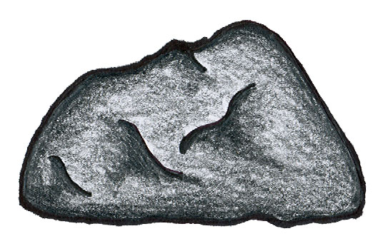
Discovering Magnets
Even after more than a thousand years, people were still interested in the rocks. Scientists like the ones who live today began to study the rocks.
  They found that the rocks were made up of a special type of mineral.
  They called the special mineral magnetite because the rocks were first
  found in Magnesia.
  They discovered that when lightning
  struck a rock made of magnetite,
  the properties of the rock changed.
  This was fascinating!
Cognitive Learning Systems, Inc © 2016

Slide 5
Discovering Magnets
The rock now attracted iron and other metals. They also discovered that if they touched a piece of iron to the rock, the iron would have the same properties as the rock. It would attract other pieces of metal!
They began to call the iron and the rock magnets. They used the word magnet because the rock was first found in Magnesia. The rock made of magnetite was called a natural magnet because it was found in nature.
  The iron was called a man-made magnet. It became a magnet only after it
  was rubbed against the magnetite rock.
Cognitive Learning Systems, Inc © 2016
Notes:
Teacher’s Notes:
After the story is read, review and discuss the questions below with the students.
1. What does the rock attract?
It attracts Iron and other pieces of metal.
2. What is the rock made of?
A mineral called magnetite.
3. Are there other materials like the rock?
Yes. After a piece of iron was rubbed by the rock, the iron attracted pieces of metal. Other man-made magnets are like the rock.

Slide 6
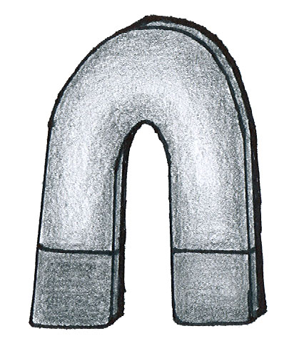
Types of Magnets
All magnets do not look the same. There are different types of magnets.
The rock from the story was made
from magnetite. It was a naturally
occurring magnet. It looked like this.
There are different types of man-made magnets.
They can be made of iron, a mixture of
aluminum, cobalt and nickel, and other
type of minerals.
Look at the two types to the right.
bar magnet
horseshoe magnet
Cognitive Learning Systems, Inc © 2016
Notes:
Teacher’s Notes:
Help students begin to make the connection between the rock they read about and the term magnet. Some questions that could be used to make this connection are listed below.
In the story, scientists used the word magnet to describe two objects. What were they?
The two objects were the magnetite rock and the man-made magnet.
Think about the properties of the special magnetite rock and the iron that was touched by the magnetite rock. Can you use these properties to describe properties of a magnet?
Student answers will vary. Students may suggest that both the magnetite rock and the iron rubbed with the magnetite rock could attract pieces of metal.
What would be some properties of a magnet? Do all magnets look the same?
Student answers will vary. Some should suggest that a magnet attracts iron or other metals. Students may or may not suggest that magnets look the same.
Explain that in addition to the properties they read about in the rock story, magnets have some other properties. Use the Types of Magnets and Effects of Magnets Slides to help introduce students to these properties.
Use the Types of Magnets Transparency first to give some examples of different types of magnets and discuss properties such as the shape of magnets and origin of magnets. Compare the rock made of magnetite to the horseshoe and bar magnet. The magnetite rock is an example of a naturally occurring magnet. The horseshoe and bar magnets are man-made magnets.
Transition to the Effects of Magnets Transparency to begin a discussion of another property of magnets: the ability to attract some types of metals.

Slide 7
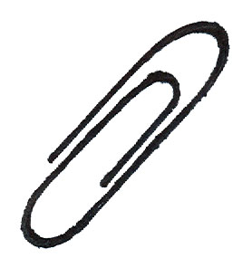
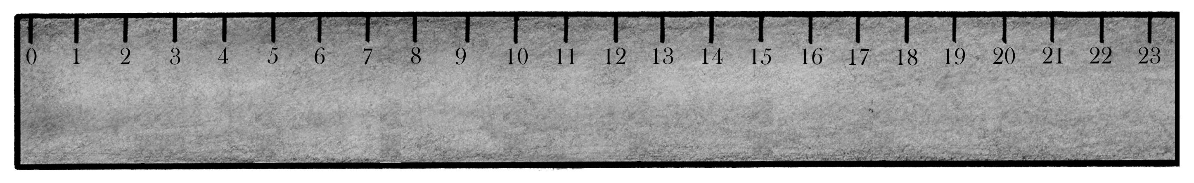
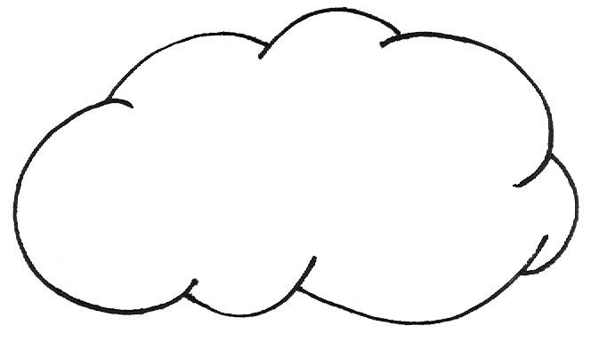
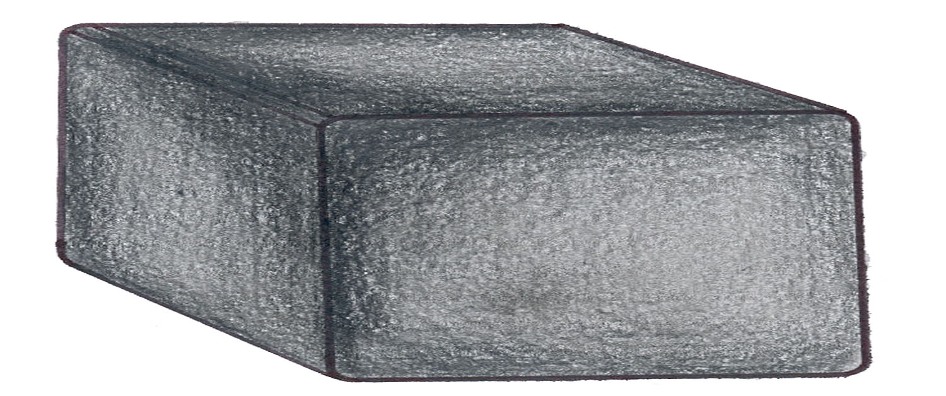
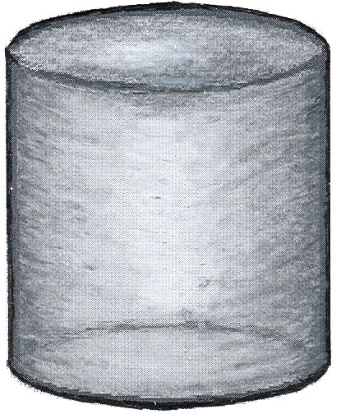
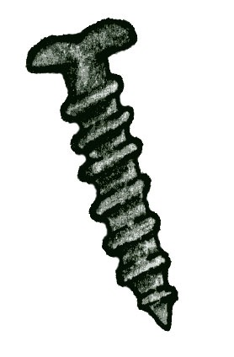
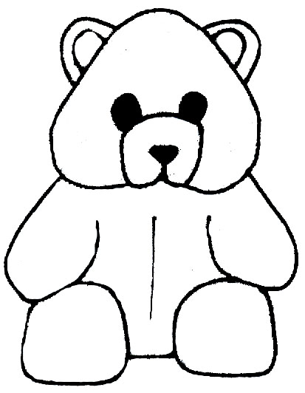
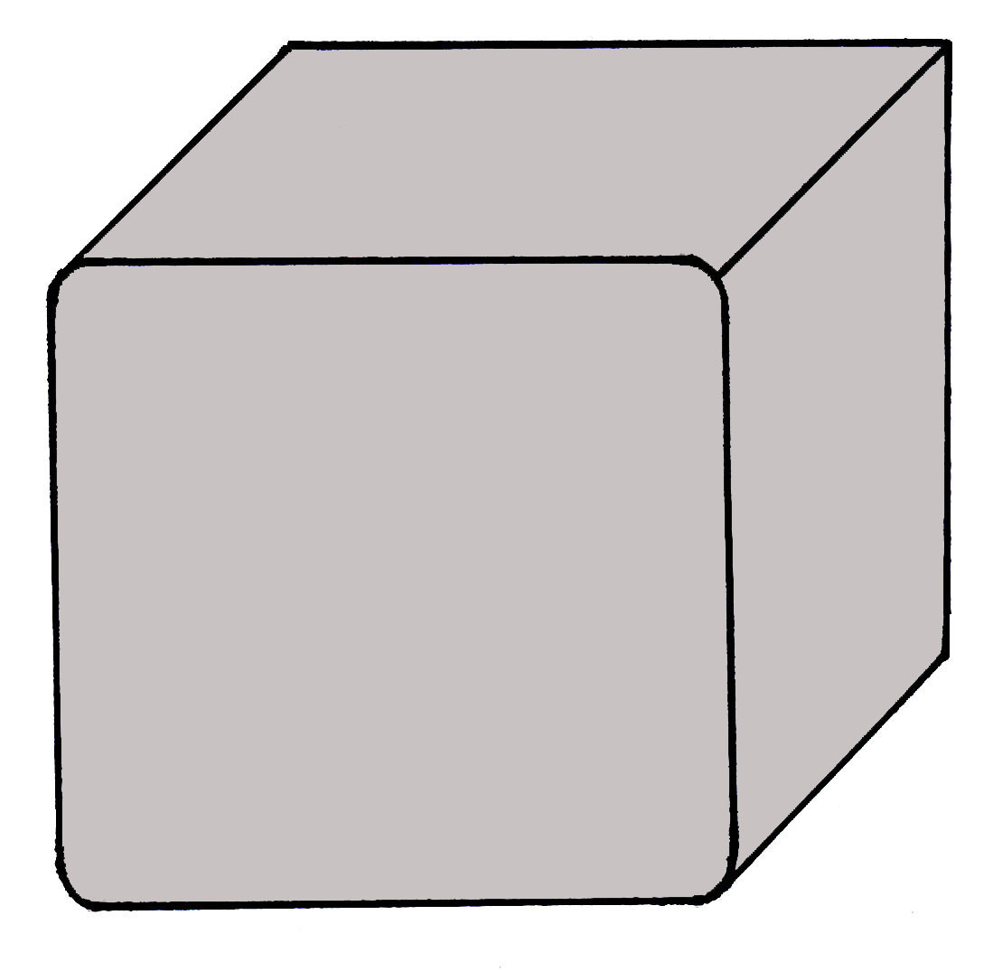
Effects of Magnets
Effects of Magnets
Objects can be ATTRACTED
to a magnet and objects may NOT be attracted to a magnet .
Metal paperclip
Cotton ball
Wood block
An experiment was done to find out which types of objects were attracted to a magnet.
Create a table to record the results.
2. Which objects were ATTRACTED to the magnet?
Plastic cylinder
Metal screw
Metal cube
Plastic bear
Cognitive Learning Systems, Inc © 2016
Notes:
Teacher’s Notes:
Use the Effects of Magnets Slides to discuss the property of attraction to a magnet. Walk students through the experiment that was done with the bar magnet and objects made of different materials. Draw students’ attention to the suggestion that they create a table to record the results of the experiment. This suggestion is provided as a way to help students become more familiar with the use of tables in recording scientific data. A sample table is provided on the second slide of the Effects of Magnets Slide Set. One option is to walk students through the set-up and completion of this table. A second option would be to work with students to either create their own or a class table that could be used to record the results of the experiment.

Slide 8
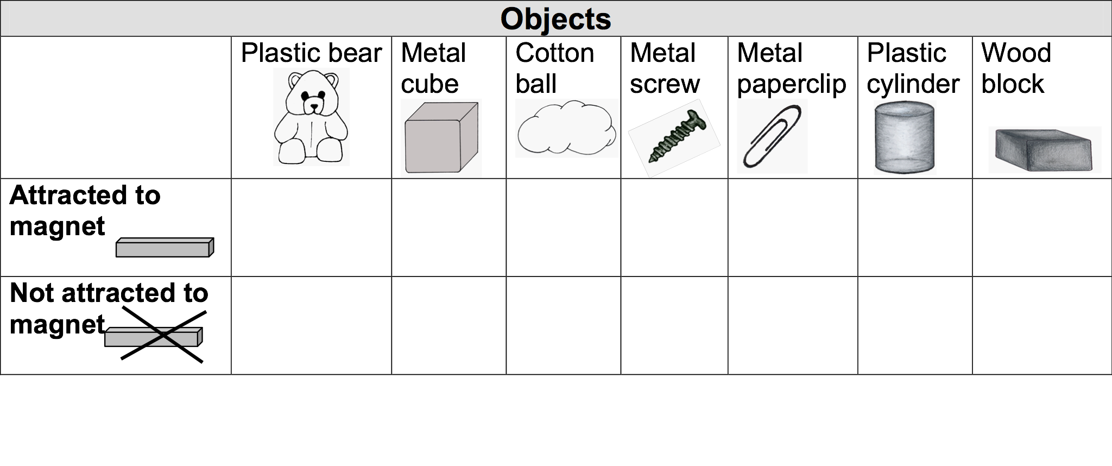
Effects of Magnets
What conclusions can you make about the objects that were attracted to a magnet?
Were the objects made of the same material?
Which type of material was attracted to the magnet?
Which types of materials were NOT attracted to the magnet?
Cognitive Learning Systems, Inc © 2016
Notes:
Teacher Notes
Once the table is complete, discuss the results of the experiments and the types of conclusions that students can draw from the experiment. From the specific objects in the experiment, help students make the more general conclusion that objects made of metal are more likely to be attracted to a magnet than those not made of metal. (As students progress in their science education they may eventually learn that magnets tend to attract only certain metals such as iron, copper and nickel. Other metals such as aluminum and brass are not attracted to magnets.)
What conclusions can you make about the objects that were attracted to a magnet?
Were the objects made of the same material?
The objects are made from different materials. Some are wood, some are metal, some are cotton, some are plastic.
Which type of material was attracted to the magnet?
Objects made from metal were attracted to the magnet (metal cube, metal screw, metal paperclip.)
Which types of materials were NOT attracted to the magnet?
Objects that were not made of metal were not attracted to the magnet. Objects made of wood, plastic, and cotton were not attracted to the magnet (plastic bear, cotton ball, plastic cylinder, wood block.)

Slide 9
Check Understanding
1. Why was the rock found in ancient Greece special?
2. Why do you think objects that attract metal are called magnets or magnetic?
3. How could you complete the following
Venn diagram?
4. Some objects are ATTRACTED to
magnets. Describe them.
How are they alike?
How are they different?
Natural magnet
Man-made magnet
Cognitive Learning Systems, Inc © 2016
Notes:
Teacher Notes
The Check Understanding section of the GAP Unit has been provided as a way to help students rehearse and process the information learned during a section of a GAP Unit. The questions are designed to highlight some of the major concepts or facts of a GAP section.
Answers
Question 1: The rock was special because it attracted iron and other metals. This is not something that is a property of most
rocks.
Question 2: The first rock that attracted metal was found in area of Greece called Magnesia. Magnets are named after that area. Magnetic is the word used to describe the property of being like a magnet (attracting metal). It also comes from the name of the area of Greece, Magnesia.
Question 3: Student answers may vary. Sample answers are provided.
Under Natural magnet
Found in nature
Rock made of magnetite
Irregular shape
Under Man-made magnet
Made by man.
Made of iron and other minerals
Horseshoe and bar shaped
Under area of similarities (middle of Venn Diagram)
Attract metal objects
Question 4: They are alike in that hey are made of metal. They are different in that some of their other properties
such as shape, size, texture and color may be different.

Slide 10
Magnets
Exploring Magnets
Cognitive Learning Systems, Inc © 2016

Slide 11
What Can You Recall?
  1. How do magnets affect metal objects?
  2. Are all magnets the same? How are they alike? How are they different?
  3. A boy tells everyone in his class that a magnet ONLY attracts round
  metal objects. Is he right or wrong? Why?
Cognitive Learning Systems, Inc © 2016
Notes:
Teacher Notes
The What Do You Recall section of the GAP Unit has been provided as a way to help students rehearse and process the information learned previously during the Discovering Magnets section of the Magnets GAP Unit. The questions focus on some of the major concepts or facts of the Discovering Magnets portion of the GAP Unit.
This What Do You Recall section is designed to be the first activity done at the beginning of the Exploring Magnets section of the Magnets GAP UNIT.
Answers:
Question 1: Many metals are attracted to magnets. If a metal gets close to a magnet it is likely that it will be attracted to or stick to the magnet.
Question 2: Magnets are not all the same. All magnets tend to attract objects made of metal but not made of other materials like plastic, wood or cotton. Magnets can be different shapes, sizes, color and can be either man-made or occur naturally.
Question 3: He would be wrong. Magnets will attract metal objects regardless of their shape, size or color. The property of an object that makes it stick to a magnet is that is it made of metal. Paperclips, metal screws and metal cubes are all attracted to a magnet. Each of these are a different shape.

Slide 12
Parts of Magnet
Magnets usually have two different ends called POLES.
One end is a SOUTH POLE
The south pole is marked by the letter S
One end is a NORTH POLE
The north pole is marked by the letter N
Look at the magnets. Can you find the north and south poles?
S
N
bar magnet
N
S
horseshoe magnet
Cognitive Learning Systems, Inc © 2016
Notes:
Teacher Notes:
Students previously learned about several properties of magnets: they be naturally occurring or man-made, various shapes, and tend to attract objects made of metal, but not wood, plastic, or cotton.
In this section, the focus in on two different parts of a magnet: the north and south poles.
The identification of poles will help students with later concepts such as magnetic force and understanding the magnetic properties of Earth.

Slide 13
Parts of a Magnet
Did you notice?
There is no N
There is no S
So where are the poles?
What about other types of magnets like refrigerator magnets?
Examples of refrigerator magnets
S
There are many different north and south poles in a refrigerator magnet in all different directions.
Because there are many and they are in all different directions, the letters are not printed on the outside of the magnet.
N
N
S
S
N
N
S
S
N
Cognitive Learning Systems, Inc © 2016

Slide 14
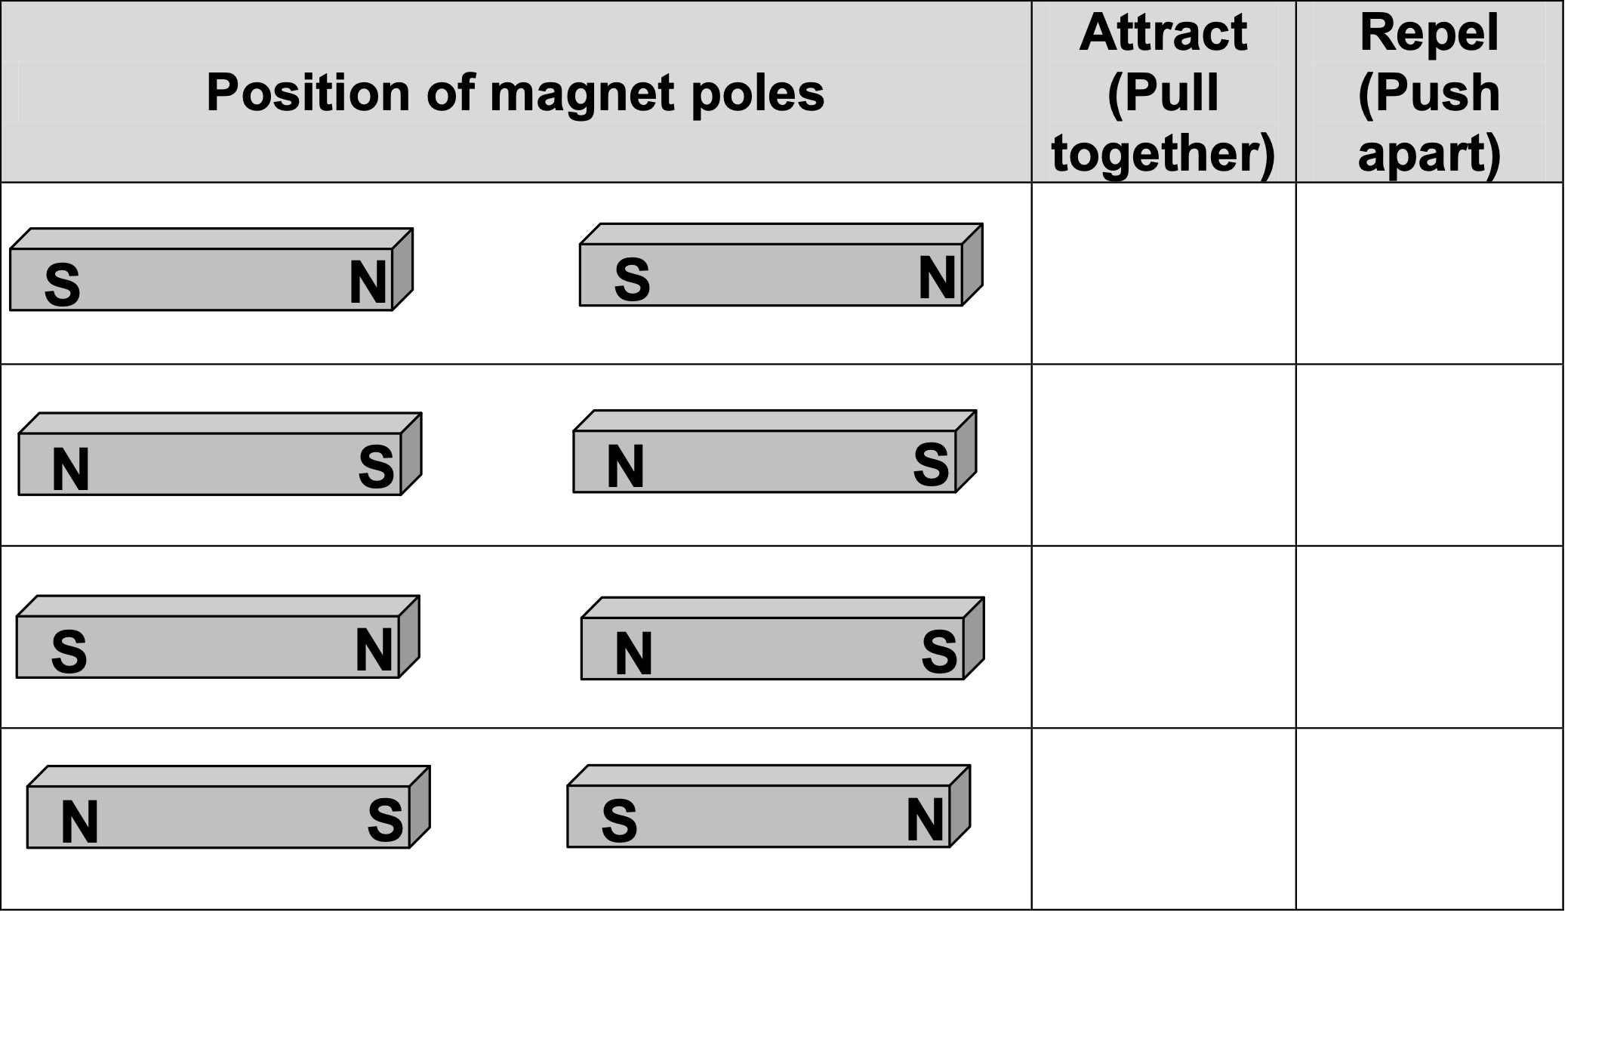
Magnetic Force and Magnets
Magnetic force can ATTRACT objects to a magnet. This is like the magnet PULLING the object close to it.
A force can also be a PUSH. Magnets can also PUSH or REPEL an object away. Usually the object is ANOTHER MAGNET.
The magnetic force of a magnet is STRONGEST at its north and south poles. Copy the following table onto your paper.
Cognitive Learning Systems, Inc © 2016
Notes:
Teacher Notes:
Students have previously learned that magnets have poles. In horseshoe and bar magnets the poles are easily identified. In other types of magnets such as disc magnets or refrigerator magnets, the poles may not be labelled or as easily identified.
Students may wonder about the significance of the poles. The Magnetic Force and Magnets Slide Set is designed to introduce students to the significance of poles and to magnetic force. In this transparency series, students learn that the attraction of a magnet for metals and metallic objects is the result of a magnetic force. They will also learn that the magnetic force can repel other magnets.
Magnetic force is all around a magnet, but it is strongest at the poles. This is why on a horseshoe or bar magnet, objects “stick” to the magnet at the poles. In these cases, either the north or south pole will attract the metallic object. Students may recall refrigerator magnets which have no visibly identified poles. Because of the unique arrangement of poles in these types of magnets, the magnetic force is essentially equivalent at all areas of the magnet.

Slide 15
Magnetic Force and Magnets
Observe the results of the first experiment. Record the results in the table.
S
N
S
N
S
N
S
N
North pole of one magnet is across from south pole of other magnet.
Did the magnets attract or repel each other?
Observe the results of the second experiment. Record the results in the table.
N
S
N
S
N
S
N
S
North pole of one magnet is across from south pole of other magnet.
Did the magnets attract or repel each other?
Cognitive Learning Systems, Inc © 2016
Notes:
Teacher Notes
In contrast to magnets and metallic objects, there can be attraction OR repulsion between two magnets. Whether the magnetic force results in attraction or repulsion is determined by the ORIENTATION of the north and south poles to one another. In order to better understand this students are presented with a series of four experiments in which the orientation of the poles differs and a table in which to record and analyze the data. Work through the experiments, recording of data and analysis with the students. As you work with students make sure they understand the DIFFERENCE between REPULSION and simple “non-attraction.” Cotton balls, wood blocks are NOT ATTRACTED to magnets. This does NOT mean that they are REPELLED. REPELLED means that there is a force that PUSHES two magnets APART.
From this set of experiments, students should discover the following:
OPPOSITE MAGNETIC POLES ATTRACT (North facing South)
SAME MAGNETIC POLES REPEL (North facing North or South facing South)

Slide 16
Magnetic Force and Magnets
Observe the results of the third experiment. Record the results in the table.
S
N
N
S
S
N
N
S
North pole of one magnet is across from north pole of other magnet.
Did the magnets attract or repel each other?
Observe the results of the fourth experiment. Record the results in the table.
N
S
S
N
N
S
S
N
South pole of one magnet is across from south pole of other magnet.
Did the magnets attract or repel each other?
Cognitive Learning Systems, Inc © 2016

Slide 17
Magnetic Force and Magnets
Look at your
results.
Cognitive Learning Systems, Inc © 2016
Notes:
Students should work together to complete the table based on the results from the experiment.
OPPOSITE MAGNETIC POLES ATTRACT (North facing South)
SAME MAGNETIC POLES REPEL (North facing North or South facing South)

Slide 18
Magnetic Force and Magnets
Magnet Role Play
Pretend that you are the north or south pole of a magnet.
Your teacher will tell you whether you are a north pole or south pole.
Imagine that you will meet the pole from another magnet.
What will you do when you meet the other pole?
Will you ATTRACT the other pole?
Will you REPEL the other pole?
Cognitive Learning Systems, Inc © 2016
Notes:
Teacher Notes
This series of transparencies also invites students to rehearse what they have learned by participating in a role play. In the role play students are divided into the “POLES” of magnets. One suggestion for assignment of poles is described below. However, other alternative are available and left to the teacher’s discretion.
Boys= NORTH POLE
Girls= SOUTH POLE
Explain that the force of attraction will be simulated by students extending their hands, holding the hands of the person across from them and then gently pulling their hands inward to their bodies so that each person (POLE) would move closer to each other.
The force of repulsion would be simulated by students extending their hands, making their hands meet and then gently pushing so that their bodies move away from each other.
Some sample interactions of the poles are described on the transparency, but can be extended through other student or teacher suggestions.

Slide 19
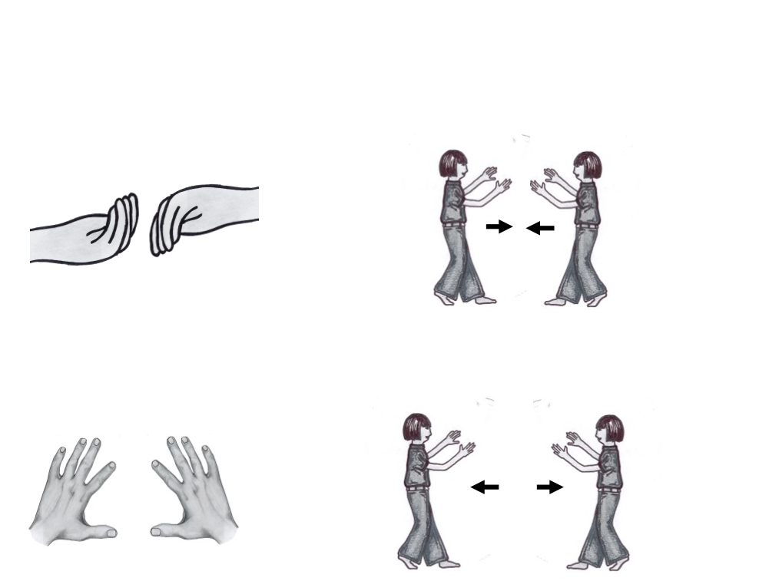
Magnetic Force and Magnets
Magnet Role Play
If you ATTRACT the other pole, put your hands out and PULL yourselves TOGETHER.
If you REPEL the other pole, put your hands out and PUSH yourselves APART.
Cognitive Learning Systems, Inc © 2016
Notes:
Teacher Notes
This series of transparencies also invites students to rehearse what they have learned by participating in a role play. In the role play students are divided into the “POLES” of magnets. One suggestion for assignment of poles is described below. However, other alternative are available and left to the teacher’s discretion.
Boys= NORTH POLE
Girls= SOUTH POLE
Explain that the force of attraction will be simulated by students extending their hands, holding the hands of the person across from them and then gently pulling their hands inward to their bodies so that each person (POLE) would move closer to each other.
The force of repulsion would be simulated by students extending their hands, making their hands meet and then gently pushing so that their bodies move away from each other.
Some sample interactions of the poles are described on the transparency, but can be extended through other student or teacher suggestions.

Slide 20
Magnetic Force and Magnets
Magnet Role Play
1. Get Ready.
Find an opposite pole around you. What did you do?
2. Try again. Get ready.
Find a pole that is the same as you. What did you do?
3. Try again. Get ready.
Find a pole that you will be ATTRACTED to. What did you do?
4. Try again. Get ready.
Find a pole that you will REPEL. What did you do?
5. Try again. Get ready.You have 2 minutes.
Go around room and find as many other “poles of magnets” as you can.
How many did you ATTRACT?
How many did you REPEL?
Cognitive Learning Systems, Inc © 2016

Slide 21
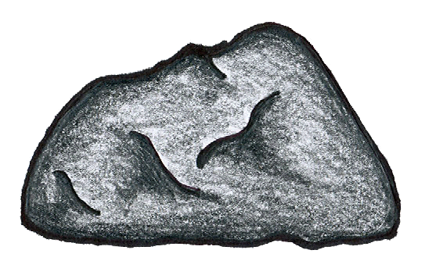
The Lodestone and The Compass
Do you remember the special rocks found in Greece? Well, sometimes when people would visit Greece, they would take some of the rocks with them. Chinese travelers were fascinated by the rocks. They took some of the special rocks back to China with them.
They did some experiments with the rocks. In one experiment they hung several of the rocks from a string. They noticed the rocks always ended up pointing in the same direction. The rocks always pointed to the North Star.
They carved the rock into a spoon and placed it on a flat plate. The spoon would spin until the tip of the spoon pointed to the North Star. This was the invention of the compass.
Direction of North Star
Cognitive Learning Systems, Inc © 2016
Notes:
Teacher Notes:
The Magnets and Earth Slide Set is designed to help students discover one of the many uses of magnets throughout history and in the present day. In this set of transparencies, students will learn about the invention of the compass, a navigational device that uses a magnet to determine direction.
The short story entitled The Lodestone and The Compass provides students with a historical perspective on the invention of the compass. Although not specifically stated in the story, the compass was not actually used by the Chinese as a navigational tool when first invented. Although they recognized that the stone they used to create a compass always pointed in the same direction, it is thought that they used it to describe emotional states of being. Instead of the directions of north, south, east and west on the flat plate with the stone, they inscribed emotional states of being. The compass always pointed to one emotional state of being that was considered the ideal. Some consider this the beginning of the current practice of feng shui.
Early Europeans did, however, use the compass as a navigational tool. They recognized that the lodestone pointed to the North Star. This observation is the reason that the direction of north is aligned with the direction of the North Star. They did NOT realize, however, that the true reason the lodestone pointed in the northern direction was because of the magnetic properties of the Earth. This discovery came later.

Slide 22
Hundreds of years later, people in Europe placed the rocks on top of pieces of wood. They floated the wood and rock in water. They noticed that the rock always pointed in the same direction.They gave the name lodestone to the rocks. The word lodestone means leading stone because the stone led them in the direction of the North Star. Sailors used the floating lodestone to help them find their way when sailing. The floating lodestone was another type of compass.
Do you think compasses still used today? Are they made from lodestones? How do they work?
Cognitive Learning Systems, Inc © 2016

Slide 23
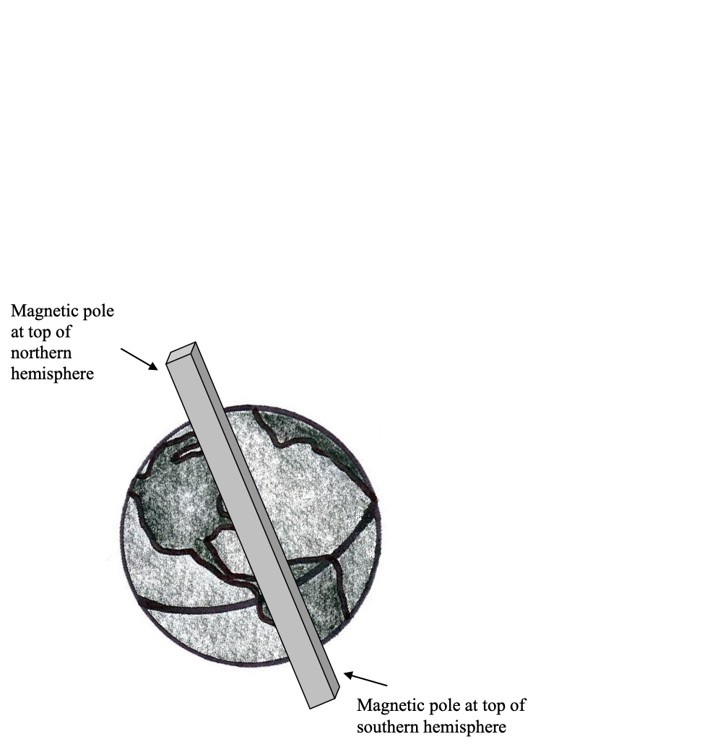
Magnets and the Earth
Scientists have shown that the Earth behaves like a magnet. It has two magnetic poles.
One magnetic pole of the Earth is at the top of the northern hemisphere.
The other magnetic pole of the Earth is at the top of the southern hemisphere.
To imagine this, pretend that there is a bar magnet that goes through the Earth.
Cognitive Learning Systems, Inc © 2016
Notes:
Teacher Notes:
Our current understanding of the Earth is that there is an iron rich liquid that composes the outer core of the Earth. This rotates around the solid inner core of the Earth. The rotation of this liquid generates a magnetic field around the Earth. Another way to think of this is that the Earth behaves in many ways as if it has a bar magnet that runs through its center. Scientists describe the Earth as having a north and south magnetic pole. Here, however, here is where things can get tricky. The magnetic pole at the top of the NORTHERN HEMISPHERE is the MAGNETIC SOUTH POLE. The magnetic pole at the top of the SOUTHERN HEMISPHERE is the MAGNETIC NORTH POLE. This is the reason that the needle of the compass always points to the top of the Northern Hemisphere. The shaded end of the needle in a compass is a NORTH POLE. It is therefore attracted to the MAGNETIC SOUTH POLE of the Earth.

Slide 24
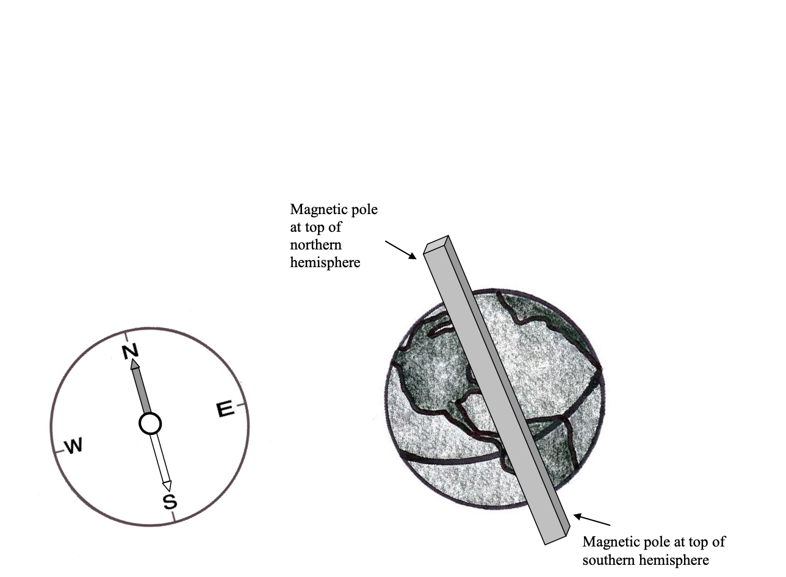
Magnets and the Earth
Did you know that a compass uses a magnet?
The needle in a compass is a man-made magnet. It is attracted to the magnetic pole at the top of the Northern Hemisphere. This causes the shaded part of the needle to point in the direction of North.
Cognitive Learning Systems, Inc © 2016
Notes:
Teacher Notes
Although interesting, the information about details of the origin of the compass, the magnetic field and the discrepancy between geographic and magnetic north and south may not be easily understood or conceptualized by elementary students. It has been provided for the benefit of the teacher and as a resource for possible student questions.
Instead, the Magnets and the Earth Slide Set introduces students to the compass and the magnetic properties of the earth on a much more basic level. Through these transparencies it is expected that students will learn that the Earth has some properties similar to a magnet, including two magnetic poles. One pole is at the top of the northern hemisphere. One pole is at the top of the Southern hemisphere. The existence of magnetic poles allows a compass to be used in navigation as the needle in a compass is a magnet.

Slide 25
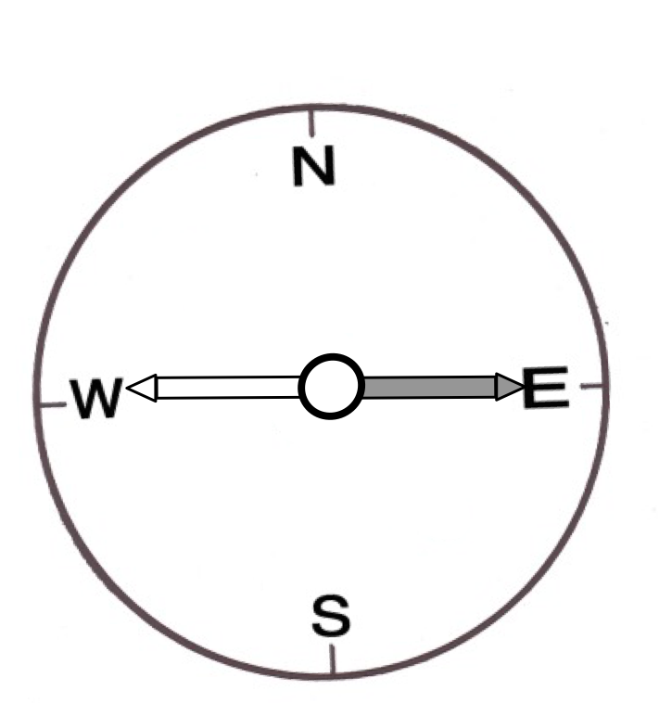
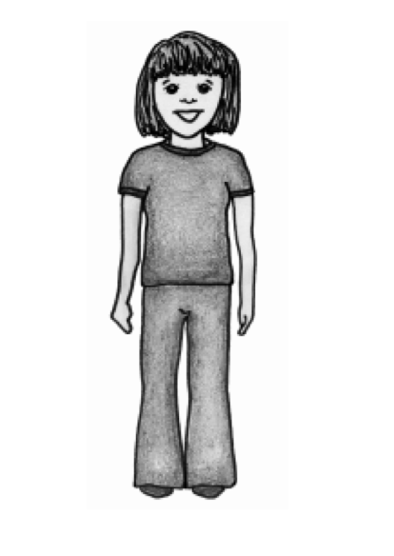
Magnets and the Earth
People use the compass to help them navigate or find their way to someplace.
How do people use a compass?
A compass has the directions of North, South, East and West on it.
People hold a compass in their hand and look at the shaded end of the needle. In order to find out which direction is North, South, East and West, they first must turn the compass so that the shaded end is lined up with the letter N or the direction of North.
Look at the example below. Imagine the girl is holding a compass and is standing in a field. Is the pointed end of the compass needle lined up with the letter N?
Cognitive Learning Systems, Inc © 2016

Slide 26
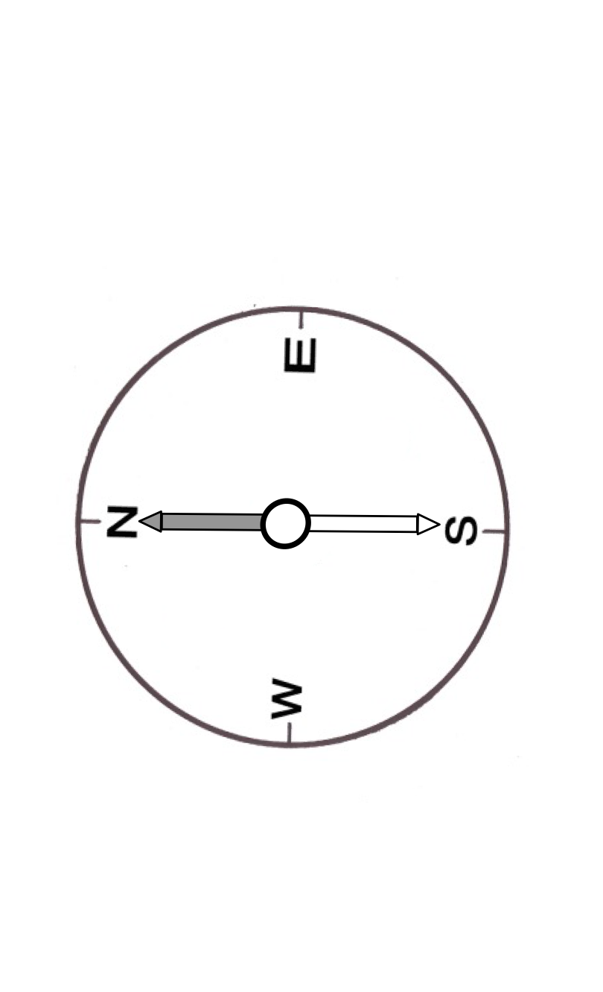
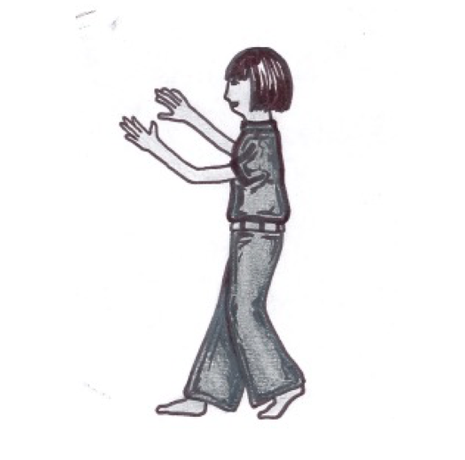
Magnets and the Earth
Imagine the girl is still standing in a field. She still holds the compass in her hand. Now she turns so that the shaded end of the needle IS line up with the letter N. Now the girl knows which direction is north.
?
?
?
Can you label the rest of the directions?
Cognitive Learning Systems, Inc © 2016
Notes:
Teacher Notes
The direction above the girl’s head would be E. The direction below the girl’s feet would be W. The direction behind the girl’s back would be S.

Slide 27
Check Understanding
1. Why does the needle of a compass point to the direction of
North?
2. Look at the different shaped magnets. What do the letters S
and N show?
3. Describe what will happen to the two magnets below.
S
N
bar magnet
N
S
horseshoe magnet
S
N
S
N
4. Where is the magnetic force the STRONGEST on a magnet?
Cognitive Learning Systems, Inc © 2016
Notes:
Teacher Notes
Answers
Question 1: The needle of a compass is a magnet. It is attracted to the magnetic pole at the top of the northern hemisphere. .
Question 2: The letter represents the north pole of a magnet. The letter S represents the south pole of a magnet. Both the bar and horseshoe magnet have a north and south pole. The north and south poles are the ends of the magnets. They are the areas of the magnet that have the greatest magnetic force.
Question 3:The two magnets will be attracted to each other because the north and south poles are facing each other. Opposite poles of a magnet attract each other
Question 4: The magnetic force is strongest at the north and south poles of a magnet.

Slide 28
Magnets
Forces and Interactions
Cognitive Learning Systems, Inc © 2016

Slide 29
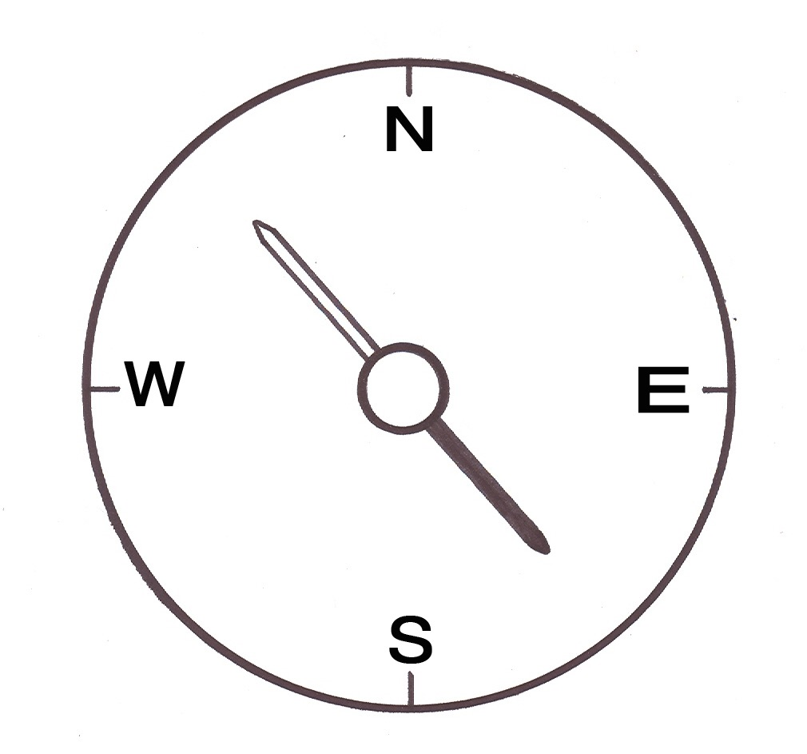
Forces and Interactions
Sailors used lodestones to guide them, because the stones always pointed toward the North Star.
  Hikers still use compasses today so that they don’t get lost.
Can we use the special properties of magnets to solve a different problem?
Direction of North Star
D
Cognitive Learning Systems, Inc © 2016
Notes:
Teacher Notes
Remind students that magnetic properties have allowed sailors and hikers to find their way. This is due to the special properties of magnets and how they interact with the Earth’s magnetic field.
Pose the question, “Can we use the special properties of magnets to solve a different problem?” to students. The problem will be presented on the next slide.

Slide 30
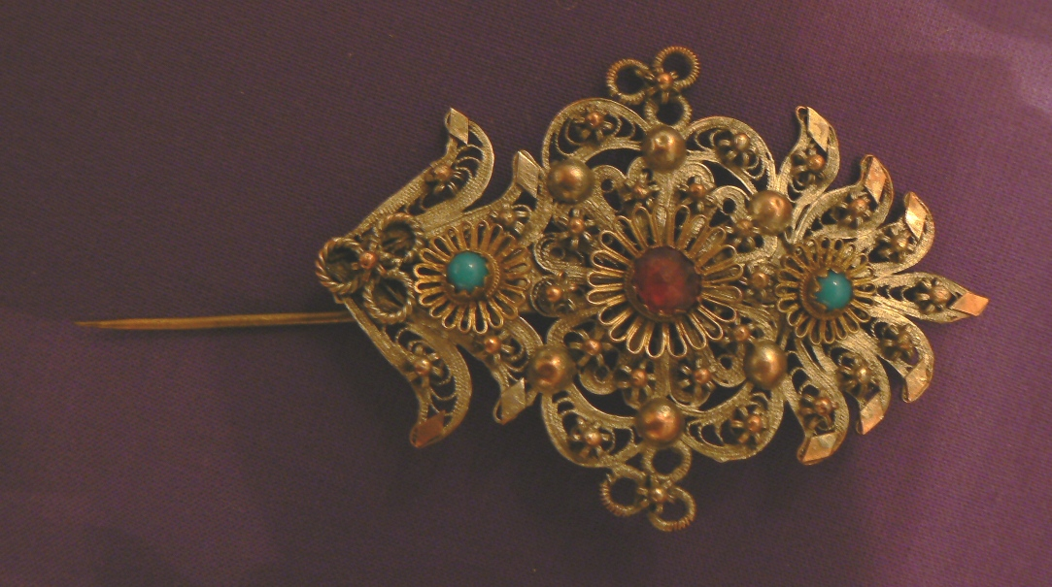
Forces and Interactions
This is a brooch worn by a woman 100 years ago.
It has a pin in the back so she could attach the brooch to her dress.
But the pin makes a hole in her dress.
What can she do?
Cognitive Learning Systems, Inc © 2016
Notes:
Teacher Notes
Slides 30-35 are designed to guide your students through applying the scientific knowledge they’ve gained about magnets. The goal is to define a design problem that can be solved by applying this knowledge.
Students were reminded that magnetic properties have allowed sailors and hikers to find their way. This is due to the special properties of magnets and how they interact with the Earth’s magnetic field.
Magnets can be used for other purposes, however, and we want student to recognize that magnets could be used to hold things together, or hold them in place.
What can she do? Students may come up with the idea that magnets could be used to hold the brooch on the dress. The brooch would have a magnetic piece attached to the back of it. There would be a separate magnet (that was attracted to it) that would be placed on the other side of the fabric. The two magnetic pieces would need to have opposite poles in order to attract.

Slide 31

Forces and Interactions
Now it’s your turn to solve a puppy problem using what you know about magnets!
Cognitive Learning Systems, Inc © 2016
Now it’s your turn to solve a puppy problem using what you know about magnets!
Notes:
Teacher Notes
This slide introduces the design problem that students will identify and solve. Who can resist a puppy problem?

Slide 32
Forces and Interactions
  You can see this puppy owner has got her hands full!
  How can she put her puppies into the fenced back yard and keep them safe if she doesn’t have a free hand for the gate?
Cognitive Learning Systems, Inc © 2016
Notes:
Teacher Notes
The puppy owner has 4 puppies in her arms, and needs to put them safely in the back yard. Students should be guided to think more deeply about the properties of magnets, and their attractive forces.
How can she put her puppies into the fenced back yard and keep them safe if she doesn’t have a free hand for the gate? Review the facts about magnetic attraction and repulsion. Also, talk about how the attraction can be broken or restored using force, using proximity of one pole to another, etc.

Slide 33
Forces and Interactions
What is the problem
that we need to solve?
Cognitive Learning Systems, Inc © 2016
Notes:
Teacher Notes
What is the problem that we need to solve? Guide students to the realization that the gate is the problem.
The owner has to be able to open the gate and make sure that it closes securely behind her — without using her hands. There must be a way that we can help her solve this problem with magnets.

Slide 34
Forces and Interactions
Design a solution for her and her puppies!
What will you design?
What materials will you use?
How will your solution work?
What properties, forces and interactions in magnets will help you?
Sketch out and label your idea.
Share it with your class!
Cognitive Learning Systems, Inc © 2016
Notes:
Teacher Notes
Design a solution for her and her puppies!
What will you design? Students should understand that they need to design a latch.
What materials will you use? Magnets!
How will your solution work? The owner can use her hip to put force on the magnetic latch, breaking the attraction between the poles so that the gate opens. When she has passed through the gate, it can be pushed closed with her hip, and the magnetic attraction between north and south poles of the magnets will be re-established to close the latch and hold the gate closed.
What properties, forces and interactions in magnets will help you? The attractive properties of the opposite poles of magnets.
Sketch out and label your idea. Students should be able to sketch a simple gate and latch system, which they label showing the poles and their attractive force.
Share it with your class! Although the images may be different, students should have come to the same conclusion about the role of magnets in solving this problem. If other solutions are offered, or if students didn’t include information about the poles, application of force to break the attraction, and re-establishment of attraction as the magnets come into proximity, these ideas can be reviewed at this time.

Slide 35

\
Forces and Interactions
Hey there smart humans!
Thanks for using magnets to keep my puppy friends safe!
Cognitive Learning Systems, Inc © 2016

Slide 36
Magnets
Making and Applying Connections
Cognitive Learning Systems, Inc © 2016

Slide 37
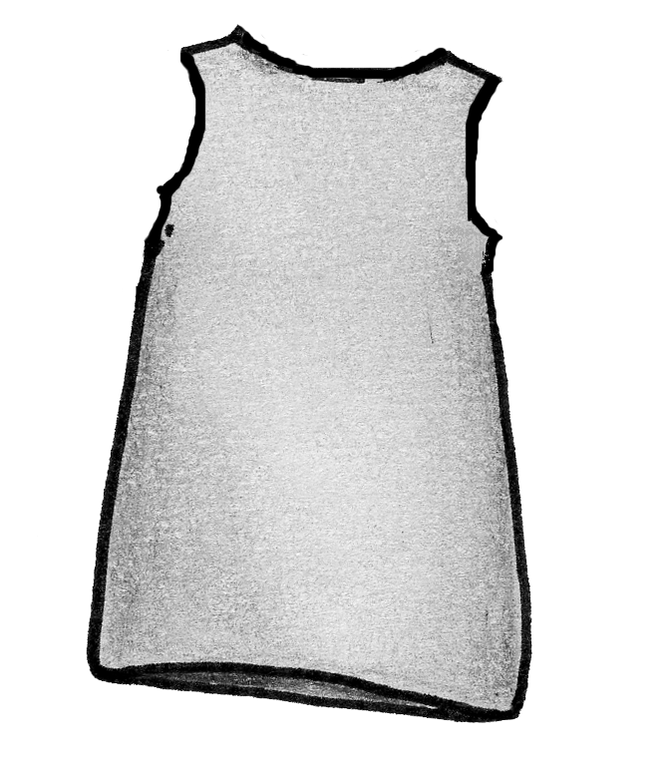
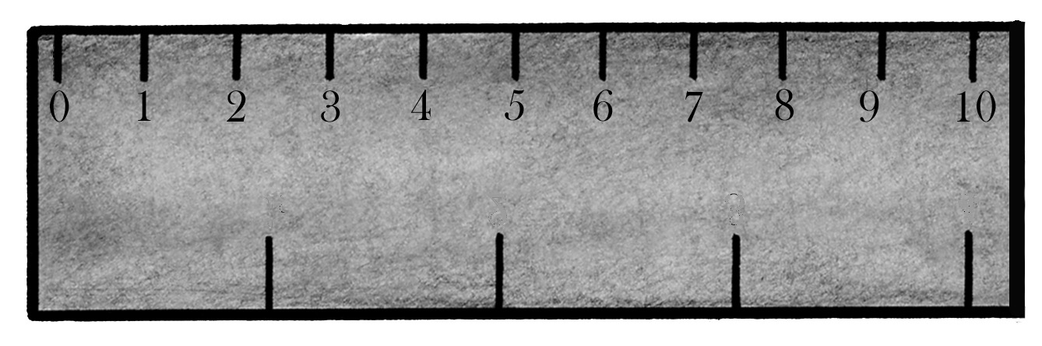
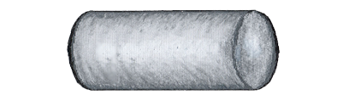
Making and Applying Connections
1. Which of the following is MOST LIKELY to be attracted to
a magnet?
wood ruler
metal screw
shirt
chalk
A
B
C
D
Cognitive Learning Systems, Inc © 2016
Notes:
Teacher Notes
Answer
Question 1: B

Slide 38
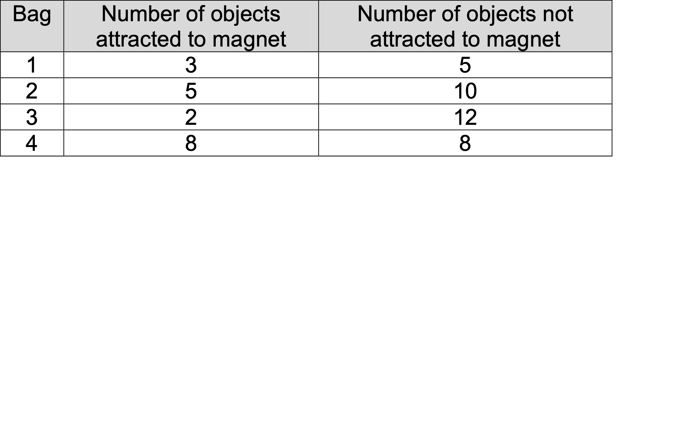
Making and Applying Connections
Madeline had four bags filled with different objects. She tested the objects in each bag to see if they were attracted to a magnet. The table below shows the number of objects that were attracted and were NOT attracted to the magnet.
Which bag had the LEAST number of objects ATTRACTED the magnet and the GREATEST number of objects NOT ATTRACTED to the magnet?
A. Bag 1
B. Bag 2
C. Bag 3
D. Bag 4
Cognitive Learning Systems, Inc © 2016
Notes:
Teacher Notes
Answer
Question 2: C

Slide 39
Making and Applying Connections
Juan found an object on his way home from school. He wanted to know if it was magnetic. What could he do to
find out?
A. See if it attracted both another magnet and metal
objects.
B. See if it attracted both another magnet and plastic
objects.
C. See if it attracted both another magnet and wood
objects.
D. See if it attracted both wood and plastic objects.
The Earth similar to a magnet because
A. It can attract metal objects.
B. It is shaped like a bar magnet.
C. It has two magnetic poles.
D. It can rotate.
Cognitive Learning Systems, Inc © 2016
Notes:
Teacher Notes
Answer
Question 3: C
Question 4: A

Slide 40
Making and Applying Connections
The needle of a compass points to
A. the magnetic pole at the top of the northern hemisphere.
B. the magnetic pole at the equator.
C. the magnetic pole at the top of the southern hemisphere.
D. the magnetic pole of the moon.
Cognitive Learning Systems, Inc © 2016
Notes:
Teacher Notes
Answer
Question 5: A

Slide 41
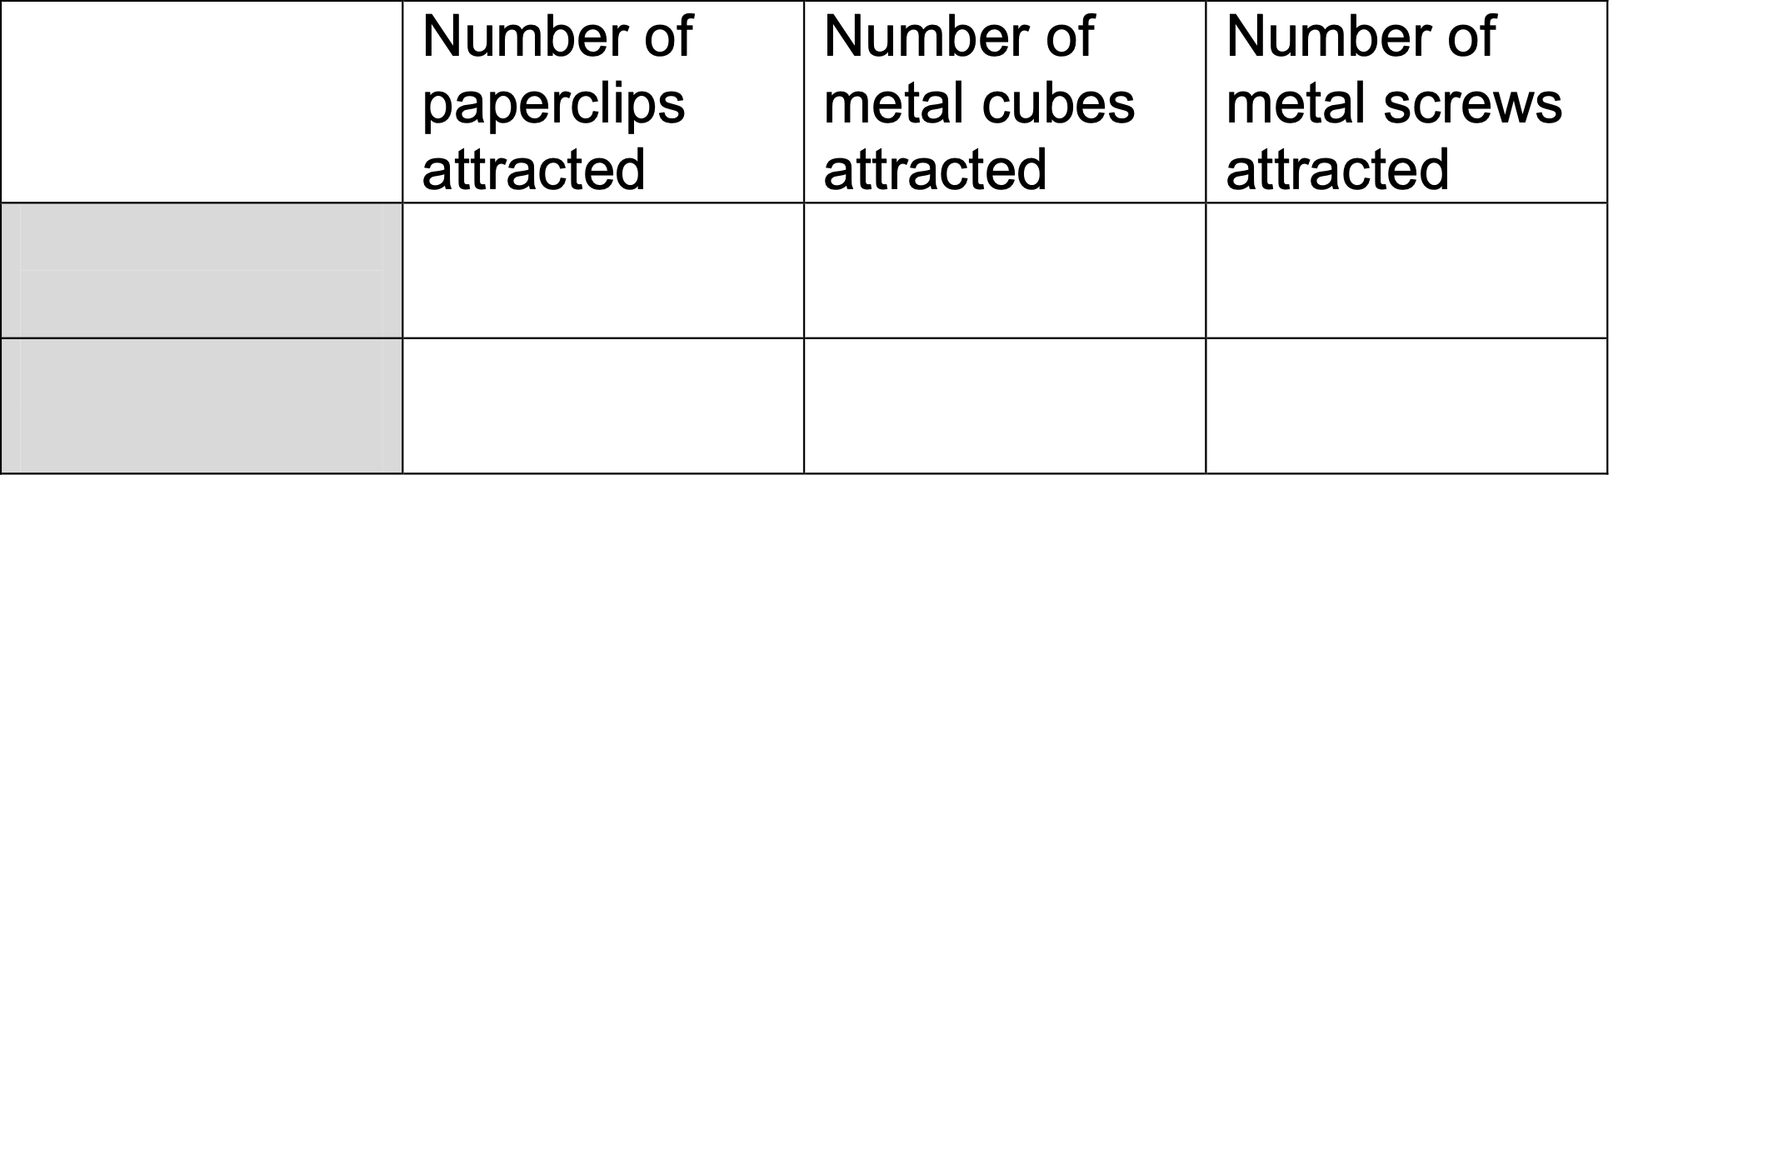
Making and Applying Connections
Your friend has two magnets. Magnet X and Magnet Y.
She thinks that Magnet X is stronger than Magnet Y. She decides to count the number of paperclips, metal cubes and metal screws that each magnet can hold. She makes the following table to record her data.
Which of the two words below should she write in the shaded parts of the table?
A. Magnet X, South magnetic pole
B. Magnet Y, South magnetic pole
C. Magnet X, Magnet Y
D. North magnetic pole, South magnetic pole
S
N
S
N
Magnet X
Magnet Y
Cognitive Learning Systems, Inc © 2016
Notes:
Teacher Notes
Answers
Question 6: C

Slide 42
Making and Applying Connections
Which of the following pairs of magnets would be ATTRACTED to each other?
A
S
N
N
S
B
N
S
S
N
S
N
C
S
N
D
S
N
S
N
Cognitive Learning Systems, Inc © 2016
Notes:
Teacher Notes
Answers
Question 7: D

Slide 43
Making and Applying Connections
Which picture shows magnets that would REPEL each other?
A
S
N
S
N
B
N
S
S
N
S
N
C
N
S
D
N
S
S
N
Cognitive Learning Systems, Inc © 2016
Notes:
Teacher Notes
Answers
Question 8: D

Slide 44
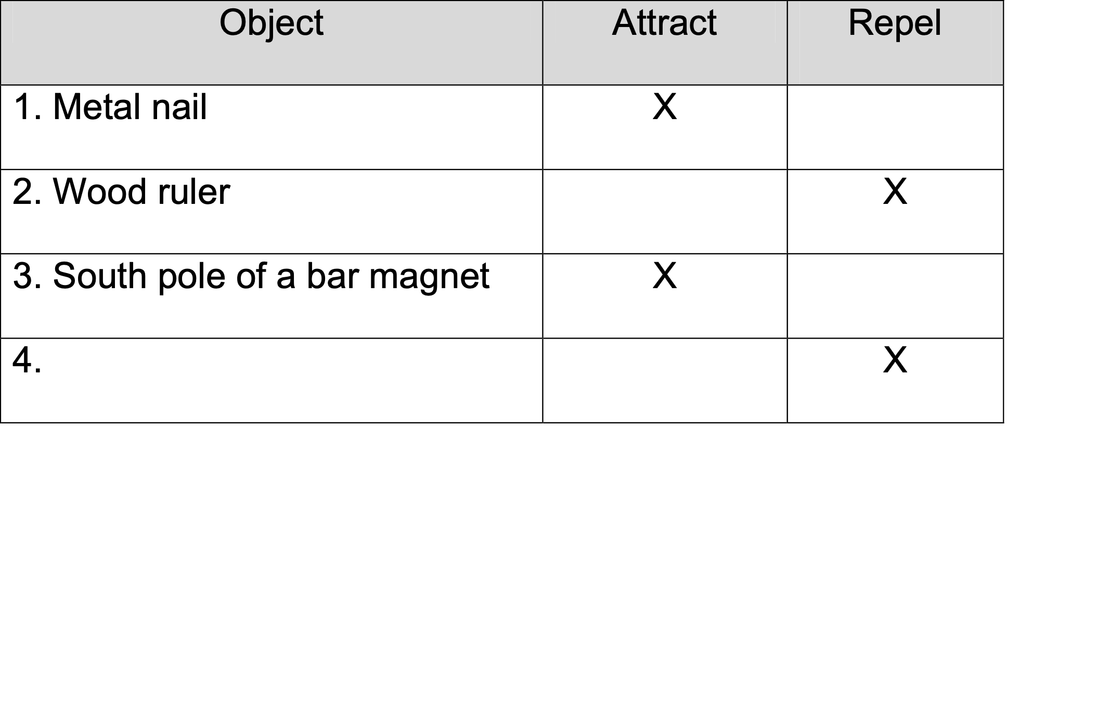
Making and Applying Connections
The table below shows three of four objects that were put next to one pole of a bar magnet.
What was the fourth object that was tested?
A. South pole of bar magnet
B. North pole of bar magnet
C. Metal picture frame
D. Iron hook
Objects put next to this pole
Cognitive Learning Systems, Inc © 2016
Notes:
Teacher Notes
Answer
Question 9: B

Slide 45
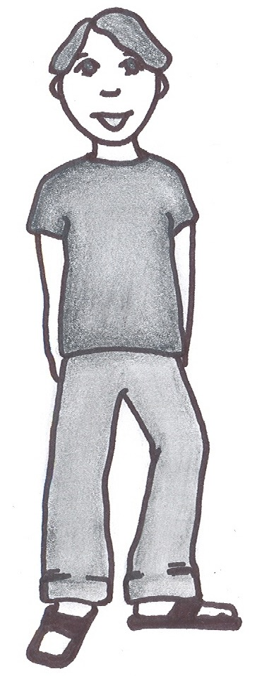

Making and Applying Connections
10. Carlos is standing on the top of a mountain looking down at a valley. The diagram below shows what his compass looks like now. What should his compass look like if he wants to find the direction of north?
Carlos’s compass
A
B
C
D
Cognitive Learning Systems, Inc © 2016
Notes:
Teacher Notes
Answer
Question 10: D

