Slide 1
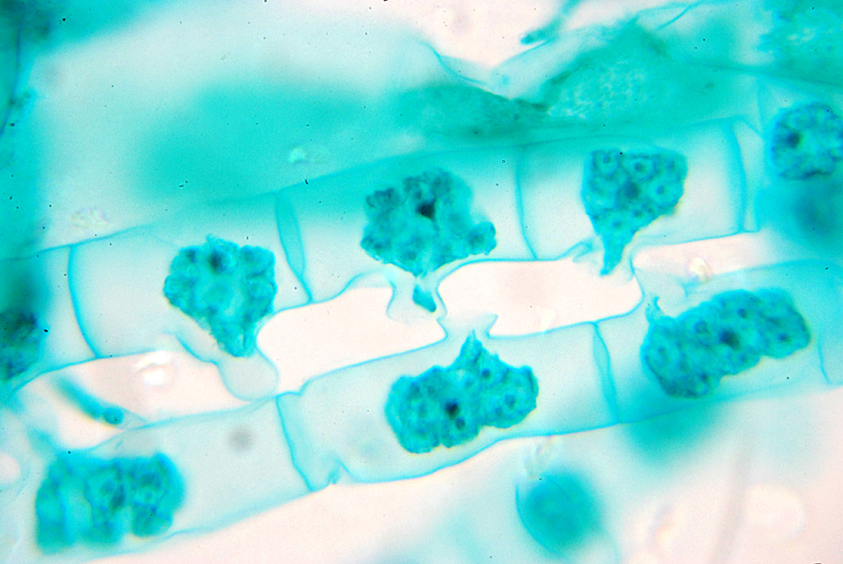

Eukaryotes
Cognitive Learning Systems, Inc © 2016

Slide 2

Eukaryotes
Understanding Eukaryotic CELLs
Cognitive Learning Systems, Inc © 2016

Slide 3
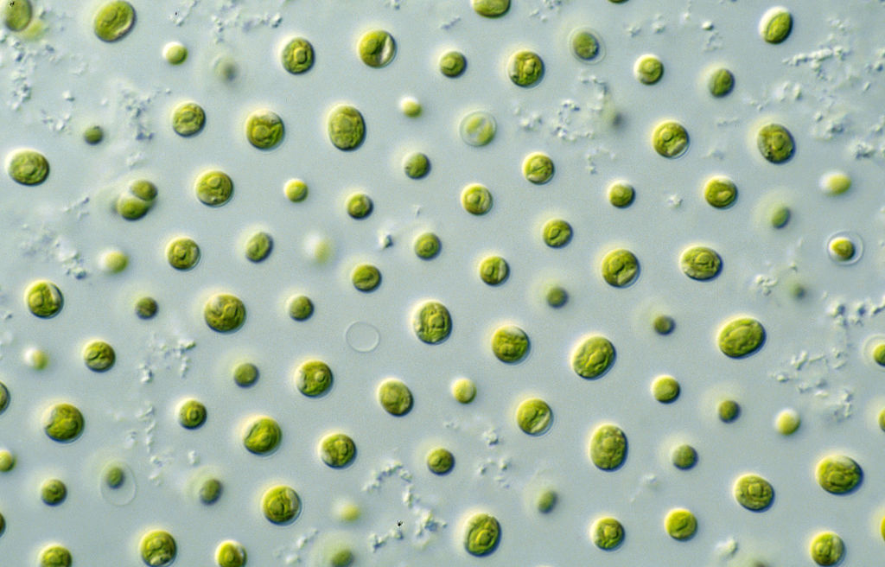
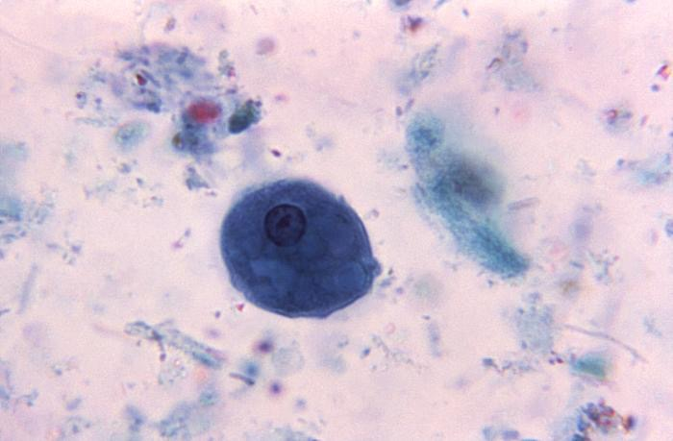

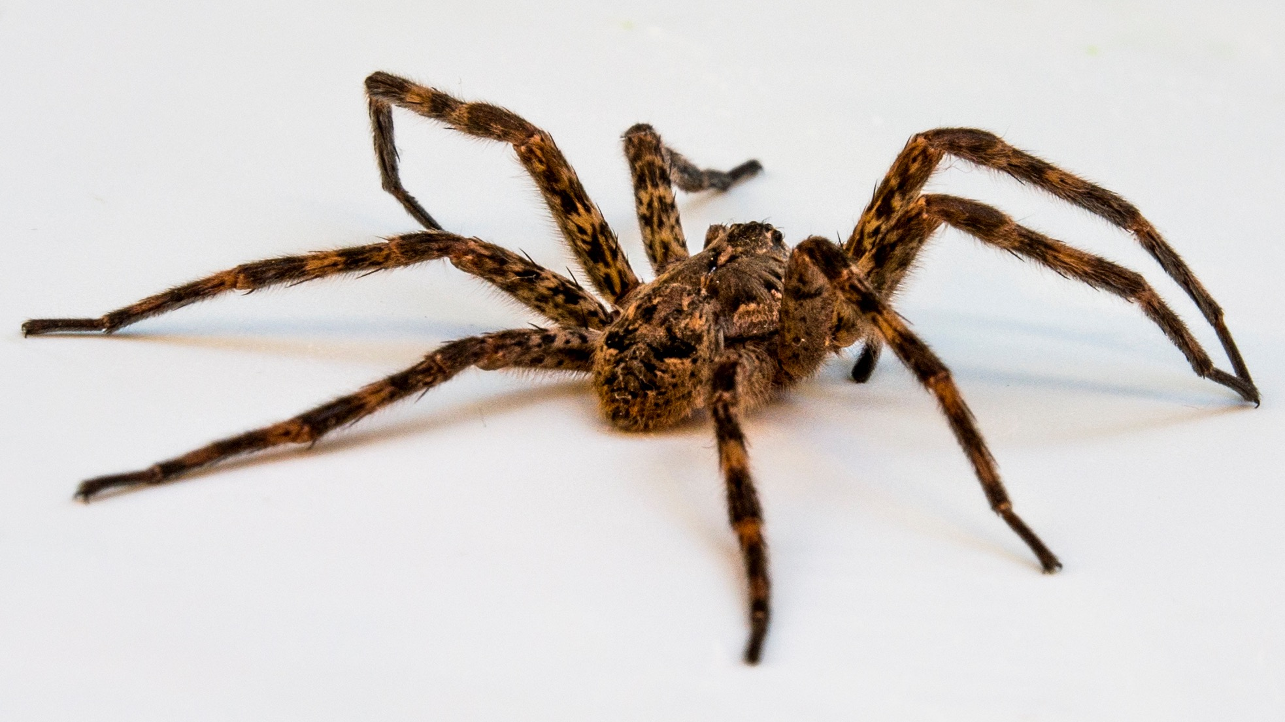
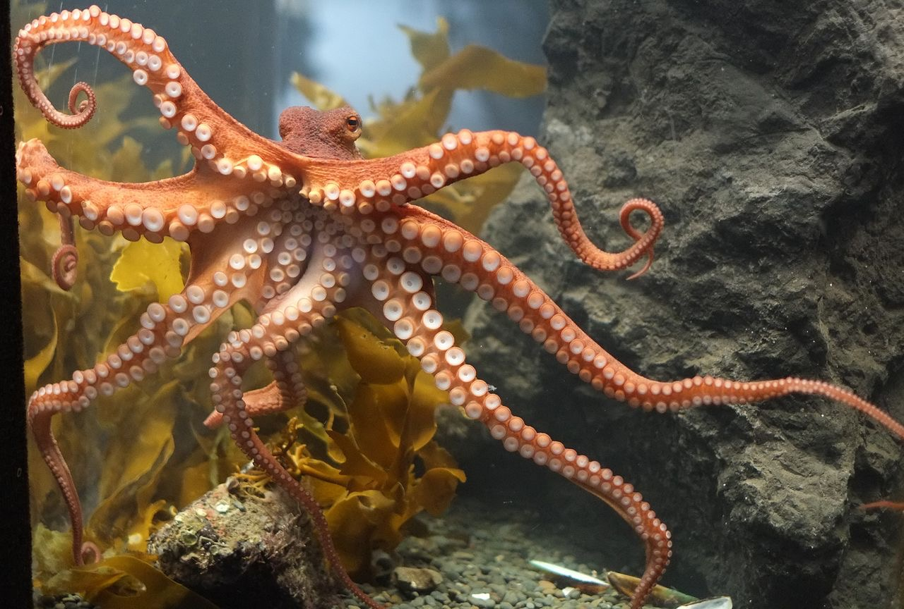
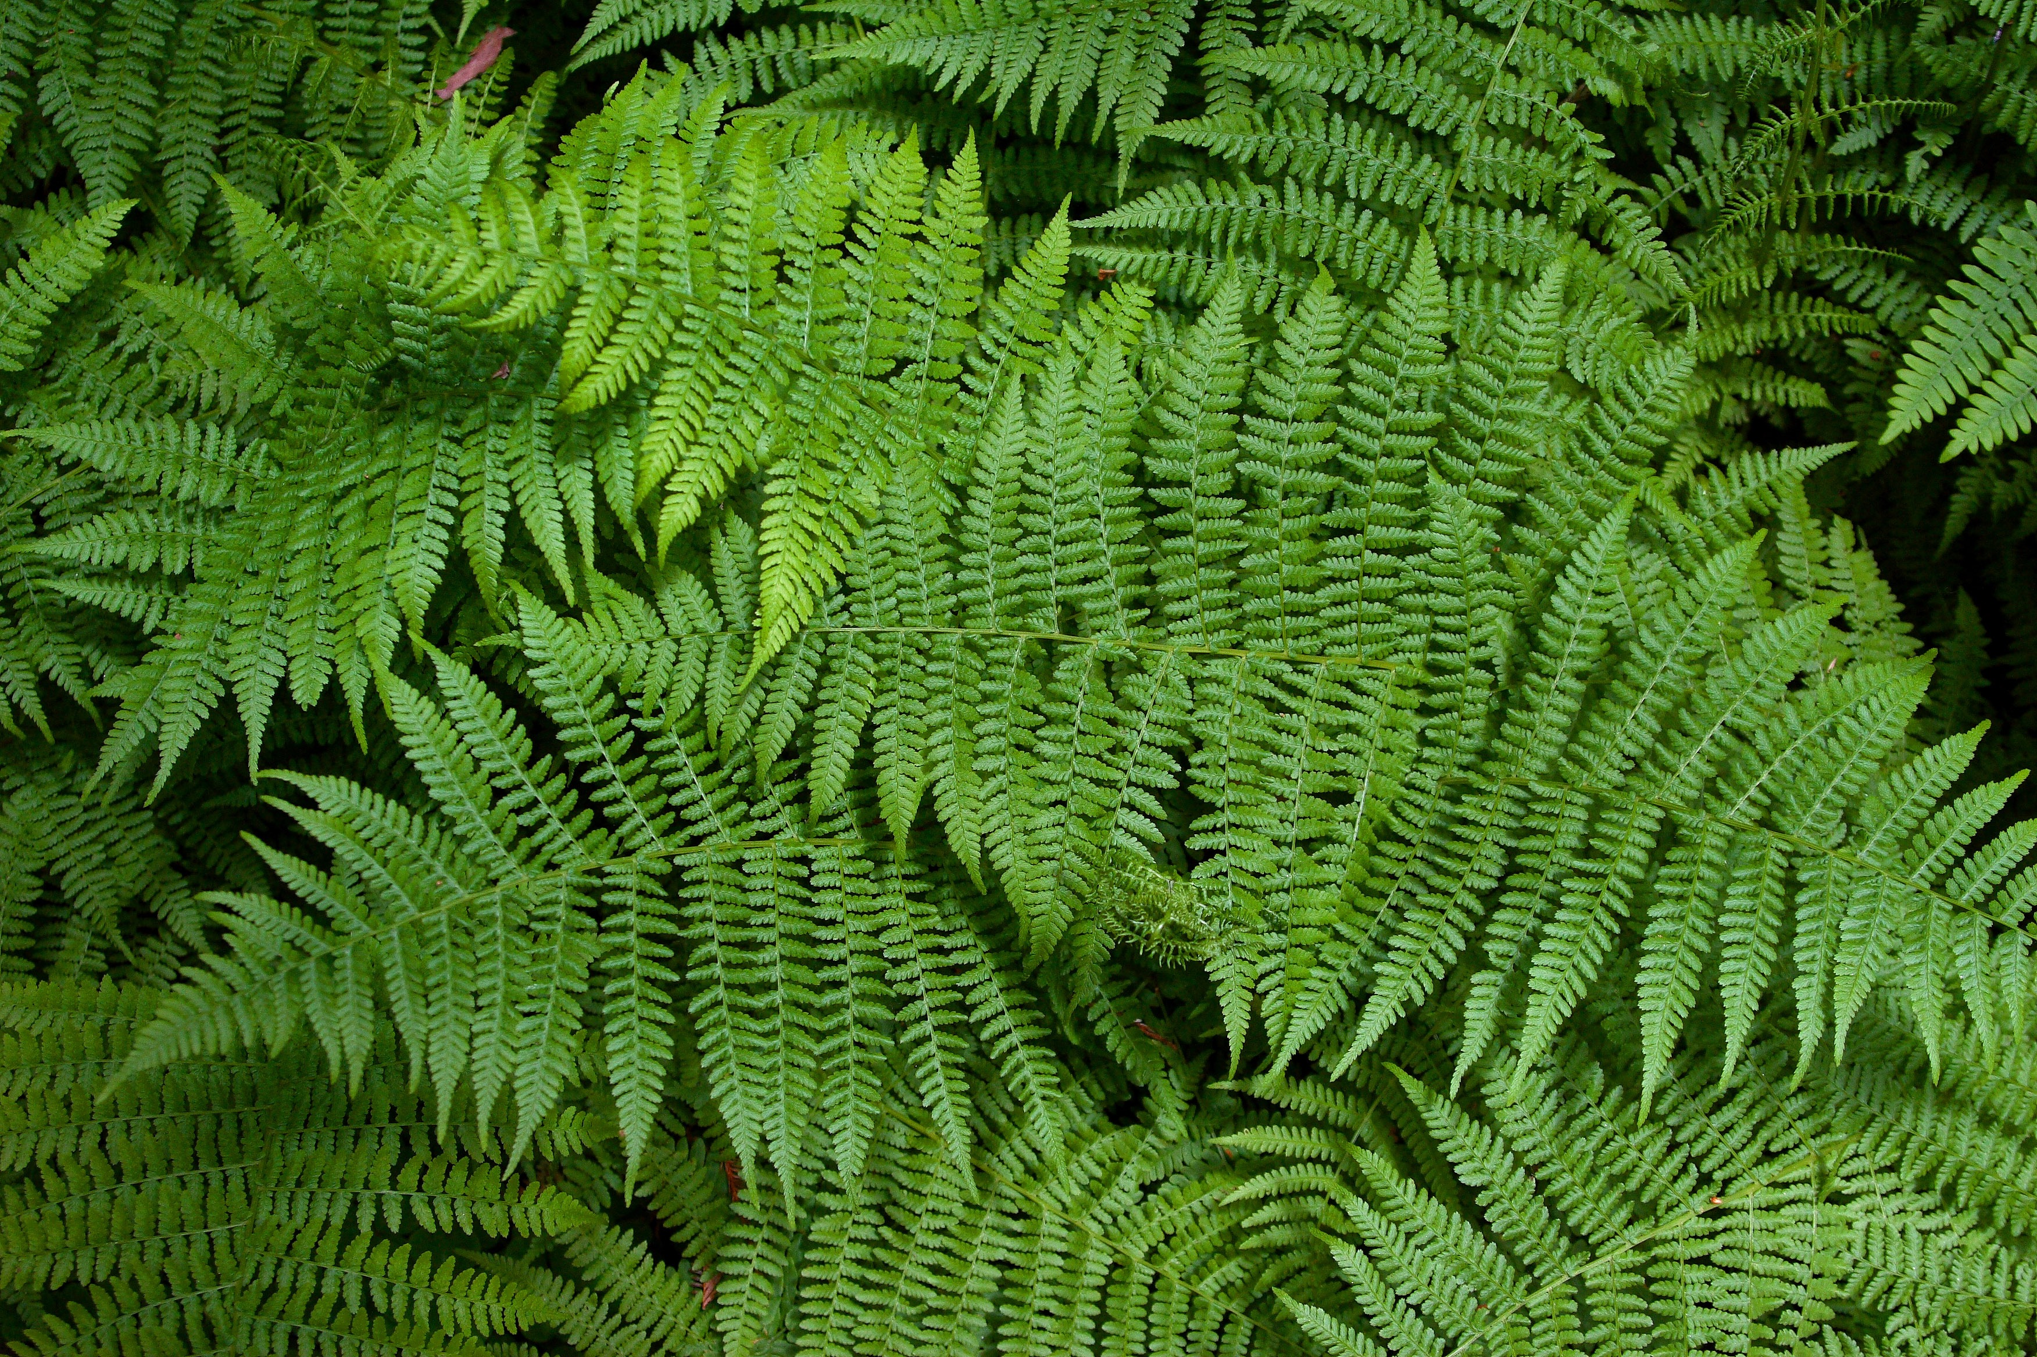

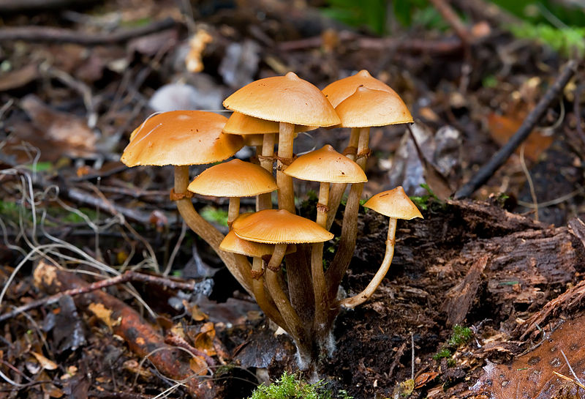
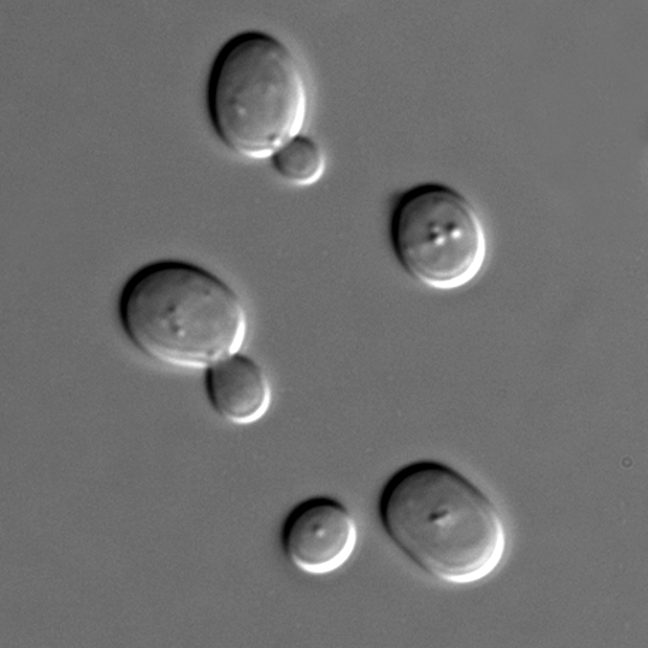
Organisms
All of these organisms are made up of cells.
Some are made of only a single cell.
(unicellular organisms)
Some are a collection or colony of single cells.
Some are made up of many cells.
(multicellular organisms)
The cells that make up these organisms are EUKARYOTIC cells.
Cognitive Learning Systems, Inc © 2016
Cognitive Learning Systems, Inc © 2016
Notes:
Teacher’s Notes
Begin the Journey by asking students the following question:
What do all of these organisms have in common?
Allow time for students to the discuss the question and their various answers.
Image credits:
“Unidentified fungi, “retrieved September 20, 2016 retrieved from https://commons.wikimedia.org/wiki/File:Unidentified_Fungi_5927.jpg,
Polar bear jumping on fast ice, retrieved on September 20, 2016, from https://en.wikipedia.org/wiki/Polar_bear#/media/File:Polar_Bear_AdF.jpg,
Wolf spider on white, retrieved September 30 , 2016, retrieved from https://commons.wikimedia.org/wiki/File:Wolf_spider_on_white.jpg,
Octopus at Kelly Tarlton’s,retrieved September 30, 2016, retrieved from https://commons.wikimedia.org/wiki/File:Octopus_at_Kelly_Tarlton%27s.jpg,;
Bald Eagle Alaska, retrieved September 30, 2016, retrieved from https://commons.wikimedia.org/wiki/File:Bald_Eagle_Alaska_(10).jpg,
Ferns at Muir Woods, California, retrieved September 30, 2016, retrieved from https://en.wikipedia.org/wiki/Fern#/media/File:Sa-fern.jpg
Microalgae – Nannochloropsis sp. Retrieved on September 30, 2016, Retrieved from https://en.wikipedia.org/wiki/Microphyte#/media/File:CSIRO_ScienceImage_10697_Microalgae.jpg
http://phil.cdc.gov and www.nasa.gov
Saccharomyces cerevisiae cells in DIC microscopy., Retrieved September 20, 2016, Retrieved from https://en.wikipedia.org/wiki/Yeast#/media/File:S_cerevisiae_under_DIC_microscopy.jpg

Slide 4
Organisms
All of these organisms are made up of cells.
Some are made of only a single cell.
(unicellular organisms)
Some are a collection or colony of single cells.
Some are made up of many cells.
(multicellular organisms)
The cells that make up these organisms are EUKARYOTIC cells.
Cognitive Learning Systems, Inc © 2016
Cognitive Learning Systems, Inc © 2016
Notes:
Teacher’s Notes
Tell students that one thing that all of the organisms pictured in the slide have in common is that they are all composed of cells. Read through the text on the slide to reinforce that some of the organisms are unicellular or only a single cell. Explain that sometimes unicellular organisms group together to form a collection or colony of cells. Each cell is still unicellular- a single cell- but cells form a larger organized structure. A good analogy would be to think of a neighborhood. Each house is a single house, but the houses are grouped together to form a larger community.
Explain that in addition to unicellular organisms, some of the organisms pictured here are made up of many cells. They are multicellular.
Students may question how multicellular organisms and a collection of unicellular organisms are different. One of the main differences is that in a multicellular organism, there are different cells to perform different functions. Only when they are organized together can they form a functioning organism. To go back to the house analogy, the different rooms and pieces of equipment in a house such as the furnace, pipes, toilets, and rooms each perform a different function. Only when they are together do they form a functioning house.
In addition, tell students that they will have a chance to learn more about unicellular and multicellular organisms later in the Journey. Thus, if the distinction is not clear here, it may become more clear later.
End the discussion of this slide by focusing on the fact that regardless whether the organisms are unicellular or multicellular, the cells of each organism are EUKARYOTIC CELLS. Eukaryotic cells are a particular type of cell that has certain characteristics. As students explore this Journey, they will learn more about the characteristics of eukaryotic cells.
Should students ask whether there are other categories of cells, remind them that they learned one way to classify cells in the Microscopic Exploration CELL. Cells could be classified as either eukaryotic or prokaryotic cells. Therefore, another category of cells would be prokaryotic cells. Prokaryotic cells lack a nucleus and other organelles found in eukaryotic cells. They also tend to be about 10 times smaller and have 1000 times less volume than eukaryotic cells. However, characteristics of prokaryotic cells will not be a focus for students within this Journey.
Image credits:
“Unidentified fungi, “retrieved September 20, 2016 retrieved from https://commons.wikimedia.org/wiki/File:Unidentified_Fungi_5927.jpg,
Polar bear jumping on fast ice, retrieved on September 20, 2016, from https://en.wikipedia.org/wiki/Polar_bear#/media/File:Polar_Bear_AdF.jpg,
Wolf spider on white, retrieved September 30 , 2016, retrieved from https://commons.wikimedia.org/wiki/File:Wolf_spider_on_white.jpg,
Octopus at Kelly Tarlton’s,retrieved September 30, 2016, retrieved from https://commons.wikimedia.org/wiki/File:Octopus_at_Kelly_Tarlton%27s.jpg,;
Bald Eagle Alaska, retrieved September 30, 2016, retrieved from https://commons.wikimedia.org/wiki/File:Bald_Eagle_Alaska_(10).jpg,
Ferns at Muir Woods, California, retrieved September 30, 2016, retrieved from https://en.wikipedia.org/wiki/Fern#/media/File:Sa-fern.jpg
Microalgae – Nannochloropsis sp. Retrieved on September 30, 2016, Retrieved from https://en.wikipedia.org/wiki/Microphyte#/media/File:CSIRO_ScienceImage_10697_Microalgae.jpg
http://phil.cdc.gov and www.nasa.gov
Saccharomyces cerevisiae cells in DIC microscopy., Retrieved September 20, 2016, Retrieved from https://en.wikipedia.org/wiki/Yeast#/media/File:S_cerevisiae_under_DIC_microscopy.jpg

Slide 5
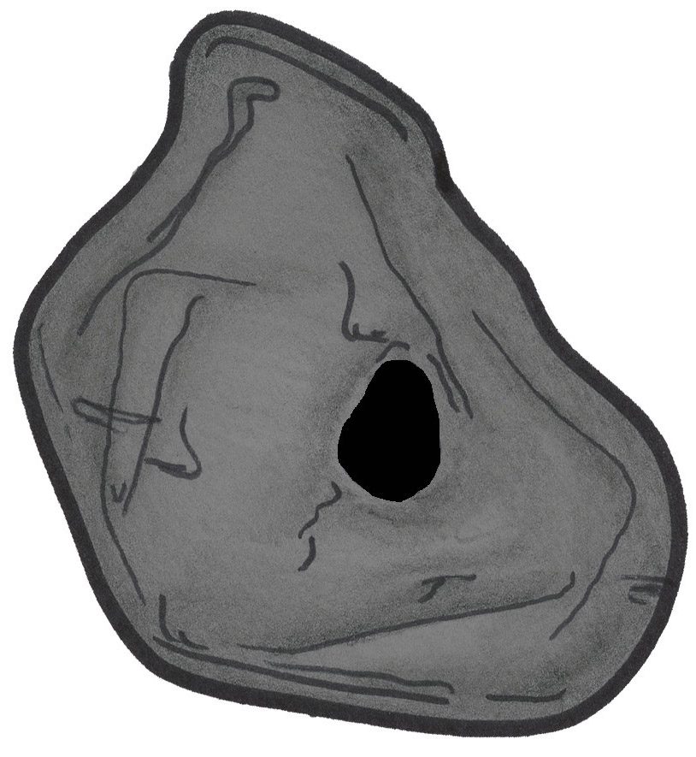
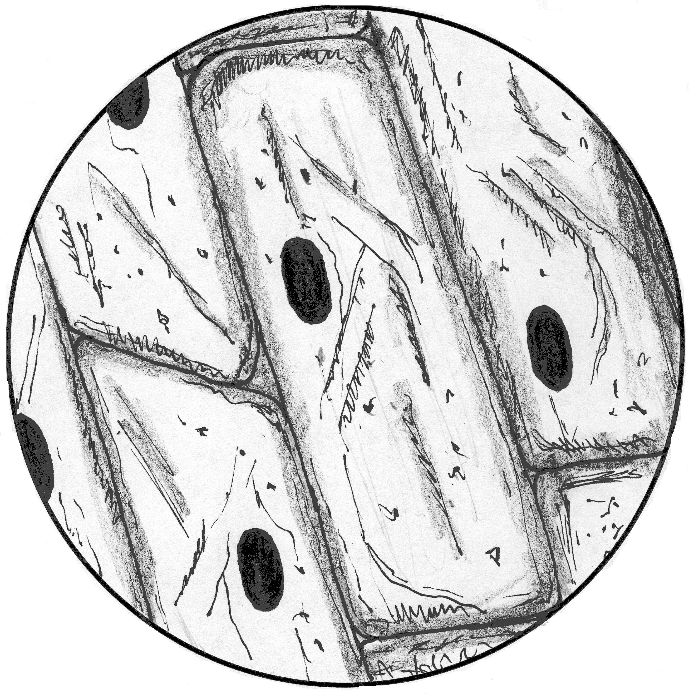
Eukaryotes
You observed eukaryotic cells from plant and animal samples in the CELL Microscopic Explorations. Here are two examples of specimens you observed.
Do these two eukaryotic cells look the same?
Do you think all eukaryotic cells look the same?
Cognitive Learning Systems, Inc © 2016
Notes:
Teacher’s Notes
Remind students that they observed eukaryotic cells from plant and animal specimens in the Microscopic Explorations CELL. Two of the specimens they observed were from the human cheek and from an onion. The two images on this slide are a human cheek cell (left side) and an onion cell from the onion bulb (right side).
Ask students the questions at the bottom of the slide.
Do these two eukaryotic cells look the same?
Students should be able to competently discuss and provide answers for this question based on the two images on this slide as well as from other specimens they observed in the Microscopic Explorations CELL (elodea leaf, pinus stem, large intestine, blood smear). Based solely on the two cells shown above, student should indicate that the cells have both similarities and differences. The cells are different shapes. Students may also indicate that the cells are different colors. Should this characteristic arise, discuss that this difference is the result of the drawings rather than the color of the actual cells. Help students recall that both the cheek and onion cells were clear or colorless when viewed with the microscope.
Do you think all eukaryotic cells look the same?
Students should discuss whether they believe that all eukaryotic cells have the same two shapes as the cheek and onion cells. Encourage students to recall the cells they observed in the pinus stem, large intestine, elodea leaf and blood smear. Some of these cells were different in shape than the cheek and onion cells, some were similar.
Allow time for open discussion. There does NOT need to be a consensus at the end of the discussion as the next section of the Journey will focus on discussing and answering these questions.

Slide 6
Eukaryotes
What are some characteristics that are found in both of the eukaryotic cells above?
Do you think there are characteristics that all eukaryotic cells have in common?
Cognitive Learning Systems, Inc © 2016
Notes:
Teacher’s Notes
Continue the comparison of the cheek and onion cells. Although some students may have already discussed structures within each cell such as the nucleus, cytoplasm, and cell membrane, this slide provides the opportunity to focus all students’ attention on these structures. Ask the two questions on this slide in order to direct students’ attention to characteristics of eukaryotic cells other than shape.
What are some characteristics that are found in both the eukaryotic cells above?
Students should be able to describe certain similarities such as a cell membrane, nucleus and cytoplasm in each cell.
Do you think there are characteristics that all eukaryotic cells have in common?
Encourage students to think beyond simple shape to the components of the cells: the nucleus, cytoplasm and cell membrane. Are these structures that are found in ALL eukaryotic cells? Allow time for open discussion. There does NOT need to be a consensus at the end of the discussion as the next section of the Journey will focus on discussing and answering these questions.

Slide 7
Eukaryotic Cells
A eukaryotic cell can be defined as a cell that has a cell membrane AND other structures called organelles.
The CELL MEMBRANE is the structure that surrounds the cell.
The CYTOPLASM is the jelly-like substance inside the cell membrane.
One of the organelles in a eukaryotic cell is the NUCLEUS.
Cell Membrane
Nucleus
Cytoplasm
Cognitive Learning Systems, Inc © 2016
Notes:
Teacher’s Notes
Explain that in answer to the question about eukaryotic characteristics that they discussed on the previous slide, there ARE certain characteristics that eukaryotic cells have in common. This slide points to three of those characteristics or structures: the cell membrane, the cytoplasm and the nucleus. The image here shows these three structures in a human cheek cell. However, students should also recall having seen these structures in onion and elodea cells as well as in the cells of the large intestine.
One of the concepts that this slide should drive home is that the structures of cell membrane, cytoplasm and nucleus are key characteristics of any eukaryotic cell. Having said that, it is important to point out that the Journey has refrained from using the statement that these three structures are found in ALL eukaryotic cells. The reason is that there are a FEW exceptions such as mature red blood cells. Within the human body, red blood cells go through several stages of maturation. In their youngest stages, these cells DO HAVE a nucleus. However, in their mature form, the nucleus is NOT present. Thus, a statement describing the presence of the three structures on this slide would be the most accurate if stated as: “The nucleus, cytoplasm and cell membrane” are three structures are found in ALMOST ALL eukaryotic cells. Given this statement, it is important to help students think about the MAJORITY of eukaryotic cells rather than the very few exceptions when they approach cellular structures. Thus, they should made the association between cytoplasm, nucleus and cell membrane as KEY or DEFINITIVE features of eukaryotic cells.

Slide 8
Plastic Bag
(cell membrane)
Tea Bag
(nucleus)
Jelly
(cytoplasm)
Model of a Eukaryotic Cell
Cognitive Learning Systems, Inc © 2016
Notes:
Teacher’s Notes
As students think about eukaryotic cells and their structures, it may be helpful for them to think of a concrete model. This slide introduces one model of an eukaryotic cell using everyday items with which students should be familiar.
As you introduce the model, encourage students to think about why certain materials may have been chosen to represent each part of the eukaryotic cell.
This model of an eukaryotic cell uses a plastic sealable bag filled with strawberry jelly and a tea bag.
The plastic bag represents the cell membrane of the cell. This is the structure of the cell that forms the boundary between the inside and outside of the cell. As such, the cell membrane separates the inside and outside of the cell. Although students are not required to know the function of the cell membrane, this question may arise. As a boundary, the cell membrane regulates substances that can enter and exit the cell.
The strawberry jelly represents the cytoplasm of the cell. The cytoplasm refers to both the space inside the cell membrane and the fluid/jelly like substance found within that space. Jelly is an appropriate substance because its gelatinous consistency may in some cases be similar to the consistency of a cell’s cytoplasm. Thus, students should be able to see how flexible the cell and its cytoplasm are because of both the flexibility of the jelly and plastic bag.
However, it may be important to mention that the color of the jelly does NOT reflect the color of the cytoplasm. Students should not be misled into to thinking that the cytoplasm of a cell is red. For many cells, the cytoplasm may be clear or colorless.
The tea bag represents the nucleus of the cell. Students should note that it is a self-contained structure. The contents of the tea bag are enclosed within the fabric or paper of the tea bag. Thus, the nucleus is in contact with the cytoplasm, but the inner contents of the nucleus do not spill into the cytoplasm. Likewise, the cytoplasm does not spill into the inner part of the nucleus. In terms of the model, the jelly and tea in the tea bag do not directly mix. In addition, the tea bag can move with movements of the jelly, a situation that mimics circumstances inside an actual eukaryotic cell.
Before leaving this slide, encourage students to envision this model. Ask them to imagine holding the model. Is it two dimensional like a drawing on paper or three dimensional ?
Students should realize that the model is three dimensional. This is purposeful. It emphasizes that a cell is three dimensional. Students may often forget this feature as they view cells through the microscope or on slides because of the two dimensional nature of both mediums.

Slide 9
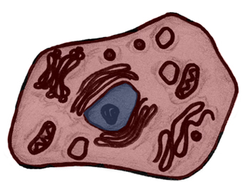
Eukaryotic Cells
One way to understand eukaryotic cells is to think of them as having two separate compartments, one inside the other. All eukaryotic cells can be divided this way.
Outside the nucleus
Inside the nucleus
Eukaryotic cells have different structures inside the nucleus and outside the nucleus.
Because they have different structures inside and outside the nucleus, there are different functions that the cell performs inside and outside the nucleus.
Cognitive Learning Systems, Inc © 2016
Notes:
Teacher’s Notes
Continue exploring the structure of eukaryotic cells by explaining that one way to understand these types of cells is to think of them as having two separate compartments: one compartment inside the other. If thought of this way, the eukaryotic cell can be divided into those two compartments: outside the nucleus and inside the nucleus.
Use the color coding on the slide to point out the location of these two compartments. The area inside the nucleus is shaded blue. The area outside the nucleus is shaded red. Discuss how different structures are found in the two compartments. Emphasize the relationship between structure and function: function relates to structure and structure relates to function. This is a concept that students learned in the Microscopic Explorations CELL. In the Microscopic Explorations CELL they explored this concept by looking at the structure and function of various tissues. For example, the large intestine is organized as a long tube. Its function is to move food along its length absorbing nutrients and storing and then eliminating waste. Another example was blood. It is composed of cells within a liquid so that it can circulate through the body and the oxygen contained within the red blood cells can be delivered to different parts of the body. The blood and large intestine have different structures. Therefore, they also have different functions.
The same concept applies here. Because there are different structures inside and outside the nucleus, there are different functions that the cell performs inside and outside the nucleus.

Slide 10
Check Understanding
Plastic Bag
(cell membrane)
Tea Bag
(nucleus)
Jelly
(cytoplasm)
Model of a Eukaryotic Cell
Cognitive Learning Systems, Inc © 2016
Notes:
Teacher’s Notes
Before moving forward to investigate the two compartments, allow some time for students to think about this concept and relate to the model of the eukaryotic cell. Encourage them to look at the slide and think about the model of the eukaryotic cell.
Ask students :
Can you describe the parts of this model that would be the outside the nucleus- the outer compartment?
Students should describe the outer compartment or the area outside the nucleus as the area between the boundaries of the plastic bag and the fabric of the tea bag. It would include all of the jelly.
Can you describe the parts of this model that would be inside the nucleus- the inner compartment?
Students should describe the inner compartment or the area inside the nucleus as the area inside the fabric of the tea bag. It is the tea inside the tea bag.

Slide 11
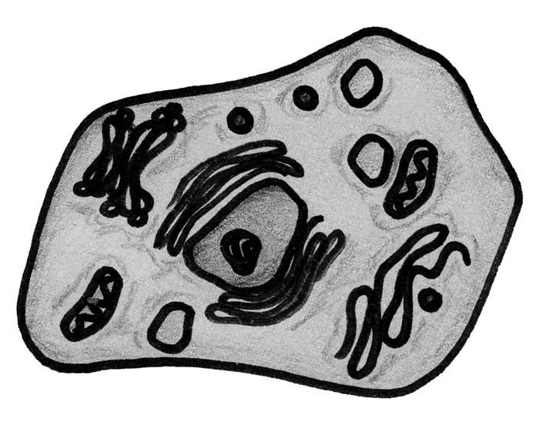
Inside the Nucleus
The nucleus is surrounded by a membrane. This membrane is called the NUCLEAR MEMBRANE.
nuclear membrane
Cognitive Learning Systems, Inc © 2016
Notes:
Teacher’s Notes
Begin a discussion of one of the compartments of a eukaryotic cell: inside the nucleus. Define the boundary of this compartment for students: the nuclear membrane. Explain that just like the entire cell has a cellular membrane, the nucleus has a membrane that separates the inside of the nucleus from the outside of the nucleus. Because the membrane surrounds the nucleus, it is called the nuclear membrane. The nuclear membrane is similar to the cell membrane in one of its functions: it controls the movement of substances across it. Therefore, the nuclear membrane determines which substances can enter and exit the nucleus.

Slide 12
The Nucleus and Inside the Nucleus
DNA
There are several structures within the nucleus.
One of the most important structures is DNA.
DNA is a substance that contains all of the information or instructions necessary for the cell to survive and multiply.
Cognitive Learning Systems, Inc © 2016
Notes:
Teacher’s Notes
Continue to explore the inner compartment of the cell by discussing one structure which lies within the nucleus: DNA. Students may be curious about DNA, its structure and its function. Explain that the very basic function of DNA will be discussed here, but that as students perform the experiments in the next LabLearner CELL- Inheritance and Adaptations, they will learn more about the structure of DNA and its functions.
For now, emphasize that DNA is the substance inside the nucleus that contains all of the instructions that the cell needs to multiply and survive.
Before leaving this slide, tell students to think back to the model of a eukaryotic cell with the plastic bag. Ask students what part of that model would represent the DNA. Students should indicate that the tea inside the tea bag would represent the DNA.

Slide 13
Inside the Nucleus
The nucleus controls cell division.
There are times when new cells need to be made. New cells are made by copying all of the substances in a cell and then splitting or dividing the cell into two.
At the end of the process there are two cells that were made from one original cell.
Cognitive Learning Systems, Inc © 2016
Notes:
Teacher’s Notes
Use this slide to focus on one of the functions of the nucleus and the structures within the nucleus: cell division. In eukaryotic cells, there are two types of cell division. One is called mitosis and the other is called meiosis.
The cell division that is discussed here is mitosis. However, for students at this level it is often easier to simply refer to the process as cell division (rather than mitosis) and describe the process by which a cell divides into two new cells. In this process, the original single cell becomes two cells. At the beginning of cell division there is one cell. At the end of cell division there are two cells.
Within eukaryotic cell division, the cell prepares to divided by first “copying” all of the substances within it so that there is a second copy of all cellular material and structures. The original and duplicate material are then equally divided to different sides of the original cell and the original cell splits or divides into two new cells. The two new cells that result each have the total complement of cellular structures of the original cell.
It is important as students view this slide that they understand that eukaryotic cell division results in the production of two cells from one original cell and that at the end of the process there are only two cells. The “original cell” no longer exists. As students view the diagram on this slide, they may be tempted to think that the original cell remains and that there are three cells at the end of cell division. This would be incorrect.
Students may wonder why cells divide. Within eukaryotic organisms mitosis (cell division) occurs mainly to replace worn out or damaged cells. In addition, student may be curious as to how often eukaryotic cells divide. The answer is that it depends upon the cell and the organism. There are some cells that divide very rapidly such as every hour. An example would be the cells in the lining of the human stomach. There are other cells that divide only every 24 hours.

Slide 14
Inside the Nucleus
The DNA inside the nucleus looks different depending upon what function occurs in the nucleus.
When the cell is NOT dividing (splitting) the DNA looks like a mass of tangled thread.
Cognitive Learning Systems, Inc © 2016
Notes:
Teacher’s Notes
Although students will learn more about cell division and DNA structure in their middle school science years, one of the concepts that students should be ready to understand at this level is that the DNA within the nucleus is organized differently when the cell is actively dividing as compared to when it is not actively dividing.
When the cell is not actively dividing the DNA looks like a mass of tangled thread. Although students are NOT required to know this, scientists call this tangled mass chromatin.

Slide 15
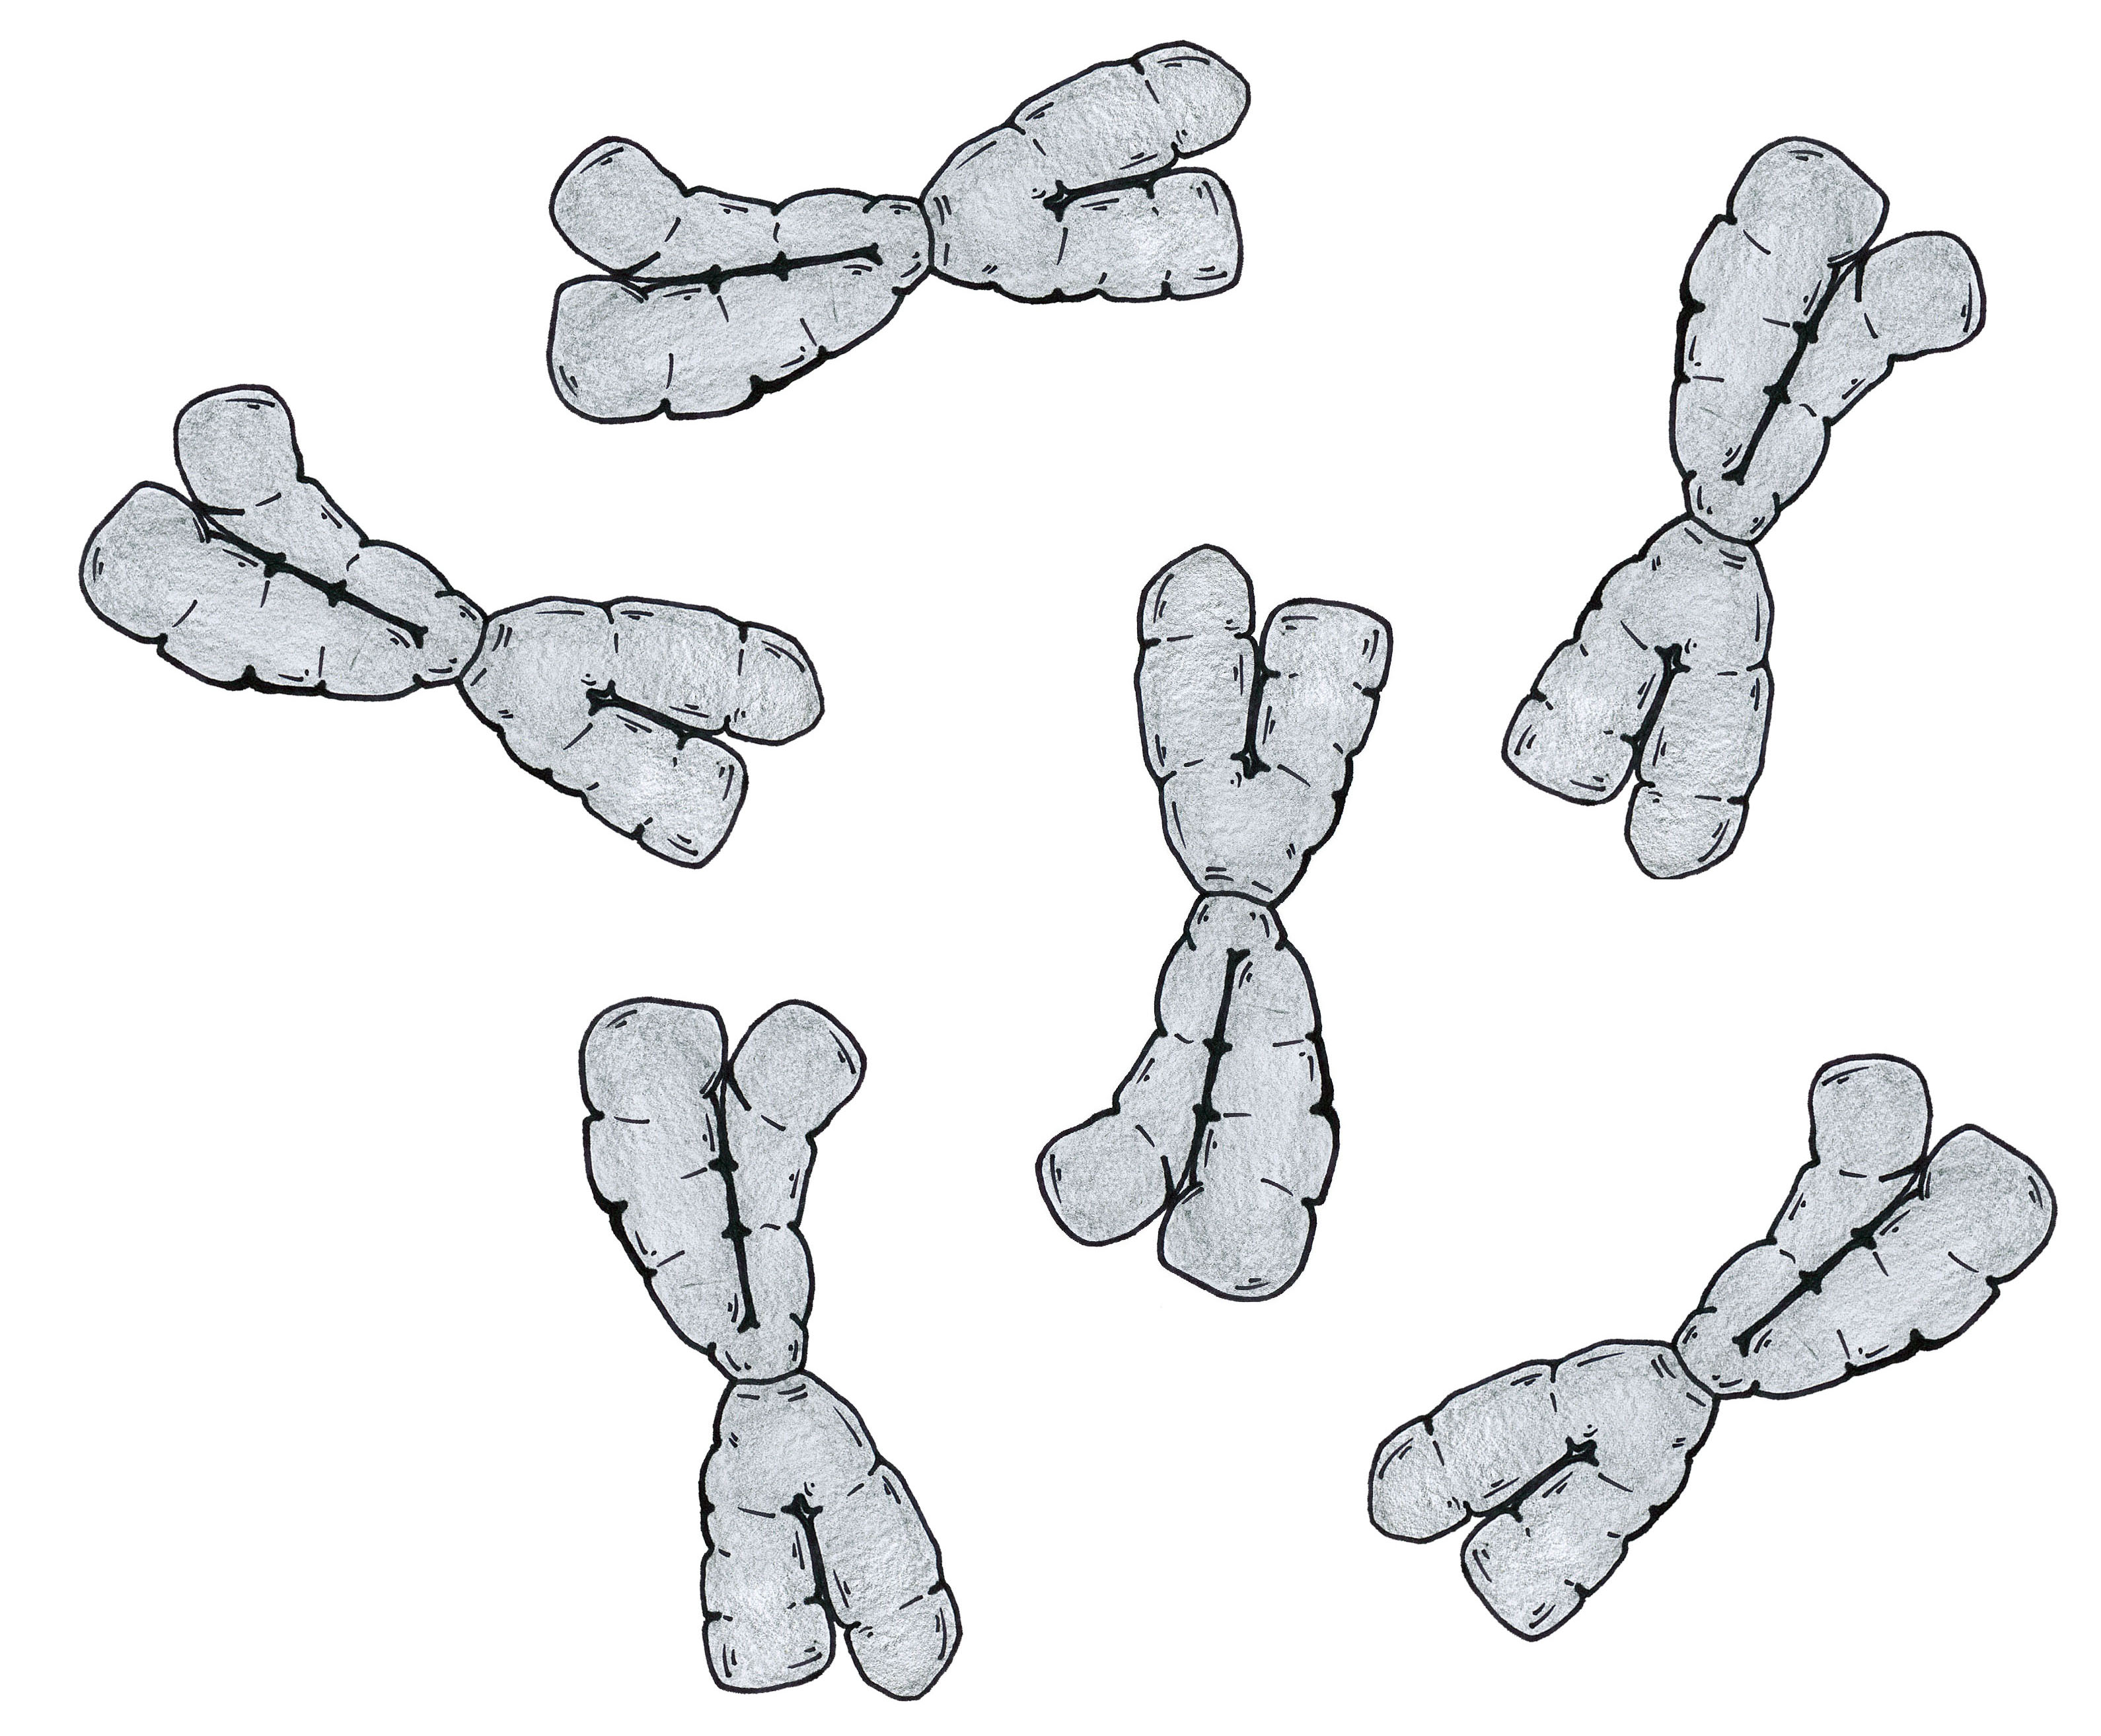
Inside the Nucleus
When the cell IS DIVIDING (splitting) the DNA is organized into structures called CHROMOSOMES.
chromosomes
Cognitive Learning Systems, Inc © 2016
Notes:
Teacher’s Notes
As explained in this slide, when eukaryotic cells are dividing, the DNA is organized differently. It is organized into structures called chromosomes. Students will learn more about chromosomes, their structure and their role in genetics and heredity as they complete the Inheritance and Adaptation CELL.

Slide 16
Outside the Nucleus
OUTSIDE the nucleus of the cell are other structures known as ORGANELLES.
Examples of some of these organelles are:
Endoplasmic reticulum
Mitochondria
Lysosome
peroxisome
Cognitive Learning Systems, Inc © 2016
Notes:
Teacher’s Notes
This section of the Journey ends with a discussion of the second compartment of the cell: outside the nucleus. Students should be able to see from the diagram that the boundaries of this compartment are between the nuclear membrane and the cell membrane. In addition, students should remember that this area is filled with cytoplasm.
Contained within the cytoplasm are other structures known as organelles. Examples of organelles are provided on the slide. They include the endoplasmic reticulum, mitochondria, lysosomes and peroxisomes. There are additional organelles within an eukaryotic cell that are not listed here. Some of these include ribosomes, vacuoles and golgi.
Although it may be tempting to ask students to memorize each of these organelles and their functions, this type of process is not likely to result in their true conceptualization of the functions of these organelles. Instead, learning the structure and function of these organelles is a concept that may be better received and understood during students’ middle school years.
As a result, this Journey expects students to understand that there are structures other than the nucleus within a cell and that the location of these structures is different from the nucleus.

Slide 17
Plastic Bag
(cell membrane)
Tea Bag
(nucleus)
Tissue Paper
(organelles)
Jelly
(cytoplasm)
Model of a Eukaryotic Cell
Cognitive Learning Systems, Inc © 2016
Notes:
Teacher’s Notes
This slide provides a way in which students can revisit the model of the eukaryotic cell and incorporate new information about organelles other than the nucleus. In this model, the organelles within the “outer compartment” (outside the nucleus) are represented by tissue paper that would be in the jelly inside the plastic bag. The interaction between the jelly and the tissue paper would be similar to that between the cytoplasm and organelles in that the organelles would be immersed within the cytoplasm and would have some freedom of movement as the cytoplasm moved. In addition, the organelles outside the nucleus would REMAIN SEPARATE from the contents of the nucleus, including DNA, as a result of the nuclear membrane.

Slide 18
Outside the Nucleus
The organelles outside the nucleus are responsible for carrying out the instructions that were contained within the DNA.
They perform many different types of functions.
Some of these functions include:
Making energy for the cell
Making other substances needed by the cell such as fats and sugars.
Breaking down harmful substances inside the cell.
Cognitive Learning Systems, Inc © 2016
Notes:
Teacher’s Notes
This section of the Journey ends by discussing some of the functions of the organelles found outside the nucleus. In general each organelle has a specific function that differs from other organelles. In addition, each of these functions is DIFFERENT from the functions of the structures inside the nucleus. It is important to emphasize this point.
However, it is also important to help students understand that the functions of organelles outside the nucleus are RELATED to the functions inside the nucleus. The tie between these these two compartments (inside the nucleus and outside the nucleus) is that the organelles outside the nucleus are responsible for carrying out the instructions that were contained within the DNA that is inside the nucleus. Without this correspondence and interdependence of functions, cells and organisms would fail to thrive or survive.
Examples of some functions that occur outside the nucleus are listed on this slide.

Slide 19
Check Understanding
Describe how the area of a eukaryotic cell that is inside the nucleus is different from the area outside the nucleus. How is it similar?
2. Why does DNA not come in contact with organelles outside the nucleus?
Cognitive Learning Systems, Inc © 2016
Notes:
Teacher’s Notes
Answers
Question 1: Students answers may vary. Students should suggest that there are different organelles inside the nucleus and outside the nucleus. DNA is found inside the nucleus while the endoplasmic reticulum, mitochondria, lysosomes and peroxisomes are found outside the nucleus. Because there are different structures found inside and outside the nucleus, there are different functions of the cell performed inside and outside the nucleus. For example, the instructions for carrying out cell division and all other cellular processes are contained within DNA and found within the nucleus. Thus, much of the coordination of cellular events is controlled from within the nucleus. Functions such as production of fats, sugars and proteins and breakdown of substances occurs in the cytoplasm.
Some of the similarities between the areas inside and outside the nucleus are that both areas are contained within the cell membrane. In addition, both areas HAVE organelles and both areas are important for the complete functioning of the cell.
Question 2: DNA does not come in contact with organelles outside the nucleus because of the nuclear membrane. This membrane separates the DNA from the area outside it- the rest of the cytoplasm.

Slide 20
Eukaryotes
Multicellular and Unicellular Organisms
Cognitive Learning Systems, Inc © 2016

Slide 21
What Can You Recall?
Your friend is looking at eukaryotic cells from three different organisms. Name two structures she is likely to see in ALL three specimens.
2. Your friend states that the DNA in a cell looks the same all of the time. Is he right or wrong? Why?
Cognitive Learning Systems, Inc © 2016
Notes:
Teacher’s Notes
Answers:
Question 1: Students should indicate that all three specimens will most likely have a cell membrane and cytoplasm. These two structures are found in all eukaryotic cells. Some students may also give examples of a nucleus, DNA, endoplasmic reticulum, mitochondria, lysosomes and peroxisomes. However, some students may question whether the three cells will definitely have a nucleus if they recall the blood smear and red blood cells they viewed during the Microscopic Explorations CELL. Mature red blood cells do not have a nucleus. However, because the goal of the GAP is to focus on structures and organelles that are characteristics of MOST eukaryotic cells, the examples of nucleus, mitochondria, etc., should also be included as correct answers for this level of student.
Question 2: Students should indicate that the friend is incorrect. DNA appears differently when the cell is actively dividing as opposed to when it is not actively dividing. During cell division, DNA is organized into structures called chromosomes which appear in the shape of an “X.” At times other than cell division, DNA is usually appears similar to a mass of tangled thread.

Slide 22
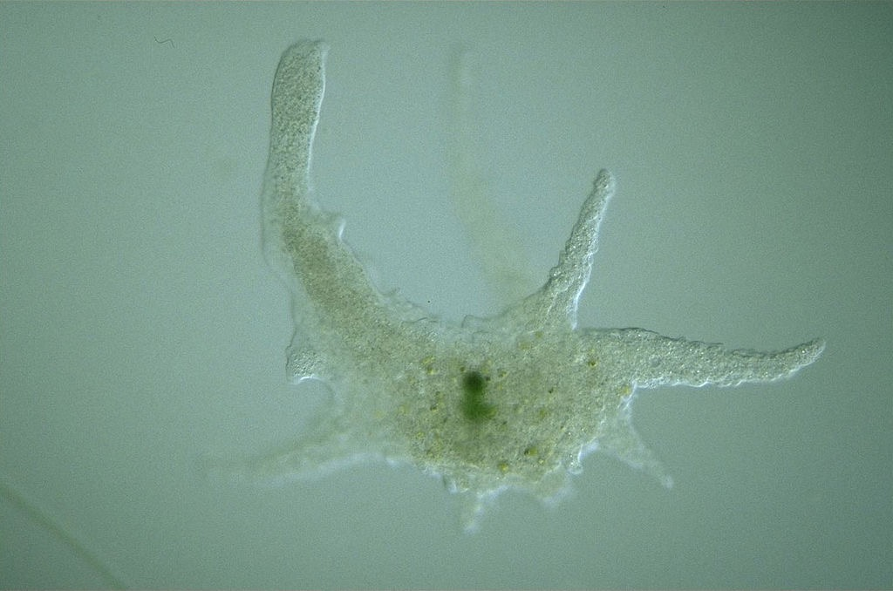
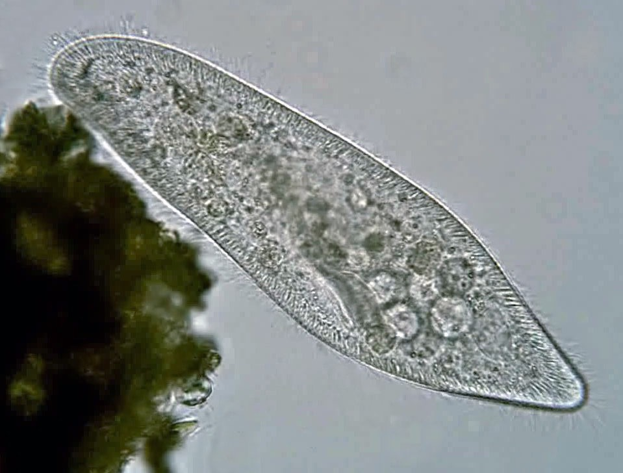
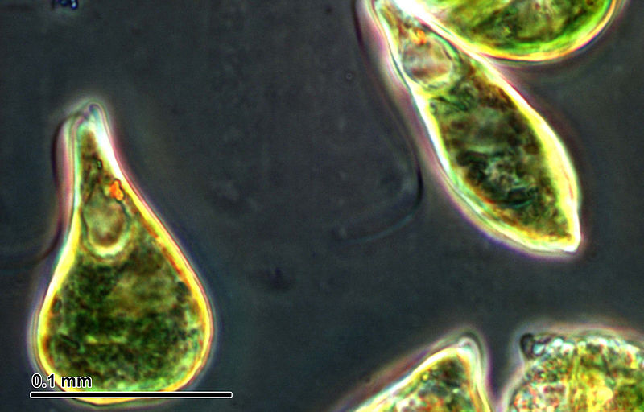
Unicellular Organisms
Protists are a group of eukaryotic organisms. SOME protists are unicellular (consist of a SINGLE CELL).
Examples of protists that are unicellular are amoebas, euglenas (a type of algae), and paramecia.
Look at the shape of each of these unicellular eukaryotes.
Is the shape the same?
Are all of the PARTS of the eukaryotic cells the same?
Cognitive Learning Systems, Inc © 2016
Notes:
Teacher’s Notes
In the first section of the Journey, students spent time understanding three structures that are characteristics of almost all eukaryotic cells. In this section of the Journey, students will explore some structures that differ between eukaryotic cells and between unicellular and multicellular organisms.
Students begin this section by learning about some examples of unicellular eukaryotes. They should remember that eukaryotic cells are found in both unicellular organisms and multicellular organisms.
Unicellular organisms are those that consist of a single cell. Although not stated here, unicellular organisms can be EITHER prokaryotic cells or eukaryotic cells. An example of unicellular prokaryotes would be bacteria. However, these are not discussed within this Journey.
There are two types of unicellular eukaryotes. Those that are protists and those that are fungi. This slide begins by focusing on protists.
It is not expected that students will have a great deal of background knowledge about protists. Explain that just like scientists use the terms plant and animal to classify or group organisms that share certain similarities, they use the term protists to describe another group of organisms that are neither plants or animals.
Some protists are unicellular. Some are multicellular. The information in the slide above focuses on three examples of unicellular protists. Students should understand that these are not the ONLY unicellular protists. In fact, there are myriad of different types of unicellular protists. As students view the images of the amoeba, euglena and paramecium, they should remember that each of these would have a cell membrane, cytoplasm and nucleus. These are common characteristics of eukaryotic cells. However, students should also focus on how these unicellular eukaryotes are different.
Ask students the two questions on the slide. Allow time for discussion. Students should point to the differences in shape between the three as well as some of the structures that differ. These differences will be explored in the three slides that follow.
Image credits:
A "Giant Amoeba", Chaos carolinense, Retrieved September 30, 2016, retried from https://en.wikipedia.org/wiki/Amoeba#/media/File:Chaos_carolinense.jpg
The ciliated protozoan Paramecium caudatum. Retrieved October 4, 2016, retrieved from https://en.wikipedia.org/wiki/Paramecium_caudatum#/media/File:Paramecium_caudatum_Ehrenberg,_1833.jpg
Euglena, retrieved September 20, 2016, retrieved from https://commons.wikimedia.org/wiki/File:Euglena_sp_(26_2_95).jpg

Slide 23
Unicellular Organisms- Protists
An amoeba is a single eukaryotic cell. It is a unicellular organism.
Parts of its cell membrane can extend outward. These are called pseudopodia.
Pseudopodia help the amoeba MOVE and ENGULF food.
pseudopodium
pseudopodium
Cognitive Learning Systems, Inc © 2016
Notes:
Teacher’s Notes
One of the ways in which an amoeba (pronounced “uh me ba”) differs from the cheek or onion cell or the euglena or paramecium is its distinctive shape. This results from the extension of parts of its cell membrane into structures call pseudopodia (pronounced “su do po de ah”). Pseudopodia in latin means “false feet”. These extensions of the cell were named pseudopodia because they resembled feet or legs and they function to help the amoeba move. In addition to locomotion, pseudopodia also help the amoeba engulf its food, a process by which the cell membrane wraps around food and pulls the food into the inside of the cell.
Image credits
A "Giant Amoeba", Chaos carolinense, Retrieved September 30, 2016, retried from https://en.wikipedia.org/wiki/Amoeba#/media/File:Chaos_carolinense.jpg

Slide 24
Unicellular Organisms- Protists
EUGLENA is a single eukaryotic cell.
flagella
A unique characteristic is that it has a small “tail” called a FLAGELLUM at one end. The FLAGELLUM helps the euglena move.
Cognitive Learning Systems, Inc © 2016
Notes:
Teacher’s Notes
The euglena is an example of a protist that has another unique structure, a flagellum (plural- flagella). The flagellum is not actually attached to the cell. Rather it is a structure that extends out from the cytoplasm but is still located WITHIN the cell membrane. In some ways it might be thought of as a rod that extends out from the cytoplasm but that still has the cell membrane wrapped around it.
In terms of function, the flagellum acts like a tail or rotor. It moves in a whip like or undulating fashion. As it moves, it propels the euglena through fluid.
Flagella are not only found on euglena. They are found on many different types of cells, including human sperm.
.
Image credit: Euglena, retrieved September 20, 2016, retrieved from https://commons.wikimedia.org/wiki/File:Euglena_sp_(26_2_95).jpg

Slide 25
Unicellular Organisms-Protists
A paramecium is an single eukaryotic cell. It is a unicellular organism.
It has tiny hairs that extend from all around its cell membrane. These hairs are called CILIA.
CILIA can move. The movement of the cilia helps the paramecium to move.
cilia
Cognitive Learning Systems, Inc © 2016
Notes:
Teacher’s Notes
The paramecium can also move. It does so through the use of cilia. Cilia are structurally similar to flagella. Thus, cilia are also enclosed within the cell membrane. One of the only differences is in their length. Cilia are shorter than flagella. Cilia also tend to move in a slightly different fashion than flagella. Instead of an undulating or rotational motion, they tend to move or beat up and down or side to side. On a paramecium, this synchronized beating helps to move the paramecium through fluid, much like oars on a boat.
Paramecium are not the only eukaryotic cells on which cilia are found. For example, within the human body, cilia are found on the cells that line the respiratory tract. In this case, their function is not to move the cells, but rather to move air within the respiratory tract and to catch dust and other particles within that air that may harm the lungs.
Image credits:
The ciliated protozoan Paramecium caudatum. Retrieved October 4, 2016, retrieved from https://en.wikipedia.org/wiki/Paramecium_caudatum#/media/File:Paramecium_caudatum_Ehrenberg,_1833.jpg

Slide 26
Unicellular Organisms- Fungi
Fungi are another group that have SOME unicellular organisms.
Yeast are fungi that are unicellular eukaryotic cells.
Yeast do not have a flagellum or cilia.
How does the shape of yeast compare to that of the amoeba, paramecium and euglena?
Cognitive Learning Systems, Inc © 2016
Notes:
Teacher’s Notes
Students just explored three examples of unicellular eukaryotic protists. In addition to protists, there is another group of organisms that contains unicellular eukaryotes: fungi. As with protists, it is not expected that students will have extensive background knowledge about fungi. Just like plants and animals, fungi is the name given to the category of organisms that share certain characteristics. Some fungi are multicellular, some are unicellular. This slide gives an example of a unicellular fungi- yeast. Yeast is used widely throughout the culinary world for baking bread and making beer.
As students view the image, they should see that yeast do not have flagella or cilia. In addition they should compare its shape to that of the other unicellular organisms they just explored.
The goal of this slide and the three that preceded it are to emphasize some of the DIFFERENCES that exists in eukaryotic cells AND to show students examples of unicellular eukaryotes.
Image credit:
Saccharomyces cerevisiae cells in DIC microscopy., Retrieved September 20, 2016, Retrieved from https://en.wikipedia.org/wiki/Yeast#/media/File:S_cerevisiae_under_DIC_microscopy.jpg

Slide 27
Plastic Bag
(cell membrane)
Tea Bag
(nucleus)
Tissue Paper
(organelles)
Jelly
(cytoplasm)
FLAGELLUM
(string)
Model of a Euglena
Cognitive Learning Systems, Inc © 2016
Notes:
Teacher’s Notes
As students view the model of a euglena, they should note the addition of the flagellum. The flagellum is represented in this model by a piece of string attached to one side of the plastic bag. They should observe that the flagellum would have some flexibility to it and could be moved in an undulating or rotational motion.
Students may note that this model does not provide for the flagellum to propel itself as it would in an eukaryotic cell. This is an accurate observation and should be discussed in terms of limitations of models.
In addition, the teacher may notice that in this model the flagellum is attached to the outside of the cell membrane rather than encompassed within the cell membrane. Tin this respect, the model does NOT adhere true structure of the flagellum. As discussed previously in the Teacher Notes, in eukaryotic cells with a flagellum, the cell membrane of the flagellum is continuous with the cell membrane of the rest of the cell. However, this information was NOT presented to students in earlier slides and it is NOT expected that students should understand the flagellum to this level of complexity during their elementary years.

Slide 28
Plastic Bag
(cell membrane)
PSEUDOPODIUM
Tea Bag
(nucleus)
Tissue Paper
(organelles)
PSEUDOPODIUM
Jelly
(cytoplasm)
PSEUDOPODIUM
Model of an Amoeba
Cognitive Learning Systems, Inc © 2016
Notes:
Teacher’s Notes
This slide and the two that follow entice students to think about what they have learned about some different eukaryotic structures in relation to their eukaryotic cell model. In each of the three slides, new structures that may NOT be characteristic of ALL eukaryotic are represented by RED arrows and lettering. Students should see that the structures they discussed in the last GAP section that ARE characteristics of all (almost all) eukaryotes are present. These are represented by the black arrows and lettering.
As students look at the model of the amoeba they should recognize that it is single eukaryotic cell. It is a unicellular organism. The pseudopodia of the amoeba could be created by “squishing” the plastic bag so that different parts of the bag form extensions. They should be able to imagine using these extensions to pull or push the bag across a surface.

Slide 29
Plastic Bag
(cell membrane)
Tea Bag
(nucleus)
Tissue Paper
(organelles)
Jelly
(cytoplasm)
CILIA
(string)
CILIA
(string)
Model of a Paramecium
Cognitive Learning Systems, Inc © 2016
Notes:
Teacher’s Notes
As students view the model of the paramecium, they should note the addition of the clilia. The cilia are represented in this model by short strings attached all around the plastic bag, including the top surface. They should observe that the clilia would have some flexibility to them and could be moved in an back and forth motion. The motion would be similar to oars moving front and back when attached to the side of a boat.
Students should also observe that the cilia are very similar in structure to flagella, although cilia are shorter than flagella. This is represented in the model by shorter pieces of string as compared to the one used in the cell model with the flagellum. Students may note that this model does not provide for the cilia to propel itself as it would in an eukaryotic cell. This is an accurate observation and should be discussed in terms of limitations of models.
In addition, the teacher may notice that in this model the clilia are attached to the outside of the cell membrane rather than encompassed within the cell membrane. Tin this respect, the model does NOT adhere true structure of the cilia. As discussed previously in the Teacher Notes, in eukaryotic cells with cilia, the cell membrane of cilia is continuous with the cell membrane of the rest of the cell. However, this information was NOT presented to students in earlier slides and it is NOT expected that students should understand cilia to this level of complexity during their elementary years.

Slide 30
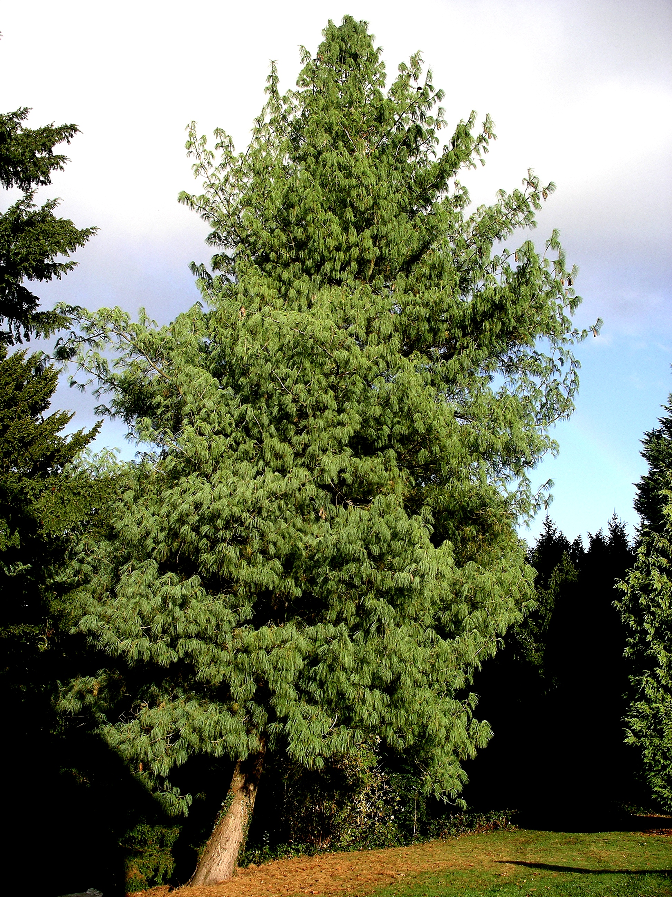
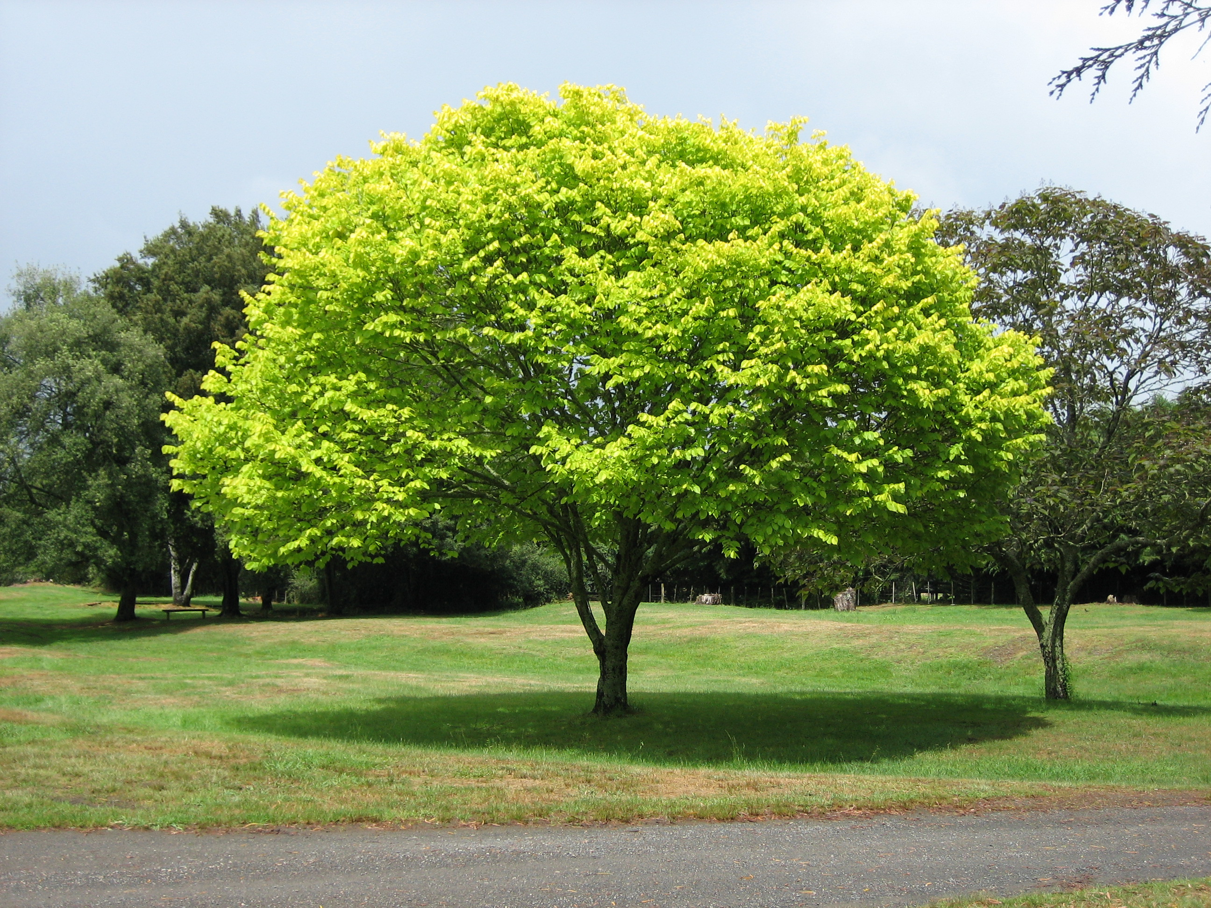
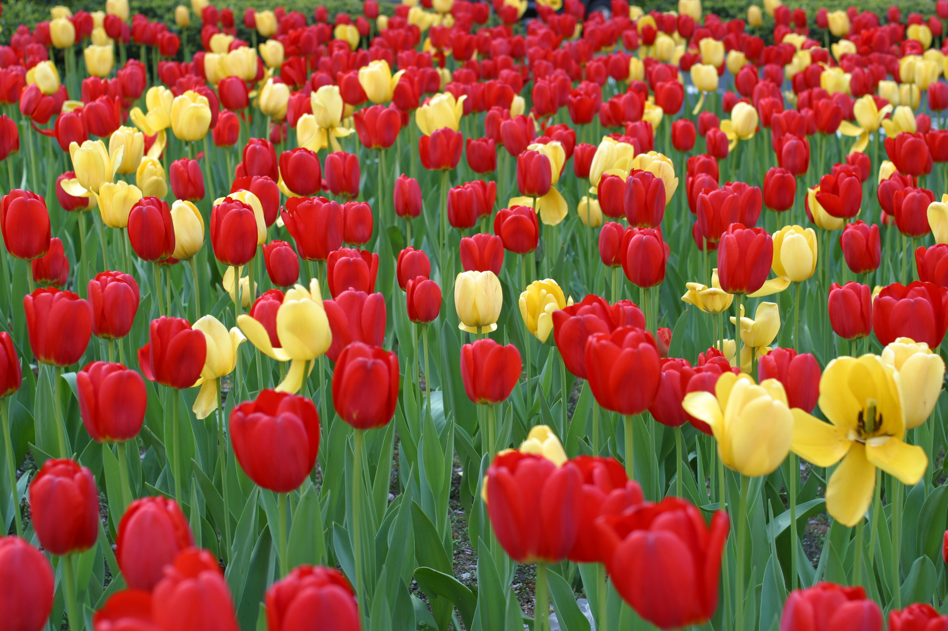
Multicellular Organisms
Multicellular organisms are organisms made up of MANY EUKARYOTIC cells.
One type of multicellular organism are plants.
Cognitive Learning Systems, Inc © 2016
Notes:
Teacher’s Notes
Students have previously learned that eukaryotic cells can exist as single celled or unicellular organisms. Although not thoroughly discussed, they may recall from the Microscopic Explorations CELL that not all unicellular organisms are eukaryotes. Some, such as bacteria, are prokaryotes.
In contrast, all multicellular organisms consist of eukaryotic cells. Multicellular organisms are those made up of many eukaryotic cells. Just as there are different types of unicellular organisms, there are different groups or categories of multicellular organisms. This slide reviews two categories of multicellular organisms: plants and animals. In contrast to protists and fungi which are groups that consist of both unicellular and multicellular organisms, ALL plants and animals are multicellular organisms. As such, all plants and animals consist of eukaryotic cells.
Images credits:
The conifer forest in Yatsugatake, Honshu, Japan, dominated by Abies mariesii., Retrieved September 30, 2016, Retrieved from https://sco.wikipedia.org/wiki/Gymnosperm#/media/File:Forest_in_Yatsugatake_11.jpg
Ferns at Muir Woods, California, Retrieved September 30, 2016, Retrieved from https://en.wikipedia.org/wiki/Fern#/media/File:Sa-fern.jpg
Tulips on Park Avenue, NYC, Retrieved September 30, 2016, Retrieved from https://commons.wikimedia.org/wiki/File:Tulips_On_Park_Ave.JPG
Unidentified tree in Waikato region, New Zealand. Retrieved September 28, 2016, retrieved https://commons.wikimedia.org/wiki/File:Bright_green_tree_-_Waikato.jpg

Slide 31
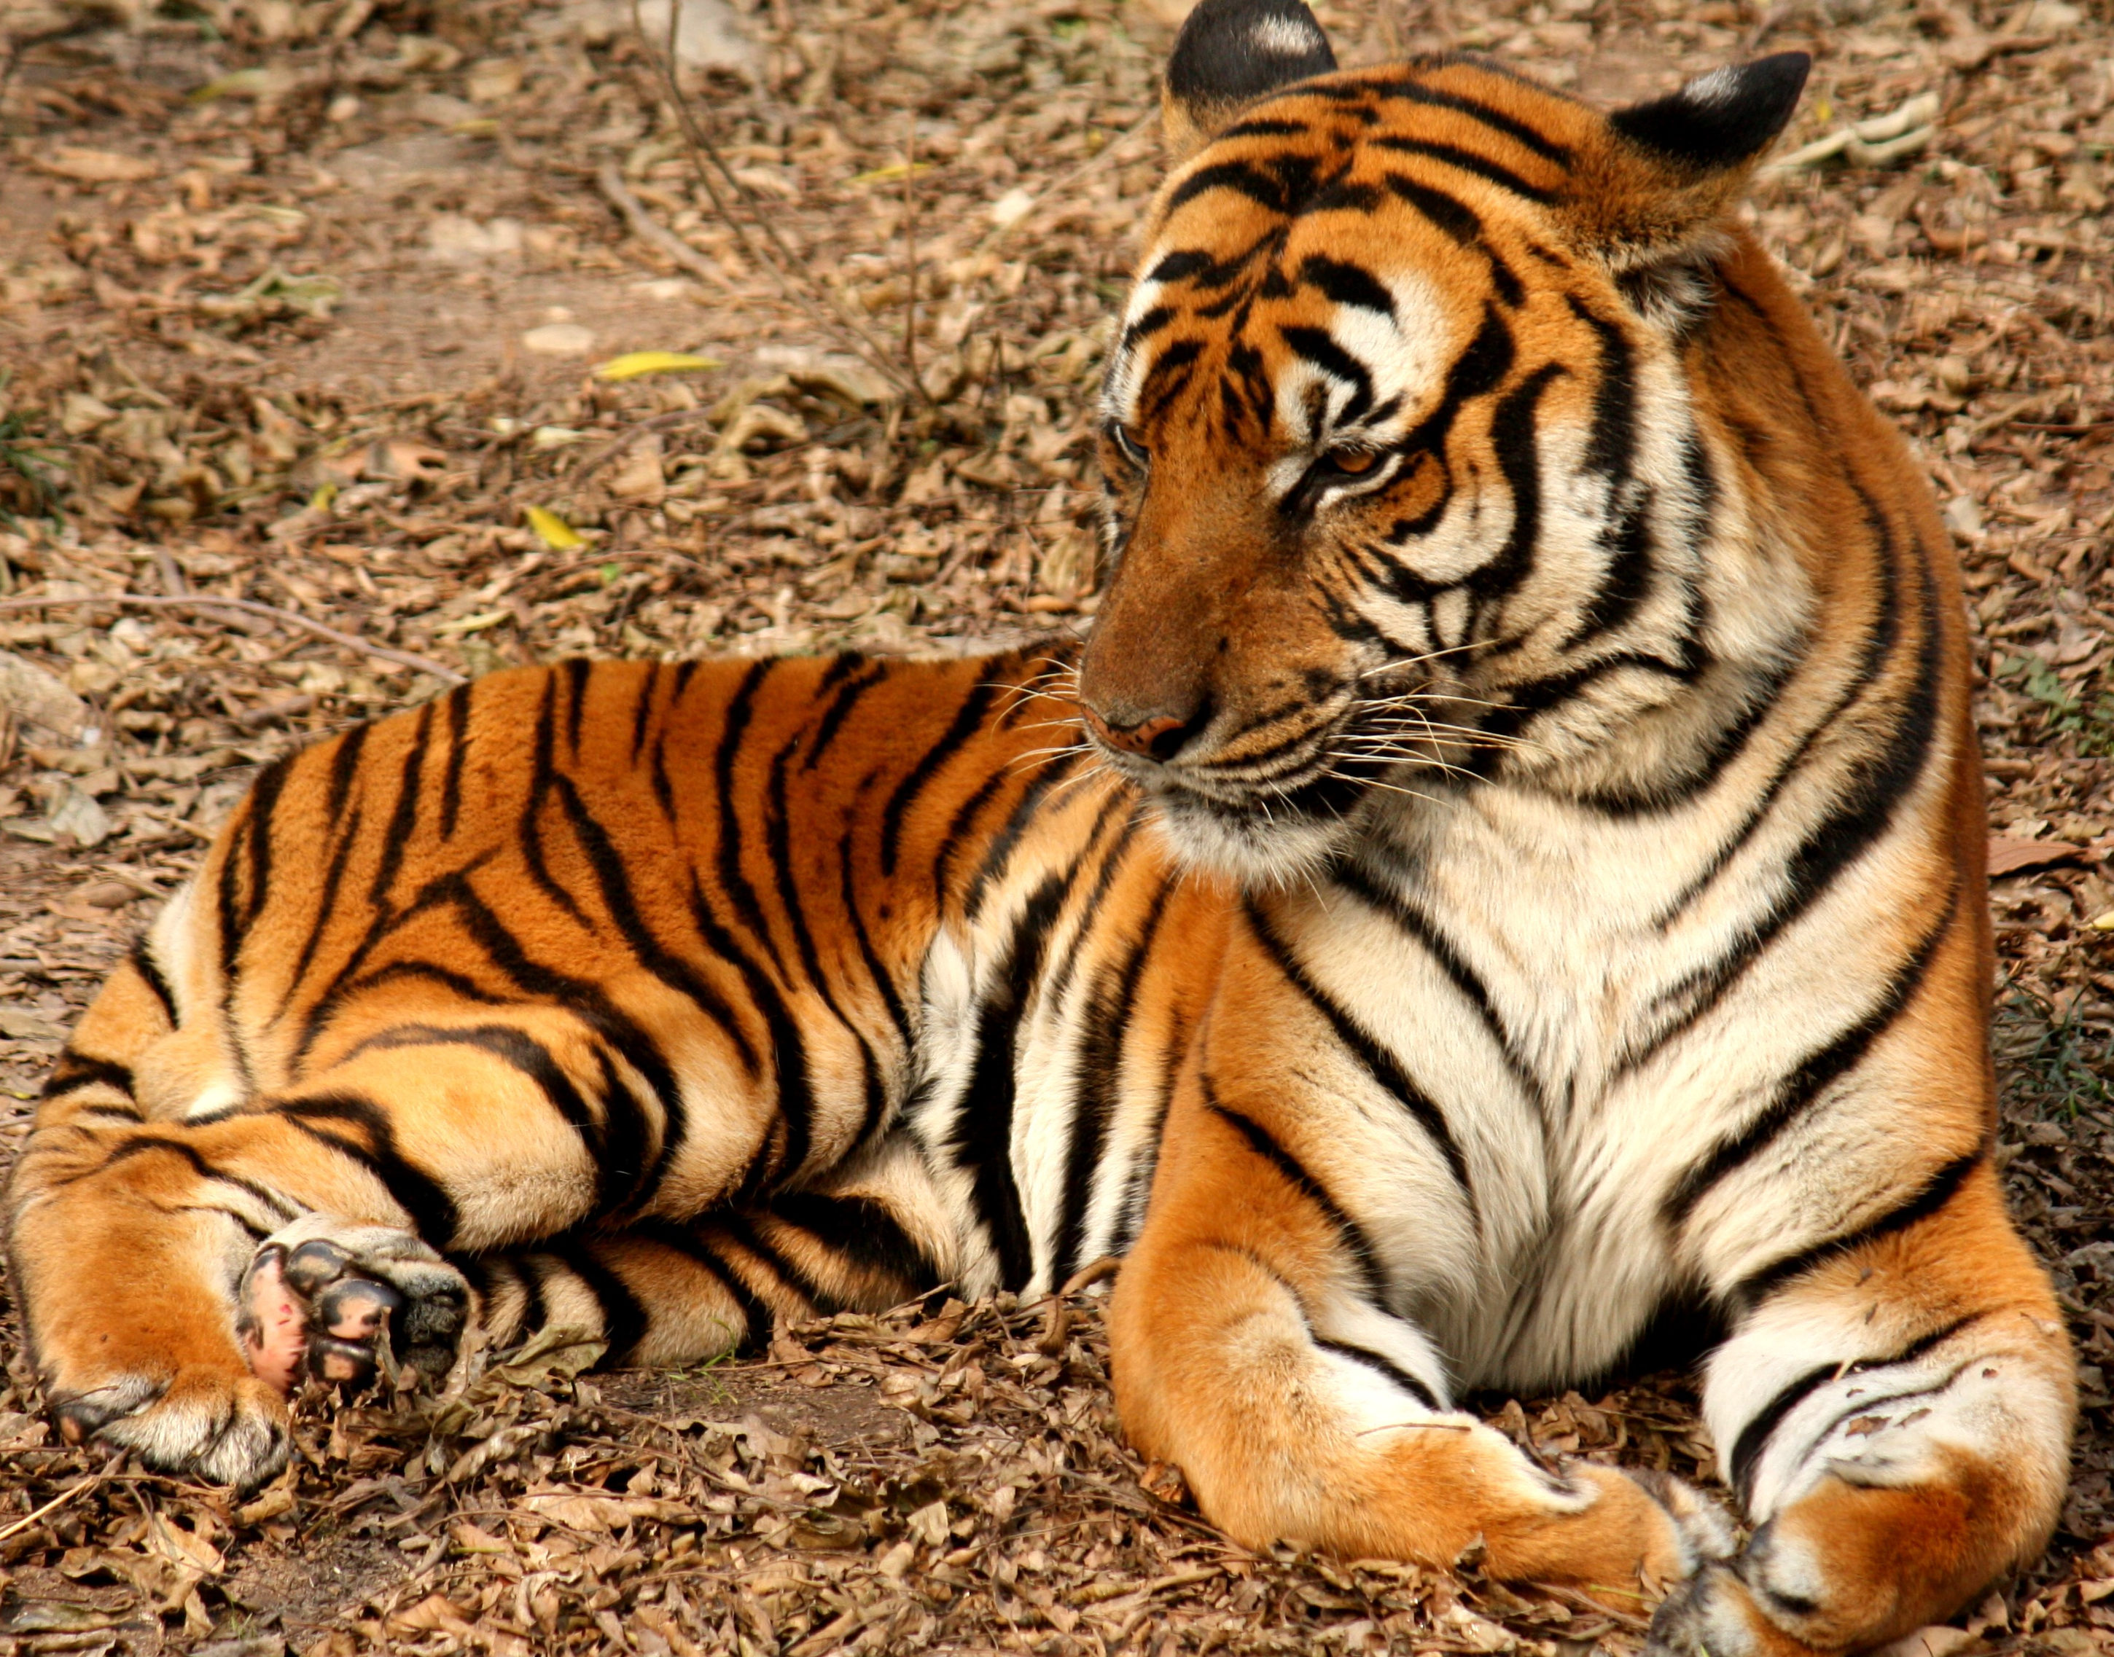
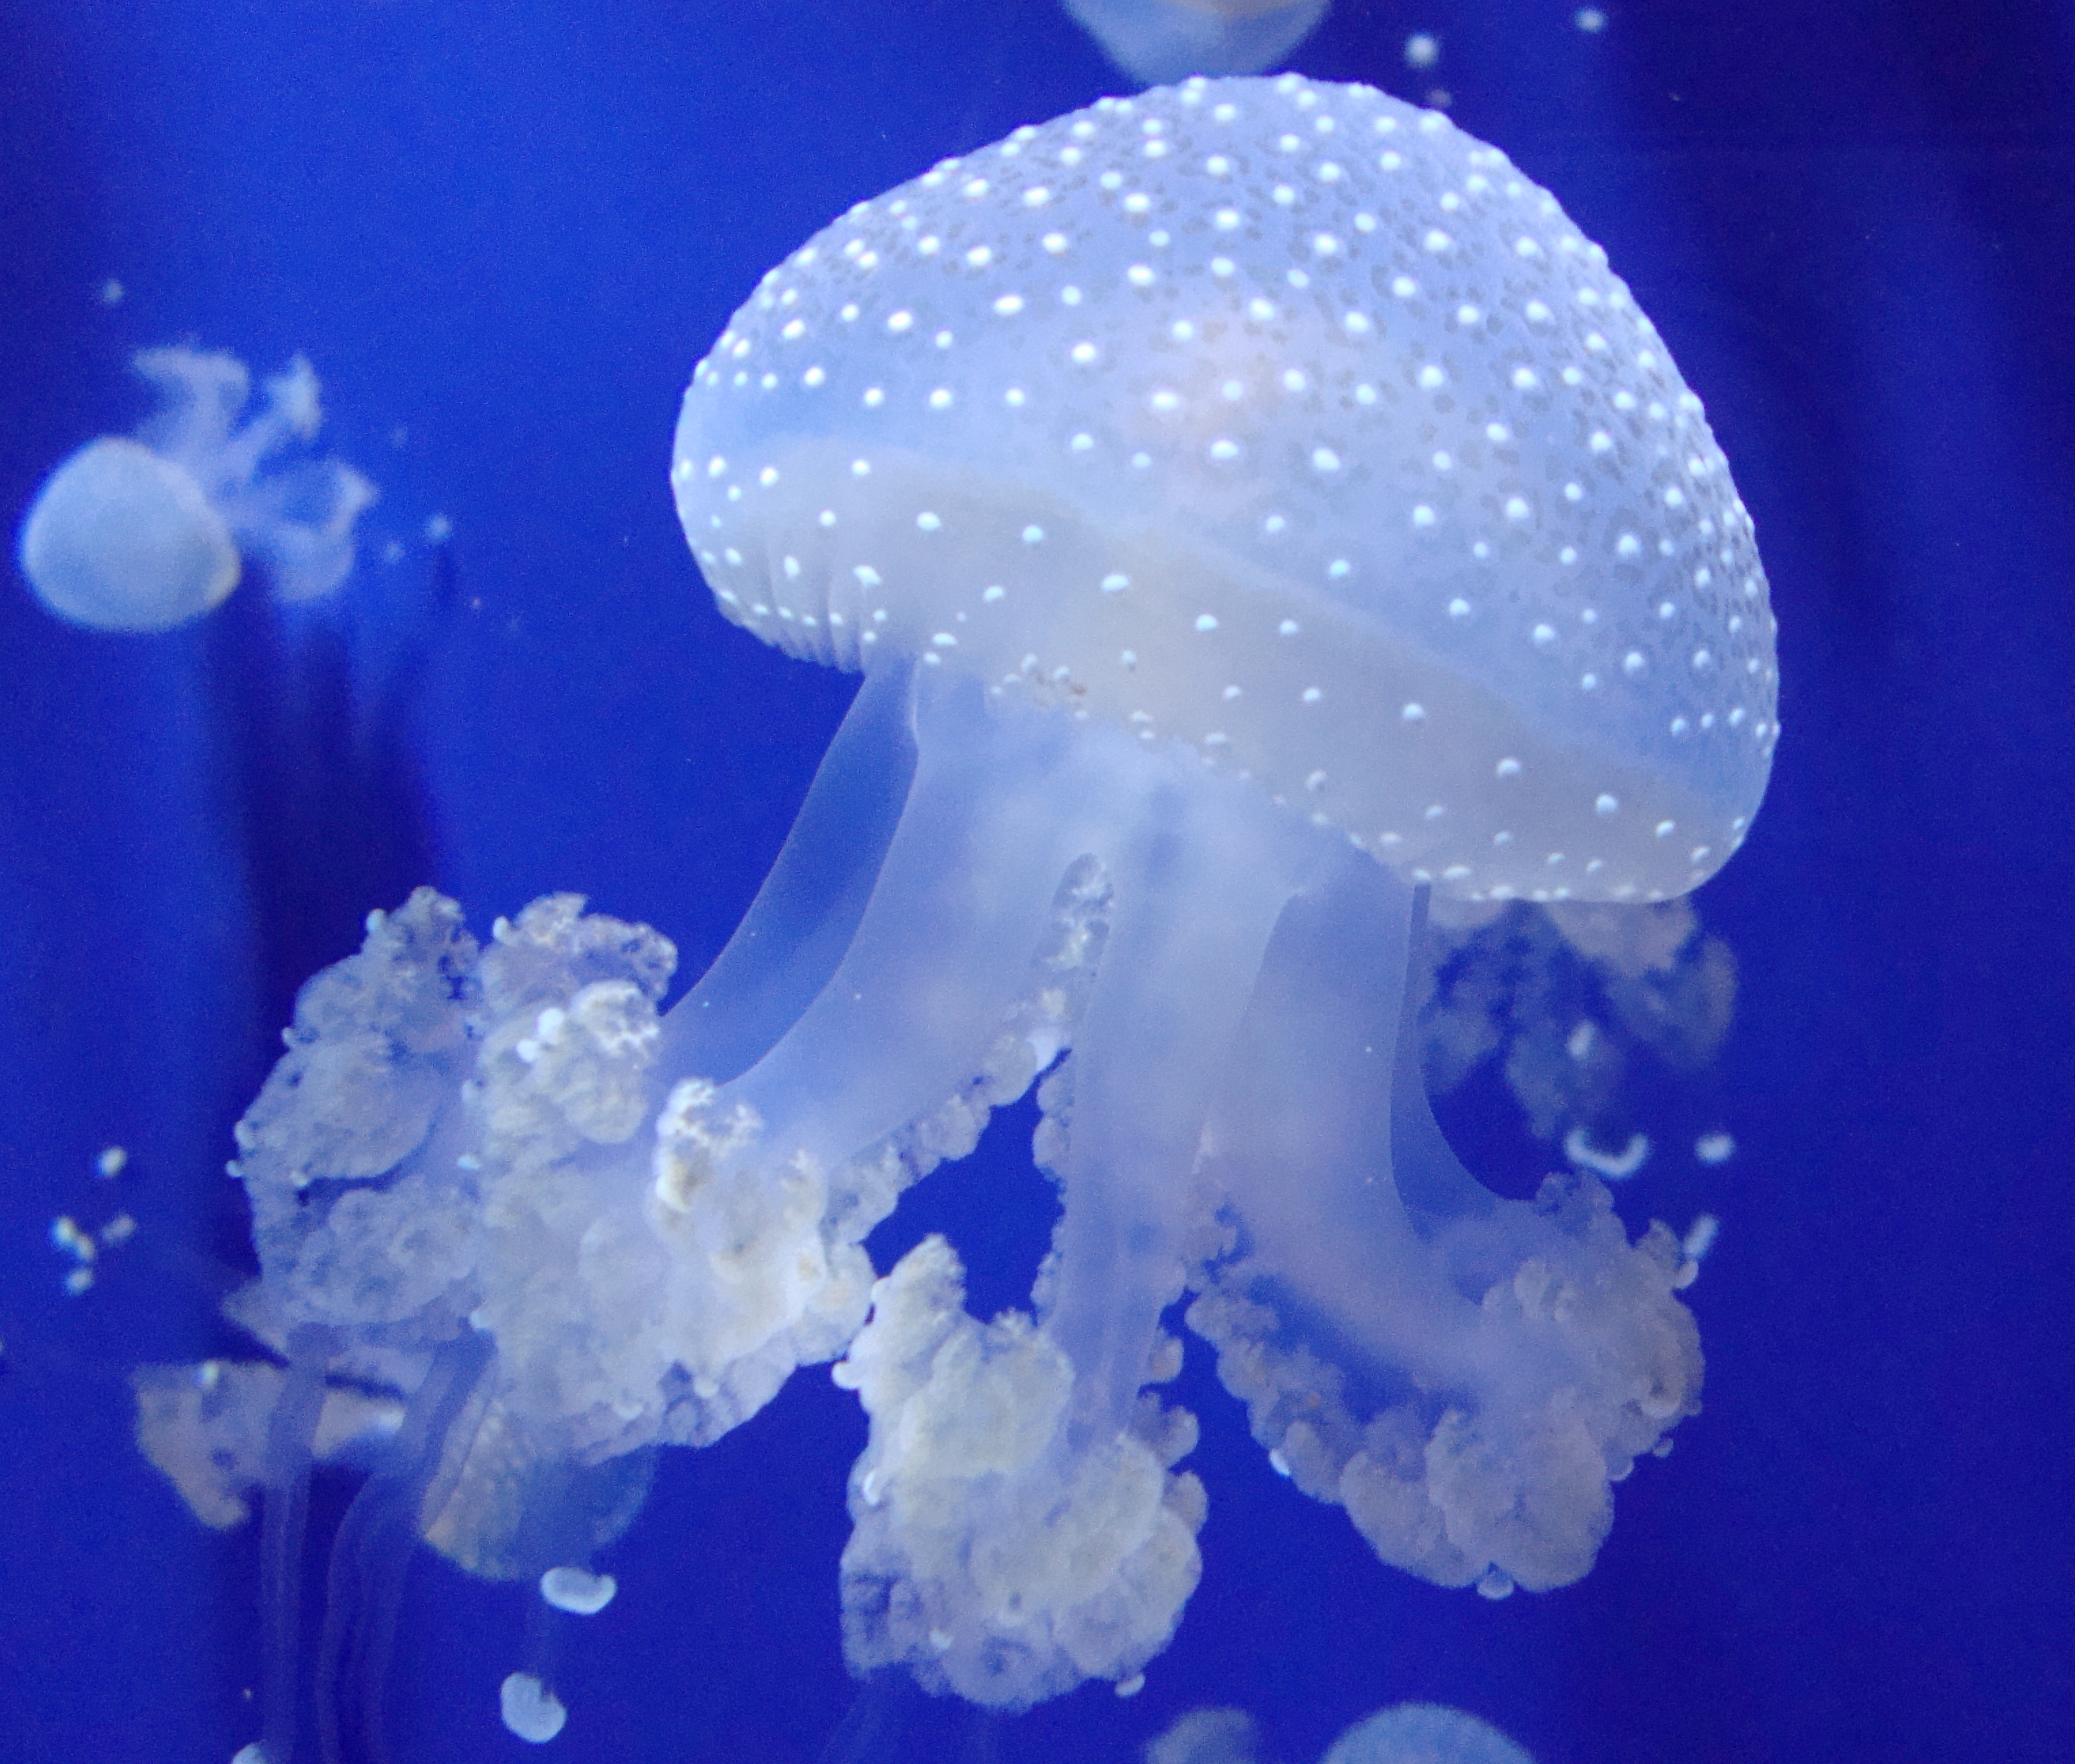
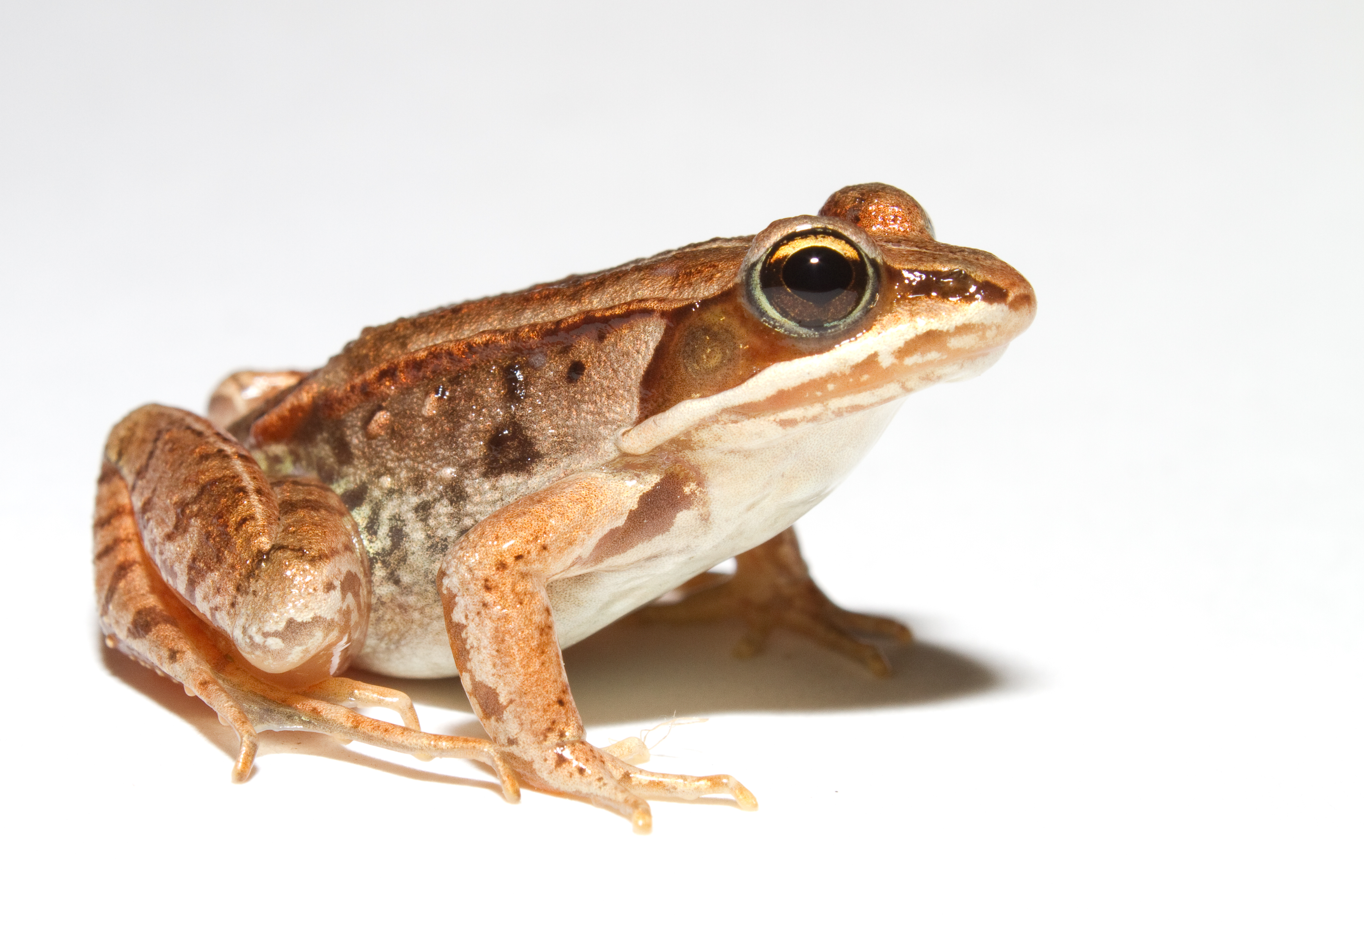
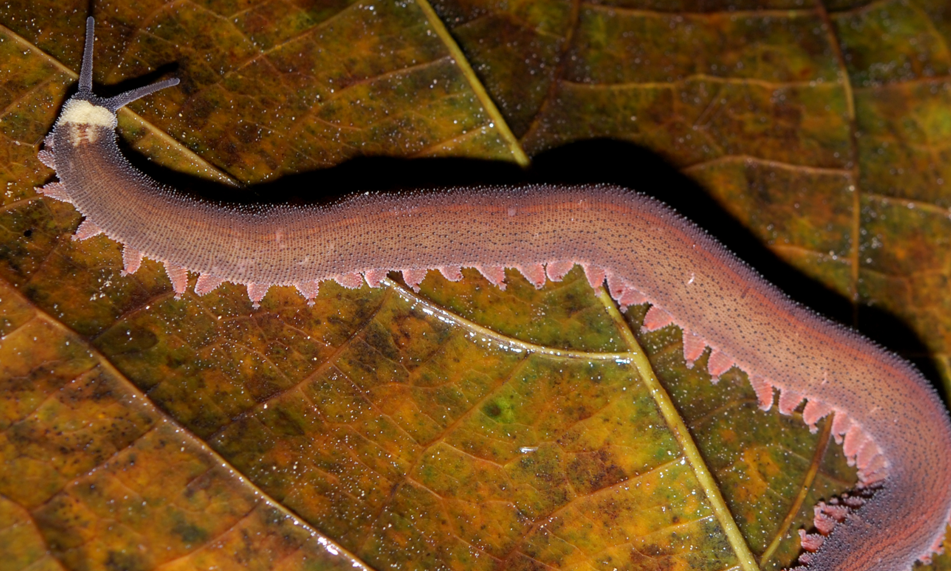
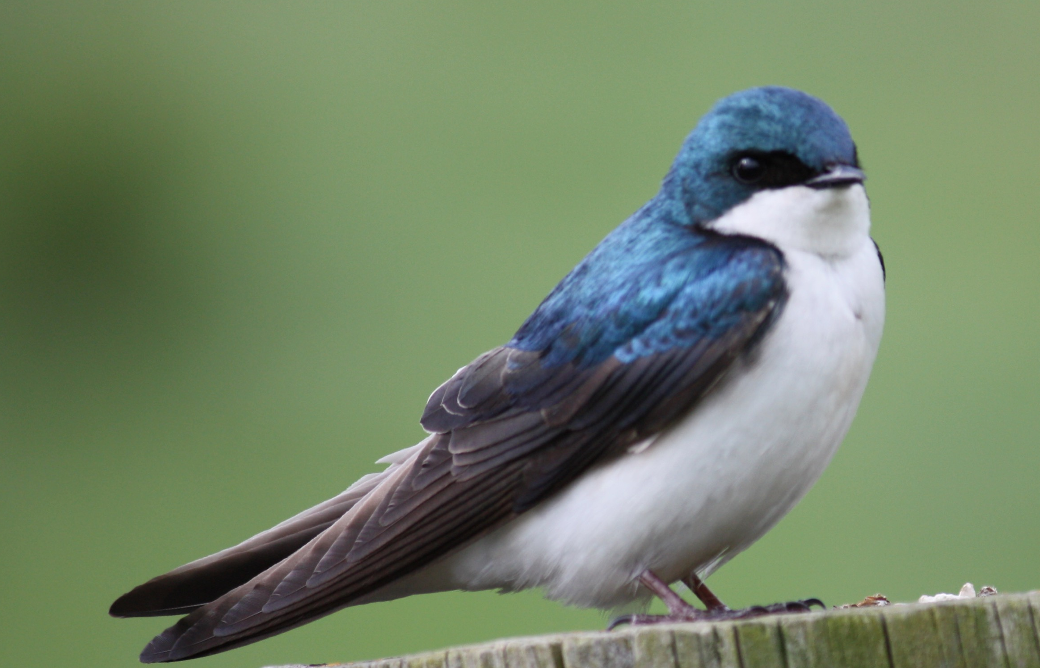
Multicellular Organisms
Multicellular organisms are organisms made up of MANY EUKARYOTIC cells.
One type of multicellular organism are animals.
ALL plant and animals are multicellular organisms.
Cognitive Learning Systems, Inc © 2016
Notes:
Teacher’s Notes
Students have previously learned that eukaryotic cells can exist as single celled or unicellular organisms. Although not thoroughly discussed, they may recall from the Microscopic Explorations CELL that not all unicellular organisms are eukaryotes. Some, such as bacteria, are prokaryotes.
In contrast, all multicellular organisms consist of eukaryotic cells. Multicellular organisms are those made up of many eukaryotic cells. Just as there are different types of unicellular organisms, there are different groups or categories of multicellular organisms. This slide reviews two categories of multicellular organisms: plants and animals. In contrast to protists and fungi which are groups that consist of both unicellular and multicellular organisms, ALL plants and animals are multicellular organisms. As such, all plants and animals consist of eukaryotic cells.
Images credits:
South Chinese Tiger (Panthera tigris amoyensis) in Shanghai Zoo, Retrieved September 30, 2016, Retrieved from https://en.wikipedia.org/wiki/South_China_tiger#/media/File:2012_Suedchinesischer_Tiger.JPG
Acquario di Genova, Retrieved September 30, 2016, Retrieved from https://commons.wikimedia.org/wiki/File:Australian_spotted_jellyfish_(Phyllorhiza_punctata)_-_Acquario_di_Genova_-_Italy_-_15_April_2012.jpg
Lithobates sylvaticus (Woodfrog), Retrieved September 30, 2016, Retrieved from https://commons.wikimedia.org/wiki/File:Lithobates_sylvaticus_(Woodfrog).jpg
Peripatidae. Retrieved September 30, 2016, Retrieved from Found in Yasuni National Park, Ecuador, https://en.wikipedia.org/wiki/Onychophora#/media/File:Velvet_worm_rotated,_mirror.png
A blue bird taken along Cullers Trail in Shenandoah River State Par, Retrieved September 30, 2016, Retrieved from https://commons.wikimedia.org/wiki/File:Blue_Bird_(7414410526).jpg

Slide 32
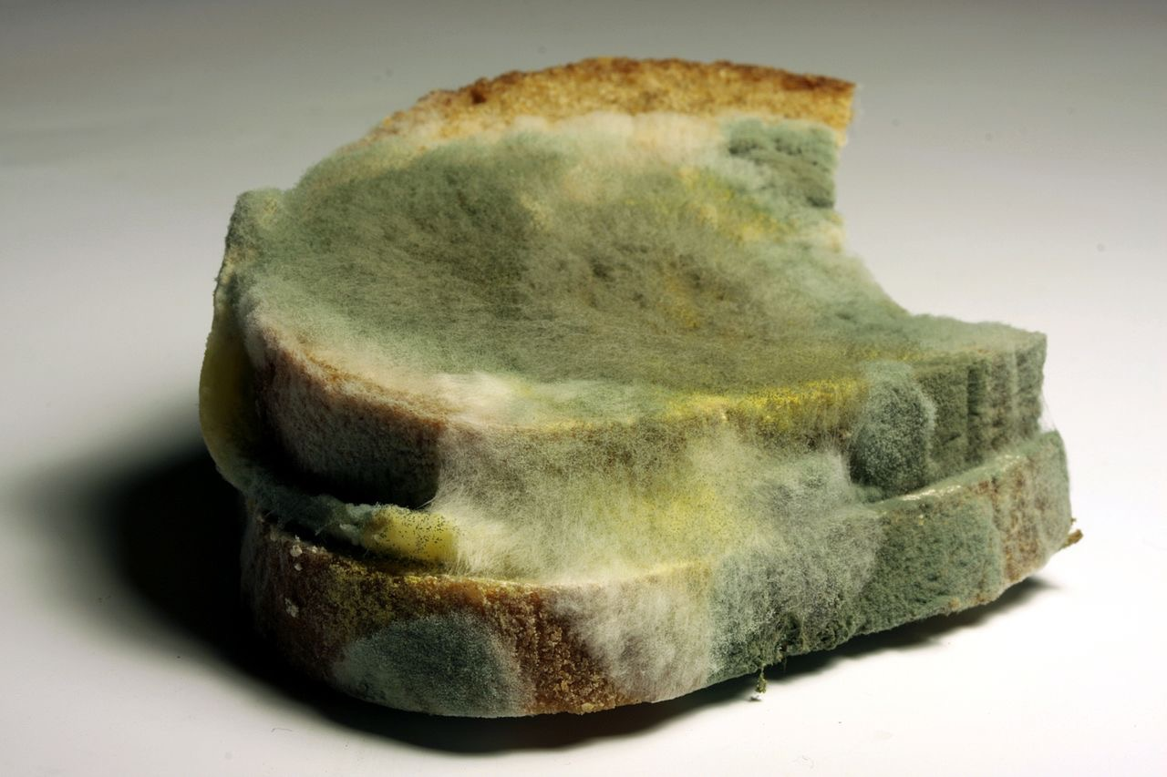
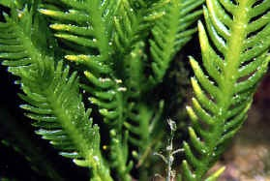
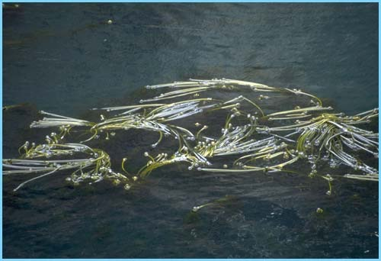
Multicellular Organisms
SOME protists and fungi are MULTICELLULAR.
Mushrooms and mold are multicellular fungi.
mushrooms
mold
Green algae and kelp are multicellular protists.
green algae
kelp
Cognitive Learning Systems, Inc © 2016
Notes:
Teacher’s Notes
Students have seen examples of protists and fungi in the earlier sections of this Journey when they viewed the amoeba, euglena, paramecium (all protists) and yeast (fungi). Each of the examples they previously viewed were unicellular protists or fungi. This slide emphasizes that the there are also protists and fungi that are multicellular. Examples of multicellular fungi are mushrooms and mold. Examples of multicellular protists are green algae and giant kelp.
In addition to understanding that the protists and fungi groups contain both unicellular and multicellular organisms, students should come to the conclusion that like plants and animals, all members of both groups are made of eukaryotic cells. In other words, ALL protists and fungi are eukaryotes.
Image credit:
Unidentified fungi, retrieved September 20, 2016 retrieved from https://commons.wikimedia.org/wiki/File:Unidentified_Fungi_5927.jpg
Mold on bread, retrieved, September 20, 2016, retrieved from http://commons.wikimedia.org/wiki/File:Verschimmeltes_Brot_2008-12-07.JPG
National Agricultural Library, Agricultural Research Service, U. S. Department of Agriculture.
www.epa.gov; www.olypiccoast.noaa.gov; and swr.nmfs.noaa.gov

Slide 33
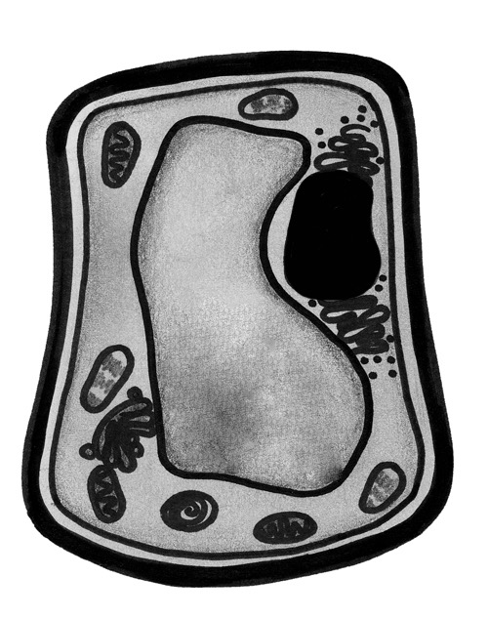
Multicellular Organisms
Just like the eukaryotic cells of unicellular organisms, the shapes of eukaryotic cells in multicellular organisms are NOT always the same.
There are also SOME structures that are different in different types of organisms.
For example, plants have two structures not found in animal cells:
CELL WALL
CHLOROPLASTS
chloroplast
cell membrane
cytoplasm
cell wall
chloroplast
chloroplast
nucleus
Cognitive Learning Systems, Inc © 2016
Notes:
Teacher’s Notes
Just as students saw that the shape and SOME structures of unicellular eukaryotic organisms differed, they should conclude from this slide that the shape and some of the structures of eukaryotic cells in multicellular organisms can differ. As student view this slide, they should observe that the characteristics structures of a cell membrane, nucleus and cytoplasm are found in this plant cell. However, as illustrated by the red shading, there are at least two structures, the cell wall and chloroplasts that are found in eukaryotic plant cells but NOT in eukaryotic animal cells.
It should be mentioned that this slide does NOT highlight ALL of the differences between eukaryotic plant and animal cells nor does it include any differences between eukaryotic cells found in plants versus fungi or protists. However, this example should help students understand that while there are common characteristic structures that ARE found in almost all eukaryotic cells, there are some structures that can differ between eukaryotic cells.

Slide 34
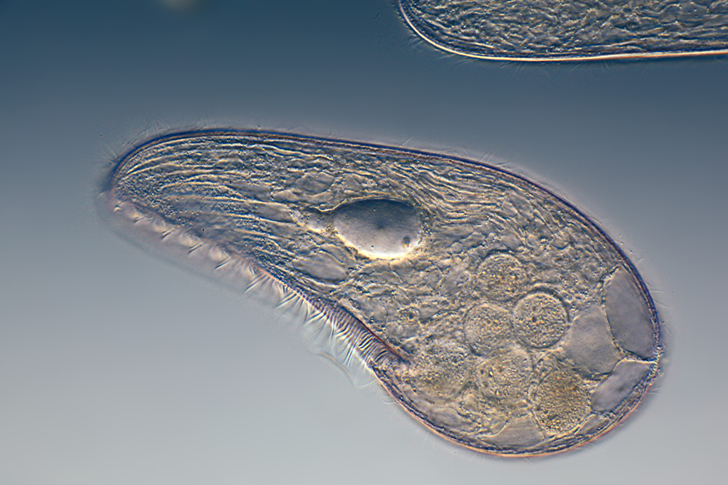
Unicellular vs Multicellular Organisms
UNICELLULAR ORGANISMS: Each cell accomplishes ALL of the functions necessary for the organism’s survival.
MULTICELLULAR ORGANISMS: Different cells can perform different functions.
The cells are ORGANIZED in a special way to perform ALL of the functions needed for survival.
Cognitive Learning Systems, Inc © 2016
Notes:
Teacher’s Notes
Having discussed and observed eukaryotic cells from both unicellular and multicellular organisms, students may wonder how these cells function and whether there is a difference in function between cells of unicellular and multicellular organisms.
One of the ways in which unicellular and multicellular organisms differ is in the functions carried out by individual eukaryotic cells. In unicellular organisms, each cell accomplishes ALL of the functions necessary for the organism’s (cell”s) survival. This includes locomotion, if necessary, nourishment, gas exchange, respiration, etc. Such is not the case for most cells within a multicellular organism. In general, there are different cells within a multicellular organism that perform different functions. For example, in a human, lung cells are responsible for the exchange of carbon dioxide and oxygen within the lung. Muscle cells are responsible for contraction of muscles and thus for locomotion. The organism survives because the different cells are organized such that when they all work together, all functions necessary for life are coordinated and completed.
Although students are not expected to know the following information, it has been provided should questions arise.
In terms of evolution, it is thought that life began with unicellular organisms and evolved into multicellularity. The single-celled ancestor of multicellular organisms has not yet been determined, but based on genetic and molecular data, scientists have been able to observe shared characteristics between multicellular organisms and extinct unicellular organisms. Over the course of evolution multicellularity allowed for increasing specialization of body tissues and systems. In addition, it allowed for organisms to become larger because individual cells, tissues and organs could perform specialized functions.
One of the other differences between unicellular and multicellular organisms is in their reproduction. Unicellular organisms tend to reproduce quickly and the single cell can be used for reproduction. In contrast, reproduction in many multicellular organisms occurs over a longer period of time and only specialized cells can be used for reproduction. Please note that the last several sentences refer to the process of reproduction NOT the type of cell division (mitosis) previously discussed with students. For example, in humans only sperm and egg cells can be used for reproduction of the species. However, all other cells within the human body are capable and do divide by the process of mitosis, the process described earlier in the Journey.
It should be noted that in some multicellular organisms there are periods in the organism’s development or within certain tissues that eukaryotic cells are pluripotent or capable of becoming any type of cell and performing any type of function. Stem cells are an example of this type of cell. In this regard, stem cells may be similar to the eukaryotic cells of unicellular organisms. However, far from everything is known about stem cells and other pluripotent cells. This continues to be an active area of scientific research.
Image Credit:
Blepharisma japonicum, a free-living ciliated protozoan. retrieved on September 20, 2016, https://en.wikipedia.org/wiki/Protozoa#/media/File:Mikrofoto.de-Blepharisma_japonicum_15.jpg
Polar bear jumping on fast ice, retrieved on September 20, 2016, from https://en.wikipedia.org/wiki/Polar_bear#/media/File:Polar_Bear_AdF.jpg

Slide 35
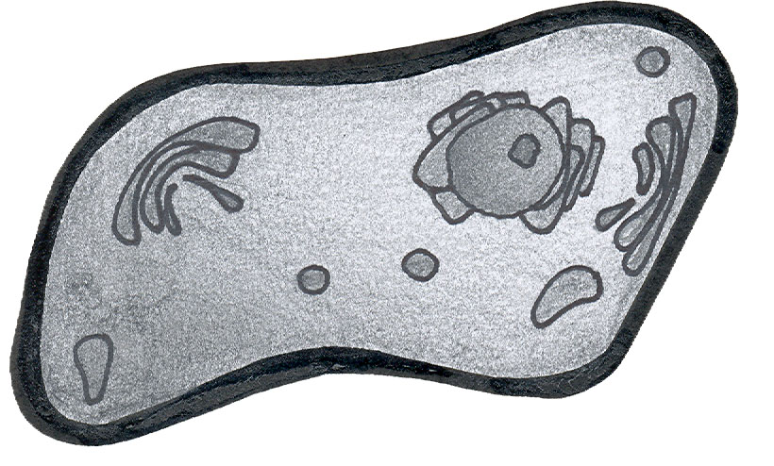
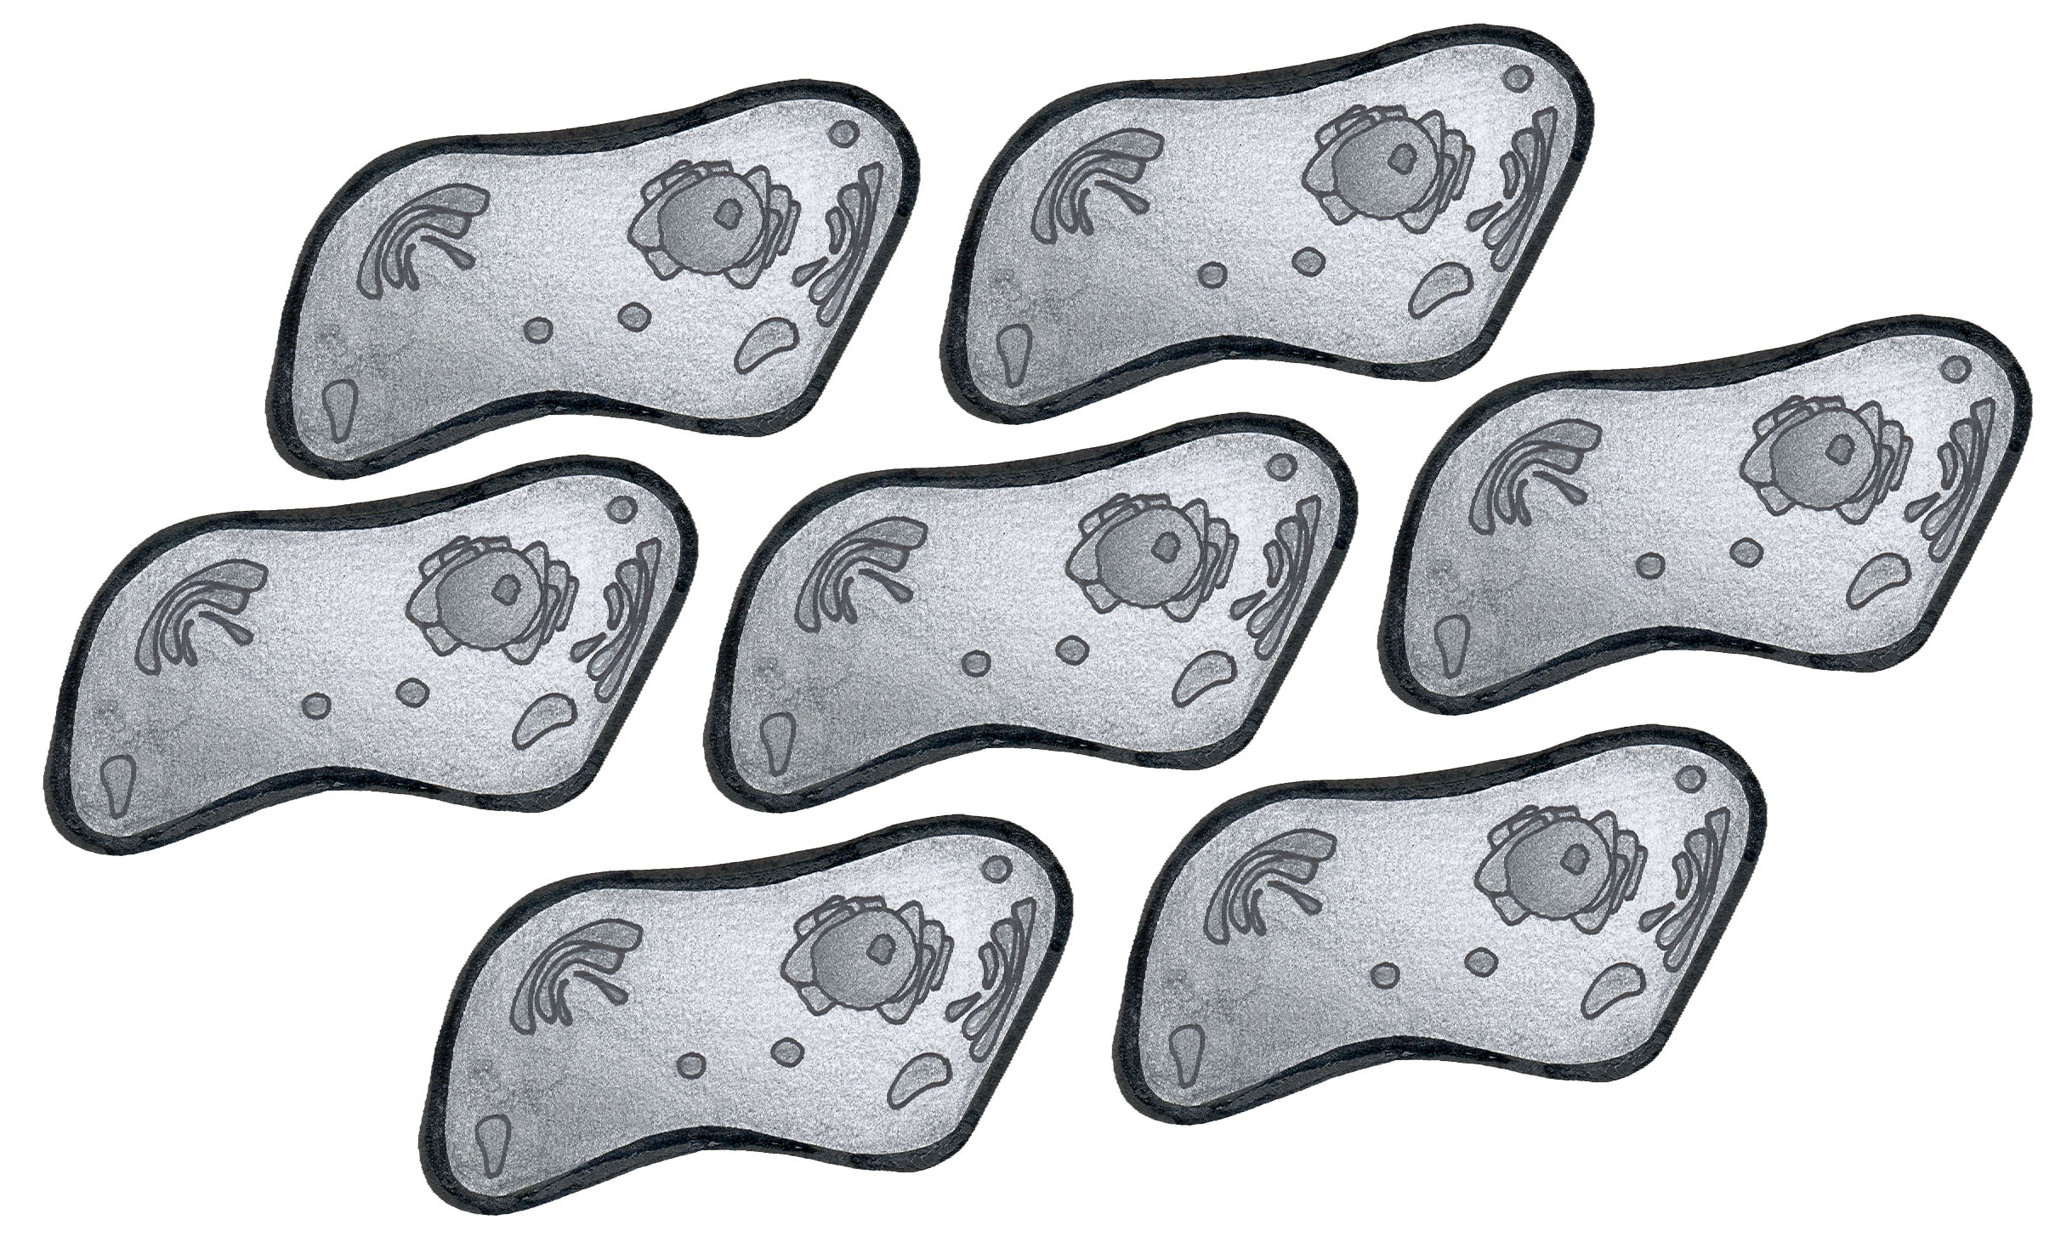
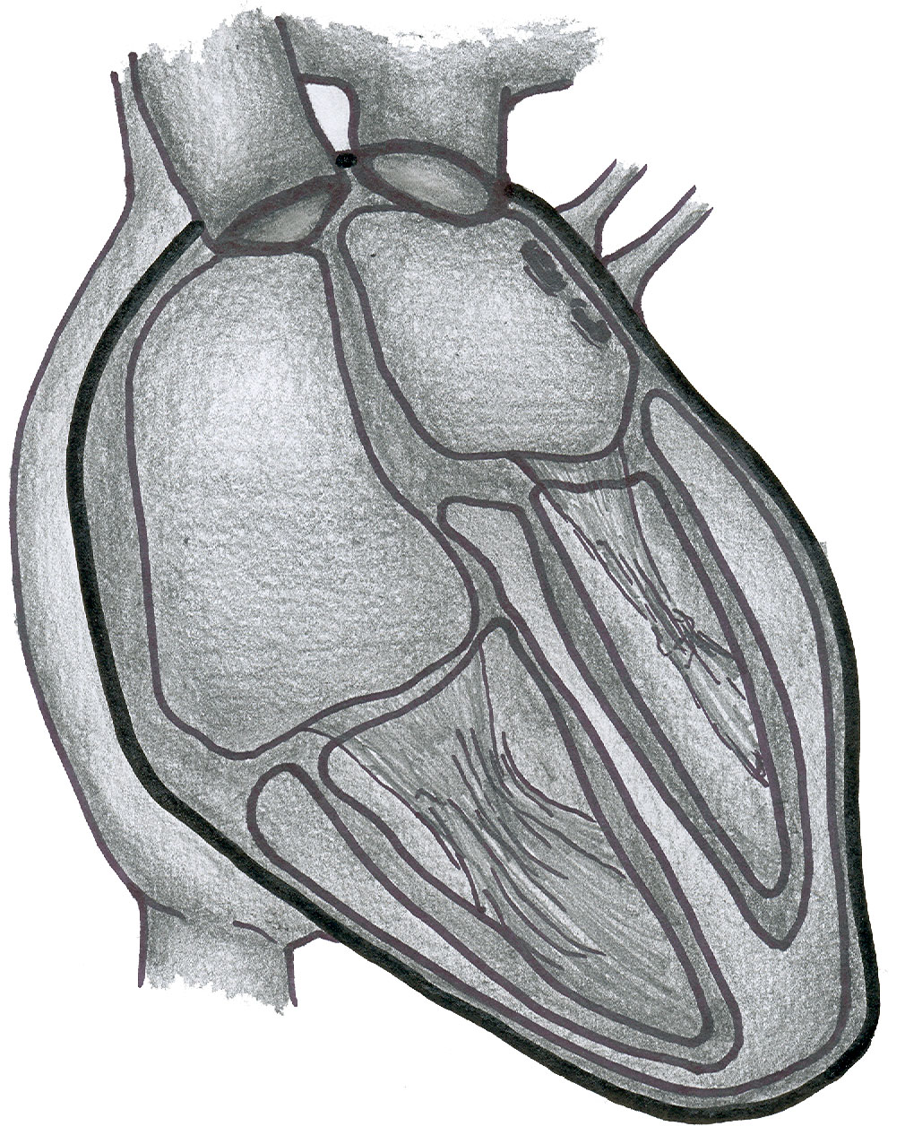
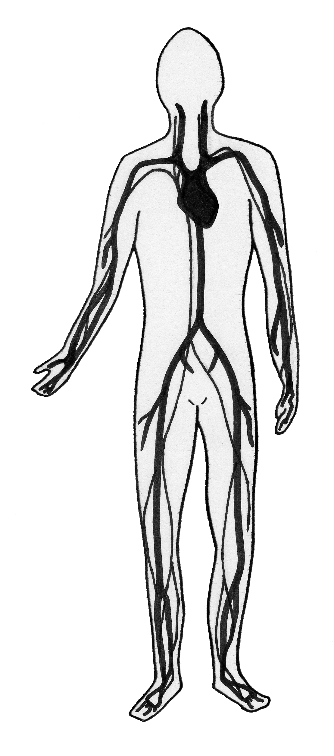
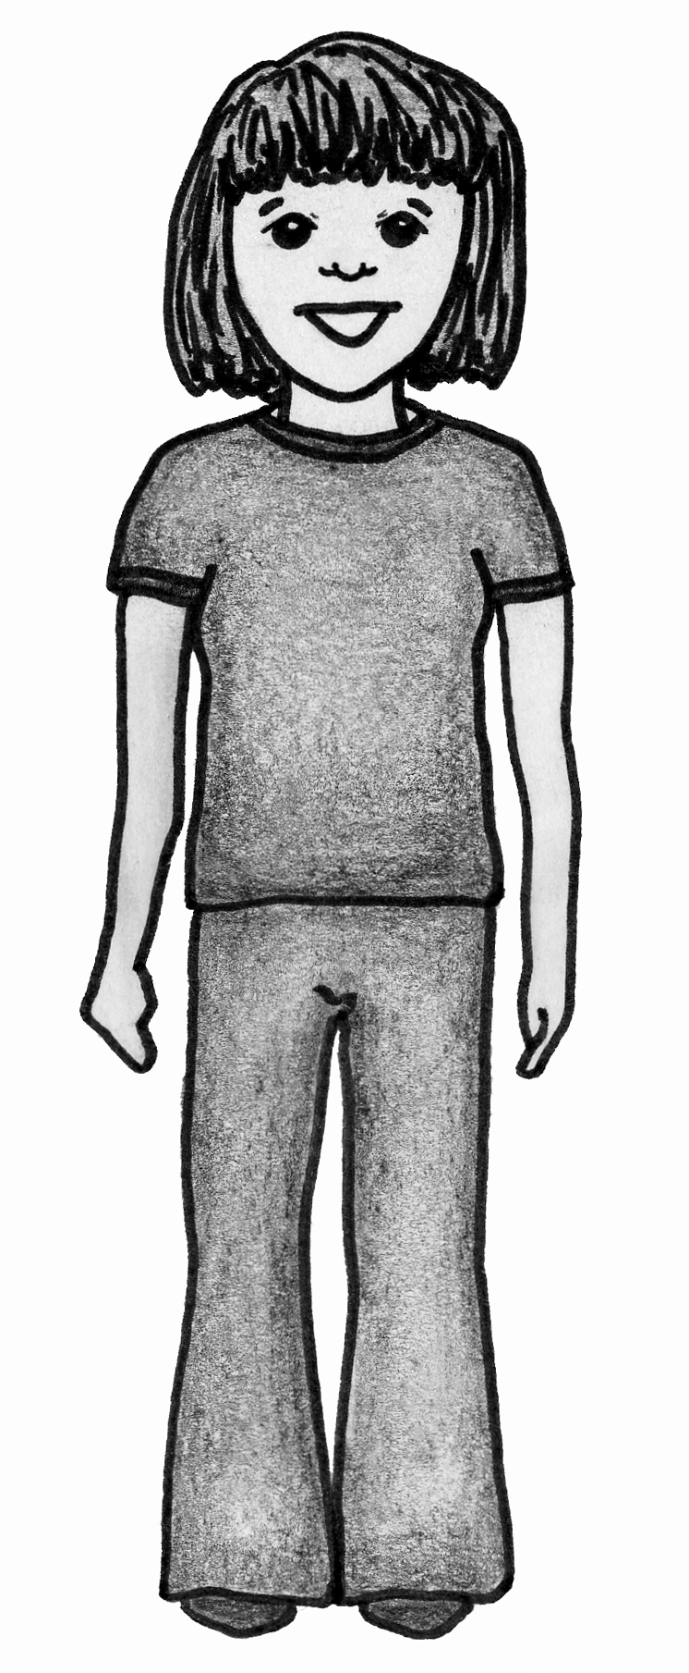
Hierarchical Organization
Multicellular organisms have developed a system of organizing cells in order to best accomplish functions necessary to sustain life.
cell
In many multicellular organisms, cells are organized into larger structures called tissues.
(Example: Heart cells are organized into muscle tissue.)
Tissues are organized into larger structures. In some organisms like animals these structures are called organs.
(Example: Muscle tissue and other tissues are organized to form the heart.)
Organs in animals (other structures in other organisms) are organized into systems.
(Example: the circulatory system)
Systems work together for overall function of an organism.
(Example: human)
tissue
organ
system
organism
Cognitive Learning Systems, Inc © 2016
Notes:
Teacher’s Notes
This Journey ends with a discussion of how cells are organized within most multicellular organisms. This type of organization is described as hierarchical because each level of organization depends upon and builds upon the one below it. The example shown here is given in the context of a human, a type of multicellular animal.
Most plants and animals follow the hierarchy described on this slide: an organization of cells to tissues, tissues to organs, organs to systems and systems to full organisms. This concept should be familiar to students as they should have discussed and investigated it during the Microscopic Explorations CELL.

Slide 36
Check Understanding
Describe how eukaryotic unicellular organisms differ from multicellular organisms. Describe how they are similar.
2. Give two examples of structures that may NOT be found in all eukaryotic cells.
Cognitive Learning Systems, Inc © 2016
Notes:
Teacher’s Notes
Answers
Question 1: Student answers may vary. Some sample answers are provided. Students should indicate that eukaryotic unicellular organisms differ from multicellular organisms in the number of cells that compose the organism. A unicellular organisms consists of a single cell. Multicellular organisms consist of many cells. The cells of unicellular eukaryotes perform ALL of the functions necessary for that organism’s/cell’s survival. In multicellular organisms, different cells perform different functions. However, unicellular and multicellular eukaryotes all have some cellular structures in common such as a nucleus, cell membrane and cytoplasm.
Question 2: Students answers will vary. Some examples include pseudopodia (found in amoeba), flagella (found in euglena), cilia (found in paramecium), chloroplasts (found in some plant cells), and a cell wall (found in plant cells).

Slide 37
Eukaryotes
Making and Applying Connections
Cognitive Learning Systems, Inc © 2016

Slide 38
Making and Applying Connections
Which of these are you most likely to find in all eukaryotic cells?
A. Flagellum
B. Pseudopodia
C. Chloroplasts
D. Cytoplasm
Cognitive Learning Systems, Inc © 2016
Notes:
Teacher’s Notes
Answer
Question 1: D

Slide 39
Inside the Nucleus
Charles looks at a eukaryotic cell using a microscope. The cell he sees is below. The arrow points to structures he observes in the nucleus. From the structures in the nucleus, Charles can conclude that that
the cell is moving
the cell is dividing
the cell is eating
the cell is resting
Cognitive Learning Systems, Inc © 2016
Notes:
Teacher’s Notes
Answer
Question 2: B

Slide 40
Making and Applying Connections
Which of the specimens has cells with both a flagellum and chloroplasts?
Specimen | Cells have chloroplasts | Cells have cilia | Cells have a flagellum | Cells have a cell membrane
Elodea leaf | X |  |  | X
Human white blood cells |  |  |  | X
euglena | X |  | X | X
paramecium |  | X |  | X
Elodea leaf
Human white blood cells
Euglena
Paramecium
Cognitive Learning Systems, Inc © 2016
Notes:
Teacher’s Notes
Answer
Question 3: C

Slide 41
Making and Applying Connections
1. fungi
2. protist
3. plant
4. animal
Which of the above contain eukaryotic cells?
A. 1 and 2 only
B. 1 and 3 only
C. 1, 2 and 3 only
D. 1, 2, 3 and 4
Cognitive Learning Systems, Inc © 2016
Notes:
Teacher’s Notes
Answer
Question 4: D
Image credits:
Unidentified fungi, retrieved September 20, 2016 retrieved from https://commons.wikimedia.org/wiki/File:Unidentified_Fungi_5927.jpg
Blepharisma japonicum, a free-living ciliated protozoan. retrieved on September 20, 2016, https://en.wikipedia.org/wiki/Protozoa#/media/File:Mikrofoto.de-Blepharisma_japonicum_15.jpg
Tulips on Park Avenue, NYC, Retrieved September 30, 2016, Retrieved from https://commons.wikimedia.org/wiki/File:Tulips_On_Park_Ave.JPG
Wolf spider on white, Retrieved September 30, 2016, Retrieved from https://commons.wikimedia.org/wiki/File:Wolf_spider_on_white.jpg

Slide 42
Making and Applying Connections
Jill is studying the organelles in the area of the cell shaded red. All of these organelles are
Inside the nucleus and inside the cell membrane
Outside the nucleus and outside the cytoplasm
Outside the cytoplasm and inside the cell membrane
Inside the cell membrane and outside the nucleus
Cognitive Learning Systems, Inc © 2016
Notes:
Teacher’s Notes
Answer
Question 5: D

Slide 43
Making and Applying Connections
Henry wants to test whether amoebas can survive feeding only on algae or only on bacteria. He places two amoebas in matching containers of water. What should he do next?
Add algae to both containers
Add bacteria to both containers
Add bacteria to one container and algae to the other container
Add bacteria and algae to both containers
Cognitive Learning Systems, Inc © 2016
Notes:
Teacher’s Notes
Answer
Question 6: C

Slide 44
Making and Applying Connections
The diagram below shows a eukaryotic cell that will soon divide. After the process of the cell division is completed, how many cells will there be?
A. 1
B. 2
C. 3
D. 4
Cognitive Learning Systems, Inc © 2016
Notes:
Teacher’s Notes
Answer
Question 7: B

Slide 45
Making and Applying Connections
The functions that occur outside the nucleus and inside the nucleus are different because
A. The cell membrane surrounds only the organelles outside the nucleus.
B. The structures inside and outside the nucleus are different.
C. The cytoplasm comes in contact with both the nucleus and the organelles outside the nucleus.
D. The structures inside and outside the nucleus are the same.
Cognitive Learning Systems, Inc © 2016
Notes:
Teacher’s Notes
Answer
Question 8: B

Slide 46
Making and Applying Connections
Plastic Bag
(cell membrane)
Tea Bag
(nucleus)
Jelly
(cytoplasm)
Tissue Paper
(organelles)
The diagram above shows a model of a eukaryotic cell. Which answer best explains how the model would change if the nuclear membrane burst?
The grape jelly would leak out of the plastic bag.
All of the tissue paper would leak out of the plastic bag.
The tea in the tea bag would mix with the jelly.
The fabric of the tea bag would leak out of the plastic bag.
Cognitive Learning Systems, Inc © 2016
Notes:
Teacher’s Notes
Answer
Question 9: C

Slide 47
Making and Applying Connections
Which of the following statements is true?
A. Eukaryotic cells in all unicellular organisms are the same shape.
B. Eukaryotic cells in multicellular organisms all perform the same function.
C. Eukaryotic cells in unicellular organisms are organized into tissues.
D. Eukaryotic cells are found in unicellular and multicellular organisms.
Cognitive Learning Systems, Inc © 2016
Notes:
Teacher’s Notes
Answer
Question 10: D

