Slide 1
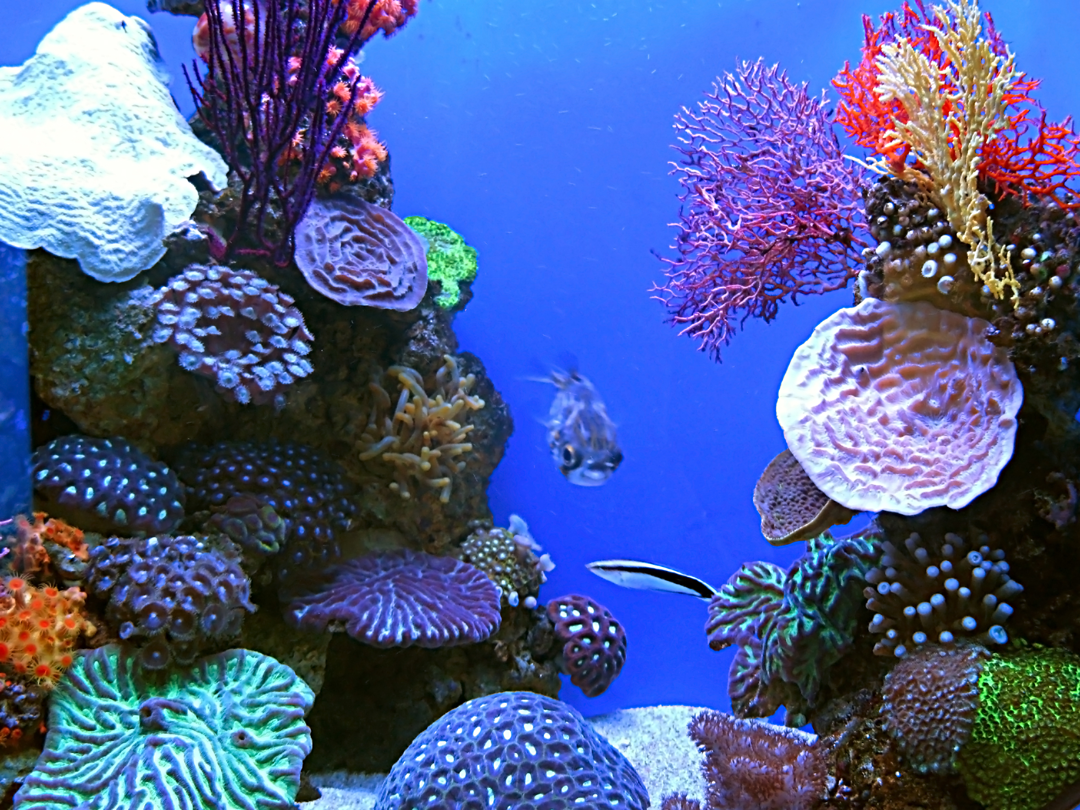

Biomes
Cognitive Learning Systems, Inc. © 2016
Notes:
Image credit:
Coral, from FreeImages.com, retrieved on May 11, 2016 from http://www.freeimages.com/photo/aquarium-1360326 [Public Domain]

Slide 2
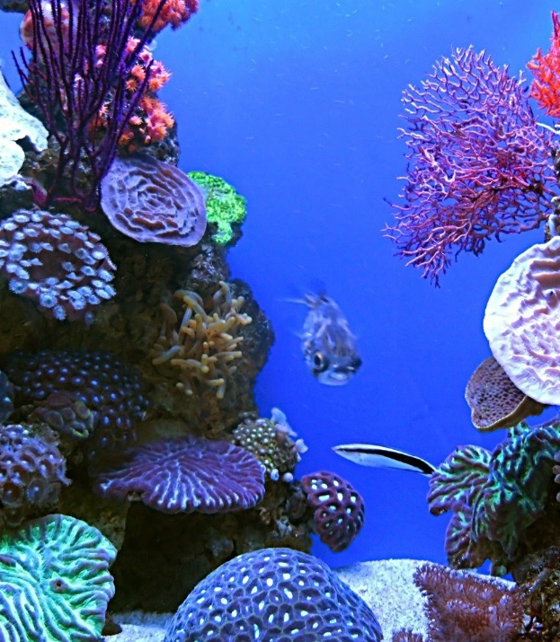

Biomes
Parts of Biomes
Cognitive Learning Systems, Inc. © 2016
Notes:
Image credit:
Coral, from FreeImages.com, retrieved on May 11, 2016 from http://www.freeimages.com/photo/aquarium-1360326 [Public Domain]

Slide 3
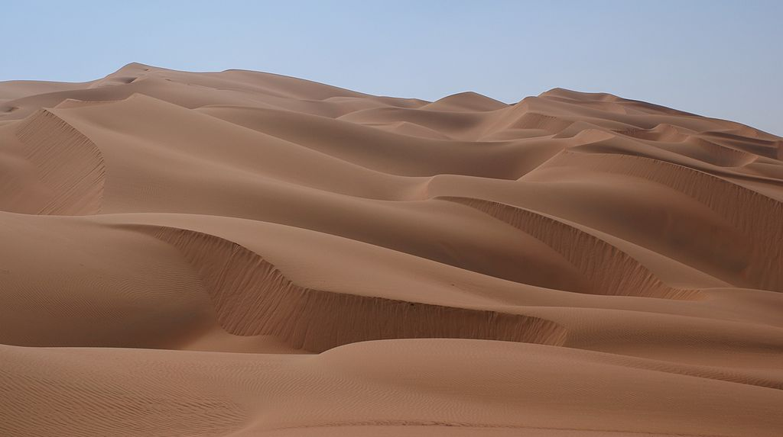
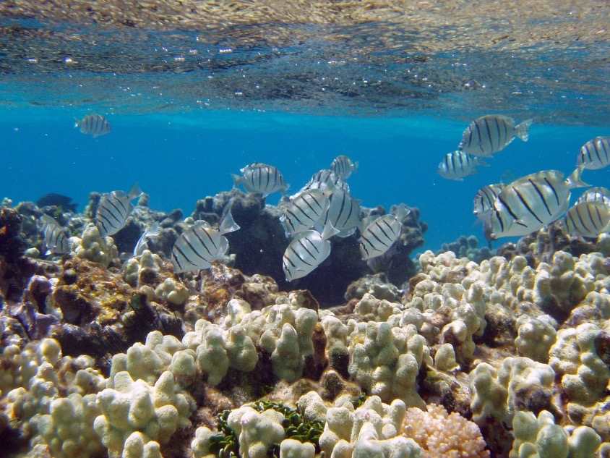
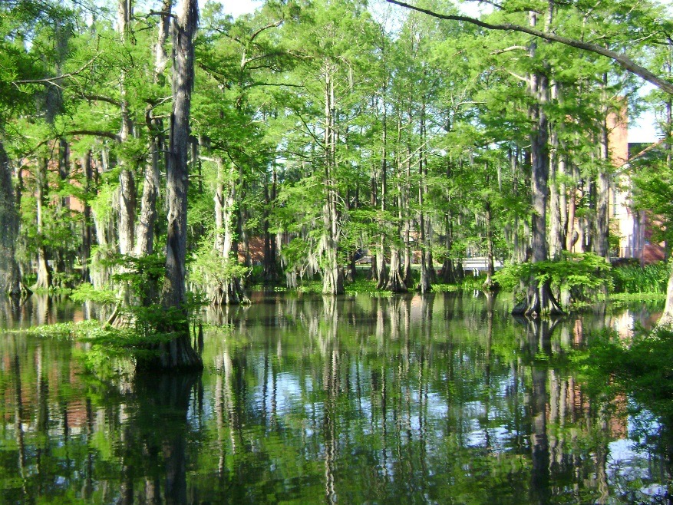
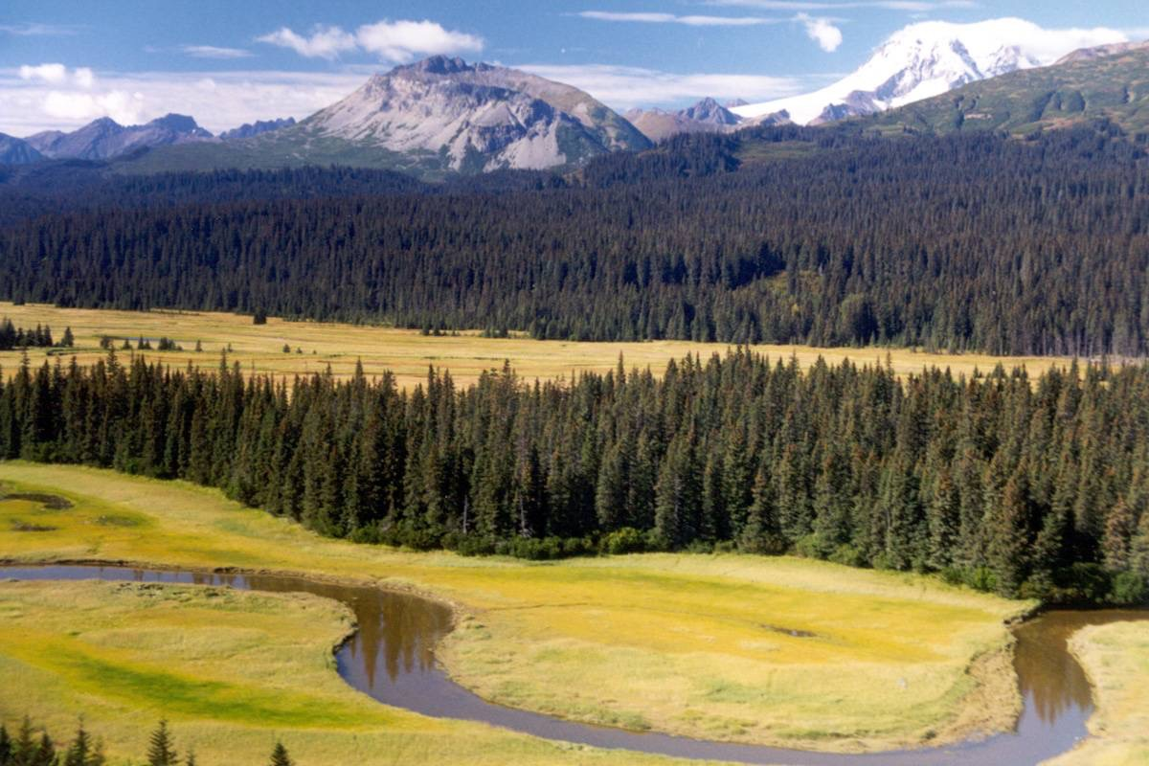
Earth
Cognitive Learning Systems, Inc. © 2016
Notes:
Teacher’s Notes
Begin the Journey Unit by asking students to look at the pictures on the slide. Tell students that these represent different areas on the Earth. Ask students the following questions:
What is similar about the pictures?
What is different about the pictures?
Allow students time for discussion.
Using the pictures, discuss that one of the similarities is that in all of these areas on Earth there are living organisms. This includes plants and animals as well as other organisms such as fungi and bacteria. Continue the discussion focusing on the differences of the areas: different terrains, different climate, and different organisms that live in each of the areas.
Conclude the discussion by explaining that these pictures represent one of the ways in which scientists can classify the Earth. They can classify different areas of the world into groups called biomes. Tell students that to better understand the concept of a biome, they will first begin by looking at what makes up a biome in the next several slides.
Image credits (clockwise from top left):
Rub al Khali Desert, by Nepenthes, retrieved August 23, 2016 from https://commons.wikimedia.org/wiki/File:Rub_al_Khali_002.JPG [CC BY-SA 3.0 (https://creativecommons.org/licenses/by/3.0/)]
Manini or convict tangs amongst finger coral, by Claire Fackler/NOAA, retrieved August 23, 2016 from https://www.flickr.com/photos/51647007@N08/5077894923/ [CC BY-SA 2.0 (https://creativecommons.org/licenses/by/2.0/)]
Lake Clark National Park, from US National Park Service, retrieved May 11, 2016 from https://www.nps.gov/media/photo/view.htm?id=8CD91474-1DD8-B71C-07A37AA675973CCA [Public Domain]
Cypress Lake at University of Louisiana, by Jcarriere, retrieved August 23, 2016 from https://commons.wikimedia.org/wiki/File:The_Swamp_1.jpg [Public Domain]

Slide 4
Biome
Scientists observed there were areas of the Earth that had similar climates and similar types of plants and animals.
They gave the name BIOME to these areas.
Biomes represent different geographic areas of the Earth. The map below shows different biomes. Different colors represent different biomes.
Cognitive Learning Systems, Inc. © 2016
Notes:
Teacher’s Notes
Introduce the concept of a biome to students using the slide above. Students may not completely understand the concept of a biome from the definition on this slide. However, as students view the next set of slides and the rest of the slides in the Journey Unit, they should develop a deeper understanding of the concept of a biome.
There are essentially three factors that constitute a biome: climate, plants, and animals. Climate and plant life tend to be more indicative or descriptive of a biome than animal life. Many times, a biome can be described solely by vegetation and climate. Once described, the animals that live in that biome are identified. In addition, biomes carry with them a geographical component. This means that all over the Earth, you will tend to find similar biomes at similar latitudes. This is because of the correlation of biomes with climate.

Slide 5
Climate
The climate is ONE of the NON-LIVING parts of a biome.
What is climate?
Climate describes the condition of the atmosphere over a certain area on Earth over long periods of time. It describes the pattern of temperature, precipitation, wind, and other weather events over many years.
The CLIMATE of a certain area will be the same year to year.
CLIMATE INCLUDES
the temperature
the precipitation
the wind
the type and number of seasons in an area
regular weather extremes such as hurricanes, droughts and rainy periods
Cognitive Learning Systems, Inc. © 2016
Notes:
Teacher’s Notes
This slide introduces students to one of the key parts of a biome- climate. Climate is intricately linked with biome classification. Therefore, if students are to develop a deeper understanding of biomes, they need to understand what is meant by climate and what determines the climate of a geographical area on Earth.
Stress to students that an area’s climate cannot be determined by one, two, or even five years of data. To truly define and describe an areas climate requires study several decades of data so that any unusual weather events, such as back-to-back blizzards one winter followed by a string of sunny, 70°F days the same time next year do not exert too much influence in determining the area’s climate. This is similar to students collecting multiple observations in their own experiments in order to form accurate conclusions from their investigations.

Slide 6
Climate
How is climate different from weather?
Weather is the day to day changes in the atmosphere. It includes any precipitation that falls, the temperature of the air, and the wind conditions. BUT: the weather over an area changes from day to day.
Climate describes the PATTERN of weather that occurs in an area over a long period of time such as 30 years. The climate of a certain area will be the same year to year.
Cognitive Learning Systems, Inc. © 2016
Notes:
Teacher’s Notes
Because climate includes conditions such as temperature, precipitation, wind and seasons, students may be tempted to confuse the climate of an area with its weather. This slide provides an opportunity to discuss the difference between the weather of an area with the climate of an area.
In addition to the points listed above, another way that students can distinguish weather from climate is to think of the climate of a region as the result of the weather. The day to day weather when looked at over a long period such as 30 years makes up the climate of a region. In this way, students may understand that the reason that people can predict what the weather will be like during different months of the year is that they are really describing the climate of the area in which they live.
When people began keeping records of the daily weather and then reviewing it they found that they could predict what the temperature, and precipitation would be like during different times of the year. This is because the climate of the area is relatively consistent year after year. The weather, however, usually changes from day to day.

Slide 7
Climate
The differences in temperature, precipitation, and wind created by the tilt of the Earth’s axis create 5 different types of climate around the world.
polar
cold
temperate
hot
tropical
Different plants and animals can live in different climates. Some can survive in very cold climates, some in very hot climates. The type of climate in an area determines which plants and animals can live there.
Cognitive Learning Systems, Inc. © 2016
Notes:
Teacher’s Notes
The slide above helps students to view climate in a global sense. When observations of climate around the world were combined, a pattern emerged. The Earth could be divided into five basic types of climate based primarily on annual and monthly averages of temperatures and precipitation. Although not presented, here, students will hopefully later see that these five basic climate regions correspond to different biomes.
The division of the Earth into 5 major climatic regions was introduced in 1900 by a Russian-German climatologist, Wladimir Köppen. It should be noted that although five basic climate regions were initially described by Köppen and are presented in this slide for elementary students, today’s scientists can actually further divide these 5 major climate regions into smaller climate regions that distinguish specific seasonal characteristics of temperature and precipitation. For example, they may define two different types of areas in the tropical region: one that has adequate precipitation all year round and no dry season, and those areas that have precipitation most of the year with a short dry season.

Slide 8
Living Parts of a Biome
Plants and animals interact with each other in a variety of ways:
A population is a group of organisms that live in the same place at the same time and can reproduce.
A community is all of the populations in an area that interact with each other.
Food chains and food webs describe interactions within a community:
A food chain describes the pattern of feeding between plants and animals.
A food web describes the interactions between plants and animals from different food chains.
Cognitive Learning Systems, Inc. © 2016
Notes:
Teacher’s Notes
In addition to climate which is a non-living component of a biome, a biome also includes a living component. This living component encompasses all of the living organisms including plants, animals, fungi, bacteria and viruses. For the purposes of this Journey Unit, the living component will be described as the plants and animals living within that geographical area.
Within a biome, the plants and animals interact with each other in specific ways. Understanding these interactions can help scientists understand the effects of climate change on organisms as well as the effect of organisms on each other within the biome. One of the ways to describe the organisms within a biome is to look at the different populations of organisms. A population essentially refers to each individual species of organism. This includes species of plants and animals. Although the word species is not used in the definition of population, the concept of a species is given in the definition. A species is a group of organisms that share genetic similarities and can reproduce.
What are examples of a population? Examples of a population would be all the deer in a forest or all the pansy plants in a garden. Ask students to brainstorm additional examples.
However, if you think about a biome, you realize that it is not inhabited by only one population of organisms. Many different populations co-exist. This co-existence is referred to as the biome community. A community of organisms is essentially all of the populations of organisms that interact with each other. There are many different communities within a biome, because not all areas of a biome have exactly the same resources and living conditions.
What are examples of a community? Examples of a community would be all the deer, grass, and mice in a meadow, or all the fish, coral, algae, and sharks in a coral reef. Ask students to brainstorm additional examples.
One of the ways in which students may be familiar with a community is through a food web or food chain. All organisms eat other organisms. Some animals eat other animals. Some animals eat only plants and some eat both plants and animals. A food web or food chain describes the patterns of feeding and being fed upon within a community. A food chain describes a simple feeding relationship between organisms. A food web describes interactions between plants and animals from different food chains.
Within a biome, climate or other changes produce changes in the populations within a biome as a result of disturbances within food chains or food webs.

Slide 9
Interactions of Living and Non-living Components
How does an organism interact with BOTH the living and non-living parts of the area where it lives?
The term habitat describes where an organism, population or a community lives. The habitat must supply all of the needs of the organisms in it such as food, water, temperature, minerals, and gases.
If the habitat does NOT meet the needs of the population or community, the organisms must move to another habitat to survive.
Cognitive Learning Systems, Inc. © 2016
Notes:
Teacher’s Notes
Begin a discussion by asking the rhetorical question listed at the top of the slide. It is not expected that the students spend much time discussing the question but rather that they think about the question and what it means in terms of the interactions between the living and non-living components of a biome. The question is listed on the slide so that students are reminded that a biome consists of BOTH living and non-living components.
One way in which students can think about the interactions of non-living and living biome components is to describe the habitat of different organisms. An organism’s habitat is where an organism, population or community lives and it includes components such as food, water, temperature, oxygen and minerals. For example, an eagle’s habitat is its nest within the tallest pine trees of a forest biome near a water source.
In general, if a habitat does not or cannot meet the needs of a particular population or community, the organisms within the community must move to another habitat in order to survive. In many cases, changes within a habitat may occur over a relatively long period of time and the organisms within the affected habitat will likely have migrated to another habitat that can support life. This migration may be easier in the short term for animals because they are mobile. However, plants also “migrate” through dispersal of seeds. Seeds either carried by the wind or attached to animals can be moved to different locations in which the habitat will support life. There are circumstances in which the change to the habitat is so quick that organisms cannot re-locate. In these circumstances, the organisms face the possibility of not being able to survive the change.

Slide 10
Biome
Animals and plants have developed adaptations to survive in certain habitats.
Scientists study the adaptations of plants and animals that allow them to survive in certain habitats.
They find that there are areas of the Earth that have similar climates and that tend to have similar populations or communities.
These areas are called BIOMES.
One way to think of a biome is as an area of similar climate that is made up of many habitats.
Some examples: Coral Reef, Desert, Tropical Forest, Forest
Cognitive Learning Systems, Inc. © 2016
Notes:
Teacher’s Notes
As students view this slide, they should be able to meld together what they have learned so far about climate, populations and habitat to gain a more complex understanding of a biome. After discussing the information on the slide, students should understand that a biome is a GEOGRAPHICAL AREA on the earth that has a particular climate, and is inhabited by particular plants and animals.
If the plants and animals within a biome are studied, students will find that in these organisms often have certain traits, structures and functions that help them to survive within a particular biome. These traits/structures/functions are called adaptations. Although these adaptations are not described here, students will have the opportunity to learn some of the adaptations of plants and animals from different biomes in later portions of this Journey Unit.
Students should recall from the Ecosystems and Adaptations CELL that adaptations occur naturally within a population. Animals and plants that naturally have a certain trait or structure that allow them to better obtain food or survive a certain climate will live to reproduce other organisms with the same trait. These organisms will therefore continue to thrive in a certain habitat. Organisms cannot, however, change their structures or traits in order to survive. For example, if the climate of an area changes and becomes colder, living animals with no fur will NOT grow fur in order to survive. These animals would either need to migrate to another warmer region or they would likely die. However, living animals in that biome that had fur, may find that their fur is still thick enough to survive the decrease in temperature. These animals would survive the climate change.

Slide 11
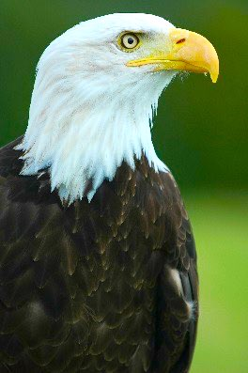
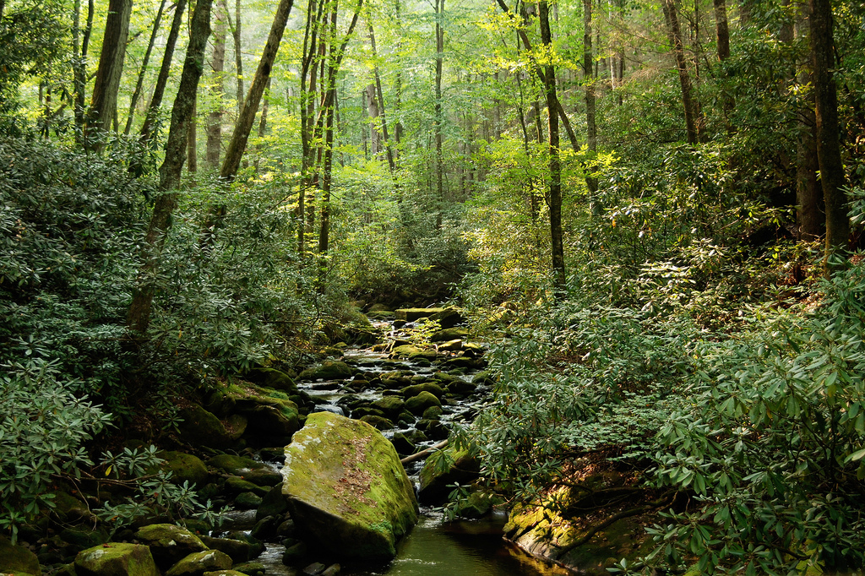
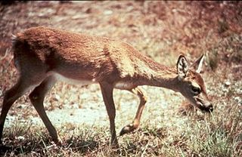
Forest Biome
eagles
deer
Cognitive Learning Systems, Inc. © 2016
Notes:
Teacher’s Notes
This slide should help to illustrate some of the differences between a biome and habitat on a very simple conceptual level. A forest (deciduous or temperate forest) is one type of biome. It generally encompasses many hundreds of miles of geographic area. Within the biome are different habitats. Habitats tend to describe a specific place or set of needs within that biome. For example, the bald eagle’s habitat is tall pine trees close to water within the deciduous forest; while the deer habitat is the underbrush of the forest.
It should be noted that there are times in which the specifications of a habitat are not deemed necessary when discussing an organism and the “habitat” of an organism is described simply by stating the biome within which it lives. For example, there are many circumstances in which a deer’s habitat has been described as “temperate forest” rather than the underbrush of the forest. This often happens because the discussion of habitat centers around the vegetation and climate which are conducive to deer rather than a description of all of the requirements of its habitat. In this circumstance the vegetative and climatic needs of deer can be simply described by its association with a certain biome since biomes are based on climatic and vegetative conditions. Students are likely to encounter this circumstance as they read and view information from various resources. Should this question arise, the information above may be useful to in helping students understand the more informal use of the term habitat.
Image credits:
Joyce Kilmer National Forest, by Marshal Hedin, retrieved on August 23, 2016 from https://www.flickr.com/photos/23660854@N07/2285322484/ [CC BY-SA 2.0 (https://creativecommons.org/licenses/by/2.0/)]
Bald eagle, by Paul Friel, retrieved on August 23, 2016 from https://commons.wikimedia.org/wiki/File:Bald_Eagle_-_%22Helga%22.jpg [CC BY-SA 2.0 (https://creativecommons.org/licenses/by/2.0/)]
Key deer, by Ludwig Gerald/U.S. Fish and Wildlife Service, retrieved on August 23, 2016 from https://commons.wikimedia.org/wiki/File:Key_deer_animal_mammal_odocoileus_virginian_clavium.jpg [Public Domain]

Slide 12
Making and Applying Connections
Tundra, desert, rainforest are all examples of
  Populations
  Communities
  Food chains
  Biomes
2. Which of these best describes how climate is different from weather?
  Climate describes the precipitation that occurs in an area. Weather does not.
  Weather describes the temperature of the air in an area. Climate does not.
  Climate describes the pattern of weather in an area over a long period of time.
  Climate describes changes in the wind from day to day.
Cognitive Learning Systems, Inc. © 2016
Notes:
Teacher’s Notes
Answers
Question 1: D
Question 2: C

Slide 13
Making and Applying Connections
  The table below shows the climate of an island in the Pacific Ocean. It was copied by a student from a website. The student missed one of the years. What is the most likely temperature for 2001?
  A. 40 °F
  B. 60 °F
  C. 79 °F
  D. 100 °F
Year | Temperature in June | Precipitation in June
1976 | 80 °F | 100 cm
1981 | 78 °F | 90 cm
1986 | 81 °F | 90 cm
1991 | 77 °F | 95 cm
1996 | 80 °F | 100 cm
2001
2006 | 77 °F | 90 cm
Cognitive Learning Systems, Inc. © 2016
Notes:
Teacher’s Notes
Answer
Question 3: C

Slide 14
Biomes
Terrestrial Biomes
Cognitive Learning Systems, Inc. © 2016
Notes:
Image credit:
Coral, from FreeImages.com, retrieved on May 11, 2016 from http://www.freeimages.com/photo/aquarium-1360326 [Public Domain]

Slide 15
What Can You Recall?
Which is larger a biome or a habitat? Why?
2. Describe the factors that make up the climate of an area.
Cognitive Learning Systems, Inc. © 2016
Notes:
Teacher’s Notes
Answers:
Question 1: A biome is larger than a habitat. A habitat describes the location in which an organism, population or community lives. This generally refers to a relatively small area. A biome is an large geographic area defined by climate and vegetation. It can encompass hundred and thousands of miles. Scientists describe biomes as being made up of many different habitats. Therefore, a biome is larger than a habitat.
Question 2: Two of the main factors that make up the climate of an area are the temperature of the atmosphere in that area and the amount of precipitation of the area. In addition to temperature and precipitation, the amount and type of wind, the number and kinds of seasons, and regular weather extremes such as hurricanes and droughts are considered part of the climate of an area.

Slide 16
Terrestrial Biomes
Terrestrial biomes are biomes found on land.
A terrestrial biome is CLASSIFIED by the temperature, precipitation, and types of plants found in the biome.
The plants and animals in each type of biome will have ADAPTATIONS that help them survive the climate in the biome.
Examples of terrestrial biomes are:
Deserts
Forests (rainforests, temperate forests, alpine forests)
Tundra
Grasslands (temperate grasslands, savannas)
Cognitive Learning Systems, Inc. © 2016
Notes:
Teacher’s Notes
In this section of the Journey Unit, students will explore several terrestrial, or land, biomes. Reinforce the concept that terrestrial biomes are classified by the temperature, precipitation and vegetation in a geographical area.
Introduce four examples of terrestrial biomes to students. Explain that this list is one way of classifying biomes. Students should notice that some of the groups contain smaller subgroups. For example, one group of biomes is forests. However, within that large group are different types of forests such as rainforests, temperate or deciduous forests and alpine forests. Students may encounter other resources that list each of these types of forests separately. Neither method is incorrect. Ultimately they both describe different types of biomes. The difference is in how they may be grouped together. The reasons for this difference is that the grouping of biome is in essence an artificial grouping and that as scientists continue to study organisms and climate, some of these distinctions and classifications result in the need for more detailed classification.
Explain to students that as they continue through the presentation, they will have an opportunity to view where on Earth these biomes are found and examples of the types of vegetation found in each biome.

Slide 17
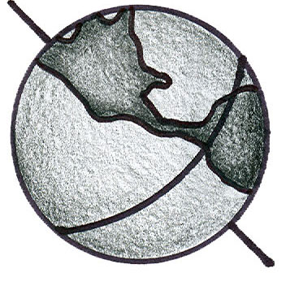
Terrestrial Biomes
If you look at areas from the equator to the poles of the Earth, there are differences in temperature.
Warmest near the equator
Coldest near the poles
Cognitive Learning Systems, Inc. © 2016
Notes:
Teacher’s Notes
Because the classification of biomes is based upon climate, one of the easiest ways to understand biome distinctions and to remember the location of biomes is to focus on the differences in temperature that occur with differences in latitude. From their previous exploration of the solar system and their understanding of the tilt of the Earth on its axis, students should recall that in general, areas of the Earth near the equator are warmer and areas near the poles are colder. In addition, as one travels from the equator toward the poles, there would be a gradual decrease in overall seasonal temperature.
It is important to note that the above diagram focuses on GENERAL temperature variations from the poles to the equator. It does NOT include a discussion with respect to seasonal temperature changes. Thus, a student may point out and would be correct in stating that the temperature in Pennsylvania in July would be hotter or equal to the temperature at the equator.
Although not presented here, students should recall that the tilt of the Earth’s axis not only sets up a temperature gradient from the equator (warm) to the poles (cold) but it is also responsible for seasonal differences. When the northern hemisphere is tilted toward the Sun, it is warmer (summer). When the northern hemisphere is tilted away from the Sun, it is colder (winter). The same is true for the southern hemisphere. Because the equator always receives direct light from the Sun, the temperature is essentially the same year round.
Should students ask, climate and biome classification not only takes into account the general equator/pole temperature variations, but also includes the seasonal variations in temperature.

Slide 18
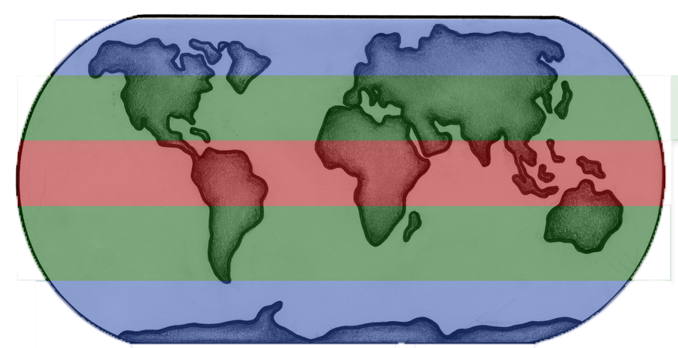
Terrestrial biomes can be classified by their TEMPERATURE.
Tropical: Biomes with warm temperatures all year round: close to the equator. (Tropical Rainforests, Tropical deserts, savannas)
Temperate: Biomes with moderately warm and moderately cold seasons: middle latitudes. (Temperate forests, Temperate grasslands)
Arctic: Biomes with cold temperatures almost all year round: closer to the poles. (Tundra, Alpine Forest)
Cognitive Learning Systems, Inc. © 2016
Notes:
Teacher’s Notes
As students view this slide, they should not be surprised to see the three basic biome classifications as based on temperature. From the previous slide, students should have been able to predict the different temperatures that would be found in different regions of the Earth. Because temperature is ONE of the factors in determining climate, it is also one of the ways in which biomes can be grouped or classified.
Students should be able to see that the grouping of biomes in this slide differs from that shown previously. Again, neither method is incorrect. Both still represent the same biomes. They simply present them under different types of headings or grouping. Students may find the grouping by temperature easier to remember.

Slide 19
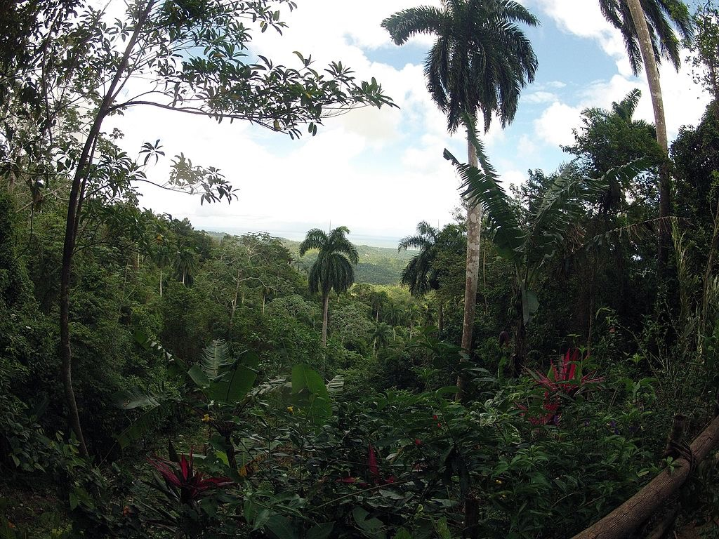
Tropical Rainforest
Look at the map.
You should see TWO different areas of the world.
They both have the SAME TEMPERATURE and the SAME amount of PRECIPITATION.
They have the SAME CLIMATE.
They are the SAME type of BIOME. They are both areas of a tropical rainforest.
Cognitive Learning Systems, Inc. © 2016
Notes:
Teacher’s Notes
As students view this slide, they should notice from the map that both areas are found around similar latitudes and therefore similar temperature “zones.” In addition, from reading the text, students should see that these areas also have the same precipitation. In other words, they have the SAME CLIMATE.
Students should realize that these areas are the same type of biome because these two areas have the same temperature AND amount of precipitation -the same climate. This is an important concept for students to understand. This slide should be used to reinforce the idea that it is the CLIMATE which includes BOTH temperature and precipitation that governs the type of biome that exists in an area. Therefore, if students know that the climate is the same, then it is likely that the biomes of two areas will be the same. If the climate is different, then it is likely that the two areas will have different biomes.
Image credits:
El Yunque rainforest in Puerto Rico, by MaggoMaggo, retrieved on August 24, 2016 from https://commons.wikimedia.org/wiki/File:GOPR1037.jpg [CC BY-SA 4.0 (https://creativecommons.org/licenses/by/4.0/)]

Slide 20
Tropical Rainforest
Near the equator:
The temperature is hot year round.
There is a large amount of precipitation year round.
The rainforest contains many different plants and animals.
Few plants grow under the trees. The canopy formed by their leaves blocks most light from reaching the ground.
Vines grow downward from treetops so their leaves receive more light.
Heavy rains wash away much of the nutrients in the soil.
Plants have shallow roots to absorb nutrients from dead leaves that fall to the ground and decay rapidly in the tropical heat.
Cognitive Learning Systems, Inc. © 2016
Notes:
Teacher’s Notes
In this slide and the one that follows, students are introduced to the tropical rainforest biome.
The tropical rainforest is one of the biomes that illustrates extremes in precipitation and near extremes in temperature. It receives over 200 cm of rain annually, the one of the highest amounts of precipitation of terrestrial biomes, and has an average daily temperature of 20-25° C (70-80° F).
The large amount of precipitation results in tremendous plant growth, as students should observe from the picture in the slide. In this biome, the plants grow so rapidly that they consume nutrients from decomposed leaf litter almost immediately. Thus, most of the nutrients are found within the plants and not within the soil. As a result, the soil of rainforest is relatively infertile. Unfortunately, many people associate the rich vegetation with fertile soil and so there have been many cases in which rainforest has been cleared in an attempt to use what was assumed to be rich fertile soil for farming. These attempts have most always been met with failure as the nutrient poor soil does not produce significant agricultural yields.
As students will see on this slide, plants within the rainforest have adaptations that permit their survival in this unique biome. Although not mentioned here, animals within the tropical rainforest also have adaptations for living within this area. One of the most intriguing facts about animal life in the rainforest is that most species of animals live within the trees of the rainforest. Animals commonly found within the rainforest include the great apes and monkeys such as gorillas, orangutans and spider monkeys. In addition, sloths and toucans are some of the other animals found within this biome.
The unique climate and vegetation within this biome makes it home to over 15 million species of plants and animals. This is perhaps the greatest biodiversity within a biome in the world.
Image credits:
El Yunque rainforest in Puerto Rico, by MaggoMaggo, retrieved on August 24, 2016 from https://commons.wikimedia.org/wiki/File:GOPR1037.jpg [CC BY-SA 4.0 (https://creativecommons.org/licenses/by/4.0/)]

Slide 21
Not all places with similar TEMPERATURES are in the SAME BIOME.
Why? PRECIPITATION!
A biome is classified by its temperature AND precipitation. Areas that have the same temperature but DIFFERENT amounts of precipitation support different types of plant and animal life. Examples:
Grasslands
Temperate Forest
Cognitive Learning Systems, Inc. © 2016
Notes:
Teacher’s Notes
This slides helps students re-focus on the concept that climate and therefore biomes depend NOT only on temperature, but also on precipitation. Previously they saw two areas with the same temperature and the same amounts of precipitation (tropical rainforest) and came to understand that these two areas were the same type of biome.
In this slide, two different biomes are presented. In looking at the maps, they are both found around similar latitudes and therefore similar temperature “zones.” However, they are classified as two different biomes because although these areas have relatively the same temperature during each season, they receive different amounts of precipitation. Thus these two areas have DIFFERENT climates. It is important that students understand this distinction so that they do not incorrectly infer that two areas with the same temperature will always be the same type of biome.
The next two slides illustrates how the difference in precipitation even with the same temperature results in different vegetation and therefore in different animals that live in each biome. In addition, it presents adaptations of the plants and animals that live in each biome. As students encounter each slide they should be reminded to consider how each component of the biome is interacts with the others. As they finish the third slide, they should be able to mentally compose a picture of the biome in terms of temperature, precipitation, vegetation, animals and adaptations that are characteristic of that biome.
It should be noted that the information contained in the next three slides is by no means a complete description of the climate, animals or plants in each biomes. However, the information should serve as a base for understanding biomes, their components and adaptations of organisms within biomes. As students progress in their science education, it is expected they will add to this knowledge.

Slide 22
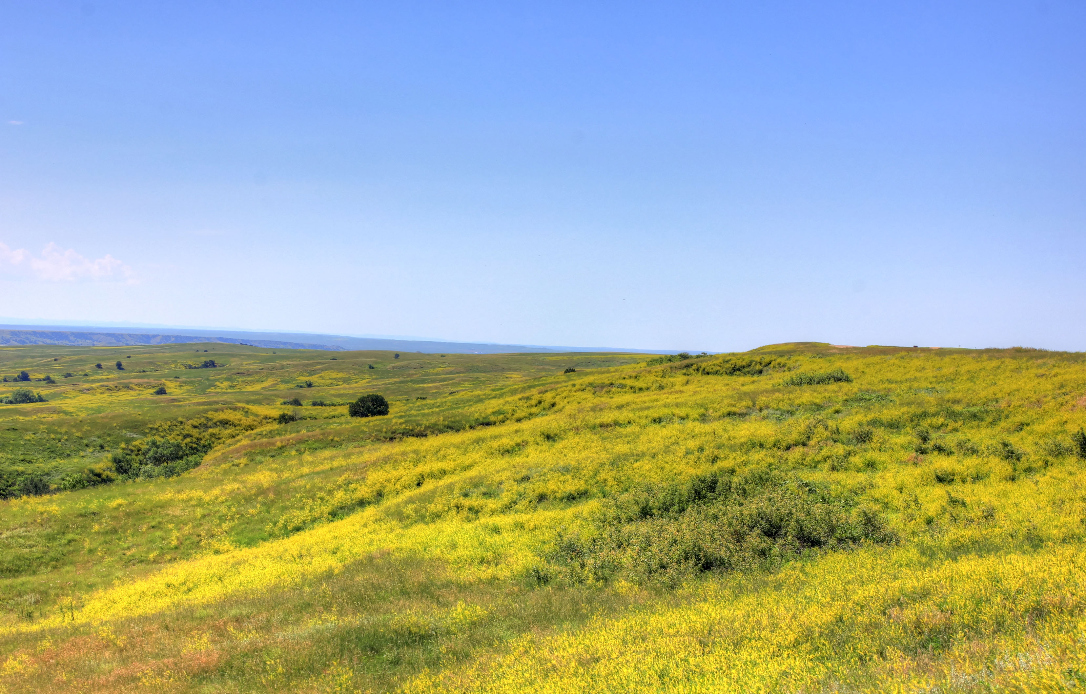
Terrestrial Biomes
There are places which have similar TEMPERATURES but are DIFFERENT BIOMES.
Why? PRECIPITATION!
Grasslands (Prairie)
Temperate Forest
Cognitive Learning Systems, Inc. © 2016
Notes:
Teacher’s Notes
Direct students’ attention to the difference that precipitation makes to the vegetation of the grasslands and forest. Ask students which biome they think receives more precipitation. Allow time for discussion.
Image credits:
Yellow Flowers on the grassland at Badlands National Park, South Dakota (3/60), retrieved August 24, 2016 from https://www.goodfreephotos.com (Good Free Photos) [Public Domain]
Joyce Kilmer National Forest, by Marshal Hedin, retrieved on August 23, 2016 from https://www.flickr.com/photos/23660854@N07/2285322484/ [CC BY-SA 2.0 (https://creativecommons.org/licenses/by/2.0/)]

Slide 23
Terrestrial Biomes
Grasslands and Temperate Forests are different biomes.
They have similar TEMPERATURES but different amounts of PRECIPITATION.
Grasslands (Prairie)
Temperate Forest
4 seasons: winter, spring, summer, fall
Warm summers
Cold winters
Precipitation occurs mostly during late spring and early summer
Less precipitation than a temperate forest biome
4 seasons: winter, spring, summer, fall
Warm summers
Cold winters
Precipitation occurs year round
More precipitation than a grasslands biome
Cognitive Learning Systems, Inc. © 2016
Notes:
Teacher’s Notes
In this slide, student should observe that the temperature of both biomes is essentially the same. Each has four seasons, with summer being warm/hot, winter being cold and spring and fall as intermediate temperatures between the two. However, the precipitation differs between the two biomes. The temperate forest receives what scientists would call moderate amounts of precipitation year round. In contrast, the grasslands biome receives moderate amounts of precipitation only during a small portion of the year, the late spring and early summer. Thus the amount of precipitation received by both biomes during late spring and early summer is essentially the same. However, because the grasslands biomes receives little precipitation during other times of the year, the TOTAL amount of precipitation in the temperate forest is greater than in the grasslands.
The result of the difference in vegetation is easily seen in these two pictures. The greater amount of precipitation in the temperate forest supports a large variety of plants from grasses, flowers, and bushes to large trees. In contrast, the lesser amount of precipitation in the grasslands biome can support grasses but cannot support large bushes and trees.
Image credits:
Yellow Flowers on the grassland at Badlands National Park, South Dakota (3/60), retrieved August 24, 2016 from https://www.goodfreephotos.com (Good Free Photos) [Public Domain]
Joyce Kilmer National Forest, by Marshal Hedin, retrieved on August 23, 2016 from https://www.flickr.com/photos/23660854@N07/2285322484/ [CC BY-SA 2.0 (https://creativecommons.org/licenses/by/2.0/)]

Slide 24
Terrestrial Biomes
Grasslands
Temperate Forest
Mostly grasses with very few trees or bushes.
Animals are mostly herbivores.
Adaptations:
Animals may migrate during the cold season.
Layers of plants from the ground up:
grass > bushes > small saplings > large deciduous trees
Adaptations:
Trees lose their leaves during the cold season to prevent water loss and cold damage. Animals store food and may migrate or hibernate during the cold season.
Cognitive Learning Systems, Inc. © 2016
Notes:
Teacher’s Notes
As students view this slide, begin by reinforcing the differences in vegetation that results from differences in precipitation. Draw students’ attention to the prevalence of herbivores in grasslands. Although not specifically stated, the temperate forest has a mixture of herbivores, carnivores and omnivores. One of the reasons that there are more carnivores in the temperate forest is that the underbrush combined with the larger bushes and trees provides more shelter and places to “hide” for predators than grasslands which are essentially wide open.
In addition, discuss some of the adaptations of animals and plants that exist in each biome.
Image credits:
Yellow Flowers on the grassland at Badlands National Park, South Dakota (3/60), retrieved August 24, 2016 from https://www.goodfreephotos.com (Good Free Photos) [Public Domain]
Joyce Kilmer National Forest, by Marshal Hedin, retrieved on August 23, 2016 from https://www.flickr.com/photos/23660854@N07/2285322484/ [CC BY-SA 2.0 (https://creativecommons.org/licenses/by/2.0/)]

Slide 25
Some places with similar PRECIPITATION are DIFFERENT BIOMES.
Why? TEMPERATURE!
A biome is classified by its temperature AND precipitation. Areas that have the same amount of precipitation but DIFFERENT temperatures support different types of plant and animal life. Examples:
Desert
Tundra
Cognitive Learning Systems, Inc. © 2016
Notes:
Teacher’s Notes
In the last series of slides, students investigated biomes with similar temperature but different levels of precipitation. They may wonder whether temperature or precipitation has a greater influence on climate and biomes. The answer is that both are powerful contributors to climate and therefore to differences in biomes. This slide and the two that follow are designed to help students investigate this concept by illustrating two biomes that have similar levels of precipitation but very different temperatures.
As students look at the maps, they should once again be struck with the relationship between distance from the equator and temperature. The farther from the equator, the colder the temperature.
As with the other series of slides, students should consider how the similarities in precipitation but differences in temperature affect the climate, plant and animals in each biome and the adaptations present in the organisms of each biome.

Slide 26
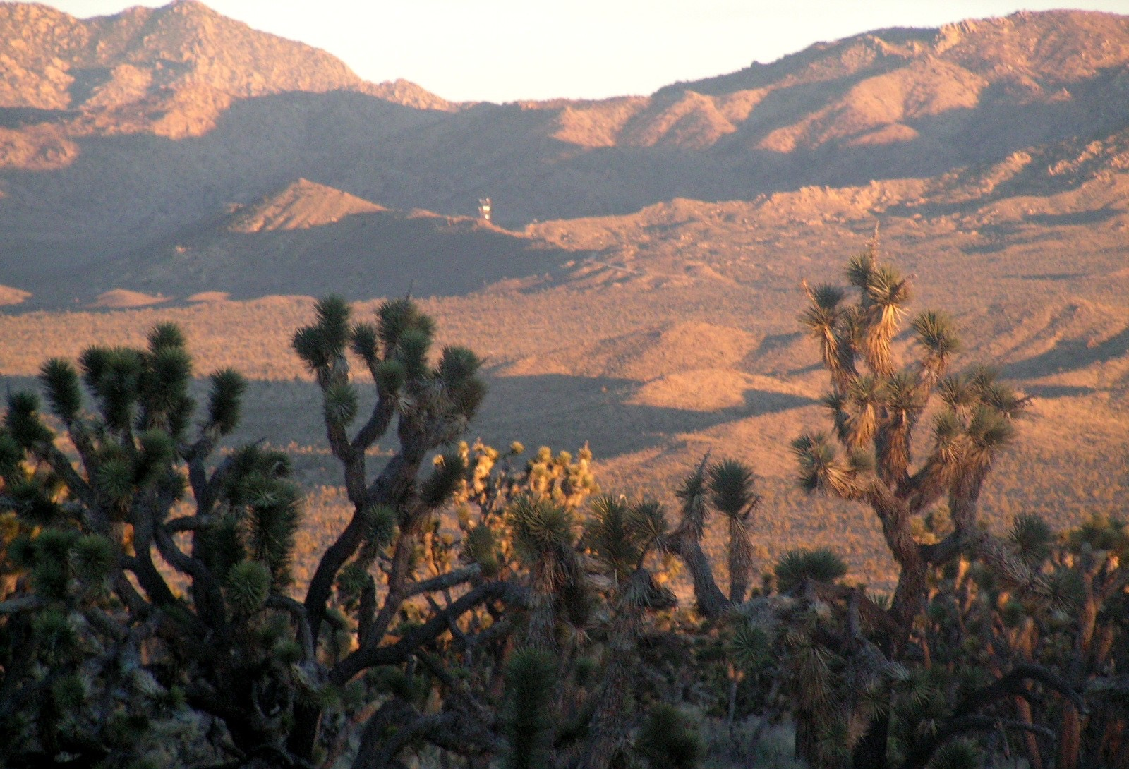
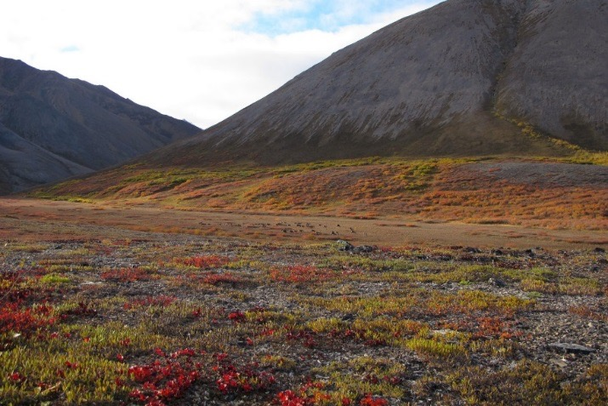
Terrestrial Biomes
Desert
Tundra
Hot and dry year round.
Short growing period tied to spring rains.
Adaptations:
Plants have needle-like “leaves” to reduce water loss.
Many animals are active at night when it is cooler. They also live in burrows that are cool and humid instead of above the ground.
Animals may have large ears or skin flaps to help their bodies stay cool.
Cold and dry year round.
Short “cool” growing period in the summer, when temperatures are warmest.
Adaptations:
Plants grow low to the ground for protection from the cold winds. Smaller plants also need less water and nutrients.
Animals have thick fur for warmth and small ears to reduce heat loss.
Cognitive Learning Systems, Inc. © 2016
Notes:
Teacher’s Notes
Students should notice that both biomes are considered dry climates. They receive little precipitation year round. As a result, students should notice the almost complete absence of large bushes and trees from either biome.
In addition, students should notice the temperature difference between the two biomes. The desert is hot year round and the tundra cold/cool year round. In general there is less variability in seasonal temperature in the desert than the tundra. The temperature remains almost the same year round in the desert. Although the tundra is described as cold year round, it does have a period in which the temperatures rise which is referred to as its “cool/warm” growing period. This short period in which the temperatures rise above freezing (40 degrees Fahrenheit) allows the growth of small plants.
Plant growth is sparse in both of these biomes as compared to the forest or grasslands biomes as a result of the low levels of precipitation. However, plants do live in both biomes. In general deserts are said to have MORE vegetation and diversity of plant life than tundras because of the difference in temperature and winds. In the tundra, high, cold winds would dry and destroy tall plants, trees or shrubs. In addition, the temperature is so cold that there is a layer of permanently frozen soil called permafrost that exists year round. Permafrost is as impenetrable as concrete. Therefore, roots cannot move deep into the ground and plants tend to be low lying. In addition, permafrost is one cause of the limited nutrient supply in the soil as it does not allow for the mixing of organic materials into the soil. This lack of plentiful nutrients also limits plant growth.
In addition, plant structure differs between the desert and tundra as a result of different adaptations plants must make in hot versus cold climates. Thus, ultimately, the differences in the type and amounts of plants that inhabit both biomes is linked to the differences in temperature between the two.
Students may suggest that the extreme temperatures in the desert and tundra are the main cause for sparse plant life. As just discussed above, temperatures, do play a part in regulating plant life. However, as students think about biomes by investigating the alpine forest and reflecting on the tropical rainforest, they should see that the temperatures in these biomes is similar to the tundra and desert, yet more plant life is supported in the alpine forest and tropical rainforest. One of the differences is the additional precipitation that these other biomes (alpine forest, tropical rainforest) receive.
Image credits:
New York Mountains of the Mojave Desert, from US National Park Service, retrieved on May 11, 2016 from https://www.nps.gov/common/uploads/photogallery/pwr/park/moja/CA841159-155D-4519-3E0ED47959AE931C/CA841159-155D-4519-3E0ED47959AE931C-large.jpg [Public Domain]
Tundra at the Noatak National Preserve, from US National Park Service, retrieved on August 24, 2016 from https://www.nps.gov/media/photo/view.htm?id=C63527F9-1DD8-B71C-07F8F57BD2F92F5C [Public Domain]

Slide 27
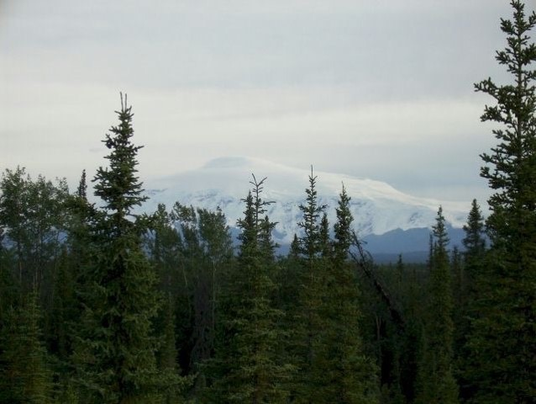
Alpine Forest
Cognitive Learning Systems, Inc. © 2016
Notes:
Teacher’s Notes
The last terrestrial biome that students will explore in this Journey is the Alpine Forest.
Image credit:
Alaska’s Mount Sanford viewed from the Copper Lake Trail, from the US National Park Service, retrieved May 11, 2016 from https://www.nps.gov/common/uploads/photogallery/akr/park/wrst/3D8D6880-1DD8-B71C-07D6ED8E7687CF5D/3D8D6880-1DD8-B71C-07D6ED8E7687CF5D-large.jpg [Public Domain]

Slide 28

Alpine Forest
Very cold during most of the year with a short, warm growing period
Precipitation is similar to the grassland biome, but snow is more common.
The plants are mostly fir and pine trees.
Animals include carnivores such as wolves and herbivores such as snowshoe hares and elk.
Adaptations:
Fir and pine needles are coated with wax to reduce water and heat loss.
Animals have large paws for running over snow, and fur to minimize heat loss.
Some animals burrow into tunnels beneath the snow to keep warm. Other animals hibernate.
Cognitive Learning Systems, Inc. © 2016
Notes:
Teacher’s Notes
The Alpine Forest is a biome associated with northern latitudes as well as higher altitudes. Many people commonly associate the word “alpine” with mountain. Although many alpine forests are located on mountains, there are many which are not. This is one of the reasons, that alpine forests are often referred by another name- Taiga. As students explore this biomes, they should understand that the term “alpine forest” refers as much to the type of trees (pine trees) as to the type of terrain that signifies this biome.
Image credit:
Alaska’s Mount Sanford viewed from the Copper Lake Trail, from the US National Park Service, retrieved May 11, 2016 from https://www.nps.gov/common/uploads/photogallery/akr/park/wrst/3D8D6880-1DD8-B71C-07D6ED8E7687CF5D/3D8D6880-1DD8-B71C-07D6ED8E7687CF5D-large.jpg [Public Domain]

Slide 29

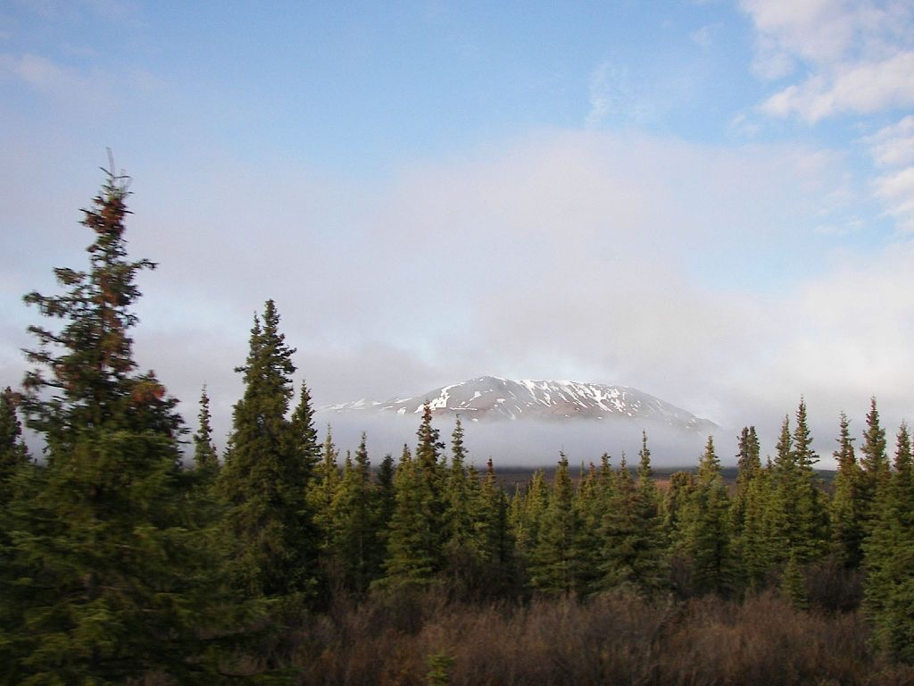
Let’s compare biomes in Alaska
This is the arctic tundra in Alaska. It is near the North Pole.
This is the alpine forest in Alaska. It is farther away from the North Pole.
How are they different?
Cognitive Learning Systems, Inc. © 2016
Notes:
Teacher’s Notes
How are they different? Guide students to think about the differences that they can see (or read), and what they can infer. (Students may immediately note that the plants are very small in the tundra, and that there are lots of swamps and pine trees in the Alpine Forest.)Thinking back on earlier slides, students may recall that the temperatures (or climate), precipitation, plant life, and animal life are all different.
Students may realize that the tundra is farther north, closer to the Arctic Circle, and that it has a shorter spring and summer, and a very short growing season during the very short summer. During the 50-60 days of summer, the sun shines for 24 hours a day! Animals would have heavy fur coats – often colored white in winter – and plants would be low growing and adapted to the very short growing season and permafrost just below the surface of the soil.
The alpine forest is a bit warmer than the Tundra, but also has a fairly short growing season. Pine and fir trees are most successful here because the narrow needles (instead of leaves) protest the trees against moisture loss and heat loss. The cone shape of the tree also helps shed heavy snows, which protects the branches from breakage. Animals would have fur coats, and would burrow or hibernate for protection against the long, cold winter.
Additional information: Alpine, or boreal (pronounced bore-ee-ul) forest, is northern coniferous forest that is found just below the snow line of a mountain, around an elevation of about 10,000 feet above sea level. No trees grow above the snow line. Another name for boreal forest is taiga (pronounced tie-guh). Taiga is the Russian word for forest.
Image credits:
Tundra at the Noatak National Preserve, from US National Park Service, retrieved on August 24, 2016 from https://www.nps.gov/media/photo/view.htm?id=C63527F9-1DD8-B71C-07F8F57BD2F92F5C [Public Domain]
Alpine (boreal) forest by kyleandkelly, retrieved on August 25, 2016 from https://commons.wikimedia.org/wiki/File:Taiga_Alaska.jpg [CC BY-SA 2.0 (https://creativecommons.org/licenses/by/2.0/)]

Slide 30
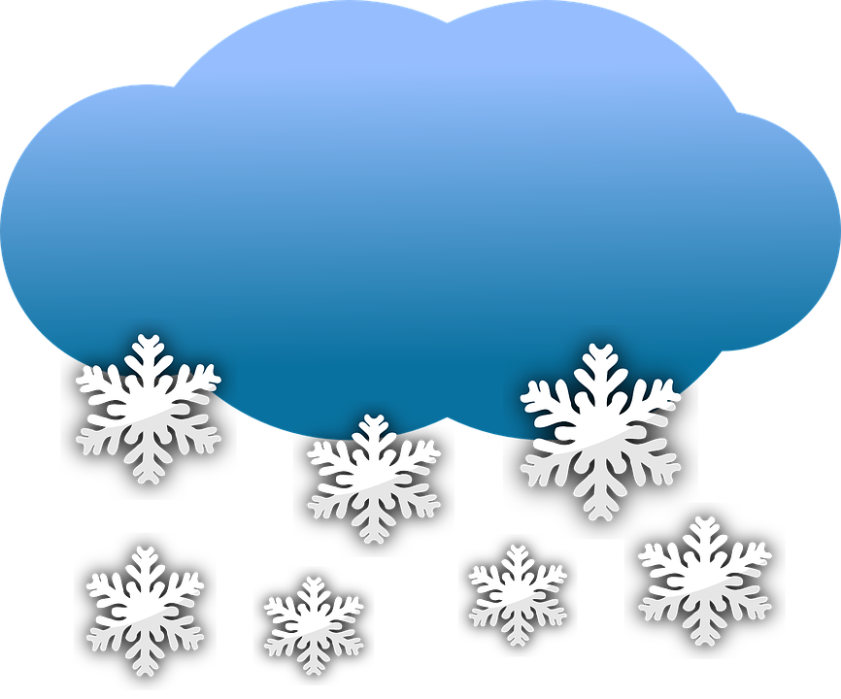
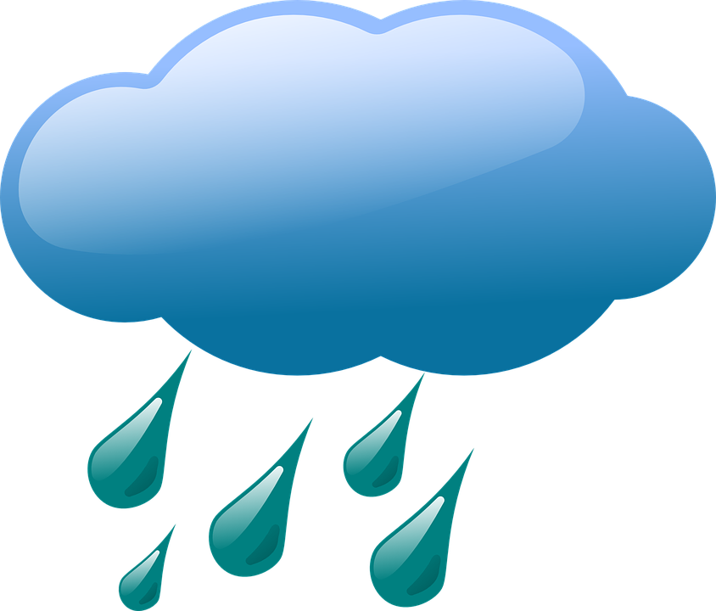
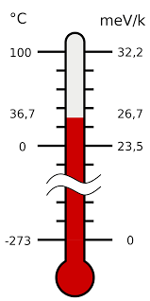
How are they different?
Let’s take a look.
To have different biomes in the state of Alaska, there must be differences in both temperature and precipitation.
How can we represent these differences?
Cognitive Learning Systems, Inc. © 2016
Notes:
Teacher’s Notes
How are they different? In the previous slide, students may have come up with lots of differences! Here, we will focus their attention on differences in temperature and precipitation — bringing them back to the defining differences in biomes.
To have different biomes in the state of Alaska, there must be differences in temperature and precipitation.
How can we represent these differences? Answers will vary — Students may be guided to think about tables, bar graphs, pictographs. In the next several slides, students will look at tables and bar graphs. They will then be able to design their own bar graphs using precipitation data.
Image credits:
Rain, from Pixabay.com, retrieved on May 11, 2016 from https://pixabay.com/en/cloud-weather-rain-rainfall-37011/ [Public Domain]
Snow, from Pixabay.com, retrieved on May 11, 2016 from https://pixabay.com/en/cloud-snow-flakes-winter-weather-306404/ [Public Domain]
Sun, from Clipart.org, retrieved on May 11, 2016 from https://openclipart.org/detail/165476/meteo-sole [Public Domain]
Thermometer in Celsius and electronvolts (eV), from Wikimedia Commons, retrieved on May 11, 2016, from https://commons.wikimedia.org/wiki/File:Temperature_in_eV.svg [Public Domain]

Slide 31
Tables
Tables show us information or data in an organized way.
This table shows the average summer temperatures for seven locations in Alaska and Canada.
Average Temperatures (Celsius) | May | June | July | August | September
Anchorage | 12.2 | 16.7 | 18.3 | 17.2 | 12.8
Fairbanks | 21.1 | 21.1 | 23.9 | 21.1 | 17.8
Denali Park | 14.4 | 20.0 | 21.1 | 17.8 | 11.7
Juneau | 16.7 | 17.8 | 17.8 | 16.7 | 13.3
Ketchikan | 13.3 | 16.1 | 18.3 | 18.3 | 15.6
Skagway | 13.9 | 17.2 | 17.2 | 16.1 | 13.9
Vancouver | 17.8 | 20.6 | 23.3 | 22.8 | 18.3
Cognitive Learning Systems, Inc. © 2016
Notes:
Teacher’s Notes
This table organizes the average summer temperatures for 7 areas in Alaska and Canada. Students should be able to identify the 2 warmest areas just by scanning the information. They are Fairbanks and Vancouver. The lowest summer temperatures are found in Anchorage and Skagway. Ask students if these differences in temperatures might indicate that these are different biomes. It is likely that students may suggest that the differences in temperatures may indicate a difference in biomes. Fairbanks is part of a Alpine Forest biome. Vancouver is part of a Temperate Forest biome. Anchorage and Skagway are part of the Alpine Tundra biome.
(Remembering that we’re focusing in on biomes, we’ll look at the average precipitation next to see if it is different for these areas as well.)
Additional information: The Fairbanks average summer temp is 21.0C, and the Vancouver summer average temp is 20.1C. These are in Celsius, and are roughly in the 68-70 degree range on the Fahrenheit scale. For Anchorage, the summer average is 15.4C or about 59F, and 15.7C or 60F.

Slide 32
Tables
Tables show us information or data in an organized way.
This table shows the average summer
rainfall for seven locations in Alaska.
Average Temperatures (Centimeters) | May | June | July | August | September
Anchorage | 1.9 | 2.9 | 4.3 | 6.2 | 6.9
Fairbanks | 1.5 | 3.5 | 4.7 | 5.0 | 2.4
Denali Park | 2.0 | 5.9 | 8.2 | 7.3 | 4.0
Juneau | 8.7 | 8.0 | 10.6 | 13.5 | 17.1
Ketchikan | 23.4 | 18.5 | 18.5 | 26.9 | 35.1
Skagway | 3.8 | 2.8 | 2.8 | 5.6 | 10.3
Vancouver | 6.1 | 4.6 | 3.6 | 3.8 | 6.5
Cognitive Learning Systems, Inc. © 2016
Notes:
Teacher’s Notes
This table organizes the average summer precipitation for the same 7 areas in Alaska. Have students scan the table and ask if they can spot the wettest and driest locations. Students should be able to quickly see that Ketchikan is the wettest location simply because it has the largest numbers all the way across the table. It has an average monthly rainfall of 24.5 cm during the summer months. Juneau is second with about 11.3 cm on average each month.
It is likely that students may suggest that the differences in precipitation may indicate a difference in biomes. Fairbanks is part of a Alpine Forest biome. Vancouver , Juneau, and Ketchikan are part of a Temperate Rain Forest biome. Anchorage and Skagway are part of the Alpine Tundra biome.
It’s a little more difficult to spot the driest location, but it is Fairbanks. Fairbanks gets a monthly average of only 3.4 cm each month, with most of the rain falling in July and August.
Ask students if these differences in temperatures might indicate that these are different biomes.

Slide 33
Bar Graphs
Bar graphs can simplify the data for us.
Blue represents summer temperatures in the tundra.
Red represents summer temperatures in the alpine forest.
Cognitive Learning Systems, Inc. © 2016
Notes:
Teacher’s Notes
Your students may be familiar with this type of graph. It is a graphical or visual representation of data which makes it much faster and easier to see differences in the temperatures of the 2 biomes. Ask them if they can tell which biome has warmer summers, and have them explain what they see.
Tell your students that they will be constructing a similar graph using precipitation data. Review the components of the graph with them: Scale, labels, use of 2 colors to show the 2 different biomes, etc.

Slide 34
Now, can you make a bar graph to show the differences in precipitation?
What units will you use?
How will you show that there are two different biomes?
Will you use different colors?
How many months will you show?
How will you label your graph?
Cognitive Learning Systems, Inc. © 2016
Notes:
Teacher’s Notes
These questions are designed to guide students to make a bar graph similar to the preceding one. You may wish to discuss some possible answers to these questions, and to refer back to the previous slide if necessary. They will use the information in the next slide to construct their graph.
Please make sure that students have access to graph paper, rulers, pencils, and colored pencils or crayons.

Slide 35
Are you ready to try?
Make a bar graph with the data in this table!
Average Summer Rainfall
Biome | May | June | July | August | September
Arctic Tundra | 2.1 cm | 3.0 cm | 4.5 cm | 6.3 cm | 7.0 cm
Alpine Forest | 6.5 cm | 2.8 cm | 3.4 cm | 4.0 cm | 6.7 cm
Cognitive Learning Systems, Inc. © 2016
Notes:
Teacher’s Notes
Leave this slide up for the students to work from, and give them time to complete a bar graph showing the different levels of rainfall for these 2 biomes.
Have students share their bar graphs with the class. Also, depending upon time available, you may wish to discuss pictographs and line graphs with your students.

Slide 36
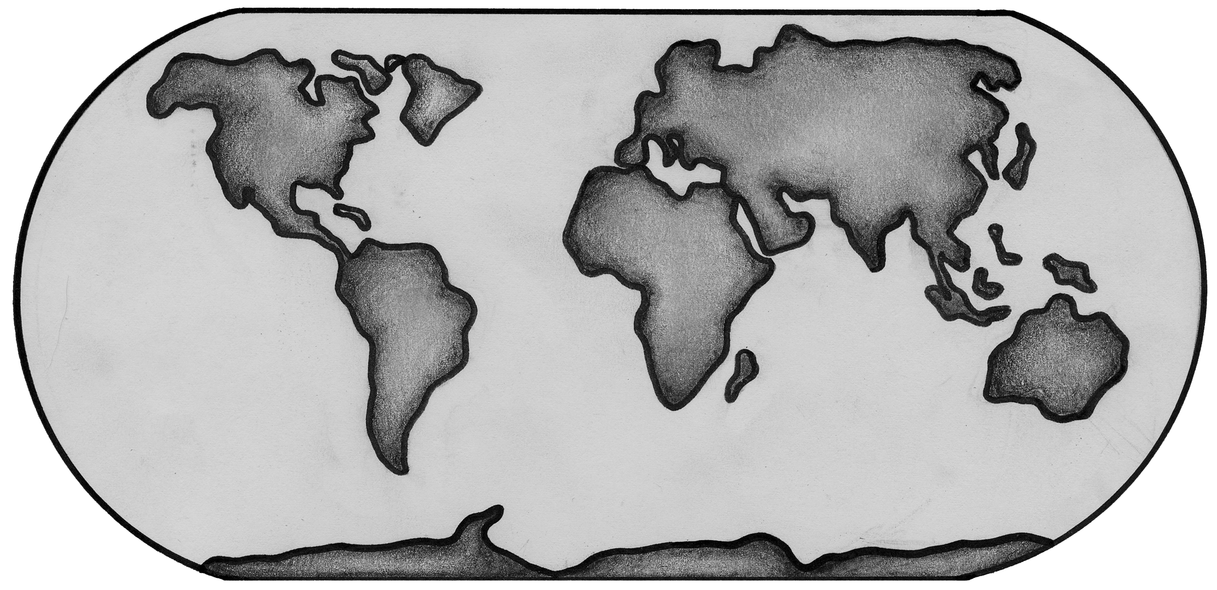
Making and Applying Connections
Which areas of the map are the most likely to have the same type of biome?
2
1
3
4
1 and 2
1 and 3
2 and 3
3 and 4
Cognitive Learning Systems, Inc. © 2016
Notes:
Teacher’s Notes
Answers
Question 1: B

Slide 37
Making and Applying Connections
Which explains why cacti and other plants in the desert have needle-like leaves?
Plentiful nutrients
Little sunlight
Intense heat
Abundant water
Cognitive Learning Systems, Inc. © 2016
Notes:
Teacher’s Notes
Answers
Question 2: C

Slide 38
Making and Applying Connections
David compares the number of droughts that happen each year in four biomes with the types of plants that grow in each.
What question is David trying to answer?
How much water is in each biome?
What types of plants are in each biome?
How many droughts occurred in each biome?
What types of plants can best survive droughts?
Cognitive Learning Systems, Inc. © 2016
Notes:
Teacher’s Notes
Answers
Question 3: D

Slide 39
Biomes
Aquatic Biomes
Cognitive Learning Systems, Inc. © 2016
Notes:
Image credit:
Coral, from FreeImages.com, retrieved on May 11, 2016 from http://www.freeimages.com/photo/aquarium-1360326 [Public Domain]

Slide 40
What Can You Recall?
Would two areas of the Earth found around the equator have DIFFERENT biomes or the SAME biome? Why?
2. Describe some adaptations that plants or animals have depending upon the biome in which they live.
Cognitive Learning Systems, Inc. © 2016
Notes:
Teacher’s Notes
Answers:
Question 1: Students should indicate that the two areas may have either the SAME biome or DIFFERENT biomes. The answer would depend on what the CLIMATE was of the areas. If the temperature and precipitation of the two areas was the same, it is likely that the climate of the two areas would be the same. If the climate is the same, then it is likely that the two areas will be the same type of biome. However, if the climate between the two areas is DIFFERENT because either the temperature or the precipitation differs between the two areas, then the two areas will be different biomes.
Question 2: Student answers will vary. Students should be able to give examples from the terrestrial biomes they explored. Two examples are described below.
Animals that live in desert biomes tend to live in burrows rather than on the surface of the Earth because of the cooler temperatures and shade that the underground provides.
Plants in the tundra tend to be low lying in order to survive the harsh winds and cold temperatures of this biome.

Slide 41
Aquatic Biomes
The differences in terrestrial biomes depend upon the in temperature and amounts of precipitation for their areas. The plants and animals that live in a terrestrial biome also depend upon temperature and precipitation.
Aquatic biomes are biomes that are found in water.
The type of aquatic biome depends upon:
The temperature of the water
The depth of water
Nutrients in the water
The amount of salt in the water
Water movement
Plants and animals in different aquatic biomes will have adaptations that suit the temperature, depth, nutrients, and salt in their biomes.
Cognitive Learning Systems, Inc. © 2016
Notes:
Teacher’s Notes
Previously students investigated the components of biomes and examples of terrestrial biomes. In the last section of this Journey Unit, students will extend their investigation to those biomes within water- aquatic biomes.
Aquatic biomes, like terrestrial biomes, have living and non-living components. The same factors which affect terrestrial biomes- temperature and precipitation- also effect aquatic biomes. However, understanding and dissociating that climate in an aquatic biome is in one sense more complex than that of terrestrial biomes. When thinking about the climate of an aquatic biome, scientists break down several climatic factors including the temperature of the water, the depth of water, nutrients in the water, the amount of salt in the water (salinity), and water movement.
Obviously temperature is a major factor as it is in terrestrial biomes. However, the amount of precipitation tends to exert its influence less directly. Precipitation can affect water movement, salinity, and nutrients in the water. But these may also be affected by other factors. In the end, scientists have determined that it is the depth of water, nutrients in the water, water salinity and water movement that have more of a DIRECT effect on plants and animals. Thus, climate in an aquatic biome is described by describing the five factors listed on this slide and below, rather than by only temperature and precipitation as with terrestrial biomes.
The temperature of the water
The depth of water
Nutrients in the water
The amount of salt in the water (salinity)
Water movement
Although students may see different factors that influence terrestrial and aquatic biomes, the point should be made that in BOTH cases, biomes are described and classified in terms of CLIMATE. And in both cases, plants and animals in different aquatic biomes experience different climates and therefore will have different adaptations depending upon the climate.

Slide 42
Aquatic Biomes
The difference between the two types of biomes is based on the amount of salt in the water. There are two major types of aquatic biomes:
Marine biomes have more than 1% salt in their water.
Freshwater biomes have less than 1% salt in their water.
Cognitive Learning Systems, Inc. © 2016
Notes:
Teacher’s Notes
As with terrestrial biomes, students may see different groupings of aquatic biomes through different resources. However, one of the easiest ways to classify aquatic biomes is to first divide them into two groups on the basis of salinity: freshwater and saltwater biomes.

Slide 43
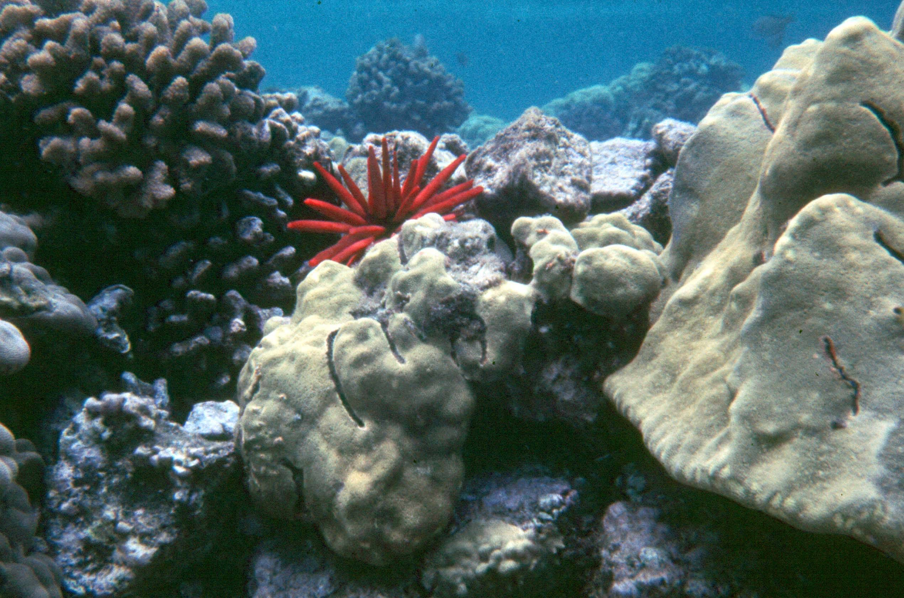
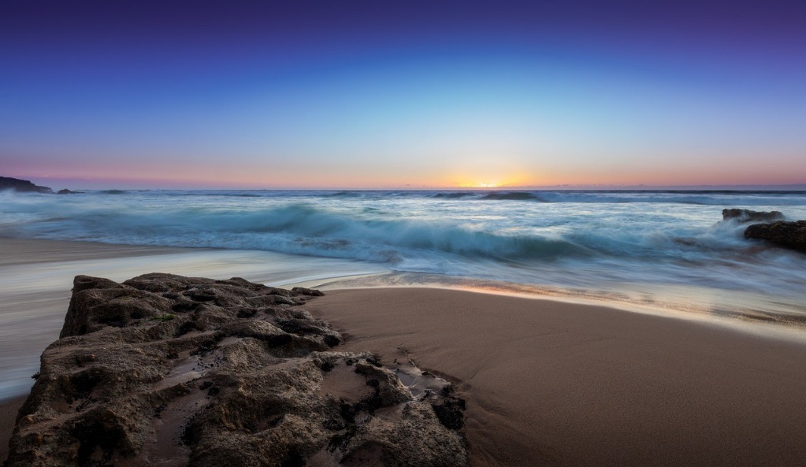
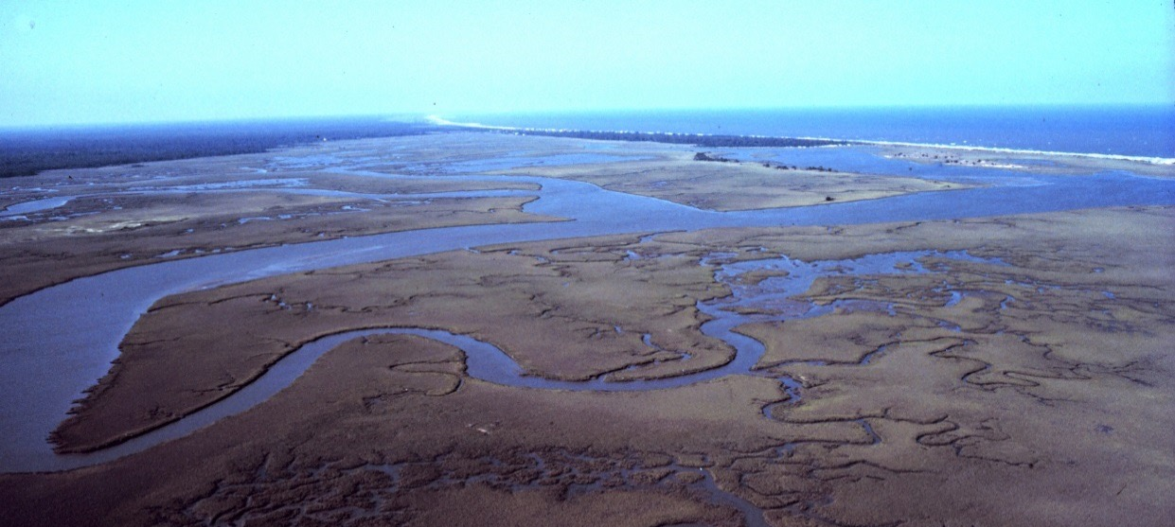
Marine Biomes
There are several different types of marine biomes. The water in each of these biomes is considered saltwater.
Coral Reefs
Open oceans
Estuaries
Cognitive Learning Systems, Inc. © 2016
Notes:
Teacher’s Notes
This slide and the next six slides are presented to help students explore three types of marine biomes: the open ocean, coral reefs and estuaries. Remind students that in each of the biomes, the water is considered saltwater.
Image credits:
Coral reef, from US National Park Service/National Park of American Samoa, retrieved August 25, 2016 from https://www.nps.gov/media/photo/view.htm?id=EE7829DF-155D-4519-3ED894882FCB74BD [Public Domain]
Ocean view, from Pixabay.com, retrieved on August 25, 2016 from https://pixabay.com/en/ocean-waves-beach-sand-stone-sand-1081834/ [Public Domain]
North Inlet - Winyah Bay National Estuarine Research Reserve, from NOAA retrieved on September 3, 2015 from https://www.flickr.com/photos/51647007@N08/5122950553/ [[CC BY-SA 2.0 (https://creativecommons.org/licenses/by/2.0/)]

Slide 44

Marine Biomes
The OCEAN biome can be divided into different zones according to DEPTH. Sunlight can only reach into the top two zones. Organisms that must have light must live in these two zones.
Sunlit zone (photosynthesis)
Twilight zone (light but no photosynthesis)
Midnight zone (no light)
crust
Pitch black zone (Abyss)
Cognitive Learning Systems, Inc. © 2016
Notes:
Teacher’s Notes
The open ocean is filled with a variety of plant and animal life. One of the feature of this biome is that it can be further divided into different zones that are unique in the plant and animal life that inhabit it. Division into zones can occur according to depth alone, depth at which light penetrates the water, as well as pressure differences.
When each of these are taken together the result is a myriad of zones, which although interesting, would itself require several days of study. Thus, for this Journey Unit, only one method of zoning has been illustrated- that based on the depth at which light penetrates the water. This factor affects plant growth and plants found within each zone as light is needed for photosynthesis. In addition, it also affects the types of animals within each zone as animals would require different methods and types of nutrition depending upon whether plants were available in a particular zone.
The slides that follow highlight each zone of the ocean, whether plants permeate that zone, and the types of adaptations that animals within the zone have.

Slide 45
Sunlit zone
This zone receives a lot of light. It also has a lot of oxygen because of the mixing action of waves. Many plants are found in this zone because there is a lot of light. There are also many animals in this zone.
Sunlit zone (photosynthesis)
crust
Adaptations:
Barnacles live on rocks and piers close to shore. They make a “waterproof glue” so they are not washed away by the waves.
Plants have flexible stems that allow movement with waves.
Some animals are a light color on the top and a darker color on the bottom. This is called “countershading.” They blend into the ocean when seen from the top or the bottom. This helps the animals “hide” from predators or prey in the zone.
Cognitive Learning Systems, Inc. © 2016
Notes:
Teacher’s Notes
The sunlit zone is the top layer of the open ocean. This includes the area next to the shore as well as farther out into the open ocean. Within this entire zone are a great abundance of fish, other marine organisms, plants and other photosynthetic organisms. This slide focuses on the abundance of plants and fish in the sunlit zone next to the shore because the majority of ocean close to the shore is composed of the sunlit zone. It is in this area that plants with stems are found.
Examples of aquatic animals with countershading include sharks, rays and skates, and penguins.
If students ask, countershading also occurs in land animals as well. Many birds have dark backs and white or light-colored stomachs. The gray and white coloring of a gray squirrel is also an example of countershading.
However, as you move out farther within the open ocean, the depth below the sunlit zone increases to such an extent that plants are not capable of extending their roots tot the ocean floor. Thus, at these larger distances from the shore, the producers in the sunlit zone do not consist of what are technically classified as plants. Rather, the producers are phytoplankton. These are microscopic organisms that can photosynthesize like plants. These microorganisms provide much of the food for the fish that inhabit the sunlit zone in this region of the ocean.

Slide 46
Twilight zone
Twilight zone (light but no photosynthesis)
crust
This zone is filled with fish and other animals that feed on smaller organisms from the sunlit zone. There is less light than in the sunlit zone.
Adaptations:
The eyes on fish may be larger and directed upward, so that they can see the silhouettes of other animals (for food) against the dim light.
Some fish “glow” as a way of providing their own light.
Cognitive Learning Systems, Inc. © 2016
Notes:
Teacher’s Notes
The twilight zone is the zone in which bioluminescence (glowing in the dark) first appears because of the low levels of light. Examples of animals that live in this zone include lantern fish, hatchet fish and viperfish.

Slide 47
Midnight zone
Midnight zone (no light)
crust
No light penetrates to this zone.
There is no photosynthesis and there are no photosynthetic producers in this zone. (No plants or other organisms that can perform photosynthesis)
Large fish in this zone either prey on fish or dead organisms that fall from the upper layers.
Adaptations:
Animals may have thin bodies that help them hide from predators.
Some are red or black in color to better blend in with the dark water.
Cognitive Learning Systems, Inc. © 2016
Notes:
Teacher’s Notes

Slide 48
Pitch black zone
crust
Pitch black zone (Abyss)
This zone is VERY COLD and has very high pressures. There are very few animals in this zone. There are no plants in this zone.
Adaptations:
Animals living in this zone must have bodies that are adapted to cold temperatures. They must also be adapted to high pressures so that their bodies are not crushed by the water around them.
Examples of animals that are in this zone are basket stars and tiny squids.
Cognitive Learning Systems, Inc. © 2016
Notes:
Teacher’s Notes

Slide 49

Marine Biomes
Coral Reefs
Estuaries
Shallow WARM saltwater areas near continents and islands
Corals are the major form of life. They are made up of small animals and algae (plants).
There are few nutrients in shallow warm waters because the nutrients sink to the bottom.
Corals adapt by having their algae part use photosynthesis to produce food and the tentacles of their “animal part” catch plankton for additional food.
Areas where freshwater rivers or streams meet the ocean
The mixing of salt and freshwater results in water of different salt concentrations.
Seaweed and marsh grasses grow here.
Grasses have adaptations to survive different salt concentrations. They can pump salt out of their “bodies” or take up extra water to dilute the salt.
Cognitive Learning Systems, Inc. © 2016
Notes:
Teacher’s Notes
Many scientists consider coral reefs and estuaries as separate biomes as a result of the unique climate, and plant and animal life found in each.
For example, although coral reefs are part of the ocean, their warm temperatures, and shallow depth result in a climate that is different from water of the same depth but of different temperatures and from water with the same temperature but different depth. For scientists concerned with classifying and defining aquatic biomes, these criteria serve as an important reason that coral reefs can be classified as separate and distinct biomes. However, it should be mentioned that the grouping and classification of aquatic biomes is a younger area of study as compared to the classification of terrestrial biomes. For this reason, there are resources and definitions which still classify coral reefs as a separate zone within an ocean biome. As with many areas of research, neither of these classifications is incorrect when explained appropriately within context. However, because of the ongoing support for a separate classification of coral reefs, they are defined within this Journey Unit as a separate marine biome.
Coral reefs are commonly found as barriers along continents and islands. One of the best know reefs is the Great Barrier Reef off the coast of Australia. Unique to coral reefs are coral, special organisms that are composed of BOTH algae and animal tissue. The result of this unique combination is that coral can “feed itself.” The algae portion of coral serves as producers since they are able to photosynthesize. Additional nutrient needs are met as the animal portion of coral extends its tentacles in order to obtain plankton from the water. In addition to coral, other fish, sea urchins, octopuses and sea stars inhabit coral reefs.
Estuaries are also considered by many scientists as distinct marine biomes. Estuaries are unique in that they represent a geographical boundary between fresh water and saltwater. Estuaries are defined as areas in which the freshwater from rivers meets the saltwater of oceans. This mixing of freshwater and saltwater creates an aquatic environment that has variations in salt content at different areas depending upon the distance from the ocean and during different times of day as a result of high and low tides. The result of this constantly fluctuating salinity is a biome inhabited by plants and animals with unique adaptations for dealing with this constant change. Plants and animals characteristically found in estuaries include seaweeds, marsh grasses, worms, oysters, crabs, and waterfowl. This estuary is located along the South Carolina coast. It connects to the Atlantic Ocean, which can be seen along the horizon in the upper right-hand corner of image.
Additional information about estuaries: Estuaries such as the one at North Inlet, above, have areas of salt marsh between which the water flows and mixes. A salt marsh is a form of wetland, and is common along protected shorelines like the one at North Inlet. The salt marshes are the “nurseries” of the estuary, where many newly hatched fish, crabs, and shrimp are protected from predators until the grow large enough to fend for themselves in the open waters of the estuary, where they remain until they are old and large enough to move into the open ocean.
Image credits:
Coral reef, from US National Park Service/National Park of American Samoa, retrieved August 25, 2016 from https://www.nps.gov/media/photo/view.htm?id=EE7829DF-155D-4519-3ED894882FCB74BD [Public Domain]
North Inlet - Winyah Bay National Estuarine Research Reserve, from NOAA retrieved on September 3, 2015 from https://www.flickr.com/photos/51647007@N08/5122950553/ [[CC BY-SA 2.0 (https://creativecommons.org/licenses/by/2.0/)]

Slide 50
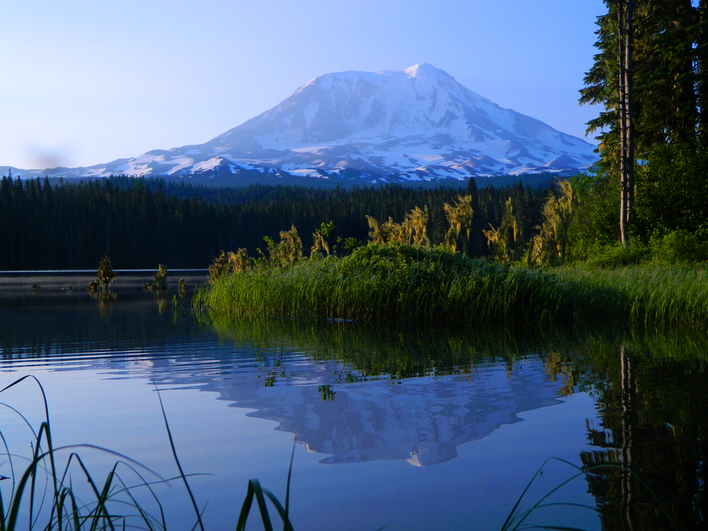
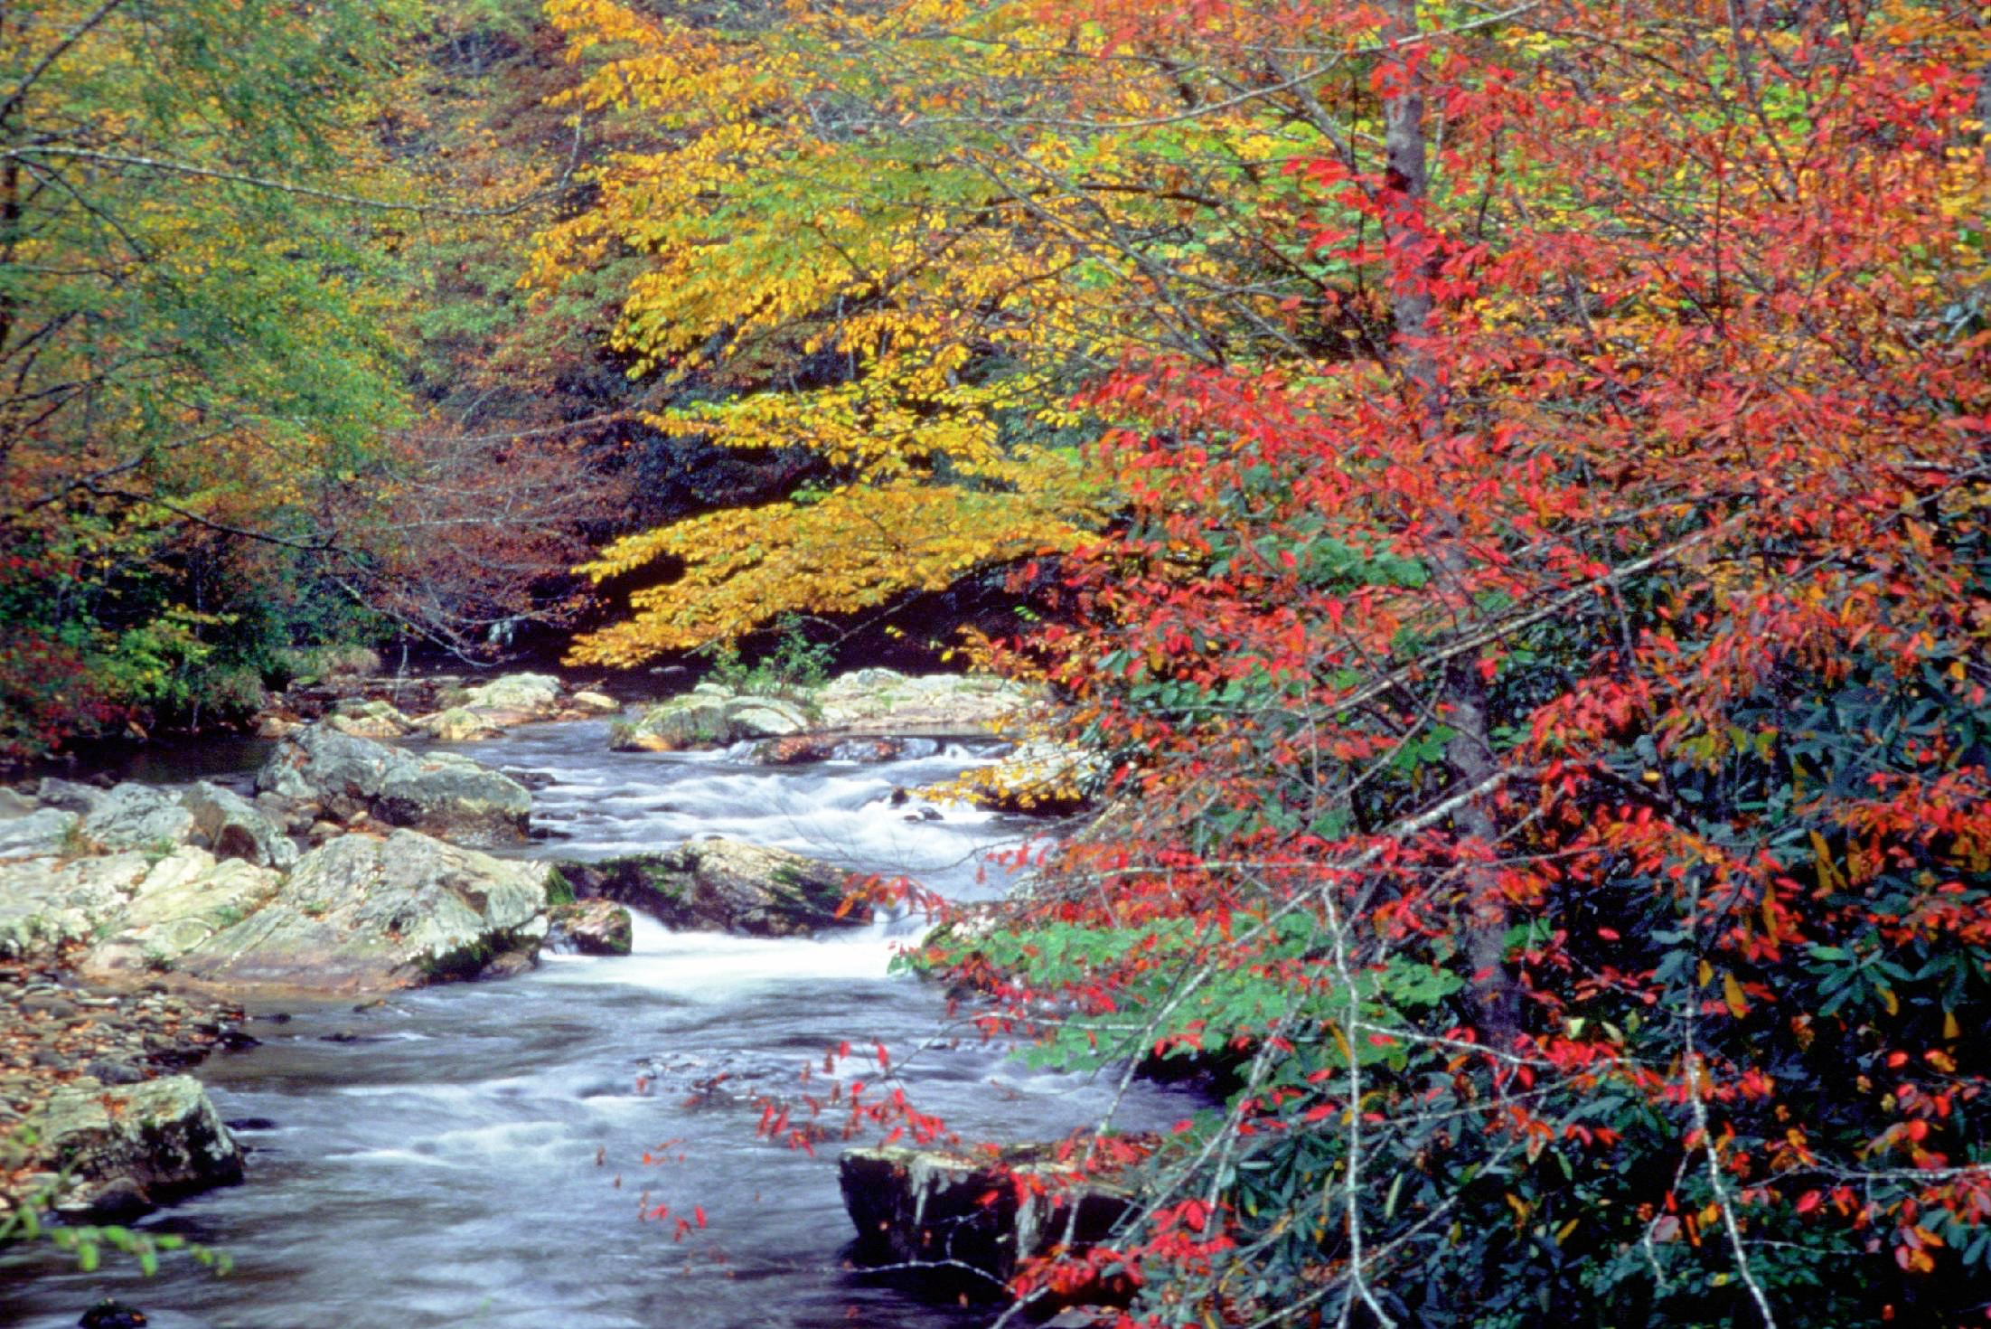
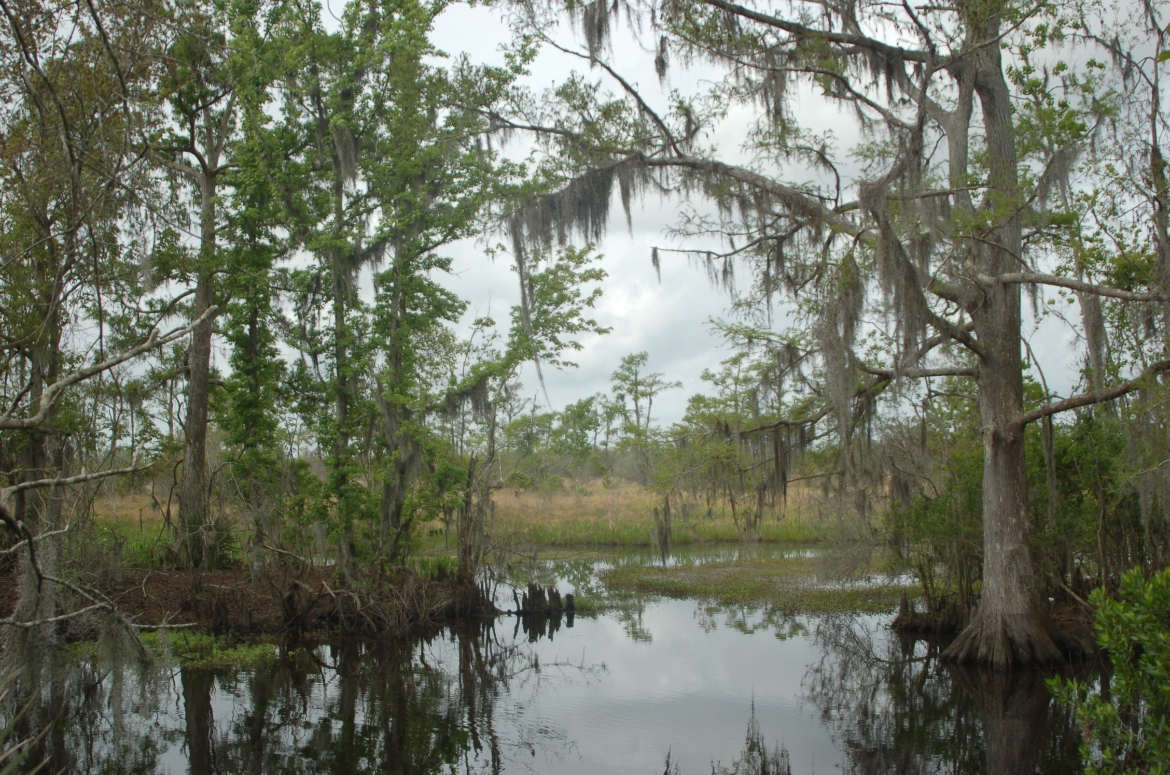
Freshwater Biomes
Lakes and ponds
Rivers and streams
Wetlands
Cognitive Learning Systems, Inc. © 2016
Notes:
Teacher’s Notes
In addition to marine or saltwater biomes, the Earth is home to three major types of freshwater biomes: lakes and ponds, rivers and streams and wetlands.
Image credits:
Takhlakh Lake in Washington, by Adorable Fluttershy, retrieved August 26, 2016 from https://commons.wikimedia.org/wiki/File:Mount_Adams_Early_Morning_Reflection_at_Takhlakh_Lake.png [[CC BY-SA 3.0 (https://creativecommons.org/licenses/by/3.0/)]
Cypress swamp in Jean Lafitte National Historical Site and Preserve (Louisiana), from US National Park Service, retrieved May 11, 2016 from https://www.nps.gov/media/photo/view.htm?id=85014CF6-1DD8-B71C-0741C10AF9FC7550 [Public Domain]
Cataloochee Creek in Great Smoky Mountains National Park (North Carolina), from US National Park Service, retrieved May 11, 2016 from https://www.nps.gov/media/photo/view.htm?id=2883F08E-1DD8-B71C-0738BC90D402ABE9 [Public Domain]

Slide 51

Freshwater Biomes
Lakes and Ponds
Animals and plants tend to be larger than in rivers or streams because the water does not move. As in oceans, different plants and animals are found in different areas of lakes and ponds. This is caused by differences in water depth, photosynthesis, water temperature, and oxygen content.
Close to the shore
Warm shallow water
Light can reach the bottom
Plants with roots, amphibians, invertebrates, crustaceans are found here
Deep layers of lake
No light
Cold water
Low levels of oxygen
Fish are adapted to dark and cold. They feed on nutrients and decaying matter that sinks to bottom from other layers.
Cognitive Learning Systems, Inc. © 2016
Notes:
Teacher’s Notes
Students are likely to be very familiar with the freshwater biome of lakes and ponds. Although not completely delineated here, lakes and ponds can be divided into zones similar to the open ocean biome. The boundaries of these zones are defined by both the distance from the shore and the depth of water. Each zone differs in its plant and animal life as a result of differences in light penetration, depth of the lake or pond floor and temperature.
The area close to the shore can be established as one zone. Most plants are found in this area because their roots can easily find the lake or pond bed. As a result of the rich plant life, there are a myriad of invertebrates, crustaceans and amphibians in this zone.
Farther out in the lake the top layer of water is considered similar to the area close to the shore in its ability to support life and nutrients. Although plants are generally not found here because the lake or pond bed is at a much greater depth, photosynthesis is prevalent and carried out by microscopic organisms known as phytoplankton. Fish such as bass and trout feed off of this plankton and other types of plankton. Both the water in this top layer and the water close to short tend to be much warmer compared to the deeper waters of a lake.
The deeper waters of a lake or pond are thought of as a third zone within the lake or pond. In this area, the depth is such that light does not penetrate and as a result photosynthesis does not occur. Therefore, no plants or photosynthesizing plankton would be found here. The lack of light and the lack of plants and photosynthesizing plankton result this zone being dark, cold and low in oxygen. Animals in this zone are adapted to these conditions. Their nutrient source comes mainly from the dead and decaying matter that falls from the zones above.
Image credit:
Takhlakh Lake in Washington, by Adorable Fluttershy, retrieved August 26, 2016 from https://commons.wikimedia.org/wiki/File:Mount_Adams_Early_Morning_Reflection_at_Takhlakh_Lake.png [[CC BY-SA 3.0 (https://creativecommons.org/licenses/by/3.0/)]

Slide 52

Freshwater Biomes
Rivers and Streams
Bodies of flowing water moving in one direction
Different types of plants and animals live at the beginning (head), middle, and mouth of a river. Different amounts of oxygen and light can reach into the water in these areas.
Rivers and streams are usually colder than lakes and ponds. Plants and animals that live in rivers and streams are adapted to these cooler temperatures.
Many plants and animals that live in lakes and ponds cannot live in rivers and streams. The water is too cold and moves too fast for them.
Cognitive Learning Systems, Inc. © 2016
Notes:
Teacher’s Notes
Rivers and streams represent a second type of freshwater biome. They differ from lakes and ponds in several ways. One of the most obvious is that the water in these biomes is moving. As a result, the water in rivers and streams tends to be colder than in lakes and ponds. Thus, temperature differences exist between the these two biomes.
As with some of the other aquatic biomes, rivers and streams can be divided into different areas. For rivers and streams, three different zones are generally described: the head or beginning of the river, the middle, and the end of the river. These three areas tend to exhibit differences in temperature, oxygen content, turbidity and accumulation of sediment. As you might expect, these factors often combine to produce a difference in water conditions that results in a difference in the plants and animals that inhabit that area.
For example, the headwaters of a river or stream tend to be cooler and have more oxygen than the water at the mouth of the stream. Salmon are found in in these cooler, more oxygen rich areas of rivers, whereas carp and catfish are found in warmer mouth sections as these are species that require less oxygen. The middle of the river tends to be an area of great species diversity as the width of the river increases. Both the head and middle of the river tend to have more plant diversity than the mouth of the river because of differences in the amount of light that penetrates these areas. Towards the mouth of the river, the water becomes more turbid or murky compared to the head or middle of the river because of the sediment that has been picked up by the water along its course. As a result of this increase in sediment, less light can penetrate the water, leading to lower levels of photosynthesis and less plant diversity.
Image credit:
Cataloochee Creek in Great Smoky Mountains National Park (North Carolina), from US National Park Service, retrieved May 11, 2016 from https://www.nps.gov/media/photo/view.htm?id=2883F08E-1DD8-B71C-0738BC90D402ABE9 [Public Domain]

Slide 53
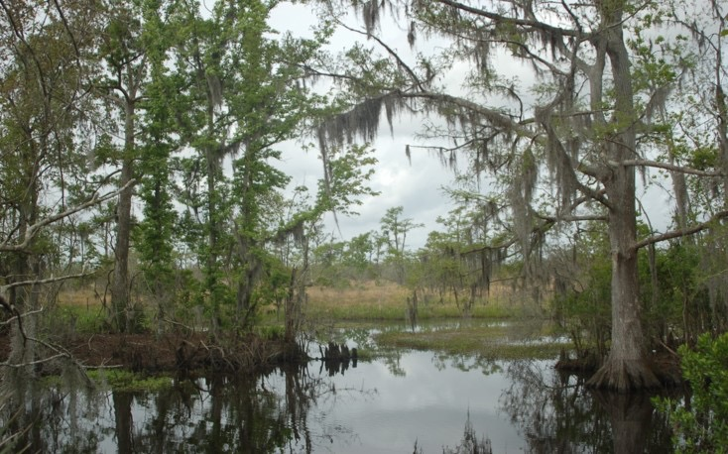
Freshwater Biomes
Wetlands
Special types of plants called hydrophytes live in wetlands. Examples are pond lilies and cattails. They have special adaptations for living in moist conditions.
Half of the space in their leaves is filled with air to help leaves float.
Most wetland plants have structures that form mats instead of roots. They also have structures that can anchor into the soft mud of a wetland.
Cognitive Learning Systems, Inc. © 2016
Notes:
Teacher’s Notes
The last freshwater biome discussed in this Journey Unit is the wetlands biomes. Students should be familiar with this biome and some of the adaptations of its plants as a result of completing the Ecosystems and Adaptations CELL. As a biome, it is one of the most intriguing because of the unique adaptations of its plants. In addition to the examples listed above, these hydrophytes have evolved a multitude of structures and functions that allow them to function in this biome. Although students may assume that these adaptations are all directed at living with large amounts of water, there are hydrophytes and other plants of the wetlands must also deal with variations in water levels as SOME wetlands do NOT remain moist or filled with water during all portions of the year.
One of the ecological functions of wetlands is that it serves as a sponge or reservoir for water from nearby rivers and streams. For some wetlands, there is a portion of the year when the wetlands have what would be considered an excess of water. However, during drier portions of the year or during droughts, water from some of these wetlands recedes. Thus the plants that thrive in the excess water conditions, must also be able to tolerate lower levels of water.
In addition to this function wetlands also serve as a filter for the chemicals and sediments that passes from the land to the ocean. This is because as water runs off the land and passes through a wetland, many sediments become trapped by the vegetation and settle into the soil. Many of the chemicals carried along with the water and sediments are often converted into less toxic forms by the plants of the wetlands.
The picture on this slide illustrates only one type of wetland, a forested wetland. This type of wetland is dominated by trees. Marshes or wet meadows are wetlands that are usually made up of grasses and leafy but not woody plants. Bogs or swamps are wetlands that have fewer grasses and low to medium height bushes and other woody plants.
Image credit:
Cypress swamp in Jean Lafitte National Historical Site and Preserve (Louisiana), from US National Park Service, retrieved May 11, 2016 from https://www.nps.gov/media/photo/view.htm?id=85014CF6-1DD8-B71C-0741C10AF9FC7550 [Public Domain]

Slide 54
Making and Applying Connections
In which ocean zone would you expect to find the most plants?
A. The sunlit zone
B. The twilight zone
C. The midnight zone
D. The pitch black zone
Sunlit zone
Twilight zone
Midnight zone
crust
Pitch black zone
Cognitive Learning Systems, Inc. © 2016
Notes:
Teacher Notes
Answers
Question 1: A

Slide 55
Making and Applying Connections
Which of these best explains the difference between marine and freshwater biomes?
A. The amount of salt in the water
B. The number of plants in the water
C. The number of animals in the water
D. The amount of light that goes through the water
Which of these would most likely be found in the deepest part of a lake?
A. Light
B. Plants
C. Animals adapted to cold water
D. Animals adapted to warm water
Cognitive Learning Systems, Inc. © 2016
Notes:
Teacher Notes
Answer
Question 2: A
Question 3: C

Slide 56
Making and Applying Connections
The graph below shows the total amount of precipitation in five different biomes around the world last year.
Which of these is true about the biomes in the graph?
A. All of the biomes received the same amount of precipitation last year.
B. The Australian grassland had the least amount of precipitation last year.
C. Most of the biomes received more than 20 cm of precipitation each year.
D. The most precipitation last year fell in the Pennsylvania temperate forest.
Cognitive Learning Systems, Inc. © 2016
Notes:
Teacher Notes
Answer
Question 4: C

Slide 57
Biomes
Diversity, Unity, and Cycles of Life
Cognitive Learning Systems, Inc. © 2016
Notes:
Image credit:
Coral, from FreeImages.com, retrieved on May 11, 2016 from http://www.freeimages.com/photo/aquarium-1360326 [Public Domain]

Slide 58
We’ve seen lots of biomes.
They’re all different…but they also have many things in common!
Let’s explore.
Cognitive Learning Systems, Inc. © 2016
Notes:
Teacher’s Notes
Slides 58-61 are designed to help students explore components that all biomes share. These slides focus on things that all biomes have in common, and will serve as reminders that there is life everywhere on Earth — all of which is subject to these same factors.
Next, we will explore the life cycles of different organisms through slides 62-76. Students will come to understand that, although organisms can have dramatically different and unique life cycles, (and be present in very different biomes), they all have certain components in common. All organisms experience birth, growth, reproduction, and death. All organisms have a life cycle.
In slides 74-75, students will be guided to develop models to describe the universality of these facets of the life cycle.

Slide 59
1. Organisms live in them.
Seals
Polar bears
ArcticHare
Caribou
Wolves
Caribou
Squirrels
Beavers
Bison
Coyotes
Rattlesnakes
Prairie Dogs
Squirrels
Bears
Mountain Lions
Woodpeckers
Elephants
Zebras
Hippopotami
Ducks
Camels
Rattlesnakes
Roadrunners
Tortoises
Sloths
Chameleons
Giant Anteaters
Jaguars
Tundra
Savannah
Ice
Tiaga Forest
Rainforest
Temperate Forest
Desert
Grassland
Cognitive Learning Systems, Inc. © 2016
Notes:
Teacher’s Notes
Students should recognize the color-coding of biomes, having seen it in the first and second sections of this Journey. You may wish to remind them that biomes are color-coded based on their geographic area, climate, and the organisms that live in them.
Here are some questions you may wish to ask for review: What biome do we live in? Have you seen the animals in our biome’s circle? What kind of plants grow in our biome? How would you describe our climate?
And if time allows, do you know someone who lives in a different biome? If so, what is that biome like?

Slide 60
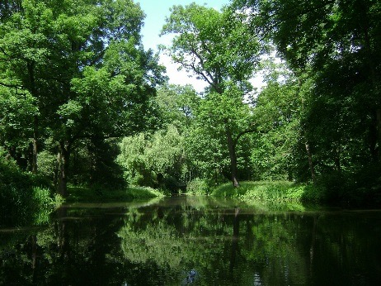
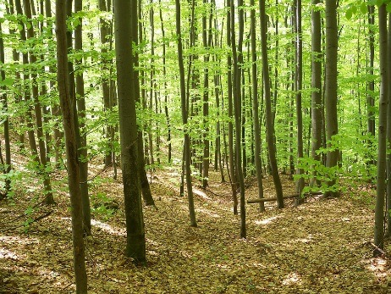
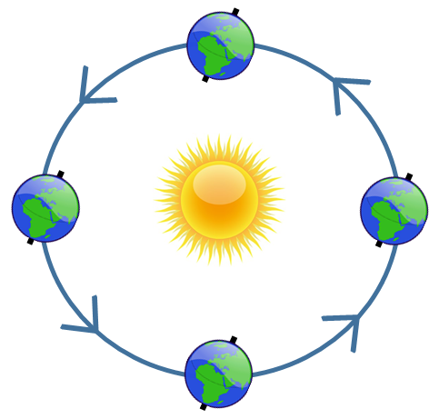
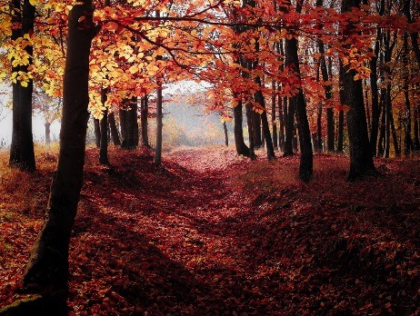
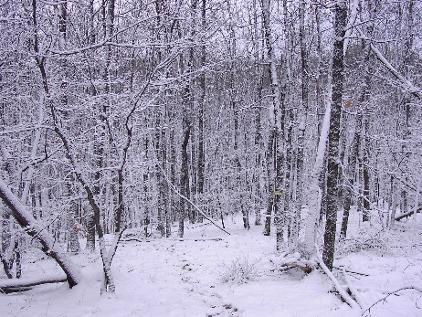
2. They have different seasons because of
the tilt of the Earth.
Summer
Spring
Autumn
Cognitive Learning Systems, Inc. © 2016
Winter
Notes:
Teacher’s Notes
For now, it will be enough to point out that there is a relationship between the tilt and the Earth’s orbit around the sun. (Students will get into the finer details of this phenomenon in both at later stages in their science education.)
All biomes on Earth have seasons due to the tilt of the Earth on its axis. The tilt, combined with the Earth’s movement around the sun, results in different areas of the Earth receiving direct or indirect sunlight at various times of the year. When there is direct sun in North America, it is summer. At the same time, South America experiences winter because the sun shines less directly on that part of the Earth.
Remind students that they’ve seen biomes that have only a 50-60 day summer, which is the growing season there (Arctic Tundra). Although the summer is short, the Arctic Tundra does have 4 seasons just like we do. Even in tropical places near the equator there are distinct seasons, with seasonal variations in temperature and rainfall, even though the variations may not be as drastic as in other latitudes.
Image credits:
Deciduous trees in summer, from Pixabay.com, retrieved on May 11, 2016 from https://pixabay.com/en/warsaw-poland-park-forest-trees-100294/ [Public Domain]
Deciduous trees in autumn, from Pixabay.com retrieved on August 27, 2016 from https://pixabay.com/en/forest-autumn-fall-nature-1345719/ [Public Domain]
Deciduous trees in winter, by Zlatan.Zlatanov, retrieved on May 11, 2016 from https://commons.wikimedia.org/wiki/File:Kazanka.winter.in.the.forest.JPG [Public Domain]
Deciduous trees in spring, from Pixabay.com, retrieved on May 11, 2016 from https://pixabay.com/en/deciduous-forest-spring-nature-111223/ [Public Domain]
Earth diagram, from Pixabay.com, retrieved on August 27, 2016 from https://pixabay.com/en/globe-world-global-earth-97870/ [Public Domain]
Sun diagram, from Openclipart.org, retrieved on May 11, 2015 from https://openclipart.org/detail/165476/meteo-sole [Public Domain]

Slide 61
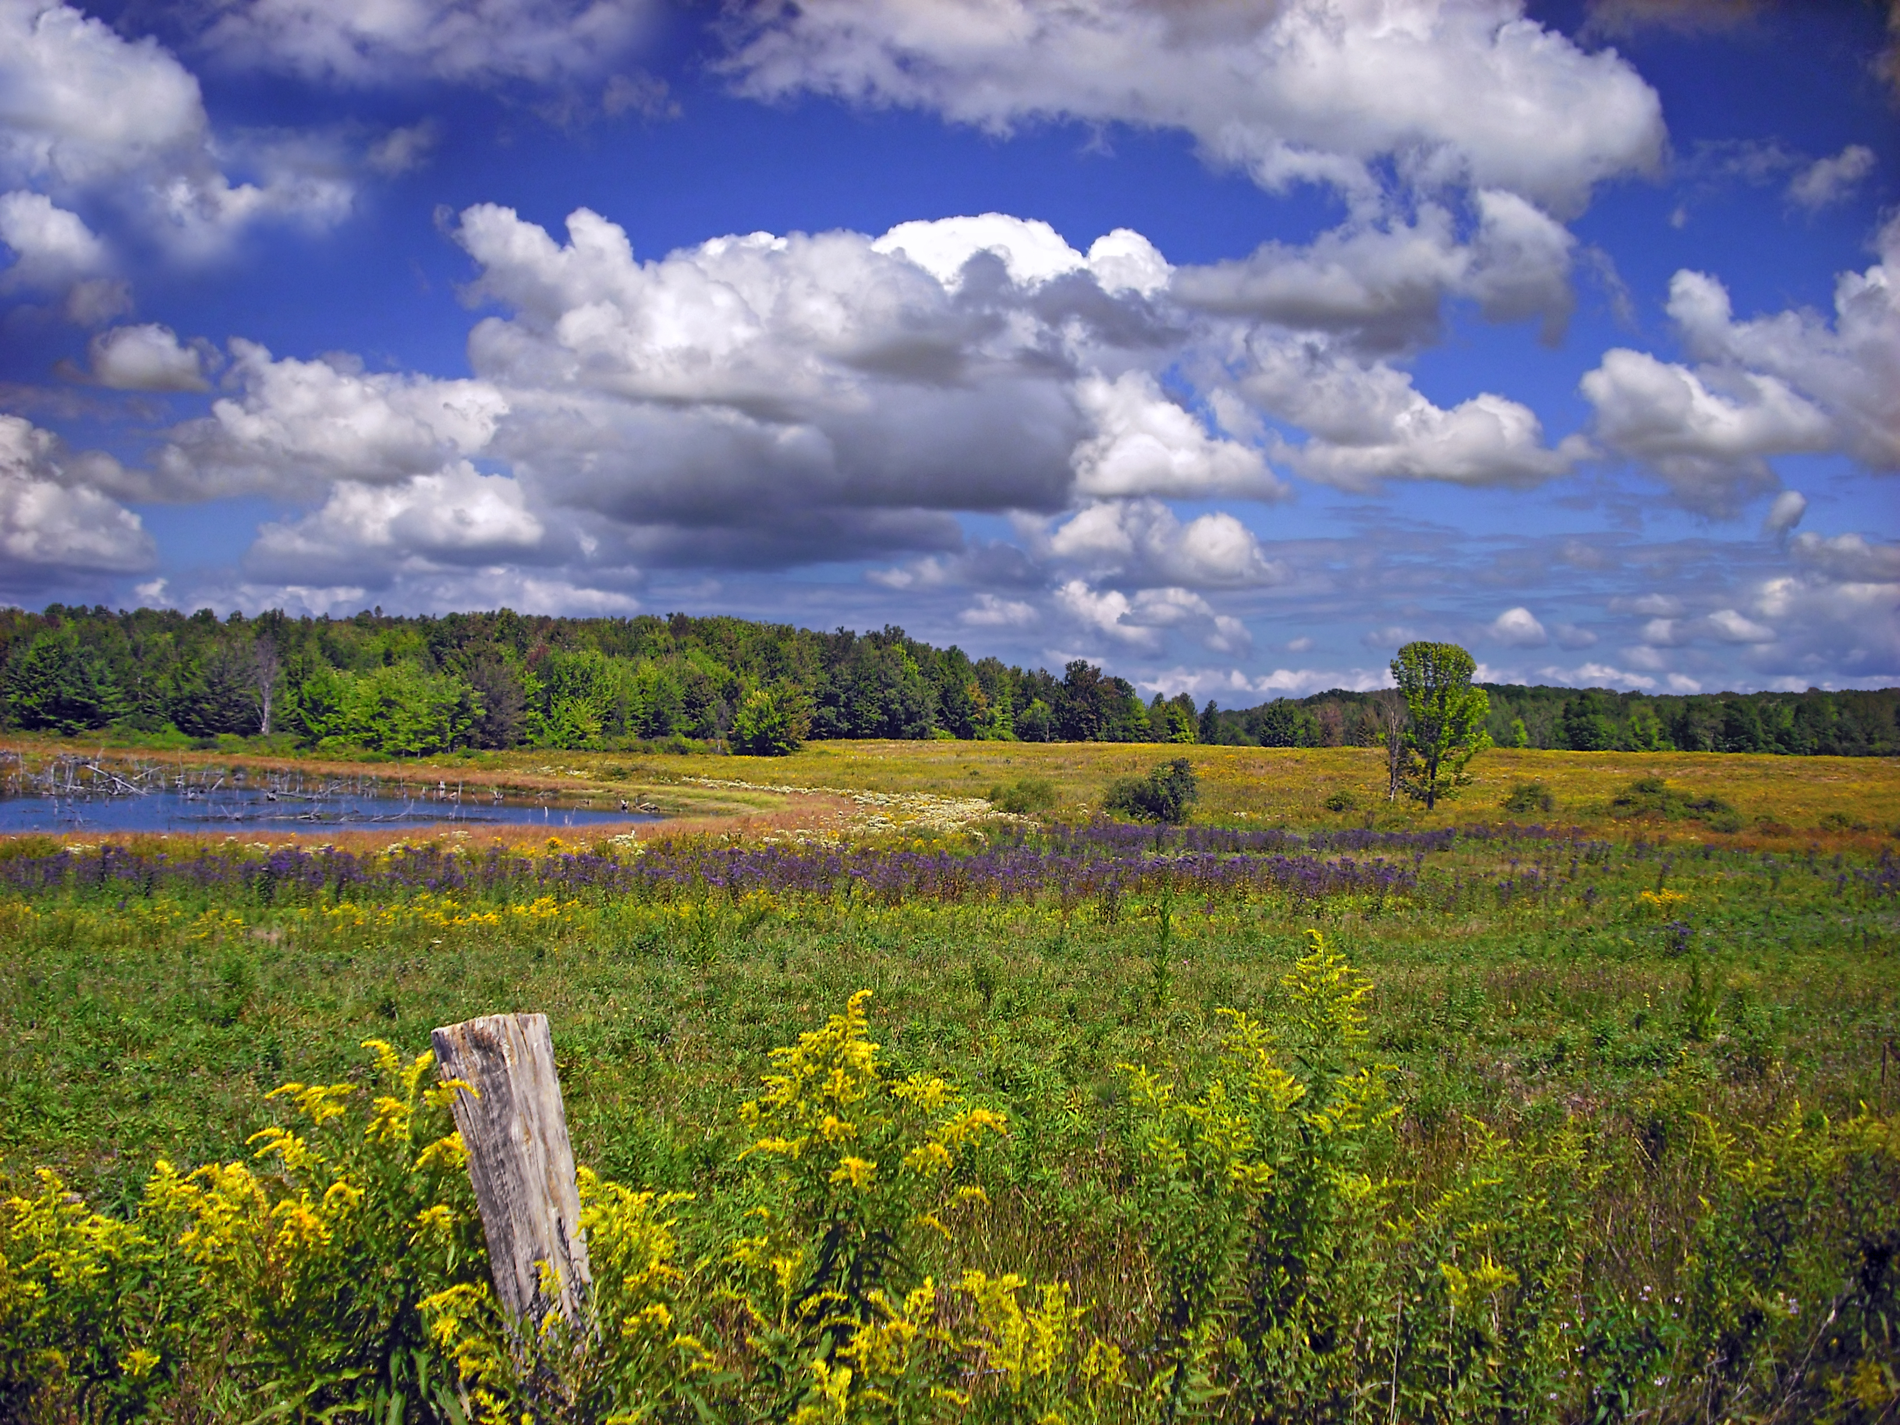
3. They are connected with other biomes.
Which biomes do you see interacting in this picture?
Cognitive Learning Systems, Inc. © 2016
Notes:
Teacher’s Notes
This slide brings home the idea that no biome stands alone. Although they are different, biomes interact and influence each other’s climate, plant life, and animal life. Their borders can be somewhat fluid as animals migrate seasonally, and plants may encroach upon a new and different area.
Which biomes do you see interacting in this picture? Here you see a grassland biome in the foreground. A small temperate forest is visible in the background, behind the pond. Animals living in the temperate forest might move into the grassland to eat grass or hunt for prey, and go to the pond to drink. Forest edges — where the biomes are transitioning from one type to another — are often hosts to smaller trees and shrubs, and to deer, rabbits, and birds.
Image credit: Erie National Wildlife Refuge, by Nicholas A. Tonnelli, retrieved on September 9, 2016 from https://commons.wikimedia.org/wiki/File:Sodden.jpg [CC BY 2.0 (http://creativecommons.org/licenses/by/2.0)]

Slide 62
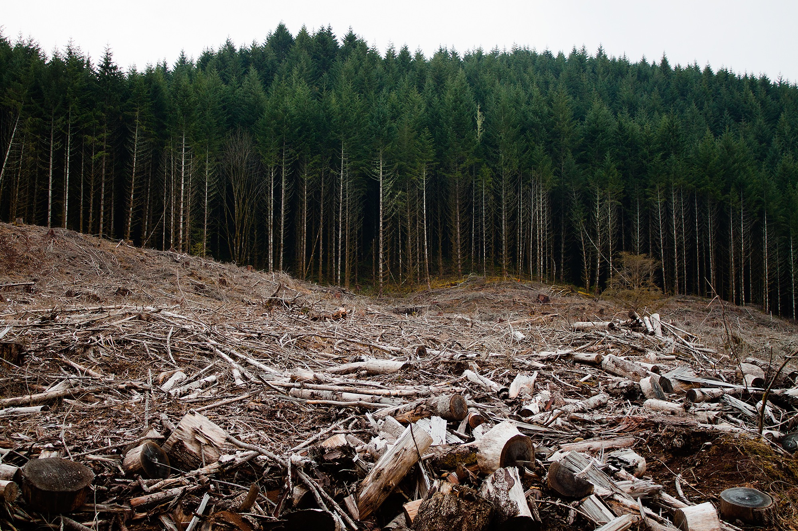
4. Humans can change biomes.
Changes can be good or bad.
Does this picture show a good change or a bad change? Why?
Cognitive Learning Systems, Inc. © 2016
Notes:
Teacher’s Notes
This is a teaser for concepts that the students will circle back to and work on later in this Journey (slides 78-93), when they are asked to consider environmental changes and human interactions with our environment.
Students will clearly see that logging has been done here. The forest in the foreground has been clear-cut, and only branches and stumps have been left behind. In the distance, there’s a tall stand of pine trees, as yet untouched.
Changes can be good or bad. Does this picture show a good change or a bad change? Why? Guide students to decide if this change is good or bad, and ask them to support their opinions. Answers may include the following:
Good — Harvesting trees provides wood for houses and furniture, and it provides jobs for the lumberjacks and the builders. Lumber can be managed sustainably, however, and If trees are replanted they can be harvested again in later years.
Bad — The forest looks dead in the foreground. Animal habitats have been destroyed both in the trees that were cut and on the ground underneath those trees. The loss of habitat will force animals to move, and will make it much harder for them to survive due to increased competition. The loss of the living trees means there aren’t as many trees absorbing excess carbon dioxide in the atmosphere.
Image credit:
Clearcutting in an Oregon forest, by Calibas, retrieved on May 11, 2016 from https://commons.wikimedia.org/wiki/File:Clearcutting-Oregon.jpg [CC BY-SA 3.0 (https://creativecommons.org/licenses/by/3.0/)]

Slide 63
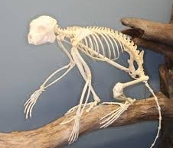
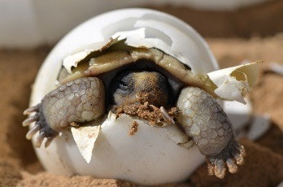

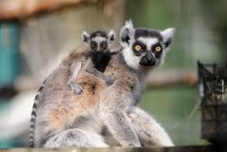
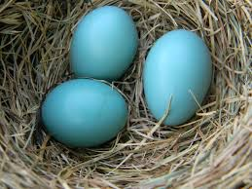
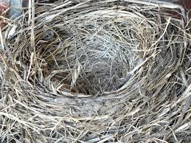
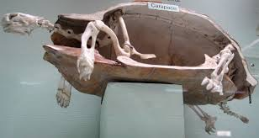
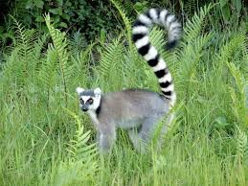
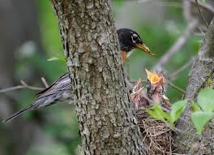
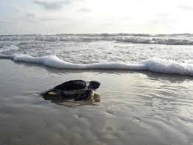
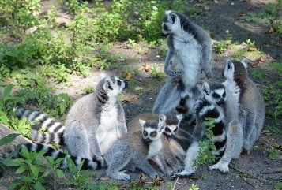
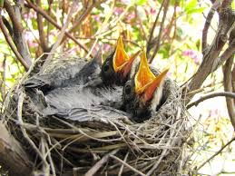
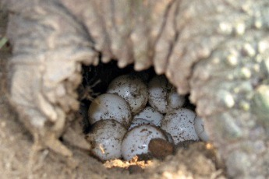
5. All living things
in biomes have life cycles.
Birth
Death
Growth
Reproduction
Cognitive Learning Systems, Inc. © 2016
Notes:
Teacher’s Notes
Here, we start to shift away from biomes and venture into life cycles.
We have reviewed the fact that all biomes contain living organisms, have seasons (including growth seasons), are interrelated, and can be changed by humans. Emphasize the point that biomes, whether on land or in water, are all made up of organisms.
Now, we’re looking deeper into the biomes and noting that the organisms within the biomes have something in common — the life cycle. All the organisms seen here are animals, but the universality of the life cycle extends to plants as well.
This is the springboard for delving deeper, and comparing the life cycles of the American robin and the Water Lily.
Image credits:
Mammal skeleton, from Wikimedia Commons, retrieved on May 11, 2016 from https://commons.wikimedia.org/wiki/File:Sifaka_Skeleton.jpg [Public Domain]
Reptile skeleton, by Cmglee, retrieved on May 11, 2016 from https://commons.wikimedia.org/wiki/File:Horniman_turtle_carapace_skeleton.jpg [CC BY-SA 3.0 (https://creativecommons.org/licenses/by/3.0/)]
Empty nest, from Pixabay.com, retrieved on May 11, 2016 from https://pixabay.com/en/robin-s-nest-nest-empty-empty-nest-334124/ [Public Domain]
Retile hatching, by K. Kristina Drake/USGS, retrieved on May 11, 2016 from https://www.flickr.com/photos/usgeologicalsurvey/16490346262 [Public Domain]
Bird eggs, by Laslovarga, retrieved on May 11, 2016 from https://commons.wikimedia.org/wiki/File:American_robin_Eggs_in_Nest.jpg [CC BY-SA 3.0 (https://creativecommons.org/licenses/by/3.0/)]
Lemur mother with baby, by Eric Kirby, retrieved on May 2016 from https://www.flickr.com/photos/ekilby/7103520489 [CC BY-SA 2.0 (https://creativecommons.org/licenses/by/2.0/)]
Young lemur, by Charlescantin, retrieved on May 11, 2016 from https://commons.wikimedia.org/wiki/File:Maki.jpg [CC BY-SA 2.5 (https://creativecommons.org/licenses/by/2.5/)]
Baby birds, by Bryancalabro, retrieved on May 11, 2016 from https://commons.wikimedia.org/wiki/File:Baby_robins_Ready_to_Feed.jpg [CC BY-SA 3.0 (https://creativecommons.org/licenses/by/3.0/)]
Sea turtle hatchling, from Pixabay.com, retrieved on May 11, 2016 from https://pixabay.com/en/green-sea-turtle-hatchling-beach-1185954/ [Public Domain]
Mother robin and family, by Bill Damon, retrieved on May 11, 2016 from https://www.flickr.com/photos/billdamon/14221061531 [CC BY-SA 2.0 (https://creativecommons.org/licenses/by/2.0/)]
Lemur family, from Pixabay.com, retrieved on September 1, 2016 from https://pixabay.com/en/apes-ring-tailed-lemur-animal-218114/ [Public Domain]
Turtle laying eggs, by Moondigger, retrieved on May 11, 2016 from https://commons.wikimedia.org/wiki/File:Snapping_turtle_eggs_md.jpg [CC BY-SA 2.5 (https://creativecommons.org/licenses/by/2.5/)]

Slide 64

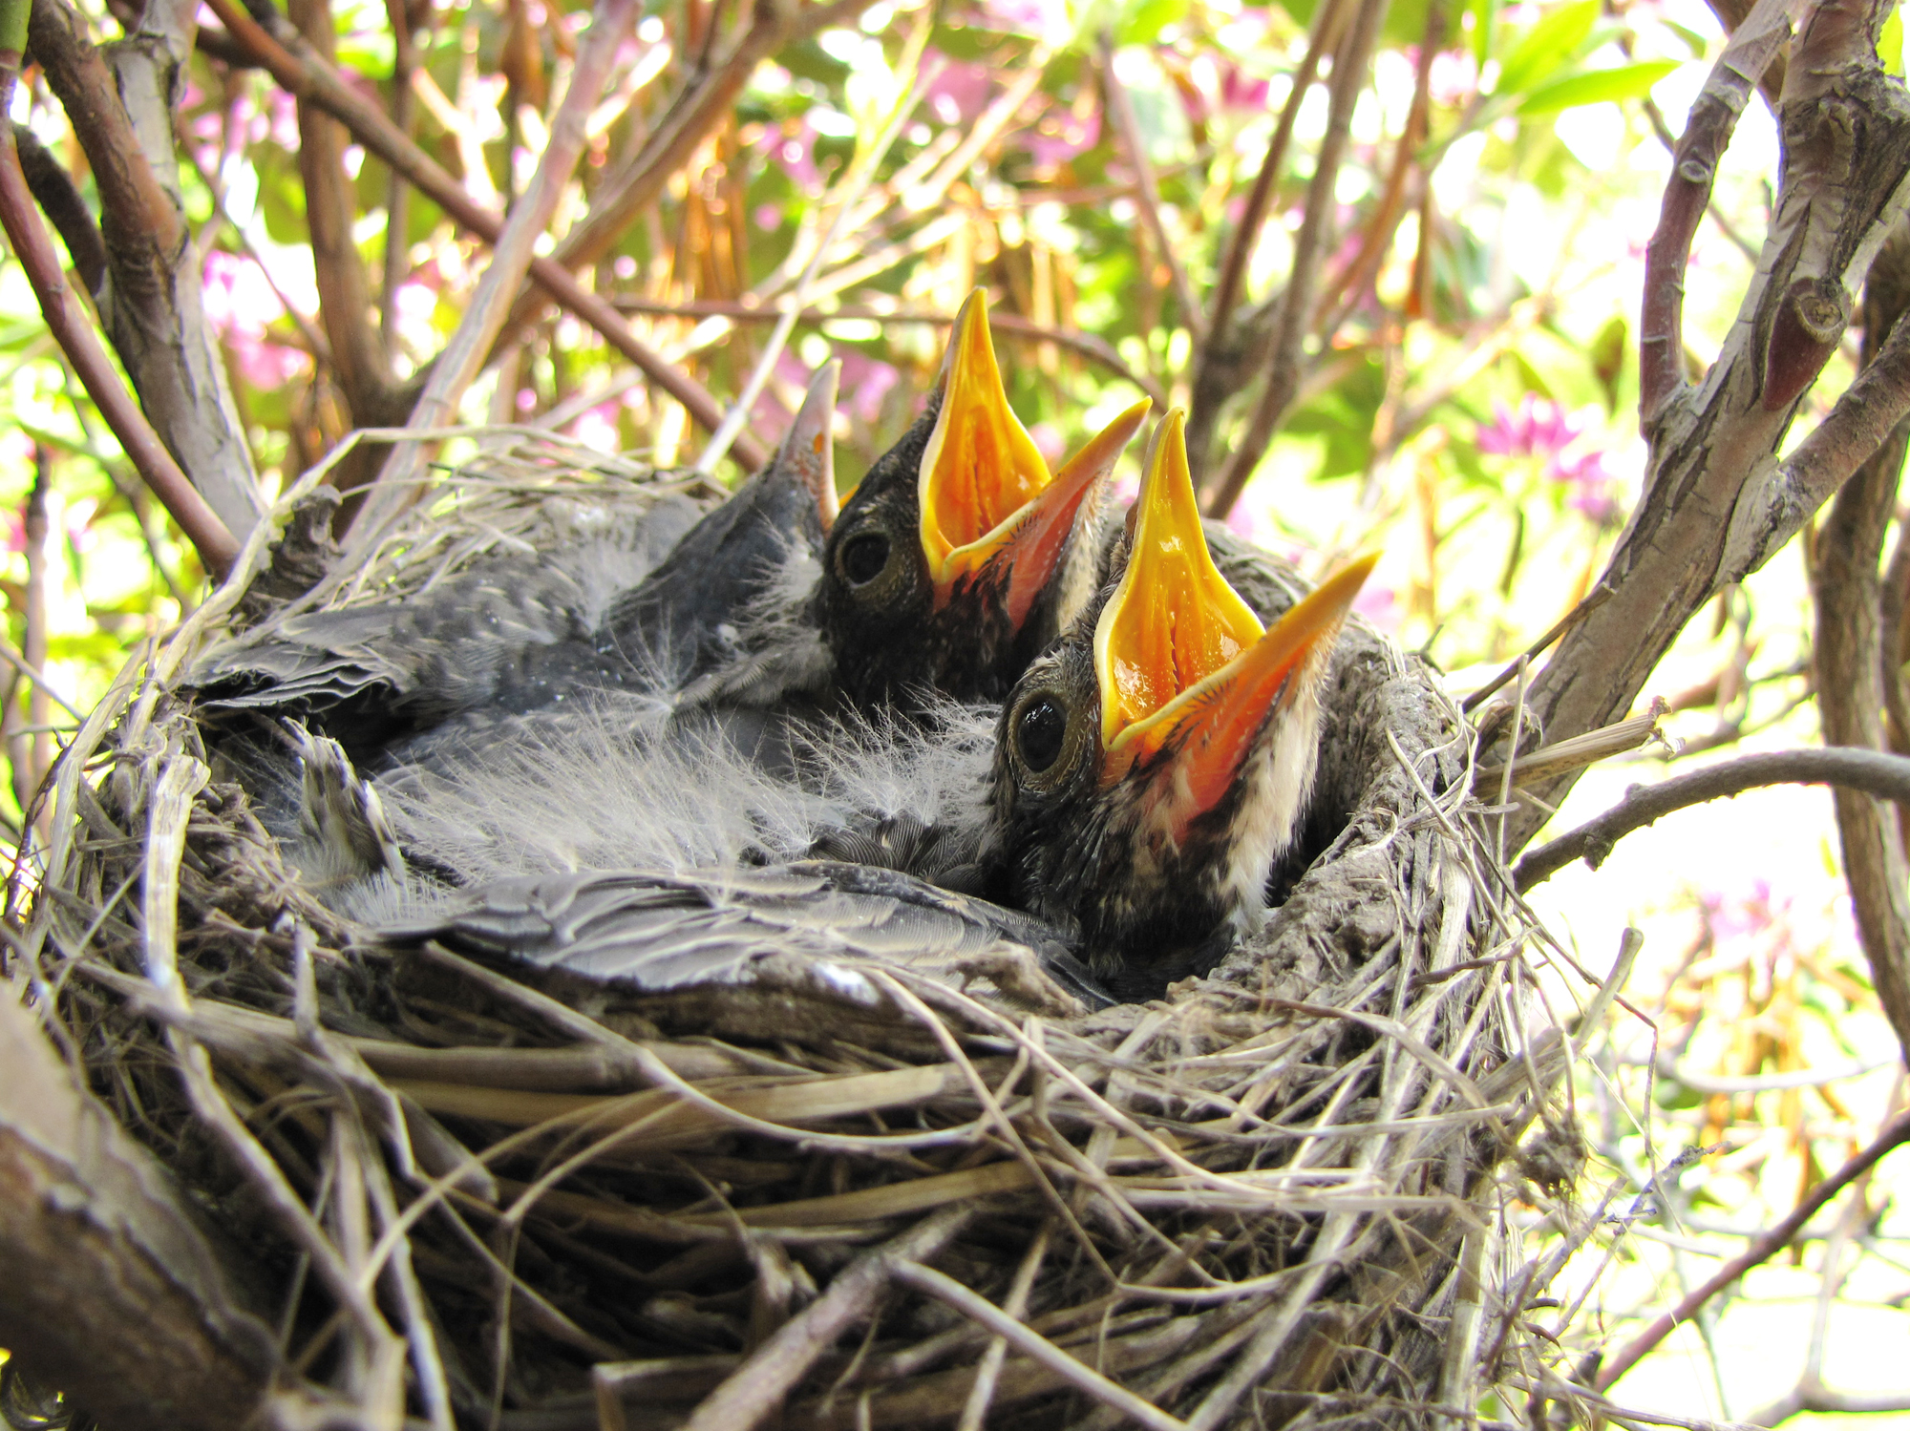
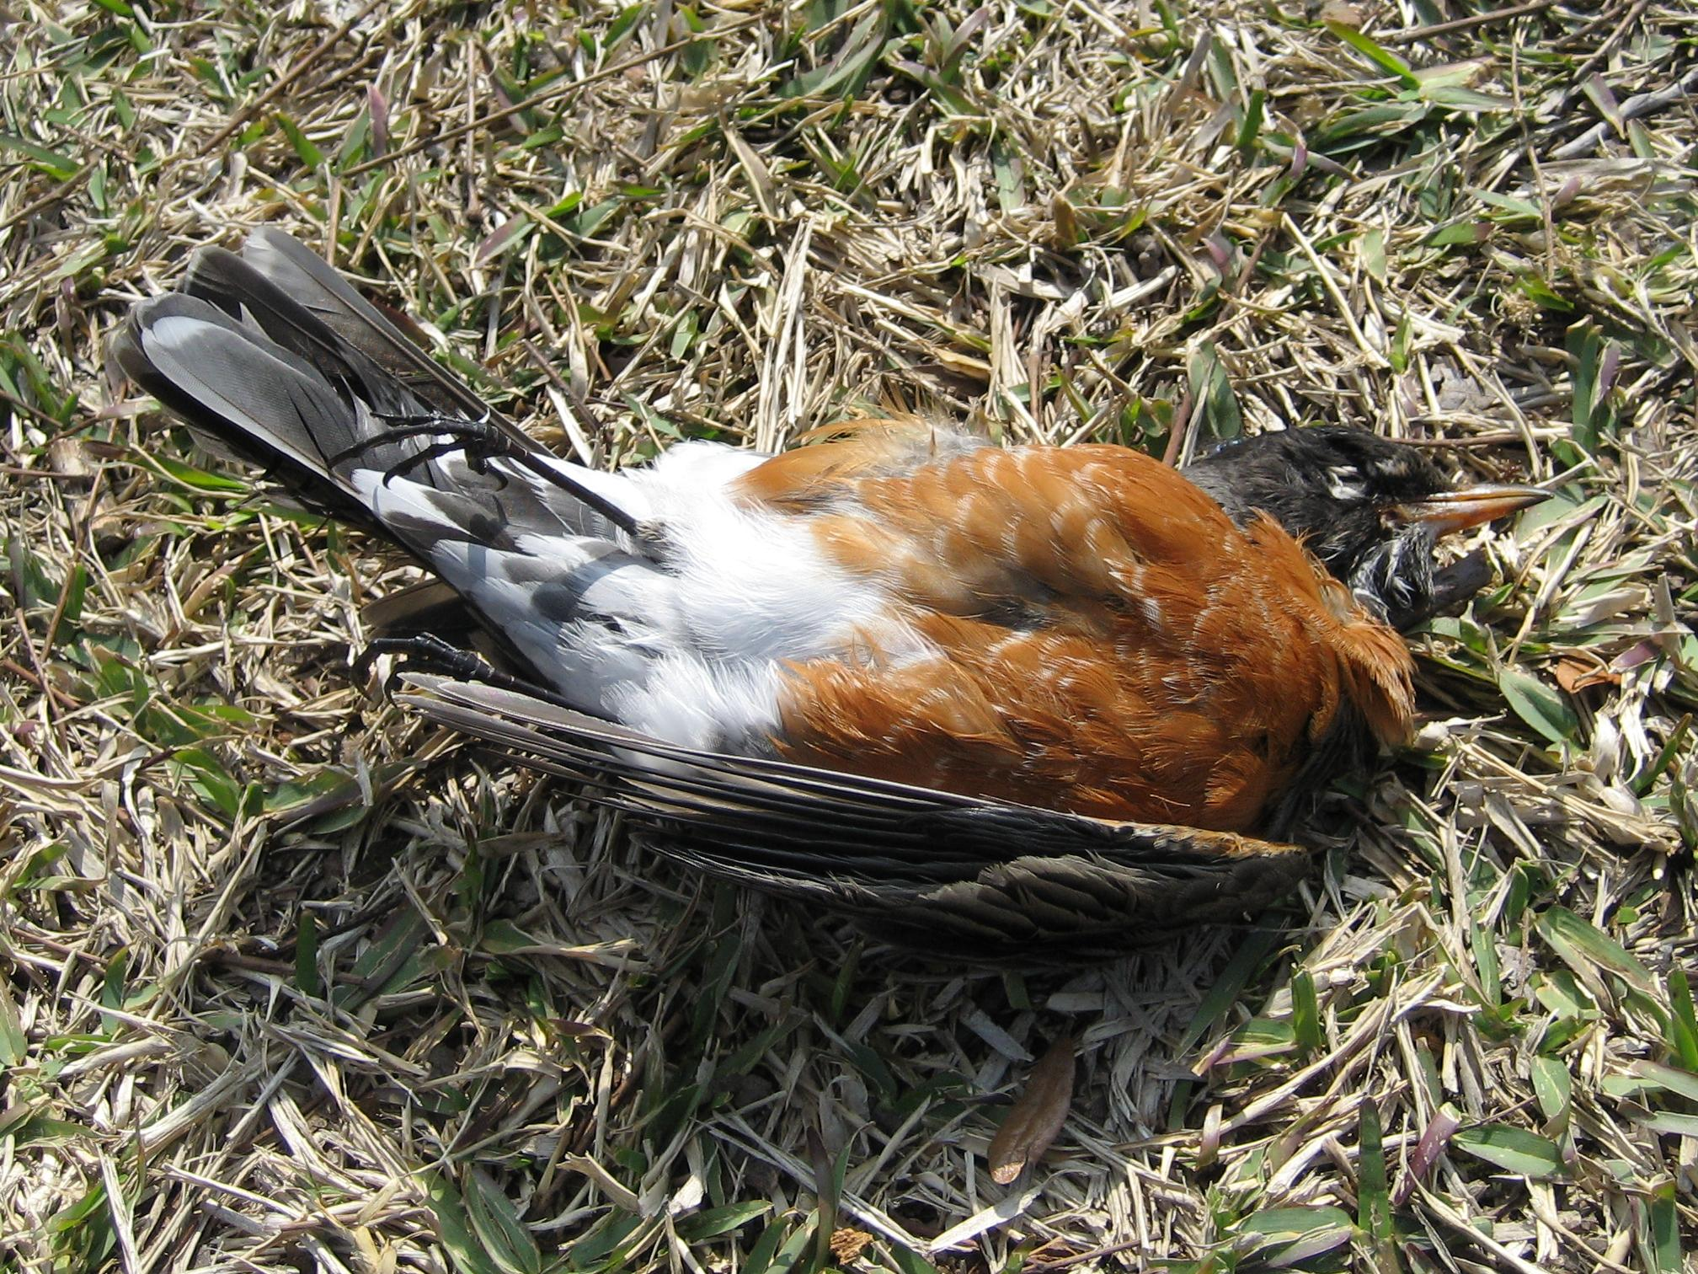
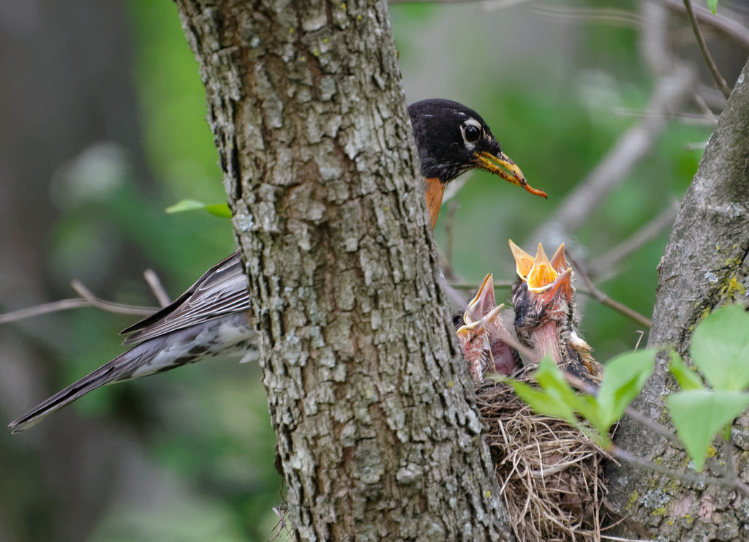
American Robins
Birth
Growth
Death
Reproduction
Cognitive Learning Systems, Inc. © 2016
Notes:
Teacher’s Notes
This slide shows 4 phases of the life cycle of American robins. Birds are “born” or hatched from eggs in early summer. In the nest they are fed by their parents and they grow very quickly until they are fully feathered and are able to fly and feed themselves. Generally, the birds migrate south to avoid harsh winter weather, and they continue to grow. Once they are old enough, a pair of birds will build a nest and lay eggs — this is the reproduction phase. At some point after several years, the birds will die, but their chicks will have grown up and will be laying eggs of their own. The cycle repeats itself.
Additional information: Depending upon your location, your students may be familiar with these birds. Robins are found over most of North America in a range of habitats. They are omnivores — they eat berries, fruits, insects, and worms. Not all robins migrate, because some of them live in areas where food is available all year. But most of them do head south for the winter to Texas or Guatemala. In more northern areas of the United States the robins’ return is often considered a sign of spring’s arrival, and it is timed to the coming of the spring rainy season and the appearance of earthworms. Where food is especially plentiful, a pair of robins may have 2 clutches of chicks within a summer. Note that their migration has them traveling through different biomes.
Image Credits:
Robin eggs, by Laslovarga, retrieved on May 11, 2016 from https://commons.wikimedia.org/wiki/File:American_robin_Eggs_in_Nest.jpg [CC BY-SA 3.0 (http://creativecommons.org/licenses/by/3.0)]
Hungry robin chicks, by Bryancalabro, retrieved on May 11, 2016 from https://commons.wikimedia.org/wiki/File:Baby_robins_Ready_to_Feed.jpg [CC BY-SA 3.0 (https://creativecommons.org/licenses/by/3.0/)]
Deceased adult robin, from Wikimedia Commons, retrieved on May 11, 2016 from https://commons.wikimedia.org/wiki/File:Dead_American_robin.jpg [Public Domain]
Adult robin feeding chicks, by Bill Damon, retrieved on May 11, 2016 from https://www.flickr.com/photos/billdamon/14221061531[CC BY-SA 2.0 (https://creativecommons.org/licenses/by/2.0/)]

Slide 65




Water Lilies
Birth
Growth
Death
Reproduction
Cognitive Learning Systems, Inc. © 2016
Notes:
Teacher’s Notes
This slide shows 4 phases of the life cycle of Water Lilies. Water lilies are “born” or sprouted from seeds in spring or summer. The water temperature has to be right, and the daily amount of sun has to be right for the seeds to germinate. Rooted on the bottom of the pond, a sprout will grow up toward the surface of the water, where the light is stronger, and then will set leaves and flowers on the surface of the water. This is the growth phase. The flowers attract pollinators, and then a seed pod is produced as the flower petals fade away. This marks the reproduction phase of the water lilies’ life cycle. The seeds mature, and then as summer ends the water lily plant “dies back.” But really, the water lily plant is still alive and is just going dormant for the winter. The roots, shoots, and seeds are protected from harsh temperatures at the bottom of the pond. They are ready to burst forth again and grow toward the light in spring. At some point after several years, the parent water lily plant will die, but its many offspring, grown from seeds, will have grown up and will be making seeds of their own. The cycle repeats itself.
Additional information: Water lilies can be seen in many different biomes, as there are many different species on Earth. Each species needs and life cycles are somewhat different. In the north in a temperate biome, water lilies will go dormant in the winter, such as the ones shown in the slide. The leaves die back and will regrow from the root structure in the spring. In a southern more tropical biome, they may grow and flower all year round because the water temperature remains warm enough and the sunlight is sufficient. Individual water lilies can live for 8-12 years or more, depending upon the species. Their seeds remain viable after long periods of dormancy (so they can withstand droughts). Water lily tubers and seeds are used for food in some areas of the world. They are also commonly called pond lilies or lotuses.
Image credits:
Water lily (lotus) seed pods and seeds, from Pixabay.com, retrieved on August 29, 2016 from https://pixabay.com/en/lotus-seed-flower-leaf-pod-indian-1549438/ [Public Domain]
Water lily bloom, from Pixabay.com, retrieved on August 29, 2016 from https://pixabay.com/en/water-lily-pink-aquatic-plant-1511553/ [Public Domain]
Developing seed pod of a water lily, by Daisuke Tashiro , retrieved on August 28, 2016 from https://www.flickr.com/photos/dice-kt/9327704716/ [CC BY 2.0 (http://creativecommons.org/licenses/by/2.0)]
Deceased water lily leaves, from Pixabay.com, retrieved on August 28, 2016 from https://pixabay.com/en/shriveled-lotus-leaf-pond-plant-86539/ [Public Domain]

Slide 66

Life Cycles
How do living things begin life?
Cognitive Learning Systems, Inc. © 2016
Notes:
Teacher’s Notes
How do living things begin life? In general, and having been reminded because of the previous slides, students will know that birds hatch from eggs and that plants grow from seeds. These pictures represent the birth phase of the life cycle for both of these organisms. Both of these methods of producing offspring have evolved over millions of years.
These life cycles are similar because they both have the same type of starting point—an embryo. In addition, both eggs and seeds provide nourishment for the offspring that will develop from them.
Image Credits:
Robin eggs, by Laslovarga, retrieved on May 11, 2016 from https://commons.wikimedia.org/wiki/File:American_robin_Eggs_in_Nest.jpg [CC BY-SA 3.0 (http://creativecommons.org/licenses/by/3.0)]
Water lily (lotus) seed pods and seeds, from Pixabay.com, retrieved on August 29, 2016 from https://pixabay.com/en/lotus-seed-flower-leaf-pod-indian-1549438/ [Public Domain]

Slide 67


Life Cycles
Then what happens?
Cognitive Learning Systems, Inc. © 2016
Notes:
Teacher’s Notes
Then what happens? Ask your students what phase these pictures represent. The previous slide showed the eggs and seeds. These slides represent the growth phase.
Students can see that the small plant, or seedling, will become the adult water lily. It will have leaves that float and collect sunlight, and it will produce a flower when it is mature. The water lily’s parents are not involved in bringing it to maturity.
In the case of American robins, the parents are still very much involved once the chicks hatch because they will need food supplied to them. Here you can see hungry offspring in the nest, leading to a parent robin feeding a chick. Once the chicks have grown enough, they will reproduce and have their own eggs and chicks, thus perpetuating the cycle.
Image credits:
Water lily bloom, from Pixabay.com, retrieved on August 29, 2016 from https://pixabay.com/en/water-lily-pink-aquatic-plant-1511553/ [Public Domain]
Adult robin feeding chicks, by Bill Damon, retrieved on May 11, 2016 from https://www.flickr.com/photos/billdamon/14221061531[CC BY-SA 2.0 (https://creativecommons.org/licenses/by/2.0/)]
Water plant seedling, by Christian Fischer, retrieved on May 11, 2016 from https://commons.wikimedia.org/wiki/File:HydrocharisBaby.jpg [CC BY-SA 3.0 (http://creativecommons.org/licenses/by-sa/3.0)]
Hungry robin chicks, by Bryancalabro, retrieved on May 11, 2016 from https://commons.wikimedia.org/wiki/File:Baby_robins_Ready_to_Feed.jpg [CC BY-SA 3.0 (https://creativecommons.org/licenses/by/3.0/)]

Slide 68


Life Cycles
How does the population survive?
Cognitive Learning Systems, Inc. © 2016
Notes:
Teacher’s Notes
How does the population survive? To put it simply, populations survive because living things are "programmed" to reproduce. As long as enough offspring survive to balance out the loss of individual members (through death or migration), the population will survive.
Image credits:
Developing seed pod of a water lily, by Daisuke Tashiro , retrieved on August 28, 2016 from https://www.flickr.com/photos/dice-kt/9327704716/ [CC BY 2.0 (http://creativecommons.org/licenses/by/2.0)]
Adult robin feeding chicks, by Bill Damon, retrieved on May 11, 2016 from https://www.flickr.com/photos/billdamon/14221061531[CC BY-SA 2.0 (https://creativecommons.org/licenses/by/2.0/)]
Water lily (lotus) seed pods and seeds, from Pixabay.com, retrieved on August 29, 2016 from https://pixabay.com/en/lotus-seed-flower-leaf-pod-indian-1549438/ [Public Domain]
Hungry robin chicks, by Bryancalabro, retrieved on May 11, 2016 from https://commons.wikimedia.org/wiki/File:Baby_robins_Ready_to_Feed.jpg [CC BY-SA 3.0 (https://creativecommons.org/licenses/by/3.0/)]

Slide 69

Life Cycles
Finally, the older generation makes way for the young.
The new generation continues the cycle.
Cognitive Learning Systems, Inc. © 2016
Notes:
Teacher’s Notes
The end of the life cycle is, of course, marked by the death of individual members of a population. Once an American robin or water lily has reproduced for several years, it dies. The younger generations continue to mature, reproduce, and carry on the cycle of life.
Image credit:
Acapulco sunset, by Arturo Mann, retrieved on August 26, 2016 from https://commons.wikimedia.org/wiki/File:Acapulco_sunset_summer.jpg [CC BY-SA 3.0 (https://creativecommons.org/licenses/by/3.0/)]

Slide 70
Life Cycles
How are the life cycles of the American robin and the water lily the same?
How are they different?
Cognitive Learning Systems, Inc. © 2016
Notes:
Teacher’s Notes
These questions are designed to guide students to review and mentally organize all the points of comparison they’ve seen for these two life cycles.
How are they the same? Birth, growth, reproduction, and death.
How are the life cycles of the American robin and the water lily different? robin: eggs, chicks are fed and cared for by parents as they grow, they reproduce when they have reached maturity, etc. Water lilies: seeds, sprouts, growing toward the sunlight, flower and seed pod, parents are not involved in the growth phase, etc.
The following two slides look at these questions in more detail.

Slide 71
How the life cycles are the same:
Birth
Life Cycle
Death
Growth
Reproduction
How can we model the life cycle?
Cognitive Learning Systems, Inc. © 2016
Notes:
Teacher’s Notes
These life cycles have birth, growth, reproduction, and death in common. These phases are common to all life cycles, in all biomes, in all parts of the world!
How can we model the life cycle? At this point, we want students to be thinking about developing models to describe that, although organisms have unique and diverse life cycles, they all share these 4 phases.

Slide 72

How the life cycles are different:
 | American robin | Water Lily
Birth | from eggs | from seeds
Growth | eats worms, berries, and sunflower seeds | makes its own food using the sun’s energy
Reproduction | robins pair up and 3-5 eggs are laid in a nest — up to 10 resulting in up to chicks each summer | Once e flower is pollinated up to 2000 seeds are made, encased in a spongy fruit or seed pod
Death | usually lives 6-7 years | usually lives 10-12 years
Cognitive Learning Systems, Inc. © 2016
Notes:
Teacher’s Notes
This chart shows each phase and how it is different for these two organisms.
Image credits:
Adult robin feeding chicks, by Bill Damon, retrieved on May 11, 2016 from https://www.flickr.com/photos/billdamon/14221061531[CC BY-SA 2.0 (https://creativecommons.org/licenses/by/2.0/)]
Water lily bloom, from Pixabay.com, retrieved on August 29, 2016 from https://pixabay.com/en/water-lily-pink-aquatic-plant-1511553/ [Public Domain]

Slide 73
Remember: the cycle repeats to ensure the survival of the species.
Birth
Death
Growth
Reproduction
Cognitive Learning Systems, Inc. © 2016
Notes:
Image credits:
Mammal skeleton, from Wikimedia Commons, retrieved on May 11, 2016 from https://commons.wikimedia.org/wiki/File:Sifaka_Skeleton.jpg [Public Domain]
Reptile skeleton, by Cmglee, retrieved on May 11, 2016 from https://commons.wikimedia.org/wiki/File:Horniman_turtle_carapace_skeleton.jpg [CC BY-SA 3.0 (https://creativecommons.org/licenses/by/3.0/)]
Empty nest, from Pixabay.com, retrieved on May 11, 2016 from https://pixabay.com/en/robin-s-nest-nest-empty-empty-nest-334124/ [Public Domain]
Retile hatching, by K. Kristina Drake/USGS, retrieved on May 11, 2016 from https://www.flickr.com/photos/usgeologicalsurvey/16490346262 [Public Domain]
Bird eggs, by Laslovarga, retrieved on May 11, 2016 from https://commons.wikimedia.org/wiki/File:American_robin_Eggs_in_Nest.jpg [CC BY-SA 3.0 (https://creativecommons.org/licenses/by/3.0/)]
Lemur mother with baby, by Eric Kirby, retrieved on May 2016 from https://www.flickr.com/photos/ekilby/7103520489 [CC BY-SA 2.0 (https://creativecommons.org/licenses/by/2.0/)]
Young lemur, by Charlescantin, retrieved on May 11, 2016 from https://commons.wikimedia.org/wiki/File:Maki.jpg [CC BY-SA 2.5 (https://creativecommons.org/licenses/by/2.5/)]
Baby birds, by Bryancalabro, retrieved on May 11, 2016 from https://commons.wikimedia.org/wiki/File:Baby_robins_Ready_to_Feed.jpg [CC BY-SA 3.0 (https://creativecommons.org/licenses/by/3.0/)]
Sea turtle hatchling, from Pixabay.com, retrieved on May 11, 2016 from https://pixabay.com/en/green-sea-turtle-hatchling-beach-1185954/ [Public Domain]
Mother robin and family, by Bill Damon, retrieved on May 11, 2016 from https://www.flickr.com/photos/billdamon/14221061531 [CC BY-SA 2.0 (https://creativecommons.org/licenses/by/2.0/)]
Lemur family, from Pixabay.com, retrieved on September 1, 2016 from https://pixabay.com/en/apes-ring-tailed-lemur-animal-218114/ [Public Domain]
Turtle laying eggs, by Moondigger, retrieved on May 11, 2016 from https://commons.wikimedia.org/wiki/File:Snapping_turtle_eggs_md.jpg [CC BY-SA 2.5 (https://creativecommons.org/licenses/by/2.5/)]

Slide 74
Recall these things about life cycles:
All living organisms have the same basic life cycle.
All life cycles within generations are interconnected.
The offspring grow into adults that reproduce to continue their own life cycle.
The offspring repeat the life cycle.
Cognitive Learning Systems, Inc. © 2016

Slide 75
Let’s develop models to illustrate the
life cycle.
  What organism will you use?
  What are the phases of its life cycle?
  How will you model these phases?
  How will you show that its offspring or offspring continue on in new, but connected life cycles?
Cognitive Learning Systems, Inc. © 2016
Notes:
Teacher’s Notes
This activity can be completed by having your students sketch out their ideas for a model using white or colored paper, and crayons or colored pencils.
If you have more time and want to go into more detail, however, students can model the life cycles using toothpicks or straws to represent arrows, materials from the lab to represent seeds or eggs, and drawings or cut-outs from magazines to show the animals or plants. In addition, you might have students do a little research at home or at school if time allows.
Students can work in pairs or small groups. You can assign organisms, have them choose from a list of organisms that you have ready. Include a selection of animals and plants, there will be plenty of variety in the details of the life cycles. (For example: cactus, pine tree, alligator, shark, bison, and eagle.) In pairs or group, students can talk about how the animal or plant is “born,” grows, reproduces, and even how long they might live. Note: These life cycles could become quite detailed and complex, so be sure and set an appropriate time limit for your students.
What organism will you use? Again, you might assign an organism or have them choose from a list you’ve prepared.
What are the phases of its life cycle? Students will need to know the phases and components of the organism’s life cycle. If an alligator is chosen, for example, students should know that alligators lay eggs in a nest much like birds do, and that baby alligators are protected by their mother for up to 2 years!
How will you model the phases of its life cycle? Using items that are in your LabLearner lab, a cotton ball could represent a mass of fish eggs, parent organisms can be built out of gram cubes or clay, and split peas or sunflower seeds can represent seeds of a plant.
How will you show that its offspring or offspring continue on in a new, but connected life cycle? We’ve reviewed this concept already, but here we are asking students to think about how the original cycle they’ve model will be connected to new cycles once the offspring move on, mature, and reproduce on their own. For example, if the mother alligator successfully raises 10 offspring, then each of those will eventually strike out and continue the cycle of life — that original circle will now have 10 more circles coming off of it, and so on.

Slide 76
Ready to try?
Build a model or sketch out
a plan for your life cycle model.
Share your model with your classmates.
Can you connect your model
with anyone else's?
Cognitive Learning Systems, Inc. © 2016
Notes:
Teacher’s Notes
Allow students to work on their sketches of models, reminding them that they must show the four (4) universal phases that all organisms share. In addition, you may wish to allow them to add more complexity if they know or want to research details, and if time permits.
Can you connect your model with anyone else’s? If you have more than one team working on a particular organism, they might be able to link their cycles together to show how different generations are connected through the recurrence of life cycles.

Slide 77
Making and Applying Connections
Which statement is true of all organisms on Earth?
Organisms are all different because each species has a unique life cycle.
Organisms are the same because they all have birth, growth, reproduction, and death in common.
Organisms on Earth live in a great diversity of biomes.
All of the above.
Cognitive Learning Systems, Inc. © 2016
Notes:
Teacher’s Notes
Which statements are true of all organisms on Earth? Answer: D

Slide 78
Biomes
Environmental Changes and Human Activity
Cognitive Learning Systems, Inc. © 2016
Notes:
Image credit:
Coral, from FreeImages.com, retrieved on May 11, 2016 from http://www.freeimages.com/photo/aquarium-1360326 [Public Domain]

Slide 79

The Case of the Disappearing Lake
Part 1
This is Mirror Lake in Yosemite National Park, as it looked between 1873 and 1883.
Cognitive Learning Systems, Inc. © 2016
Notes:
Teacher’s Notes
Students should be able to see that the lake appears to be very large in this photograph. The water comes all the way to the immediate foreground, as though the photograph were taken by someone in a boat on the lake’s surface.
Image credit:
Mirror Lake in Yosemite National Park (mid 1870s), by Carleton Watkins, retrieved on May 11, 2016 from https://commons.wikimedia.org/wiki/File:14._Mirror_lake,_Yosemite_valley.jpg [Public Domain]

Slide 80

The Case of the Disappearing Lake
Part 1
This is how Mirror Lake looks today.
Cognitive Learning Systems, Inc. © 2016
Notes:
Teacher’s Notes
Compare this photograph with the previous photograph, taken about 140 years ago. Although it was taken from a slightly different angle, we can see the same mountain in the distance. Here, you can see the shore and a much narrower expanse of water between the photographer and the trees and mountain in the distance.
Image credit:
Mirror Lake today, by chensiyuan, retrieved on May 11, 2016 from https://commons.wikimedia.org/wiki/File:Yosemite_national_park_mirror_lake_2010u.JPG [CC BY-SA 3.0 (https://creativecommons.org/licenses/by/3.0/)]

Slide 81


The Case of the Disappearing Lake
Part 1
Mirror Lake is all that remains of a large glacial lake. The lake filled most of Yosemite Valley 12,000 years ago. That is when the last Ice Age ended.
Today it is a small, seasonal lake in Yosemite National Park. It is fed by melting snow.
Mirror Lake is slowly disappearing. It is filling with natural sediments.
Cognitive Learning Systems, Inc. © 2016
Notes:
Teacher’s Notes
Point out to students that much of our landscape was shaped by the movement of glaciers during ice ages.
In Yosemite National Park, Mirror Lake is a remnant of a much larger glacial lake — which was much larger even 140 years ago than it is today. The processes of glacial movement and the resulting formation of the valley and the lake were slow. In the last 140 years, however, sediment has been deposited fairly quickly and is causing the lake to shrink.
This is a natural process caused by weathering and erosion. Sand, soil, and gravel are carried into the lake by snow-melt, and by spring and summer floods carrying debris and sediment into the lake. As each year passes, more sediment is deposited, and the lake gets smaller.
Now it exists only in the spring and summer, fed by snow-melt and spring and summer rains. By the end of most summers, it disappears.
Additional information: Scientists believe there have been as many as 5 Ice Ages on Earth. The ice scoured out valleys, deposited boulders and rocks miles away from where they originally were, and caused many species to migrate to new lands or to become extinct.
Image credits:
Yosemite Valley, by chensiyuan, retrieved on May 11, 2016 from https://commons.wikimedia.org/wiki/File:1_yosemite_valley_view_z.jpg [CC BY-SA 3.0 (https://creativecommons.org/licenses/by/3.0/)]
Mirror Lake today, by chensiyuan, retrieved on May 11, 2016 from https://commons.wikimedia.org/wiki/File:Yosemite_national_park_mirror_lake_2010u.JPG [CC BY-SA 3.0 (https://creativecommons.org/licenses/by/3.0/)]
Sedimentation process, by Jeff Schmaltz/NASA Earth Observatory, retrieved on May 11, 2016 from https://commons.wikimedia.org/wiki/File:Sediment_in_the_Gulf_of_Mexico_(2).jpg [Public Domain]

Slide 82
The Case of the Disappearing Lake
Part 1
Sediment is slowly filling the lake. The lake is now a seasonal lake. It only exists when winter snow melts and fills the lake each spring.
Spring and early summer rains add to its volume, too.
The lake dries up by the end of most summers.
When this happens, animals and plants that depend on its water all year must adapt or find other homes.
Cognitive Learning Systems, Inc. © 2016
Notes:
Teacher’s Notes
This slide restates ideas from the previous slide — but also points out that originally Mirror Lake was much larger, and now it exists only in the spring and summer. Animals and plants that once lived here may not be able to any more.

Slide 83



Eventually, Mirror Lake may disappear completely!
Plants will move in and make a meadow.
Black bears and yellow-bellied marmots will have to find water elsewhere.
Cognitive Learning Systems, Inc. © 2016
Notes:
Teacher’s Notes
If Mirror Lake were to disappear, it would be due to natural processes. In this case, the effects of weathering and erosion have been rather dramatic in the last 140 years. Over time, countless lakes have filled in with sediment and have become smaller, seasonal, or disappeared completely allowing for plants to move into the former lake-bed. Over time the area would experience a natural progression of changing plant life, accompanied by an influx of animals that thrive in that type of habitat.
Bears and marmots could conceivably stay in the area if they are still able to find food and shelter there, but they would need to travel elsewhere to find water. They could be exposed to more danger from interactions with other animals if they have to leave their home base.
Image credits:
Lee Canyon meadow, by Stan Shebs, retrieved on May 11, 2016 from https://commons.wikimedia.org/wiki/File:Lee_Canyon_meadow.jpg [CC BY-SA 3.0 (https://creativecommons.org/licenses/by/3.0/)]
Black bear, by Terry Spivey/USDA/Bugwood.org, retrieved on May 11, 2016 http://www.forestryimages.org/browse/detail.cfm?imgnum=1374239 [CC BY-SA 3.0 (https://creativecommons.org/licenses/by/3.0/)]
Yellow-bellied marmot and pup, by Alan Vernon, retrieved on May 11, 2016 from https://commons.wikimedia.org/wiki/File:Mother_Yellow-bellied_Marmot_and_pup_kissing.jpg [CC BY 2.0 (http://creativecommons.org/licenses/by/2.0)]

Slide 84

The Case of the Disappearing Lake
Part 1
Should humans “fix” the situation?
We could dredge the lake and divert water into it from Tenaya Creek.
Water would be available all year for the bears and marmots, and a meadow would not form.
Mirror Lake would not be seasonal, and it would not disappear.
The environment around the lake would be restored.
Dredging
Cognitive Learning Systems, Inc. © 2016
Notes:
Teacher’s Notes
The goal here is to have students think about, identify, and discuss the pros and cons of human interference in a situation where the environmental changes may cause changes in the plants and animals that live there.
Should humans “fix” the situation? This slide presents the idea that humans can step in and “fix” the problem of the disappearing lake…but should we? Your students may have an immediate answer to the question, and should be encouraged to voice that answer. After the next slide, they will be asked to support their answer by making lists of benefits and drawbacks, some of which are given here.
Students should be encouraged to remember that erosion and sedimentation, the filling in of a lake bed, and the formation of a meadow are all natural processes.
If we allow these processes to go on, we won’t have a beautiful lake to hike to. We also might not have the same types of plants and wildlife that are present now. So dredging might be worthwhile to protect the beauty of the place, and the species that are currently living there. If the lake was restored to a year ‘round water source, would even more wildlife come into the environment to take advantage of it?
Note on dredging: Students may be unfamiliar with the process of dredging. Dredging is the removal of sediment from the bottom of a lake or other body of water and moving the sediment somewhere else. It is often used to make shipping channels deeper. Many beachfront communities also dredge up sand to restore beaches and dunes after storms. The diagram shows that the sediment is being removed with a backhoe placed on a barge that is anchored in the water. The backhoe places the sediment on another barge that carries the sediment to land for disposal or relocation.
If we were to dredge, heavy equipment would need to be brought in. It would certainly disturb the wildlife and damage the plant life. Where would the dredged material go? It would affect the ecosystem, and might displace some organisms as well. The dredging process might have to be repeated every so often. Who will pay for the dredging operation(s)? The ecosystem around the creek would likely be disrupted too.

Slide 85
The Case of the Disappearing Lake
Part 1
What do you think?
Cognitive Learning Systems, Inc. © 2016
Notes:
Teacher’s Notes
What do you think? Looking again at this photograph of Mirror Lake, ask your students the question. In the next slide, they will be prompted to analyze the situation and support their conclusion.
Image credit:
Mirror Lake today, by chensiyuan, retrieved on May 11, 2016 from https://commons.wikimedia.org/wiki/File:Yosemite_national_park_mirror_lake_2010u.JPG [CC BY-SA 3.0 (https://creativecommons.org/licenses/by/3.0/)]

Slide 86
Let’s analyze!
With a partner, list the BENEFITS of fixing the problem by dredging. Then list the DRAWBACKS that might happen if the lake is dredged.
What should we do?
Draw a conclusion about dredging. Support your answer with information
from the list that you made. Write an essay about your conclusion.
Cognitive Learning Systems, Inc. © 2016
Notes:
Teacher’s Notes
Have students work in pairs, and allow 5-10 minutes for them to come up with lists of the pros and cons of dredging Mirror Lake to keep it from disappearing and turning into a meadow.
Students can be asked to write a short essay about their conclusion, being sure to use items from their lists to support their opinion. The essays can be written in class or assigned for homework. Alternately, students can share their lists of pros and cons, and talk about their conclusions in class.

Slide 87
Biomes
Environmental Changes and Human Activity
Cognitive Learning Systems, Inc. © 2016
Notes:
Image credit:
Coral, from FreeImages.com, retrieved on May 11, 2016 from http://www.freeimages.com/photo/aquarium-1360326 [Public Domain]

Slide 88

The Case of the Disappearing Lake
Part 2
This is a freshwater lake. It is located near the seashore in Penrhos, Wales. Wales is part of the United Kingdom.
It provides a habitat for organisms that grow well in fresh water. Thy cannot live in salt water.
Cognitive Learning Systems, Inc. © 2016
Notes:
Teacher’s Notes
Explain to students that organisms — both plants and animals — have evolved to take advantage of very specific types of habitats. Plants and animals that live in or near water have adapted to have specific requirements for the amount of salt in their water environment.
Think about fish — A goldfish needs fresh water with no salt; A moray eel can live in brackish water where fresh and salty water meet and the salt concentration is variable; and a clownfish needs saltwater to survive.
Image credit:
Lake at Penrhos Coastal Park (Wales), by Eric Jones, retrieved on May 11, 2016 from https://commons.wikimedia.org/wiki/File:Ornamental_lake_at_Penrhos_Coastal_Park_-_geograph.org.uk_-_874993.jpg [CC BY-SA 2.0 (https://creativecommons.org/licenses/by/2.0/)]

Slide 89
The Case of the Disappearing Lake
Part 2
This lake is very close to an ocean bay. It must be protected from storms that might cause saltwater to enter the lake.
If saltwater enters the lake, many of the living things in it would die.
Cognitive Learning Systems, Inc. © 2016
Notes:
Teacher’s Notes
Students might not realize that freshwater and saltwater habitats can be located so closely to each other. Plants and animals living in a freshwater lake would be killed if salt water suddenly entered their environment.
This is one of three small lakes at Penrhos Coastal Reserve on Holyhead Island, a small island off the west coast of the larger island of Anglesey, in Wales. It is separated from the waters of Beddmanarch Bay by a small parking lot to the right of this image. Beddmanarch Bay is connected to the Irish Sea, which separates the islands of Ireland and Great Britain.
Additional information on water regulation in cells and organisms: Cells must maintain a certain amount of water in their internal environment at all times to function properly. A cell membrane is a semi-permeable membrane, so water can move into and out of the cell as needed to maintain a balanced internal concentration. This process is called osmosis, and it works because there is a concentration gradient across the cell membrane.
A concentration gradient forms when the concentration of a solution is greater on one side of the membrane than it is on the other side. Water moves toward the solution with the greater concentration until both solutions have the same concentration. If the salt content of the water outside a cell increases, the water inside the cell moves out of the cell because the solution surrounding it has a greater concentration. This can cause the cell to shrivel and die. If the concentration is greater inside the cell than outside, cells must constantly work to remove extra water. Otherwise, the cell will swell until it bursts.
Many fish and other multicellular animals that live in freshwater and saltwater environments have adaptations that allow them to regulate the water content of their bodies so that cells can maintain a normal internal environment. If something happens to change the salinity of their external environment, they will no longer be able to maintain a normal internal environment and they will die.
Image credit:
Lake at Penrhos Coastal Park (Wales), by Eric Jones, retrieved on May 11, 2016 from https://commons.wikimedia.org/wiki/File:Ornamental_lake_at_Penrhos_Coastal_Park_-_geograph.org.uk_-_874993.jpg [CC BY-SA 2.0 (https://creativecommons.org/licenses/by/2.0/)]

Slide 90

The Case of the Disappearing Lake
Part 2
Flooding could cause the lake to “disappear”. It would become part of the tidal system in Wales.
The coastline would be changed.
The lake’s fresh water species would die.
Cognitive Learning Systems, Inc. © 2016
Notes:
Teacher’s Notes
During a storm, extremely high tides and flooding may occur. At the coast, seawater can be carried inland and deposited onto the land — and into existing lakes and rivers, dramatically changing their salt content. In some cases, these lakes and rivers may actually become part of the marine environment. The coastline may change dramatically, as land may be washed out into the sea.
This photograph shows the storm surge pushing on land at Key West, FL during Hurricane Dennis in July of 2005. Point out to students that the surge is created by the winds of the hurricane pushing water towards the shore. These waters can travel many miles inland, especially in areas where there are bays, rivers, shipping channels, and canals that help funnel the water deeper inland. Storm surges are worse when they occur during high tide.
If this happened in Penrhos, Wales the freshwater plants and animals would die because their environment would suddenly became a saltwater environment.
Image credit:
Storm surge during Hurricane Dennis, from Pixabay.com, retrieved on September 2, 2016 from https://pixabay.com/en/key-west-florida-hurricane-dennis-81664/ [Public Domain]

Slide 91



The Case of the Disappearing Lake
Part 2
We can’t prevent weather-related events, such as storms, storm surges, and flooding.
This is a natural sand dune.
Is this an effective barrier to reduce flooding?
How could we improve upon this solution?
Cognitive Learning Systems, Inc. © 2016
Notes:
Teacher’s Notes
Students know that humans can’t stop the weather. We can’t prevent storms and floods, but we can certainly try to mitigate their effects.
Is this an effective barrier to reduce flooding? It certainly might be helping, but….
This slide shows how a natural dune can decrease the effects of the storm surge and flooding. In some cases, maybe a dune could prevent flooding, however there is still water coming over the dune into the area where houses are located. The force of the storm surge and the wind could break down the dunes, allowing for even more flooding and damage.
How could we improve upon this solution? Answers may vary, but may include the following: Build a higher dune, or build additional dunes, build a wall that is stronger than the dunes, etc.

Slide 92

The Case of the Disappearing Lake
Part 2
This is a modern concrete sea wall.
It’s designed to hold back storm surges.
It would reduce or prevent flooding in the area.
It would prevent saltwater from entering the lake in Penrhos, Wales.
Cognitive Learning Systems, Inc. © 2016
Notes:
Teacher’s Notes
This slide presents a design solution that could better reduce or prevent flooding. Have students look at the structure of the flood walls and the channel. Ask them how they think it would work. What do they think about the merits, or strengths, of this solution? You can also refer back to the Mirror Lake case — is this different? What do your students think? Should we build a system like this to protect the lake?
Not only would this hold seawater away from Penrhos Lake, thus protecting plant and animal life there, it would also potentially protect human lives.
For centuries, humans built levees out of earth to keep flood waters away. They built sea walls of stone to keep storm surges and high tides from coming into farmlands or residential areas. (In the Netherlands, people have accessed more land by building dykes to hold out seawater. They’ve done this for hundreds of years, and now half of the country is actually one meter below sea level!) With current technology, super-strong concrete construction and channels to guide excess water away, people have been able to settle more safely in flood-prone areas.
Image Credit:
Friar’s Cliff sea wall in Great Britain, by Mike Faherty, retrieved on September 5, 2016 from https://commons.wikimedia.org/wiki/File:Friar%27s_Cliff,_sea_wall_-_geograph.org.uk_-_1210138.jpg [CC BY-SA 2.0 (https://creativecommons.org/licenses/by/2.0/)]

Slide 93
Check Understanding
The Case of the Disappearing Lake, Part 1 & 2
Slow, natural processes and fast, dramatic weather-related events can change the environment.
We have seen two cases where change is occurring or could happen quickly.
Cognitive Learning Systems, Inc. © 2016
Notes:
Teacher’s Notes
This slide brings us back to the fact that natural processes are always changing the Earth, and can slowly or quickly change our environment. We can’t stop many of nature’s processes, but we can “fix” the results, reduce the effects, or prevent them from happening.
We’ve looked at Mirror Lake where natural change is occurring, and we had to decide whether or not to stop it.
We looked at the lake at Penrhos. Environmental change is not occurring here now, but the environment is fragile and it could change at any moment. If we build a flood wall and a channel to carry away excess water, we can protect this beautiful and unique freshwater environment. We can reduce or prevent the impacts of dangers from the water.
In both cases, any human activity to “fix” the problem can create new problems. Before making changes in an environment, it is important for humans to think about what new problems might develop as a result of those changes. For example, stopping a flooding problem with a levee or channel in one place can cause flooding somewhere else that may not have had flooding problems before the “solution” was built.

Slide 94
Making and Applying Connections
Making and Applying Connections
      When should we intervene to prevent changes to our natural and man-made environments?
    We should always prevent any changes so that our environment stays exactly the same.
    We should let nature take its course unless it is going to cost a lot of money.
    We should identify the benefits and the drawbacks for us and other living organisms before we decide.
Cognitive Learning Systems, Inc. © 2016
Notes:
Teacher’s Notes
When should we intervene to prevent changes to our natural and man-made environments?
Answer: C

Slide 95
Making and Applying Connections
Making and Applying Connections
    Terrestrial biomes are like aquatic biomes because
    they both require water.
    they each have unique types of living organisms in them.
    everything is the same except their temperatures.
    Organisms in all biomes share
    the ability to make their own food.
    the need to stay with their parents for several years.
    the cycle of birth, growth, reproduction and death.
Cognitive Learning Systems, Inc. © 2016
Notes:
Teacher’s Notes
Question 2: B
Question 3: C.

